Slide 1
Welcome - meet the people at your table - what school, what do they teach - why are they in this session?
(we’ll give people a chance to get here)

Slide 2
INSIDE THE HEADS
OF DEPARTMENT HEADS
Erin Carey, Instructional Leader, Toronto District School Board / Media Producer / Sailor

Slide 3
I JUST NEED SOME
TIME TO THINK
(If just these other teachers and students, and “initiatives” weren’t here)

Slide 4
SESSION OVERVIEW
Getting handout, say hi to people at your table
Your choices on participation will determine how valuable you find this
Please put away your phones and devices, but feel free to plug in a laptop or use a smart phone if you want to write notes - like our kids, devices of distraction take away from an activity where you do want to interact in person

Slide 5
SESSION OVERVIEW
First thoughts, writing down on the sheets you’ve been given
Small group discussion, seeing examples, prioritizing your needs for further discussion

Slide 6
WE WILL TAKE A BREAK
½ WAY
The goal of this session is to:
  help people who have been leaders, ‘doing it forever’ get refreshed
  help new people in the role to get a better sense of scope, figure out how to prioritize, discard, deflect, listen
  have everyone maybe get some therapeutic support
Hmmm…? Stuff for the coffee?

Slide 7
WE WILL TAKE A BREAK
½ WAY
Part 2:
Subject-specific discussions, then personality matched discussion, remainders, then consolidation, pointed networking, next steps thinking
What is one thing I will try after this seminar to make my life easier / better / happier?

Slide 8
WHAT DO I NEED HELP WITH IMMEDIATELY AS A TECHNOLOGICAL EDUCATION DEPARTMENT HEAD?
(we’ll prioritize for our discussion in a little bit)

Slide 9
TALK ABOUT YOUR NEEDS AT YOUR TABLE
(please participate together – this is a discussion, don’t just check your emali)

Slide 10
HOW DO I FEEL ABOUT MY ROLE THIS YEAR? CHANGES? DISCUSS AT YOUR TABLE
(take a quick turn and share your experiences, what is succeeding / failing)

Slide 11
Dangerous Territory
What do you wish you could tell the one staff in your department that is making your life harder?
What is the real issue for that person? Discuss it (not naming names) in your table group.
Are there any constructive ways to deal with their prime issue? (Discuss)
Anyone willing to share an example and a possible solution?
Anyone have ideas for any of these issues?

Slide 12
I FEEL OVERWHELMED BY DEPARTMENT NEEDS
(When do I get to just teach?)

Slide 13
MY HOME LIFE AND RELATIONSHIPS OUTSIDE WORK ARE DIFFICULT
(I don’t feel healthy anymore)

Slide 14
IT HAS BEEN A ROUGH YEAR WITH JOB ACTION - MY TEAM COULDN’T EVEN MEET TO FIX ANYTHING
(When are things going to feel better?)

Slide 15
What are your NEEDS and Goals
Finishing the year
Starting next year
Trying to have more control, so you can have better time-management, resource management
Trying to enjoy work, not just get through the day
Trying to be a good leader / good teacher
What else? (Table Discussion)

Slide 16
WHAT WOULD YOU LIKE OUT OF THIS SESSION? DISCUSS. I’LL ASK FOR THE BIGGIES (YOUR PRIORITIES - WHOEVER NEEDS POINTEDLY, SHORTLY)
(What are your biggest issues?)

Slide 17
How do you FEEL right now?
How would you describe your relationship with your department?
How do you see your role as another department head at your school?
Who gives YOU support? Where can you get support?
How would you describe your relationship with your school administration?
Are you in a collaborative or hostile environment?

Slide 18
How do you FEEL right now?
Too many board and Ministry initiatives with changing names (same things, different branding) no time to fit in more on top of actual curriculum
Teaching employment environment getting you down
Clubs management getting you down
Special requests taking more time away from any possibility of true prep time
What else? Government reporting, data

Slide 19
IF YOU CAN’T THINK ABOUT THIS STUFF HERE, WHERE CAN YOU?

Slide 20
Areas of Facilitated Discussion
Budget planning organization and strategies
Cross-curricular collaboration
Understanding province-wide funding – Ministry concepts and guidelines versus applied reality, SHSM strategies
Managing teacher personalities
Section assignments, teaching outside usual
Subject specific storage considerations, planning, organization
Modern computer lab management

Slide 21
Areas of Facilitated Discussion
Sharing resources (online collaboration, Google Docs, SafetyNET, D2L)
Addressing safety at your unique board, with your unique classrooms, with your unique teachers
Promoting your department at course selection time, grade 9, school displays and events, and showcasing tech for academic teachers recognizing pathways

Slide 22
Areas of Facilitated Discussion
SHSM
OYAP, Accelerated OYAP, Apprenticeship
Dual-Credits
“Restructuring”
Losing your mind
Health and Wellness
Connecting with your community
Switching Gears vs Multitasking

Slide 23
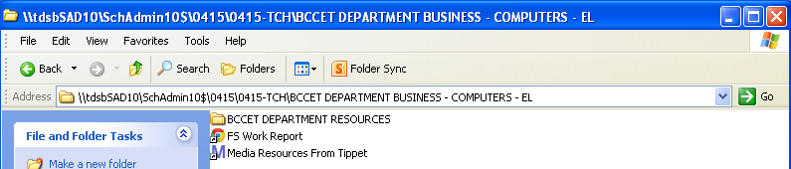
File Organization Before Google Drive
(example inside teacher share network)

Slide 24
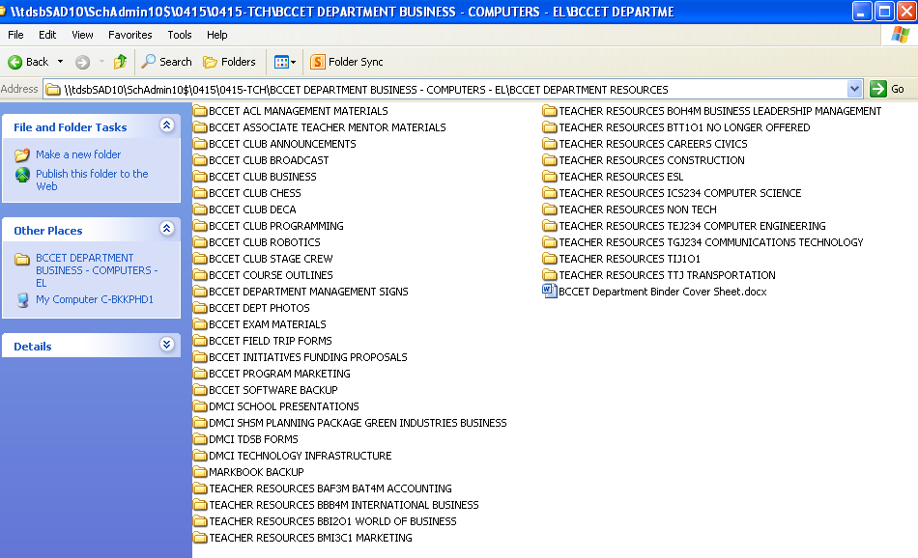
(example of organization on network server)

Slide 25
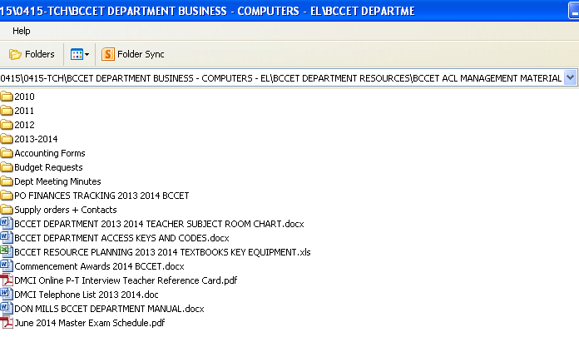

Slide 26
File Organization After Google Drive
(example inside staff and student folders)

Slide 27
How would you organize yours?
Department
Promotions
Budget
Forms
Clubs and Teams
Course Outlines
Management
Safety

Slide 28
Areas of Facilitated Discussion
Organizational ‘jigs’ and examples
Team-building and running department meetings
Building on management skills
Online textbooks – sharing textbooks
Best practices sharing
Best resources, field trips
Other ideas that come up in our discussions together

Slide 29
Areas of Facilitated Discussion
Safety training tracking – SafetyNET advice – SEE FILES IN FOLDER ATTACHED
Subject specific – talking with other teachers who lead in your course area(s) – sharing best DEPARTMENT MANAGEMENT practices for your subject area - GROUPS – TFJ, TTJ, TXJ, TPJ, TCJ, TMJ, TDJ, THJ, TEJ, TGJ, TIJ
What is your management style – hands-off? Micro-manager? LITTLE QUIZ

Slide 30
Bits and Pieces 1
Funny Things…That You Should Consider…
Issues - fridge management, who always buys the coffee?
Show - dept binder, safety binder, give your colleagues copies of the safety net blank
Make - tech guide to school
Promotions - displays, using screens in library to display digital work
Contests - Skills participation
Scheduling - looking at your year, put in dept meetings on calendar, acl, meetings staff meetings, special days on an online calendar that does reminders

Slide 31
Bits and Pieces 2
Funny Things…That You Should Consider…
Budgeting - encourage a standardized form, important that everyone is presenting budget requests the same way at your school
Web Presence - Updating your Web page for your dept
Coherent look - standardizing course outlines look at school level
Legal stuff - documenting licenses
IT - Computer inventory, XP, RCT for free computers
Managing class set mobile labs - methods for mobile lab booking
CYA - Safety training procedure tracking

Slide 32
Bits and Pieces 3
Funny Things…That You Should Consider…
Admin teams - the good, bad, ugly
Touching Base - rounds to classrooms, offices, admin, main office, checking for damage, do they look like learning places, issues, getting requests by email or in your to do book to not lose your mind
Lost in the shuffle expenses - who is responsible for whole school benefitting items - like the AV equipment, the common labs, the library

Slide 33
WHO HAS MORE BIG QUESTIONS?
CONNECTIONS
NETWORK, EXCHANGE INFO – ANY RESOURCES YOU WANT TO ASK SOMEONE HERE MORE ABOUT?
DON’T OVEREXTEND YOURSELF, BE REALISTIC
IF ALL YOU DID TODAY WAS LISTEN, OK!
LET IT PERCOLATE OR BREW LIKE GOOD COFFEE, or SIP LIKE GOOD WINE (SPEAKING OF …WE’RE DONE!)

Slide 34
THANKS FOR PARTICIPATING
erin.carey@tdsb.on.ca
(hope you got something out of this time)

