Slide 1
Technical Drawing at Home
Part 1: A Simple Title Block and Drawing Template

Slide 2
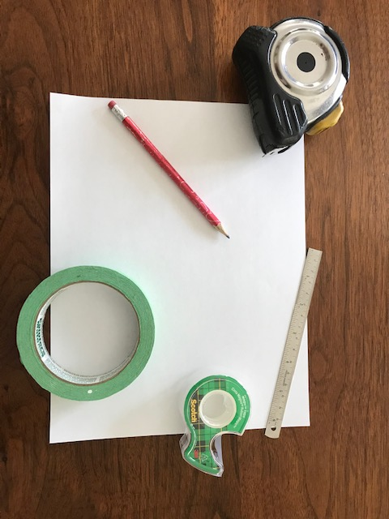
Requirements for Drawing at Home
A flat surface – not the dining room table
Paper
Masking tape or equivalent
A sharp pencil
Eraser
Ruler or tape measure
Straight Edge

Slide 3
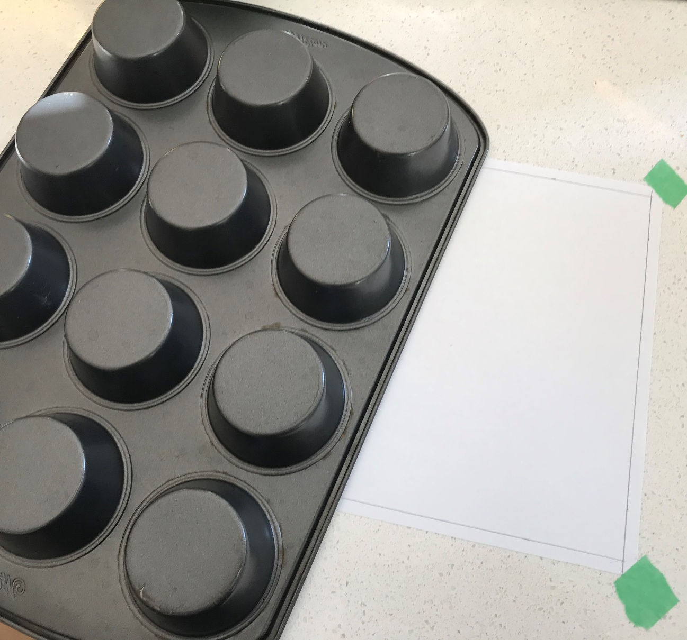
Use a straight Edge
Do you need a longer straight edge. Your home is full of them. Get creative.
Don’t always count on a ruler. Many of them are not straight or have rough edges.

Slide 4
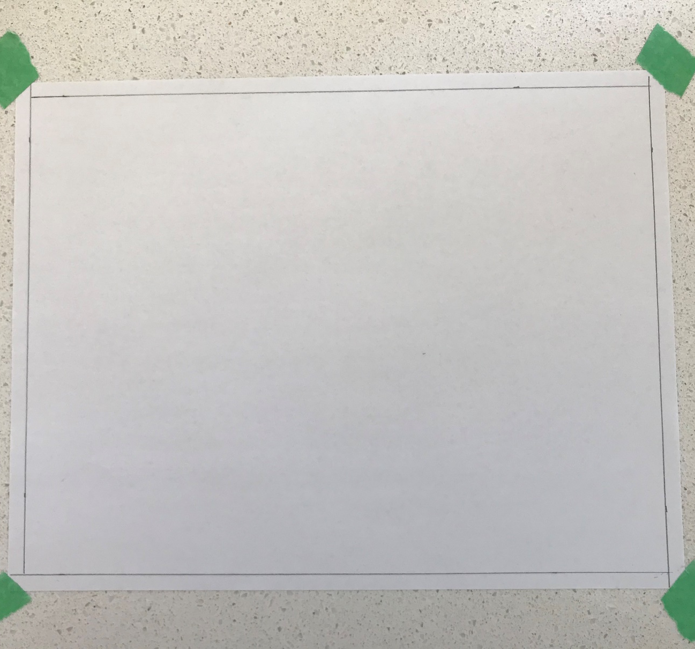
Drawing a Border
We are going to keep this simple. Let’s first start by drawing a ¼” or 6mm border around the page. Place a mark in two spots measured in from each side and then draw your line through both marks on each side.

Slide 5
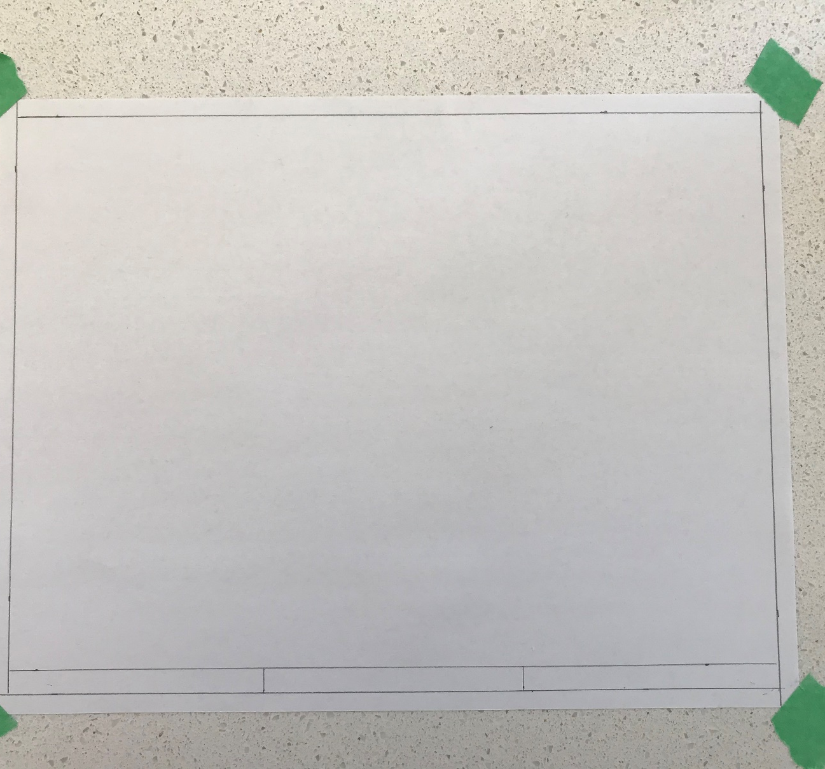
Adding the Title Block
Draw another line up 12 mm or ½” up from and parallel to your existing bottom border.
Measure the length of this space and then divide it into three.

Slide 6
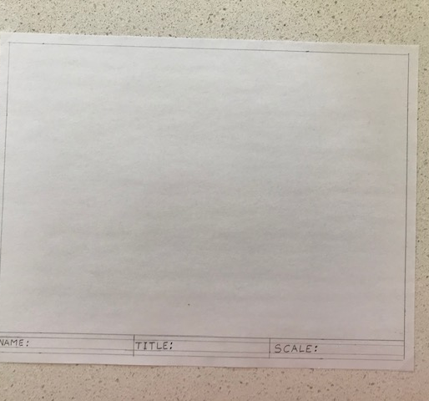
Add in Your Drawing Information
In the three boxes write in block letters the following titles: Name, Title, Scale. You can then insert your name, the drawing title and the scale you will use. Try to keep them neat. If you like, you can practice your block letters on another page.

Slide 7
Technical Drawing at Home
Part 2: Producing a Scale Drawing

Slide 8
Drawing to scale
Your drawing area on your template should be approximately 8 inches by 10 inches. For this example my tool board will have a plywood backing that is 3 feet by 4 feet. I would like to maximize my drawing area but still leave a bit of margin around my drawing so I will have to come up with the proper scale for it to fit.
First, I am going to convert my dimensions to inches. That means my tool board is 36” by 48”. (3 x 12, 4 x 12)

Slide 9
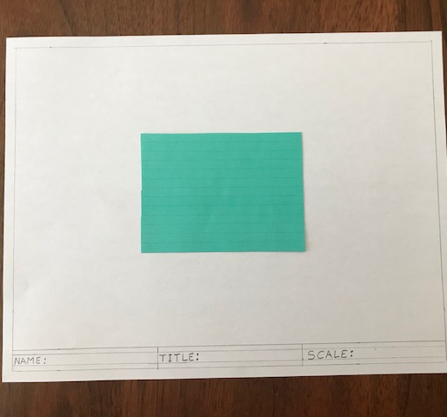
Choosing a Scale
If I choose the scale 1”=1’ or 1” on my drawing equals 1’ on my tool board, I will have a drawing that is 3” x 4” which will be too small on my drawing.

Slide 10
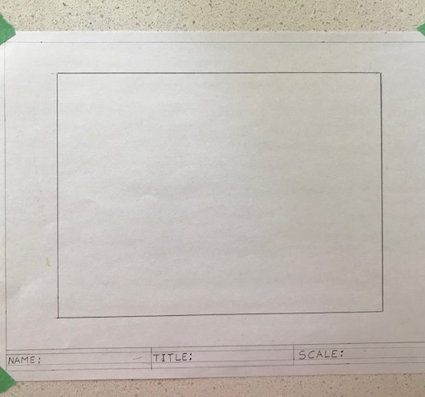
Choosing a Scale
Since we have 36” x 48” we can choose a common factor for each of these.
Let’s try 6
36/6 = 6
48/6 = 8
Our tool board will be 8” x 6” on our drawing.
Scale: 1” = 6”

Slide 11
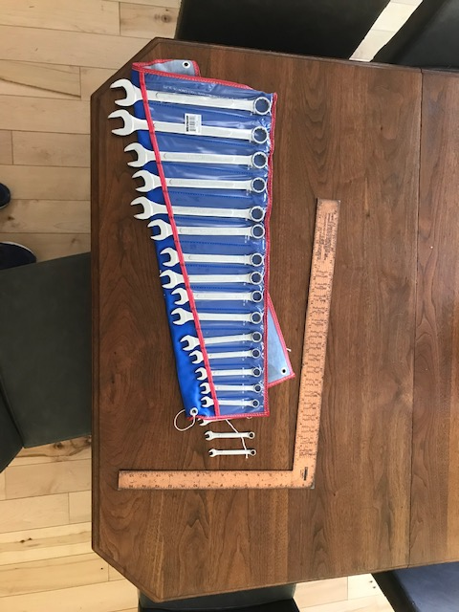
Scaling objects
Some tools will be too small in detail to be drawn to scale.
Others will be fine.

Slide 12
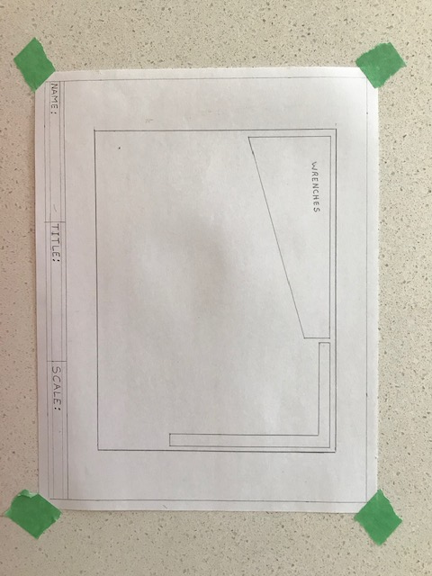
Drawing the tools
Use your judgement as to which tools should be drawn to scale and which ones require a scaled zone.
For this drawing some small freehand components will be okay. (pliers, hammers) Make sure to keep them neat.

