Slide 1
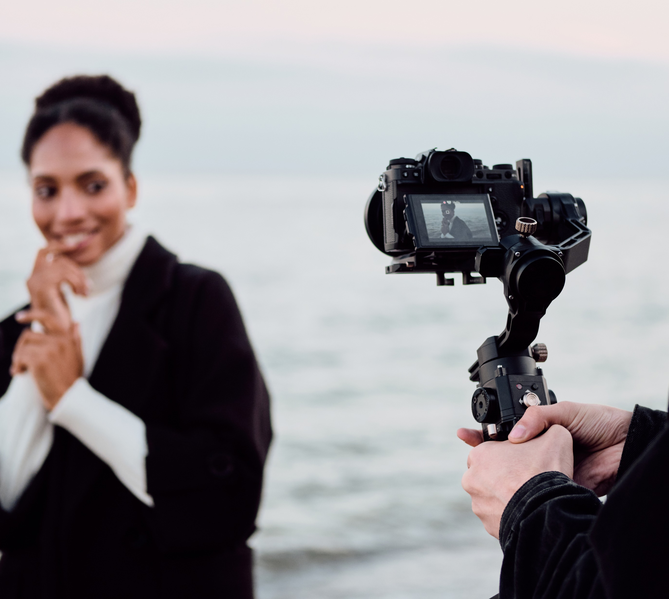
Shooting Stock Video
Lesson and Activity 2

Slide 2
Activities &
Assignment
Activity 1 – Understanding Canadian Copyright Laws
Activity 2 – The Importance Of Good B-Roll
Activity 3 – Setting The Stage For Success
Activity 4 – Ingesting, Editing and Exporting
Assignment – Shoot B-Roll

Slide 3


Importance of Good Stock
Stock footage allows filmmakers the ease of using pre-recorded video for their films without the hassle of having to go out and shooting it. Below are examples of stock footage or B-Roll:
  Cat meowing at a squirrel
  Snow boarder in a halfpipe
  Door opening to a hallway
  Clouds passing overhead
  Think About It: Think of some of your favorte indie movies? What are some shots that you think included stock footage? (Q1.1)
Importance of Good B-Roll/Stock
Canadian Copyright Laws
Setting The Stage For Success
Ingesting Editing and Exploring
Notes:
Image License - https://www.twenty20.com/photos/05abcd6e-025e-4f07-a05c-6734d34a6c74/?utm_t20_channel=bl

Slide 4

Importance of Good Stock
Stock footage is typically short clips between 5 and 60 seconds filmed to represent a specific idea or concept. The result ensures that the work can be used in many different types of video productions, covering a wide variety of topics.
Man repairing a motherboard
Farmers taking a tour of the barn
Toronto timelapse from above
  Think About It: What types of equipment would you need to shoot these stock footage videos (Q2.2)
Importance of Good B-Roll/Stock
Canadian Copyright Laws
Setting The Stage For Success
Ingesting Editing and Exploring
Notes:
Image License - https://www.twenty20.com/photos/05abcd6e-025e-4f07-a05c-6734d34a6c74/?utm_t20_channel=bl

Slide 5
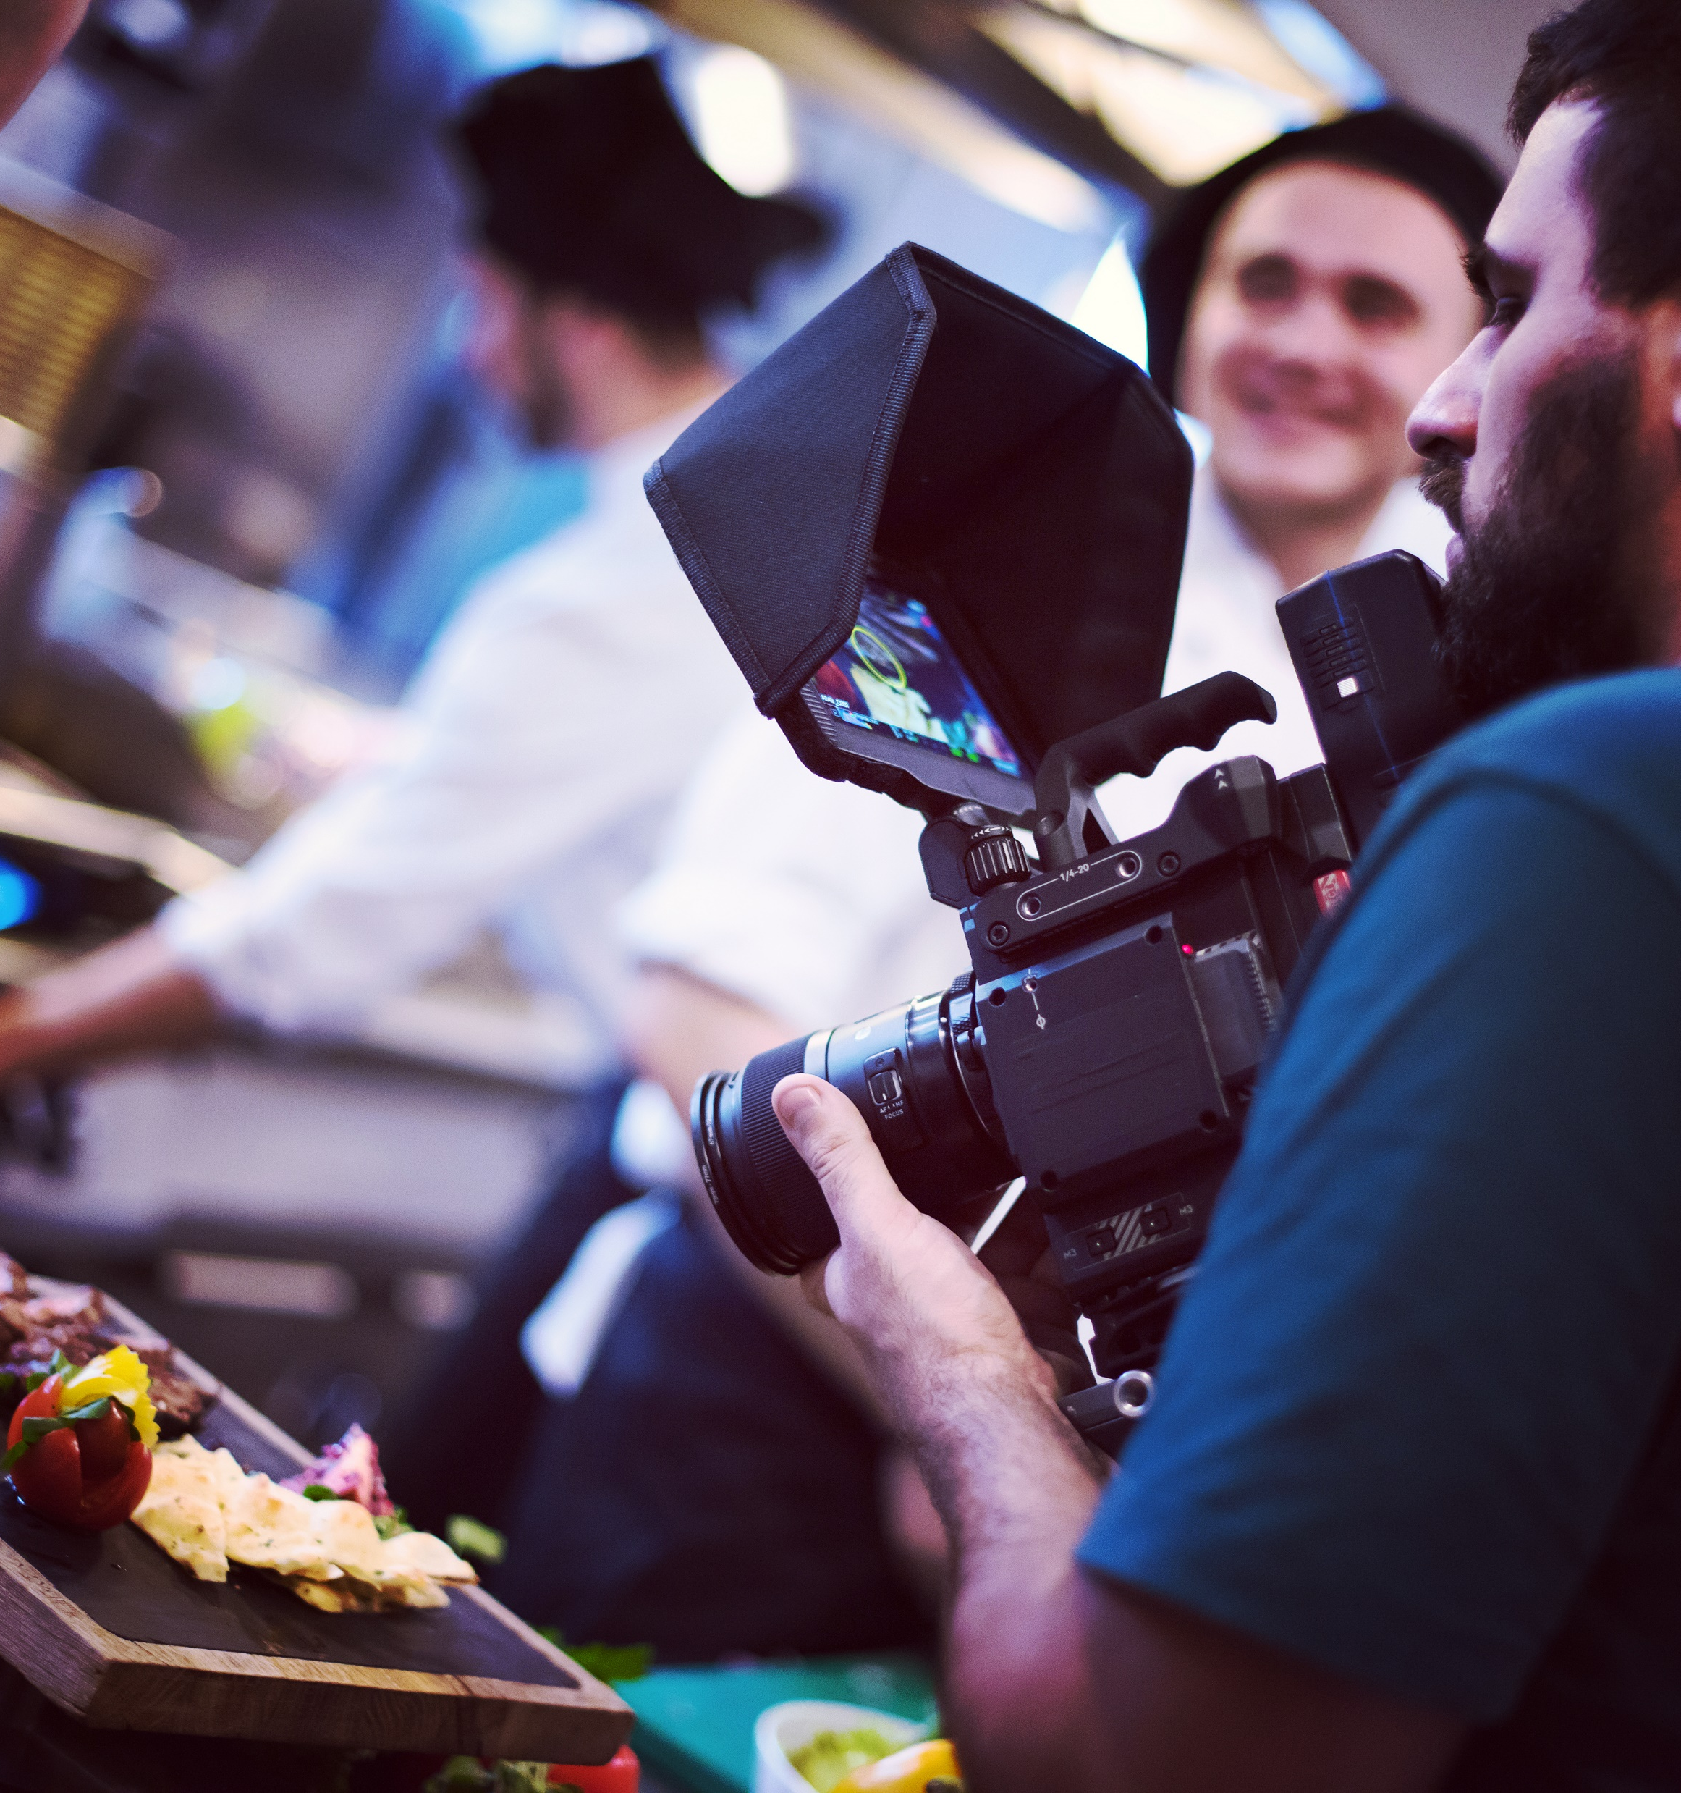
Importance of Good Stock
Good stock footage is sought after by filmmakers primarily because it is a lot less expensive than having to send someone out onto location to shoot. It is thus saving the filmmaker production costs on things like transportation, accommodation, equipment rentals, hiring talent, etc. as well as saving time.
Faster internet speeds allow stock footage for the immediate download of content, fitting perfectly into the filmmaker's workflow.
Importance of Good B-Roll/Stock
Canadian Copyright Laws
Setting The Stage For Success
Ingesting Editing and Exploring
Notes:
Image License - https://www.twenty20.com/photos/05abcd6e-025e-4f07-a05c-6734d34a6c74/?utm_t20_channel=bl

Slide 6
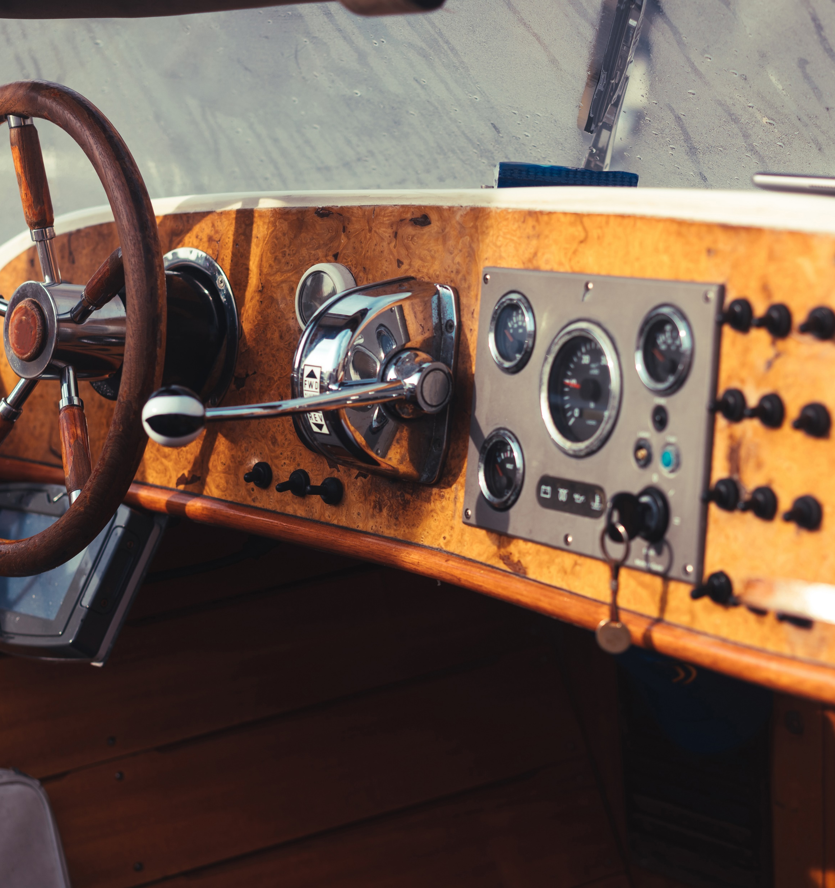
Importance of Good Stock
Stock video helps connect the scenes together, thus improving the filmmaker tell their story more effectively. An example of this is if a video requires snow between two different scenes. If your shooting in May and snow is not in the forecast stock video of snow, falling can be used to bridge the gap.
Stock videos can also be used to provide context for the viewer, like establishing shots. An example of this is a wide shot of a speed boat coming into dock in Port Stanley, Ontario. This footage can tell the viewer the video is set in a beach town.
Importance of Good B-Roll/Stock
Canadian Copyright Laws
Setting The Stage For Success
Ingesting Editing and Exploring
Notes:
Image License - https://www.twenty20.com/photos/05abcd6e-025e-4f07-a05c-6734d34a6c74/?utm_t20_channel=bl

Slide 7


Importance of Good Stock
There are many advantages to having access to good stock footage. An example you that you may not have considered is access to animals or wildlife.
As you can imagine capturing exciting footage of animals, fish, birds, etc. is incredibly challenging and requires a lot of time, expertise, and patience. Stock video provides the filmmaker access to the video that might otherwise be impossible to capture.
  Think About It: Where could you locate
  Canadian content that has been released
  through public domain (Q2.3)
Importance of Good B-Roll/Stock
Canadian Copyright Laws
Setting The Stage For Success
Ingesting Editing and Exploring
Notes:
Image License - https://www.twenty20.com/photos/05abcd6e-025e-4f07-a05c-6734d34a6c74/?utm_t20_channel=bl

Slide 8
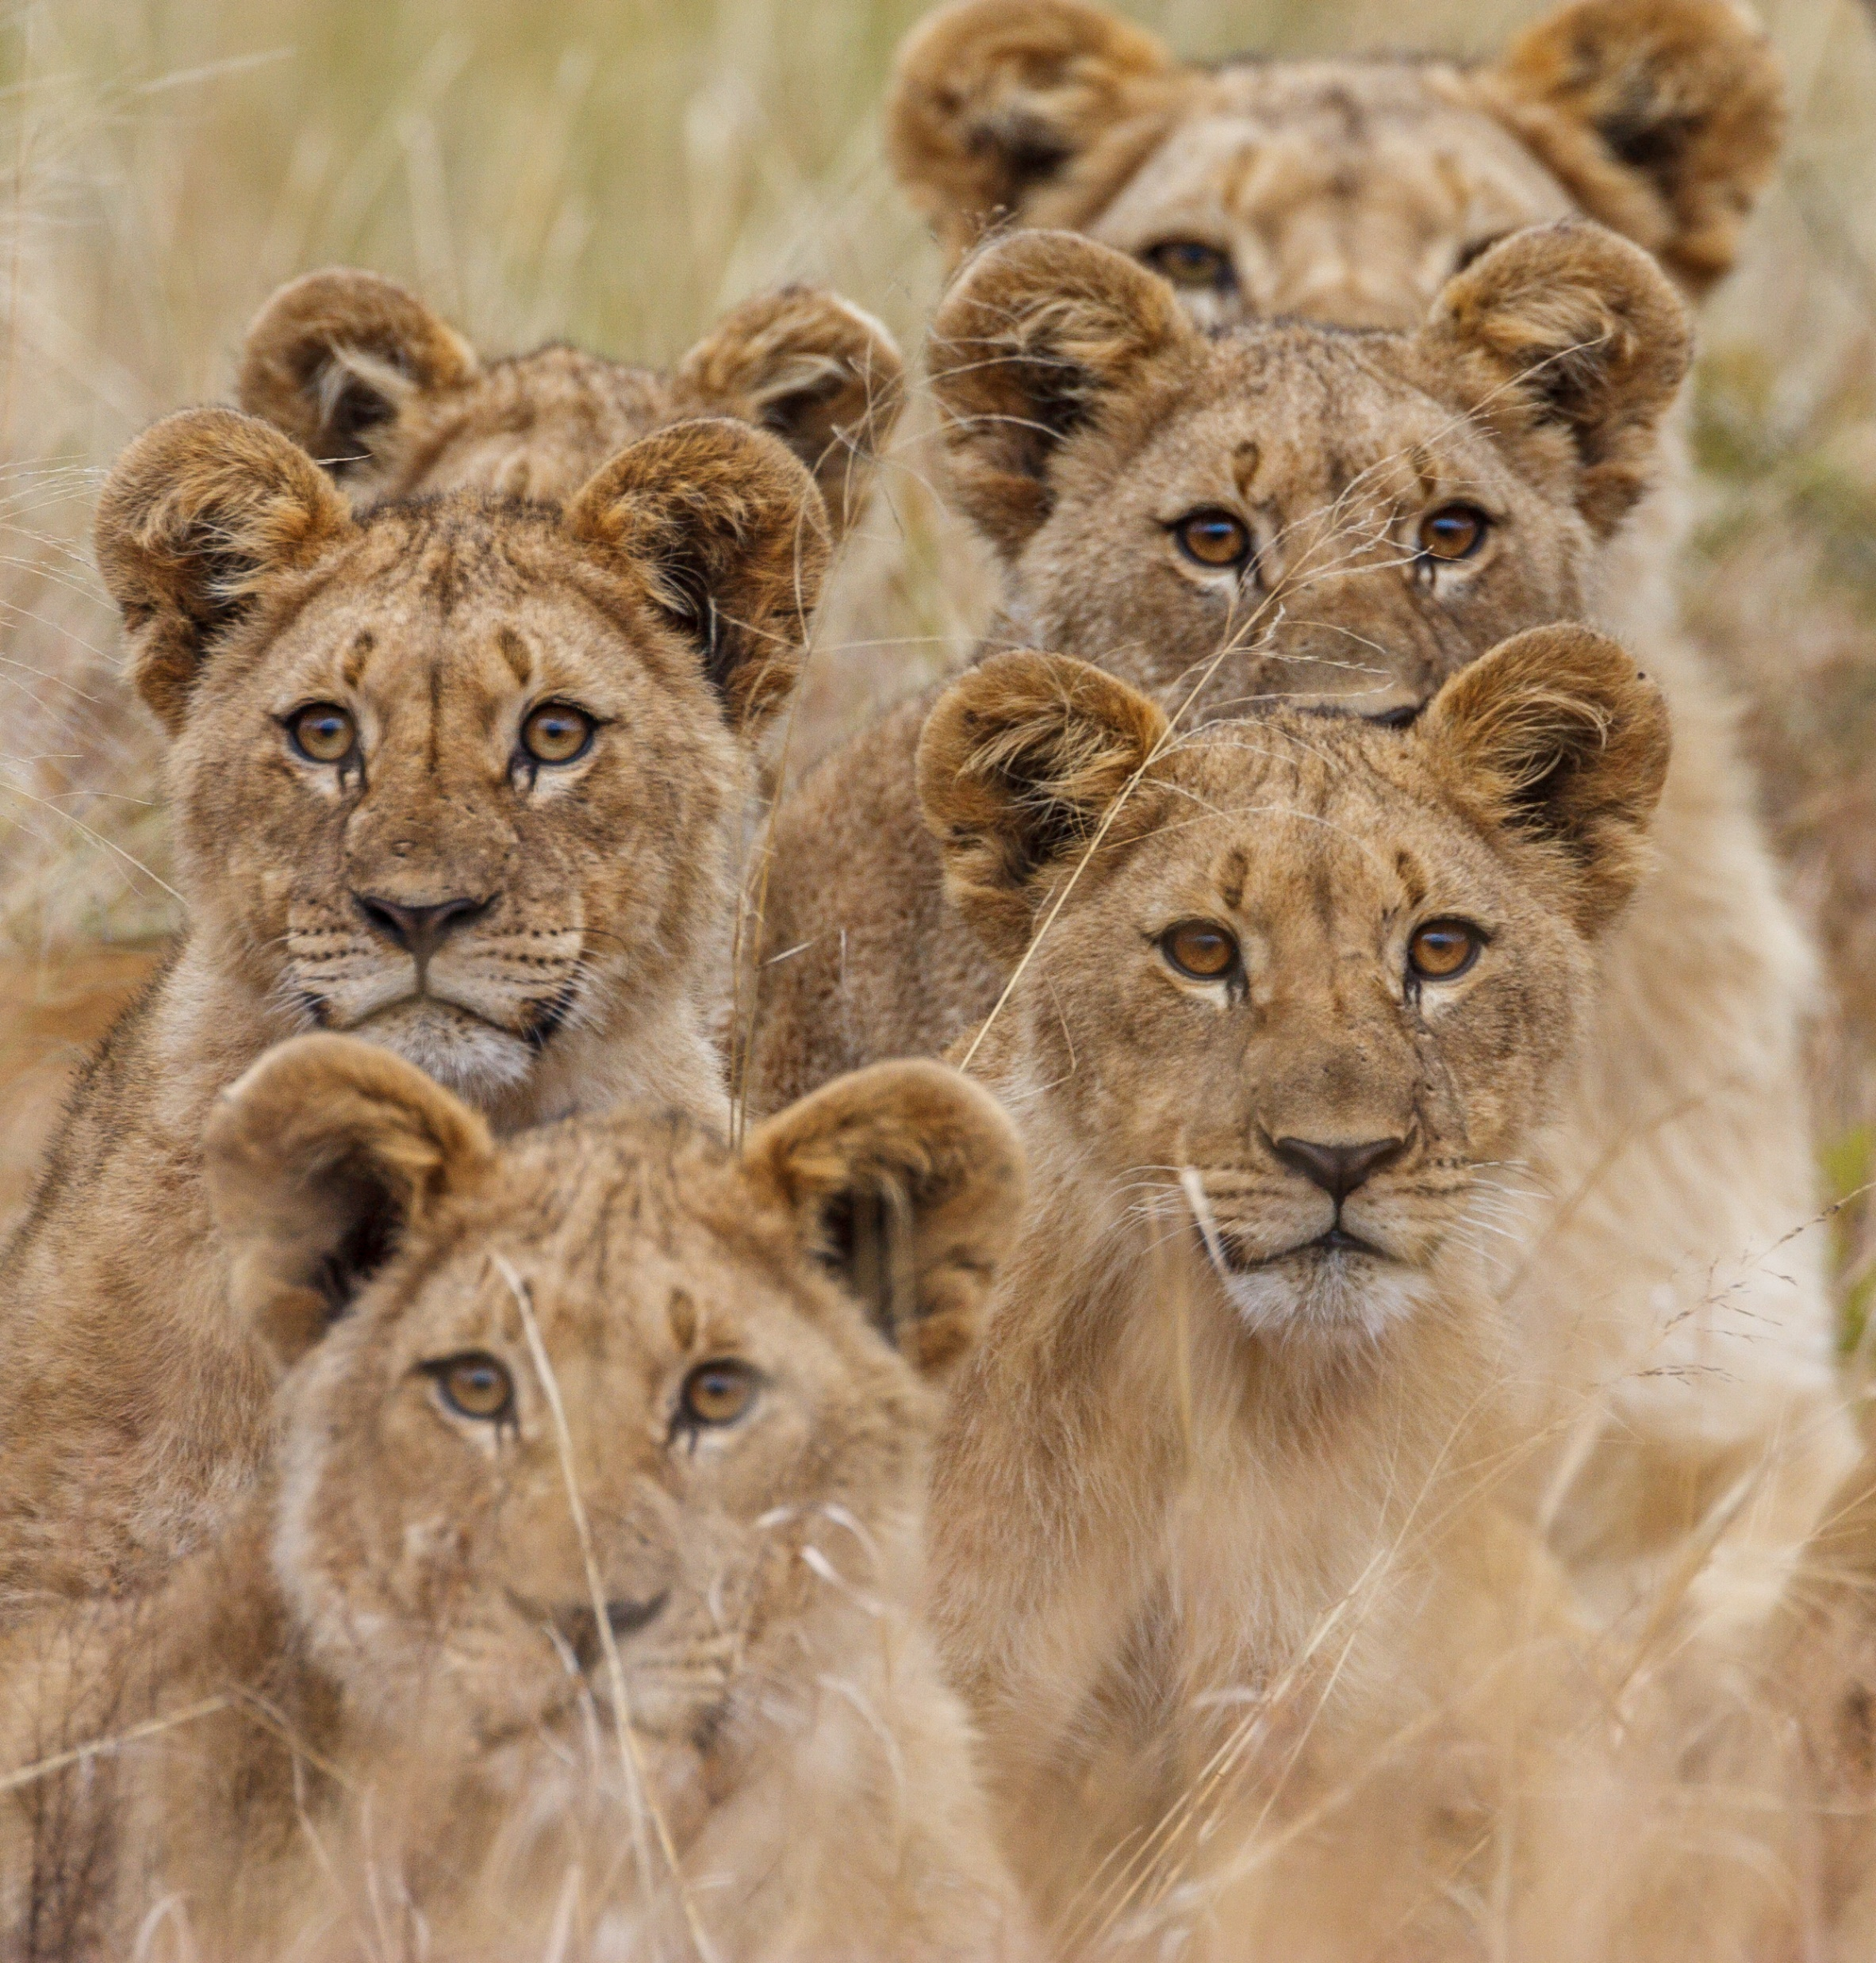
Importance of Good Stock
There are many advantages to having access to good stock footage. An example you that you may not have considered is access to animals or wildlife.
As you can imagine capturing exciting footage of animals, fish, birds, etc. is very challenging and requires a lot of time, expertise, and patience. Stock video provides the filmmaker access to the video that might otherwise be impossible to capture.
  Think About It: How could you capture
  stockvideo of exotic animals or fish
  in Ontario (Q2.4))
Importance of Good B-Roll/Stock
Canadian Copyright Laws
Setting The Stage For Success
Ingesting Editing and Exploring
Notes:
Image License - https://www.twenty20.com/photos/05abcd6e-025e-4f07-a05c-6734d34a6c74/?utm_t20_channel=bl

Slide 9
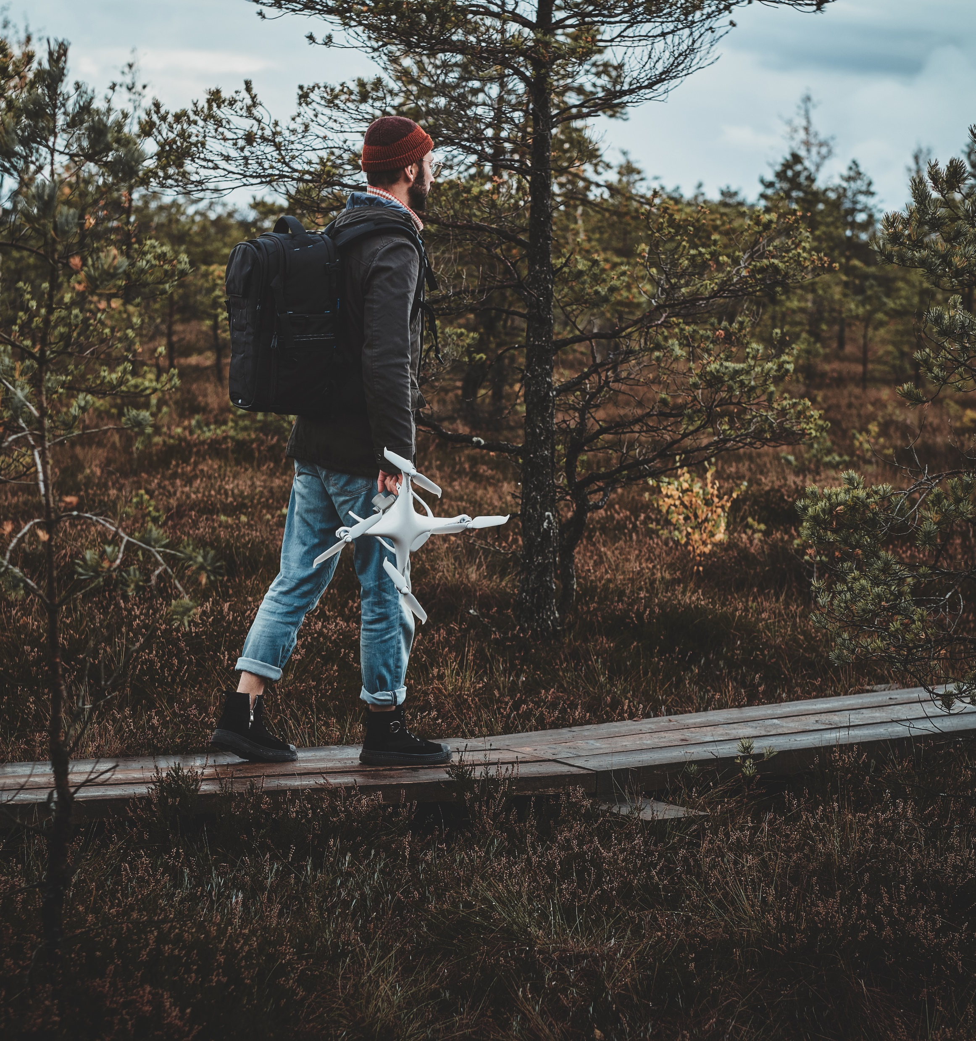
Importance of Good Stock
Watch @ Learn – Adobe Creative Cloud
  Why Consider Stock
  Think About It: What types of shots can you
  get from stock footage (Q2.5))
Importance of Good B-Roll/Stock
Canadian Copyright Laws
Setting The Stage For Success
Ingesting Editing and Exploring
Notes:
Image License - https://www.twenty20.com/photos/05abcd6e-025e-4f07-a05c-6734d34a6c74/?utm_t20_channel=bl

