Slide 1
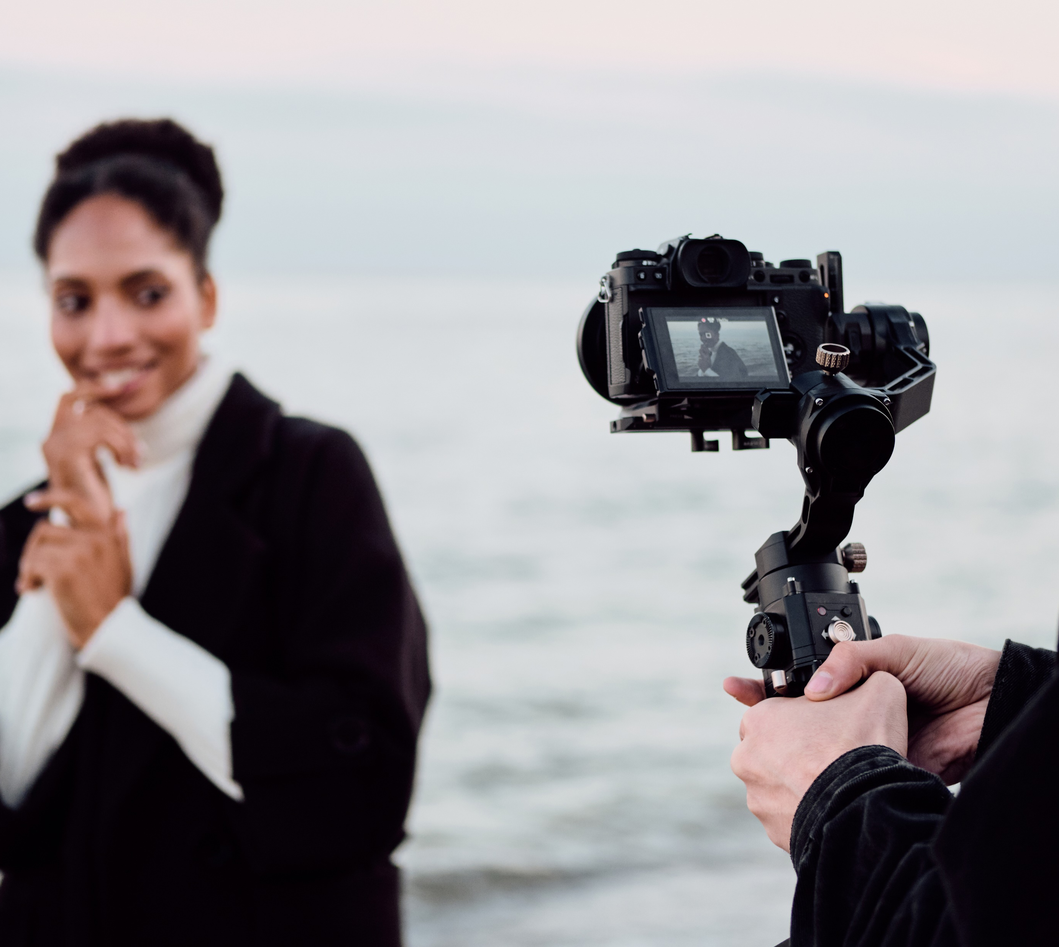
Shooting Stock Video
Lesson and Activity 3

Slide 2
Activities &
Assignment
Activity 1 – Understanding Canadian Copyright Laws
Activity 2 – The Importance Of Good B-Roll
Activity 3 – Setting The Stage For Success
Activity 4 – Ingesting, Editing and Exporting
Assignment – Shoot B-Roll

Slide 3

Setting The Stage For Success
There are many things that you can do to set yourself up for success in the creation of a stock video.
Although gear is important, it is not necessary that you go out and spend thousands of dollars on equipment. As you will experience in the assignment, a mobile device will the correct settings is all that you need to get started.
Canadian Copyright Laws
Importance Of Good B-Roll
Setting The Stage For Success
Ingesting, Editing and Exporting
Notes:
Image License - https://www.twenty20.com/photos/05abcd6e-025e-4f07-a05c-6734d34a6c74/?utm_t20_channel=bl

Slide 4
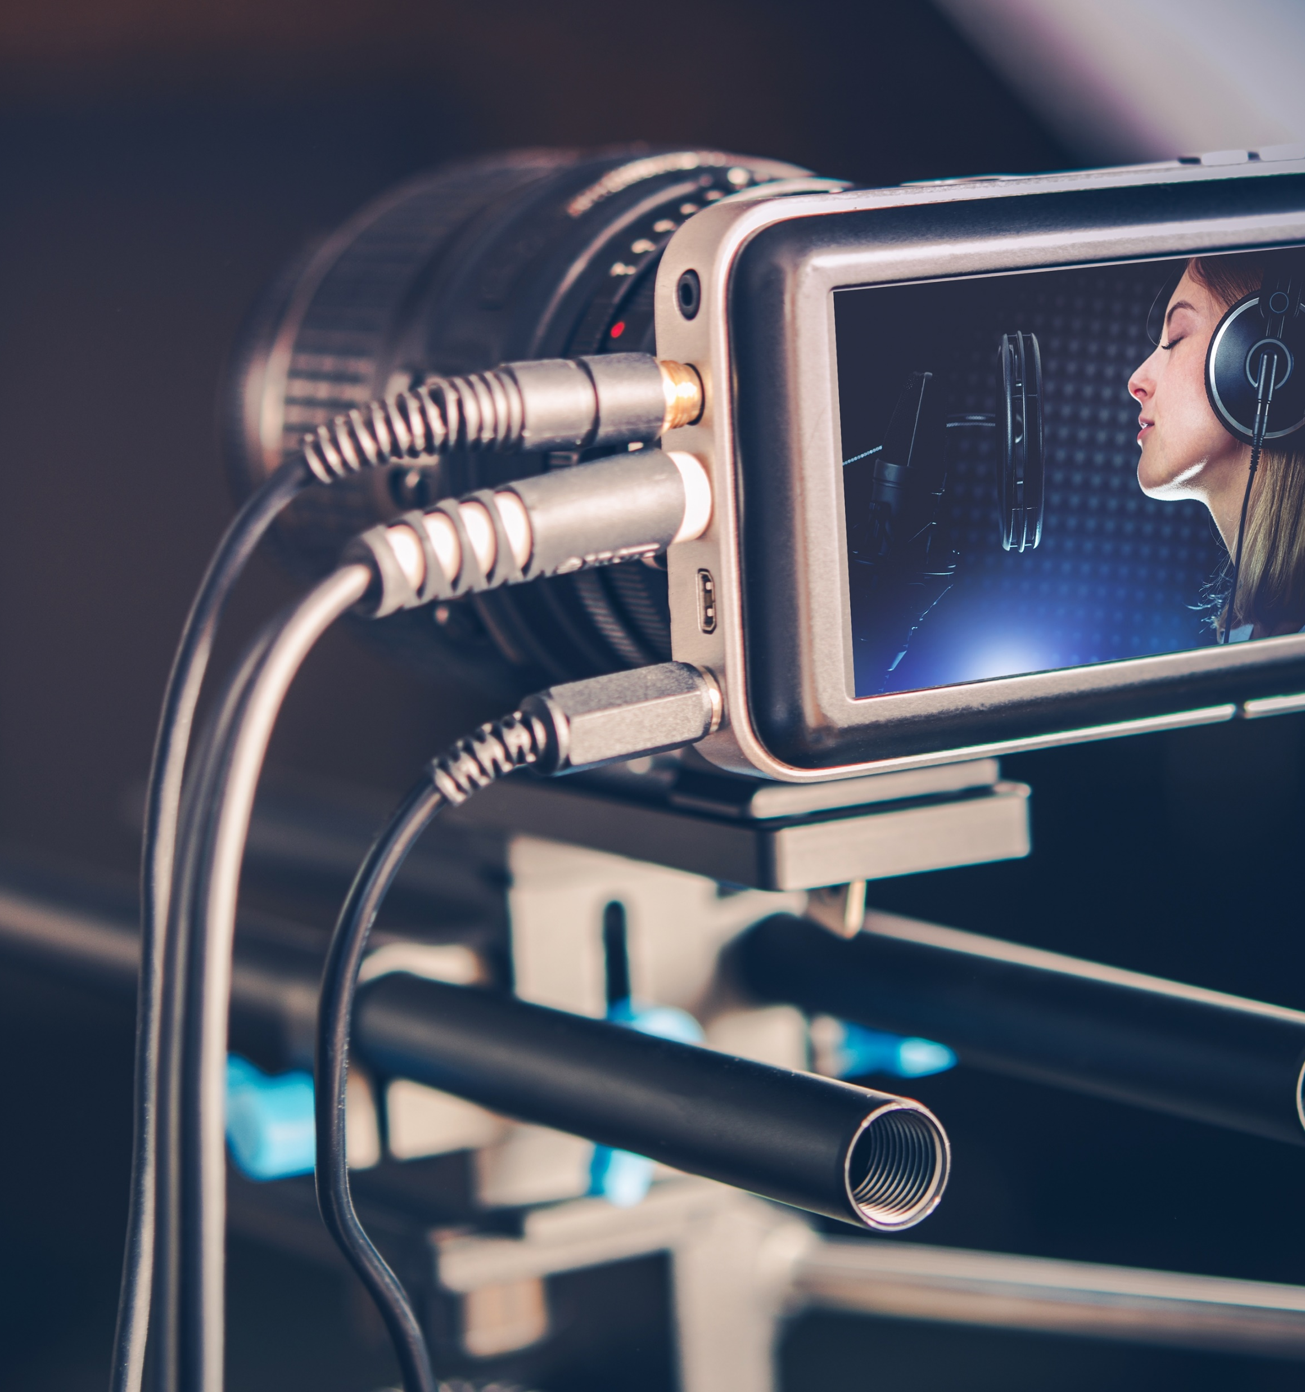

Setting The Stage For Success
Resolution
Setting up your mobile device or camera to shoot the highest resolution or shooting at different resolutions provides the user with different options.
Resolutions to consider shooting in
  4096x2304
  4096x2160
  3840x2160
  2048x1080
  1920x1080
  1280x720
  Think About It: What are some other resoutions? (Q3.1)
Canadian Copyright Laws
Importance Of Good B-Roll
Setting The Stage For Success
Ingesting, Editing and Exporting
Notes:
Image License - https://www.twenty20.com/photos/05abcd6e-025e-4f07-a05c-6734d34a6c74/?utm_t20_channel=bl

Slide 5

Setting The Stage For Success
Ever hear the term aspect ratio and wonder how it impacts your video. It is essential to know that aspect ratio and resolution are related to the width and height of the image on the screen.
Using the wrong aspect ratio can result in the work content not fitting correctly on the screen (think black bars).When shooting stock, think of shooting in different aspect ratios.
Some video aspect ratios include
  4:3 (Classic tv screens)
  16:9 (Widescreen)
  21:9 (Cinemascope)
Canadian Copyright Laws
Importance Of Good B-Roll
Setting The Stage For Success
Ingesting, Editing and Exporting
Notes:
Image License - https://www.twenty20.com/photos/05abcd6e-025e-4f07-a05c-6734d34a6c74/?utm_t20_channel=bl

Slide 6

Setting The Stage For Success
The FPS (Frames Per Second) for your stock video is an important choice you will need to make prior to shooting.
Options depend on the tool you are using but you may be able to choose.
  24 FPS
  30 FPS
  60 FPS
  120 FPS
  240 FPS
Think About It: What is the purpose of setting your frame rate (Q3.2)
Canadian Copyright Laws
Importance Of Good B-Roll
Setting The Stage For Success
Ingesting, Editing and Exporting
Notes:
Image License - https://www.twenty20.com/photos/05abcd6e-025e-4f07-a05c-6734d34a6c74/?utm_t20_channel=bl

Slide 7

Setting The Stage For Success
When shooting stock video, every element needs planning. The creator must carefully scope out the scene to avoid distracting elements; these elements could be colours, movement, or unwanted inclusions into the scene.
An example is an individual standing in front of a lamp post due to the compression of the lens; it appears the lamp post is growing out of the individual's head.
Think About It: What are some ways that you can ensure the viewer only sees what you want them to see (Q3.3)
Canadian Copyright Laws
Importance Of Good B-Roll
Setting The Stage For Success
Ingesting, Editing and Exporting
Notes:
Image License - https://www.twenty20.com/photos/05abcd6e-025e-4f07-a05c-6734d34a6c74/?utm_t20_channel=bl

Slide 8

Setting The Stage For Success
We know that the inclusion of good audio is as important as quality footage.
Audio in stock, however, plays a different role. When creating stock video, it is essential if you are going to include audio (and I would argue that you do not) that you keep your audio to only ambient sounds.
An example of successful audio inclusion would be a beach scene with the sound of waves crashing on the beach.
Canadian Copyright Laws
Importance Of Good B-Roll
Setting The Stage For Success
Ingesting, Editing and Exporting
Notes:
Image License - https://www.twenty20.com/photos/05abcd6e-025e-4f07-a05c-6734d34a6c74/?utm_t20_channel=bl

Slide 9

Setting The Stage For Success
There are many components required to create stock successfully, and you have successfully learned about some of them.
Watch @ Learn – Adobe Creative Cloud
  How to Shoot Stock Video
Watch @ Learn – Adobe Creative Cloud
  Make Passive Income with Stock
Think About It: There are hundreds
of stock video sites out there, including
opportunities to create stock for your
own projects and school (Q3.4)
Canadian Copyright Laws
Importance Of Good B-Roll
Setting The Stage For Success
Ingesting, Editing and Exporting
Notes:
Image License - https://www.twenty20.com/photos/05abcd6e-025e-4f07-a05c-6734d34a6c74/?utm_t20_channel=bl

