Slide 1

Shooting Stock Video
Lesson and Activity 4

Slide 2
Activities &
Assignment
Activity 1 – Understanding Canadian Copyright Laws
Activity 2 – The Importance Of Good B-Roll
Activity 3 – Setting The Stage For Success
Activity 4 – Ingesting, Editing, and Exporting
Assignment – Shoot B-Roll

Slide 3

Ingesting, Editing, and Exporting
It is essential to consider when capturing your footage, how much space you will need to store it.
If you are using a mobile device, it is best to preplan your shots so that you can easily upload or backup your work if you do not have much space on your device.
You will also want to consider how much data you have on a mobile plan and may wish to upload your content later over a Wi-Fi network to avoid additional charges.
Ingesting, Editing, and Exporting
Canadian Copyright Laws
The Importance Of Good B-Roll
Setting The Stage For Success
Notes:
Image License - https://www.twenty20.com/photos/05abcd6e-025e-4f07-a05c-6734d34a6c74/?utm_t20_channel=bl

Slide 4

Ingesting, Editing, and Exporting
If you are using a DSRL or other device, then it is essential to consider how you will store and backup your data: a backup hard drive or extra storage cards will save you headaches down the road.
Once you have your work backed up, it is time to ingest your media for editing. Once ingested there are a variety of ways to process your video, although a video editor is preferable you can use a built-in editor installed on your mobile device (e.g., Filmic Pro)
Ingesting, Editing, and Exporting
Canadian Copyright Laws
The Importance Of Good B-Roll
Setting The Stage For Success
Notes:
Image License - https://www.twenty20.com/photos/05abcd6e-025e-4f07-a05c-6734d34a6c74/?utm_t20_channel=bl

Slide 5

Ingesting, Editing, and Exporting
There are many paid and free video editors that you can utilize to process stock video. It is essential to consider a couple of things before you shoot and produce.
Aspect Ratio, and Resolution
Frame Rates
Colour space in neutrel or flat (if you can choose on your device)
Video container formats are either .mp4, .AVI or MOV
Video Compression (Codecs) are ProRes or H.264
Ingesting, Editing, and Exporting
Canadian Copyright Laws
The Importance Of Good B-Roll
Setting The Stage For Success
Notes:
Image License - https://www.twenty20.com/photos/05abcd6e-025e-4f07-a05c-6734d34a6c74/?utm_t20_channel=bl

Slide 6
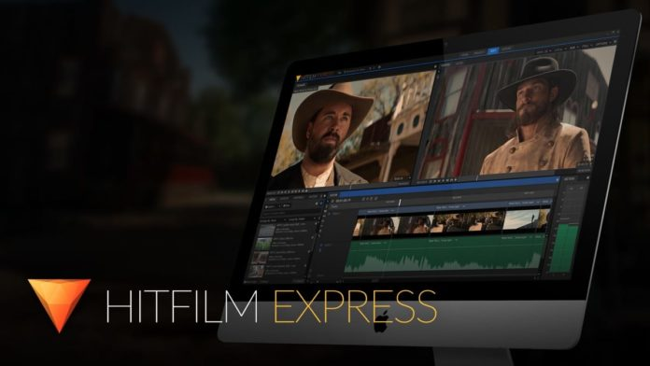
Ingesting, Editing, and Exporting
FREE Video Editors
Hitfilm Express is a FREE video editor with tools that are found in paid professional editors.
Hitfilm Express
Tutorials
Ingesting, Editing, and Exporting
Canadian Copyright Laws
The Importance Of Good B-Roll
Setting The Stage For Success

Slide 7

Ingesting, Editing, and Exporting
Video Capture and In Device Editor - Paid
Filmic Pro is a powerful mobile device capture and simple video editor tool that provides DSRL like features
Filmic Pro
Tutorials
Ingesting, Editing, and Exporting
Canadian Copyright Laws
The Importance Of Good B-Roll
Setting The Stage For Success

Slide 8
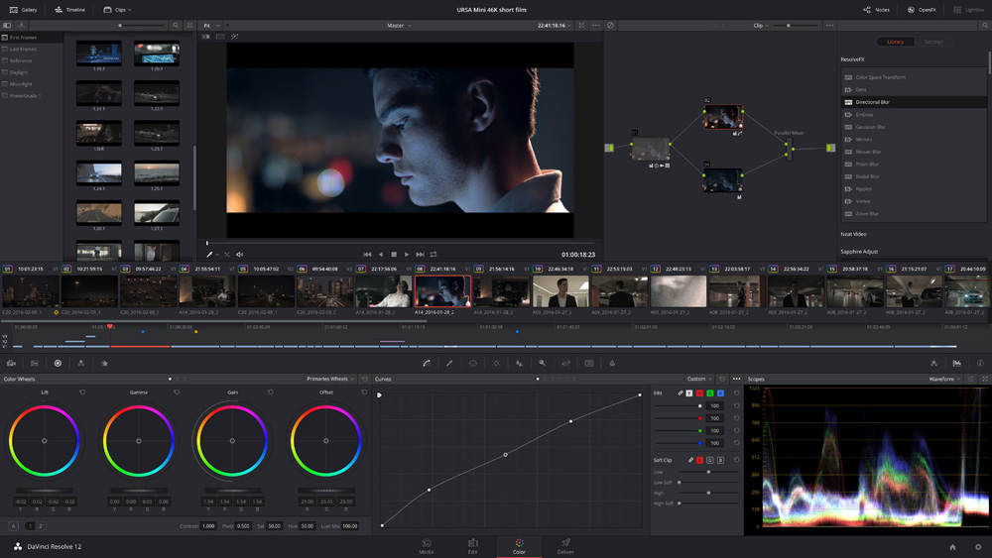
Ingesting, Editing, and Exporting
FREE Video Editors
DaVinci Resolve is a FREE non-linear video editing suite, owned by Blackmagic Design
DaVinci Resolve
Tutorials
Ingesting, Editing, and Exporting
Canadian Copyright Laws
The Importance Of Good B-Roll
Setting The Stage For Success

Slide 9
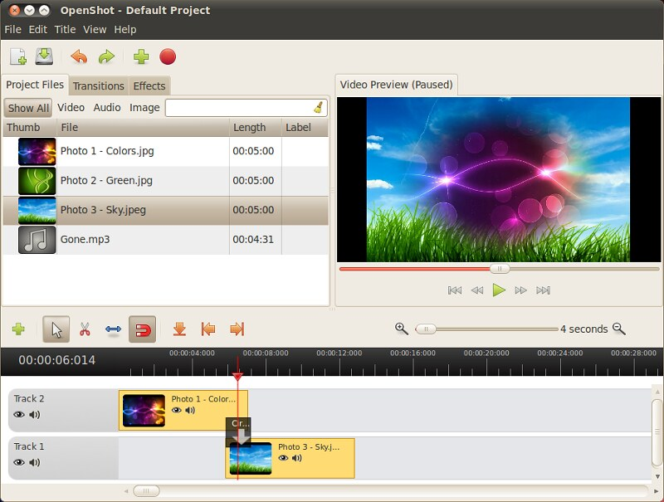
Ingesting, Editing, and Exporting
FREE Video Editors
OpenShot Video Editor allows the user to create videos with special effects, titles, and audio tracks
OpenShot Video Editor
Userguide
Ingesting, Editing, and Exporting
Canadian Copyright Laws
The Importance Of Good B-Roll
Setting The Stage For Success

Slide 10

Ingesting, Editing, and Exporting
FREE Video Editors
Adobe Spark allows students to create impactful stories, including video on mobile devices
Adobe Spark
Creating and Editing Adobe Spark
Ingesting, Editing, and Exporting
Canadian Copyright Laws
The Importance Of Good B-Roll
Setting The Stage For Success

Slide 11


Ingesting, Editing, and Exporting
There are many opportunities to create B-Roll/Stock video either for yourself, school, Creative Commons, or paid stock sites.
Think About It: It is possible to create a short video using nothing but stock video clips? (4.1)
  Pexels
  Pixabay
  Videezy
  Videvo
  Vidsplay
Watch @ Learn – TechGumbo
  Top 5 Best FREE STOCK VIDEO
Ingesting, Editing, and Exporting
Canadian Copyright Laws
The Importance Of Good B-Roll
Setting The Stage For Success

