Slide 1
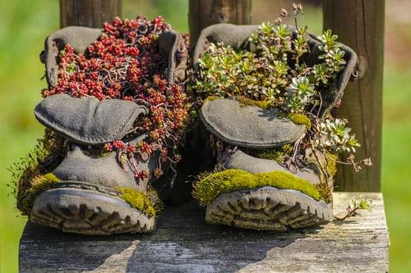
Growing Plants During a Pandemic
Limited resources - Maximum Growth
Upcycling - Repurposing - Reusing
Plants for Mental Health

Slide 2

Covid 19
Covid 19 has impacted our daily lives in an unimaginable number of ways, across the entire planet. One thing is certain, as life changes, we need to change with it. WE MUST ADAPT! We must find solutions to current problems and rethink the way we do things. It is amazing how resourceful humanity is… especially during times of crisis.

Slide 3
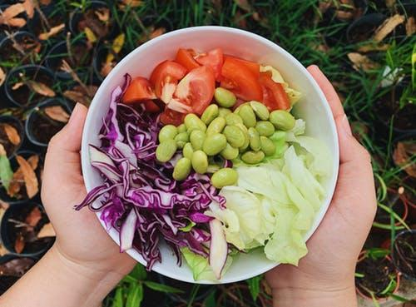
Plants are Essential
Plants are essential to life regardless of a pandemic. They are a vital component of our food chain that we can not live without. With potential threats to our national and global supply chain, growing food at home may become the new normal. Also, the nurturing nature of caring for plants is healthy for us, helping to calm us during times of stress.

Slide 4
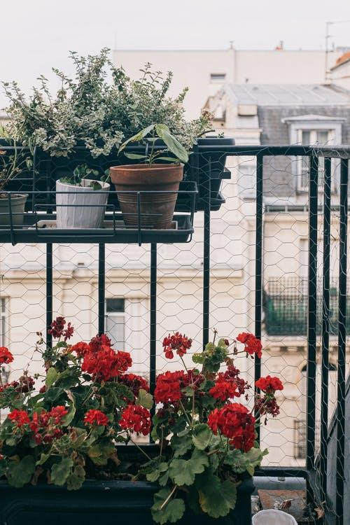
Where do you live?
For those with the benefit of having a yard out front and/or back, growing plants may come a little easier. For those who live in a high rise, growing on balconies and/or indoors is challenging but entirely doable. To keep costs at a bare minimum, it is essential to recycle and reuse items in clever and creative ways. This repurposing of objects for growing is known as Upcycle Gardening.

Slide 5
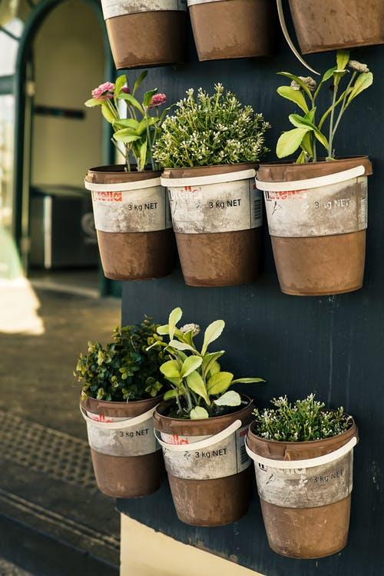
Upcycle Gardening
Try to imagine all the things that go to a landfill everyday. Think about how you can reuse, repurpose or UPCYCLE items which are commonly thrown out but could be useful for growing. These re-imagined items can be used to grow plants both outdoors and in.
Here is a small list of gardening related items you could make:
Garden ornaments
Planters
Planting tables
Raised garden beds
Bee hotels

Slide 6
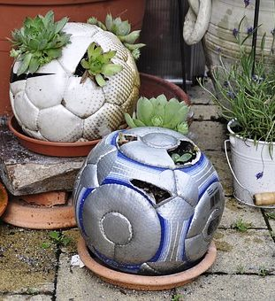
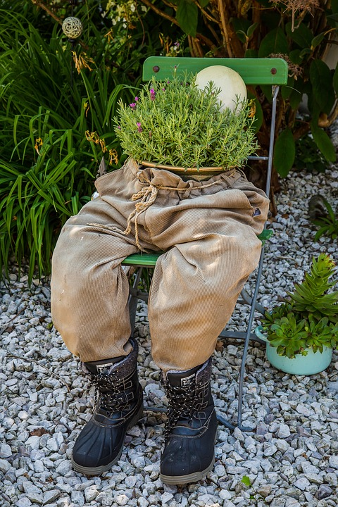
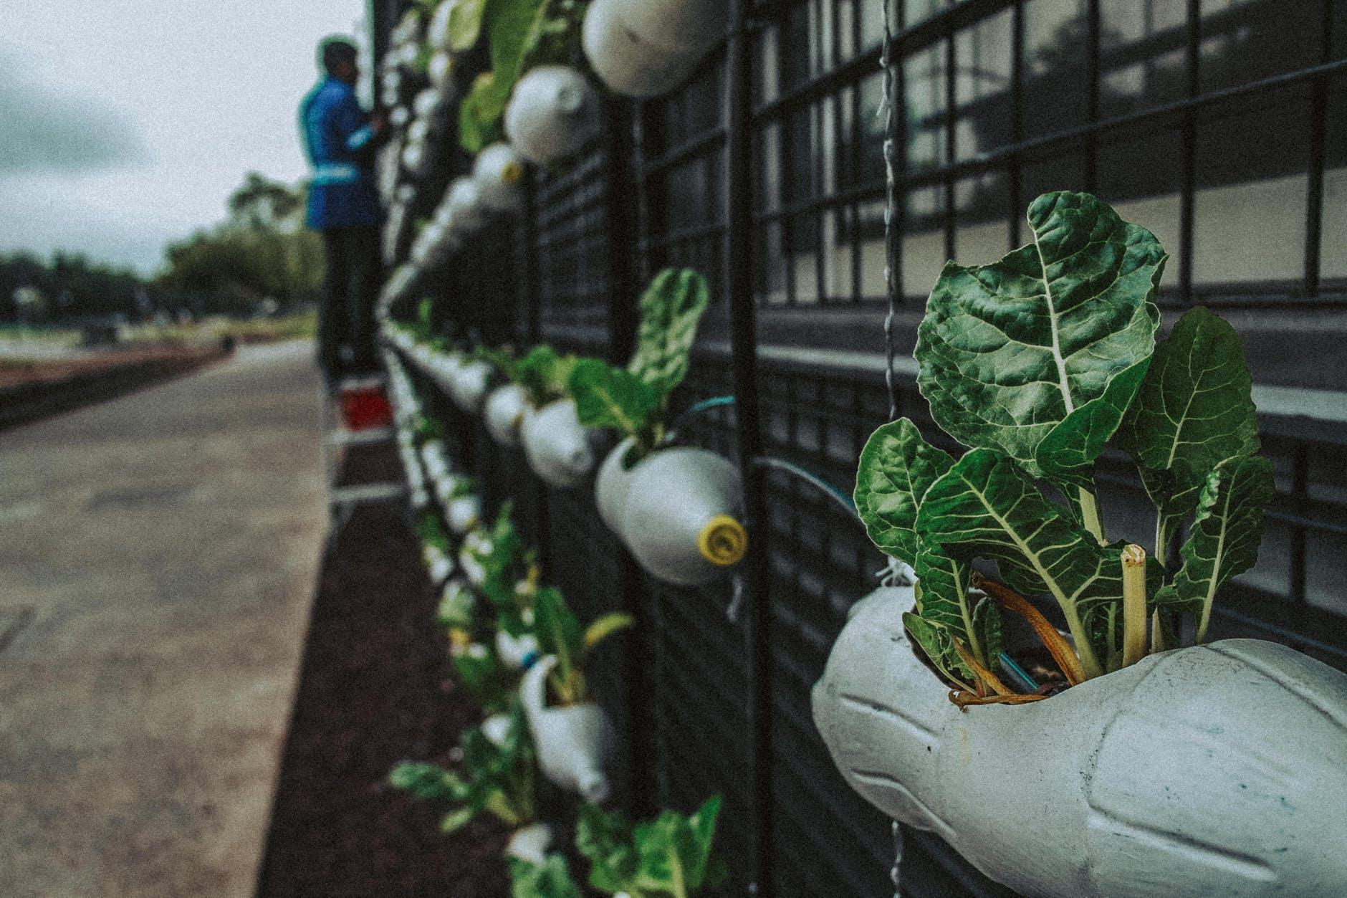
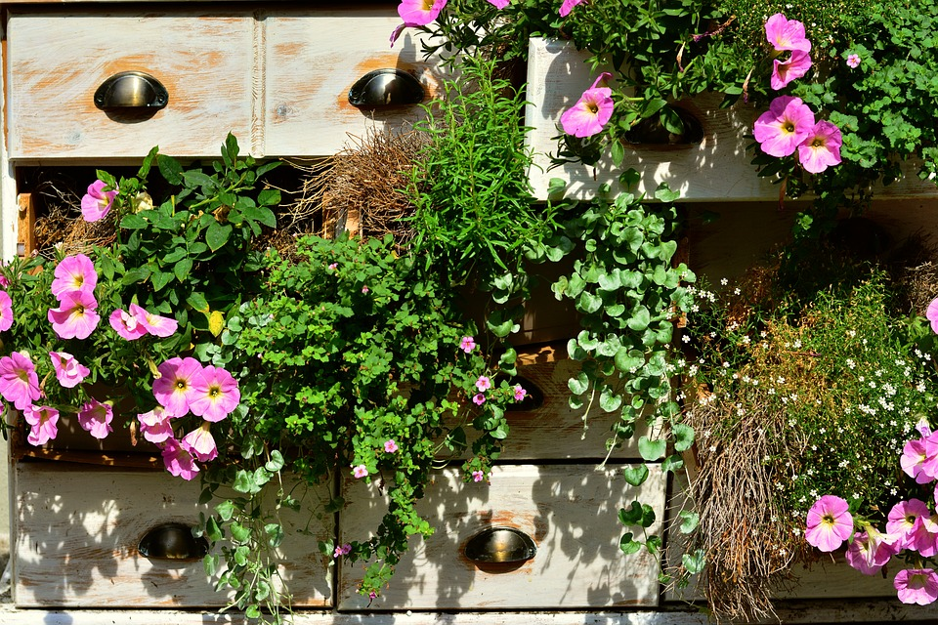
Upcycle Gardening
A few examples of clever growing opportunities.

Slide 7
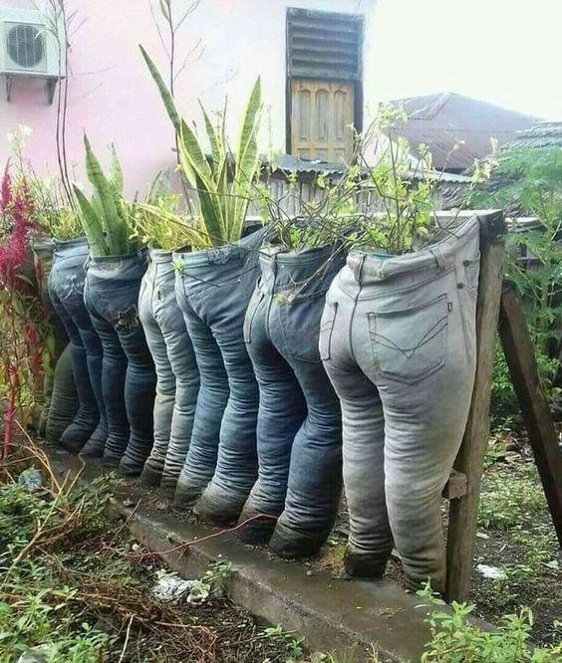
Upcycling ideas
Check out these links for more ideas
Youtube
Recycle Nation
Balcony Garden Web
Gardening Know How

Slide 8

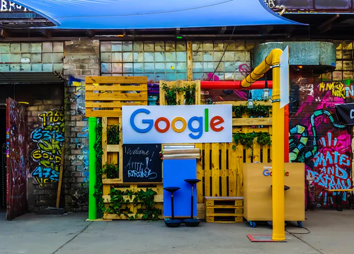
Google Sites
Create a google site webpage
Google Sites Tutorial
Use your name, class code and teachers name
Google sites is how you will present and share your project with your teacher

Slide 9
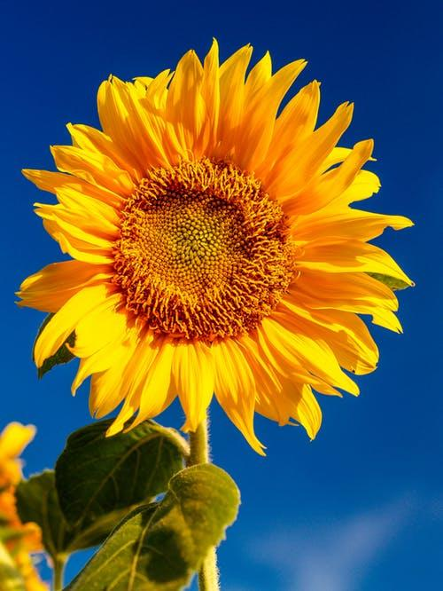
Questions
Answer these questions in your webpage. Each question should have its own page or two with headings/titles.
What are some of the challenges we face while gardening during a pandemic? What lessons could we learn?
What is sustainable gardening?
Re-thinking gardening at home, where does most of our food come from and why is this a concern?
What is Upcycle gardening?
How does growing plants and gardening help our mental health?

Slide 10
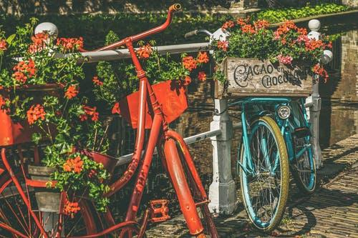
Additional Resources
Check out these links for more ideas
Landscape Ontario
Food Secure Canada
Gardening For Mental Health
Sustainable Gardening

Slide 11
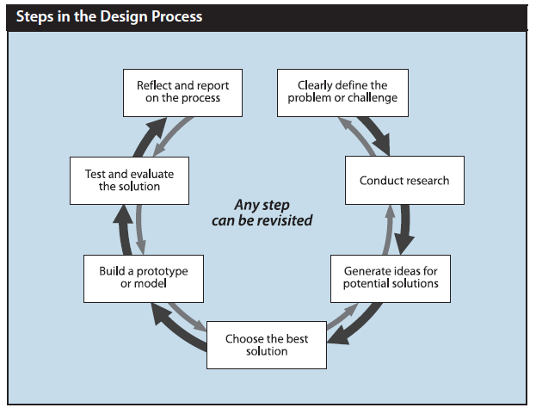
The Design Process
While thinking of an item that you would like to build, follow the steps in the Design Process and illustrate each step into your google sites webpage. Your creation should be an item that can be used for growing or somehow used in a garden.
Example: Design Process
Include pictures, descriptions and/or sketches.
Have fun with this project!

Slide 12
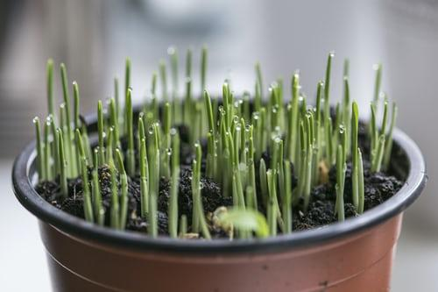
Bibliography
Images in the presentation were selected from the following three royalty free websites:
1. https://unsplash.com/
2. https://pixabay.com/
3 https://www.pexels.com/

