Slide 1



OCTE Math Literacy SPCE: Teacher information
Teachers should check all the links and resources prior to using the Math Literacy SPCE with your students.
Teachers are welcome to change or delete modules to better suit student needs.
This is designed as a fully contained 6-hour SPCE, but please edit as needed or consider approaching this SPCE over several days in smaller sections.
Consider adding information specific to your SHSM programs including community partners.
In Module 5, note that the assessment is two part and please direct students to complete part one, part two, or both if time and interest allow.
At the end of each module, students will submit work to their teacher for assessment. Please review the process for submitting work.

Slide 2
Acknowledgements
We would like to thank all the contributors for this project including:
Allyson Pele, Manager of the Northwest Business Centre
Alexis Pernsky, Owner and Operator of Sweet, Lake of the Woods Chocolate Shop
Matthew Kennedy, Owner and Operator of Upriver Media
Pauline Martin, Math Area Leader at Keewatin Patricia District School Board
Summer Company Entrepreneurs: Morgan Shepherd, Kaden Kanakakeesic, Ellie Petsnick and Cole Forsyth

Slide 3


OCTE Math Literacy SPCE

Slide 4
Math Literacy SPCE Outline
There are 6 modules that will help you explore Math Literacy and provide opportunities to relate your learning to your specific SHSM Program
Module 1: Introduction to Math Literacy
Module 2: A Practical Exploration of Problem-Based Mathematics
Module 3: Math in the Workplace
Module 4: Math Conversion Exercise
Module 5: SHSM Community Partner Connecting Math to the Workplace
Module 6: Reflective Practice
Within each module you will be asked to complete some work. At the conclusion of the module, a list of assessments will be provided that you need to submit to your SHSM Lead teacher.

Slide 5
Mathematics is more than a tool and language for science. It is also an end in itself, and as such, it has, over the centuries, affected our worldview in its own right.
Stephen Hawking

Slide 6

Module 1: Introduction to Math Literacy
In this module, students will learn about exploratory and problem-based mathematics. They will have the opportunity to learn about the connection between math and their pathway, and step into a problem-based approach to math literacy.

Slide 7
Why Math literacy?
Part of the Specialist High Skills Major Program (SHSM) is working on a Sector-Partnered Contextualized Experience (SPCE)
Math literacy is part of every pathway, and we are going to explore how math is used in varying workplaces as well as how our attitude toward math and math problem solving may need to change
In this SPCE you will have the opportunity to work on a math activity that you may face when working in your pathway or studying in college, university, or an apprenticeship

Slide 8

What is Math Literacy?
“A mathematically literate person can estimate; interpret data; solve day-to-day problems; reason in numerical, graphical, and geometric situations; and communicate using mathematics. As knowledge expands and the economy evolves, more people are working with technologies or working in settings where mathematics is a cornerstone. Problem solving, the processing of information, and communication are becoming routine job requirements.”
Source: Ontario Ministry of Education Leading Math Success http://www.edu.gov.on.ca/eng/document/reports/numeracy/numeracyreport.pdf
Source: https://unsplash.com/photos/rOYhgmDIOg8

Slide 9
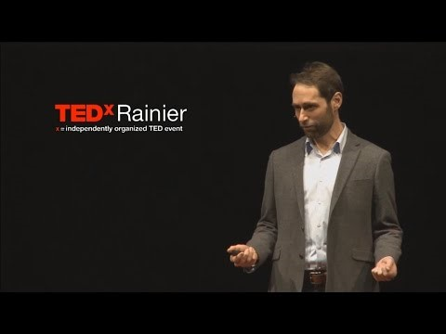
Understanding The importance of Play & Math Literacy
In this TEDtalk, Dan Finkel talks about how we can re-invent our relationship with mathematics. He discusses the critical skill of math literacy and how our approach to mathematics needs to change.
Please watch the video and answer the questions on the next slide about your own experiences with math.
If time is limited, the 5 Principles of Math Literacy can be found from the 3:00-13:30 minute mark in the TEDtalk
Video Source:
https://www.ted.com/talks/dan_finkel_5_ways_to_share_math_with_kids?utm_ca
mpaign=tedspread&utm_medium=referral&utm_source=tedcomshare

Slide 10
Math Literacy Questions
In his TEDtalk, Dan Finkel talks about how important math is in our lives. Do you agree or disagree with his belief? Please explain in a few sentences.
He uses an example of numbers with coloured circles surrounding as a problem that we can explore with mathematical reasoning. Did you find yourself trying to figure out the problem? If not, why? If so, what do you think is the solution? Explain how it felt to not know the answer at the end of the TEDtalk.
Do you identify as an individual who enjoys math or a person that would say they do not? Has this belief inhibited or enhanced your ability to use or discover mathematical solutions in your life? Explain.
Finally, if you were to approach math literacy as a critical job skill for your pathway, how would that change the way you approach math education?

Slide 11
Problem-Based Learning
Problem-based learning is both engaging and motivating because you are working to solve an issue and you as an individual have ownership over your own learning
Problem-based learning allows you to tap into your previous knowledge, listen to the knowledge of others, learn from the resources provided, and build a foundation of new knowledge that will help you solve a problem
Finally, problem-based learning allows you to be self-directed—you get to decide how you approach a problem, what you decide to do when/if things don’t work out, how you will pivot to solve the issue, and what constitutes a path for your learning.
Source: Savery, J. R. (2015). Overview of problem-based learning: Definitions and distinctions. Essential readings in problem-based learning: Exploring and extending the legacy of Howard S. Barrows, 9, 5-15.

Slide 12
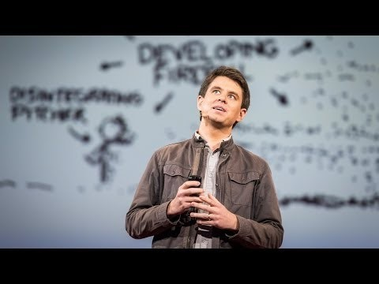
THE FUN OF PROBLEM-BASED MATH
In this TED talk, a comic/artist/math-lover looks at exploratory math. When given a problem, how can you use math to solve it? And, what are the larger issues that arise from approaching problems with math-based design?
Please watch the video and then answer the questions on the following slide.
Source:
http//www.youtube.com/watch?v=I64CQp6z0Pk
If time is limited, students can learn about problem-based math by watchinghe 3:00-9:00 mark of the TEDtalk
Source:​ http//www.youtube.com/watch?v=I64CQp6z0Pk

Slide 13
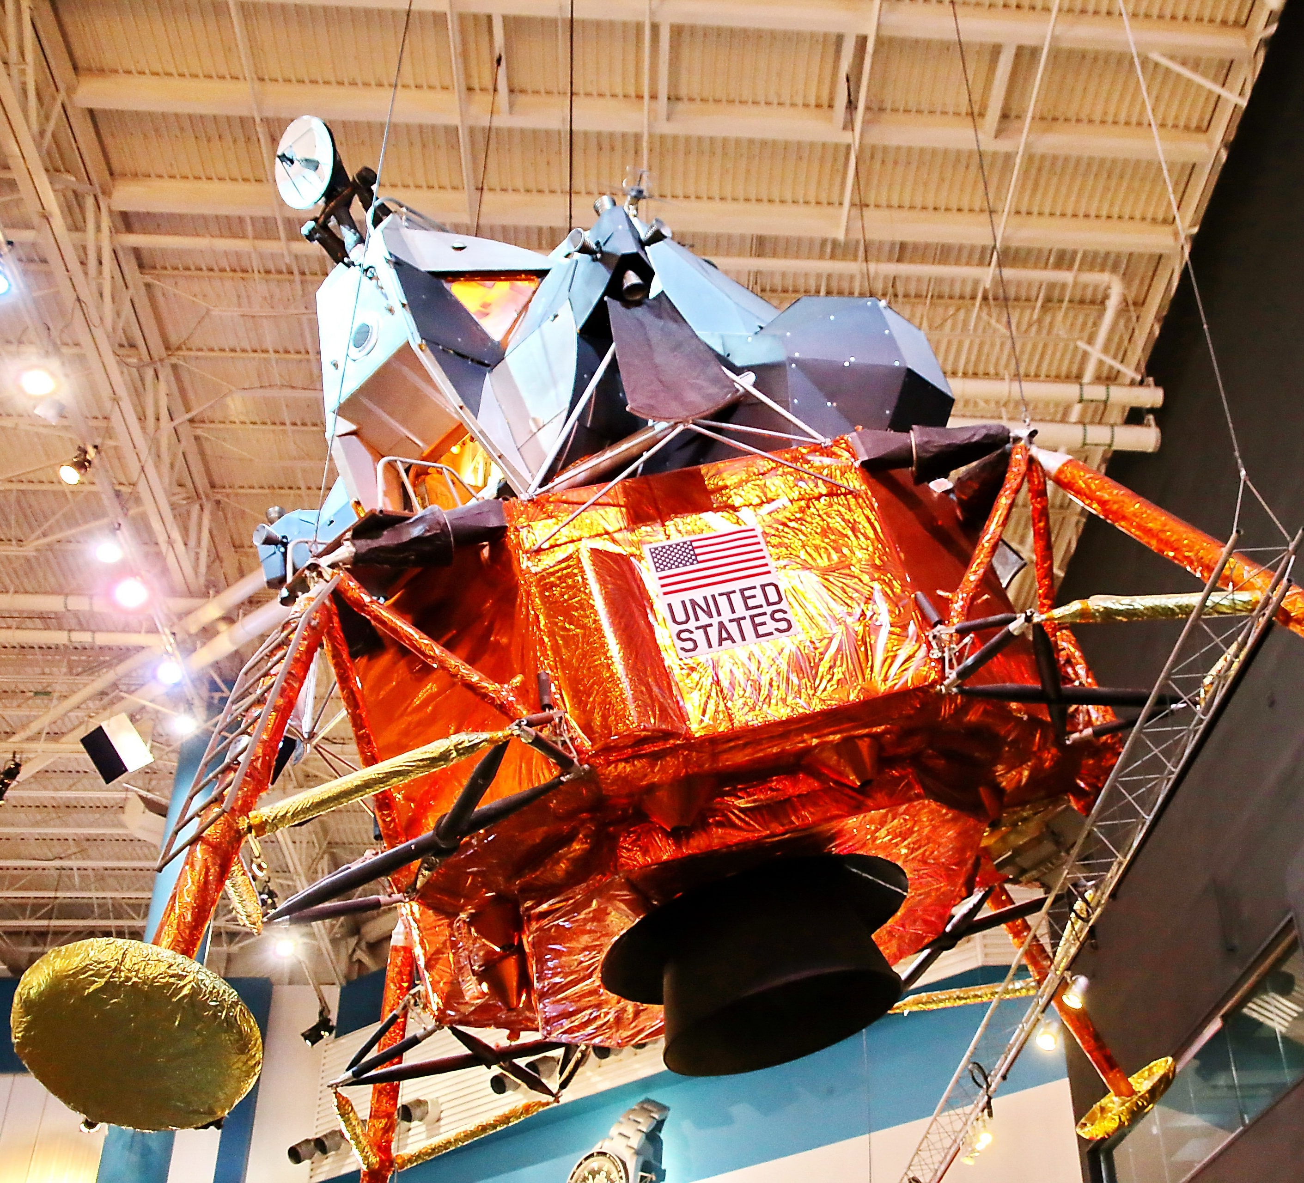
Problem-Based Mathematics
How is problem-based math different than our common perception of math?
Randall Munroe has a unique approach to problem-based math. What did you find intriguing about his approach? Did you identify with his interest in solving problems or not? Explain.
Image Source: https://unsplash.com/photos/IwRPMHU1PpE

Slide 14

Module 1: Assessment
Submit your answers to the Math Literacy Questions to your SHSM Lead Teacher
Submit your answers to the Problem-based Math Questions to your SHSM Lead Teacher
Answer the following reflective question:
Now that you understand that math literacy encompasses an understanding of problem-based learning, exploration, and play, does that alter your approach when dealing with mathematical problems? How can you see a new approach and understanding to math working for you in a workplace or learning setting?
Image Source:
https://unsplash.com/photos/fteR0e2BzKo

Slide 15
Module 2: Practical Exploration of Problem-Based Math
In this module, students will explore some practical applications to problem-based learning and make the connection to math as an exploratory subject.

Slide 16

A Series of Practical Math Tasks
You will be given 3 practical math tasks to complete using only your problem solving and general math skills.
For each task, take some time to think of a creative approach to the task and how you can complete it.
Consider how you can use some problem-based learning strategies and math literacy skills to approach each practical problem.
Image Source: https://unsplash.com/photos/jvBXiynINGE

Slide 17
Practical Math Task #1: Estimating
You are going to choose one drawer in your house. It can be a dresser drawer, kitchen drawer, or any other kind of drawer.
Next, you are going to choose a unit of measurement. You can choose a tissue box, a pencil, a sock, whatever you like.
Look at your drawer and your unit of measurement and estimate how many of that unit you think will fit in the drawer. Write down your estimate.
Now, see if you are right. If you have enough of your unit of measurement (a small sports sock, for example) fill the drawer with them and see how many fit. If you don’t have many items of the unit you choose to measure with, how else can you figure out how many units would fit into your drawer of choice? How might you work with that item and your math skills to figure this out? Write down the answer to how many items fit in your drawer.

Slide 18
Practical Math Task #2: Logic & Reasoning
A person needs to cross a river in a rowboat with a fox, a chicken and a bag of corn
She/he/they can only take one animal/item across at a time but can’t leave the fox with the chicken (it will eat the chicken) or the chicken with the corn (it will eat the corn).
How does she/he/they safely get all the animals/items to the other side of the river?

Slide 19
Practical Math Task #3: Distribution
Choose a store-bought food item that is liquid-based in your home (for example, a can of soup, a container of hummus, or a jar of hot sauce). Note the unit of measurement (ounces, milliliters, cups, etc.) to indicate the total volume of the item
Consider the number of people in your household and divide the product into equally sized portions (you only need to write the calculation not actually divide it). What portion would everyone get?
Look at the food label on the product and the portion size that is indicated on that label. Is the portion size similar to the equal division amount you calculated? Or is it significantly more or less?

Slide 20
Module 2: Assessment
Consider the 3 practical math tasks that you completed in this module and submit:
Math Estimate Work
Math Logic and Reasoning Work
Math Distribution Work
Answer the following question and submit all of your assessment work to your SHSM Lead Teacher:
Did you enjoy the practical math tasks? Why or why not? Were any of the tasks frustrating or particularly easy to complete? Explain with specific reference to one of the tasks how these tasks connect to your previous math knowledge and problem-solving skills.
Image Source:
https://unsplash.com/photos/fteR0e2BzKo

Slide 21
Module 3:
Math in the Workplace
In this module, students will conduct an oral interview to inquire about the importance of math in a field of interest. They will have the opportunity to identify and reflect upon math skills that are highly desired in many workplaces including problem solving and analytical skills. Students will be encouraged to choose a job sector related to their pathway of interest as a reach ahead opportunity.

Slide 22

WHAT DOES MATH TELL US ABOUT THE WORLD?
The body of knowledge and practice known as mathematics is derived from the contributions of thinkers throughout the ages and across the globe. It gives us a way to understand patterns, to quantify relationships, and to predict the future. Math helps us understand the world — and we use the world to understand math.
https://asiasociety.org/education/understanding-world-through-math
https://unsplash.com/photos/qxvOokGBU2U

Slide 23
Pathway interview
Choose
Choose an individual to interview preferably in a field that you are considering as your pathway.
Set up
Set up a date and time that works for you and your interviewee.
Formulate
Formulate 5-7 questions that focus on math in the workplace.
(Complete attached permission form if necessary)

Slide 24
Sample Questions
What are the main units for measurement used in this sector?
Where do you see the use of numbers in your work?
Do you have math related advice for students who are considering this field?
What kind of tools or resources do use to support your work related to math?
Can you provide an example of a math problem you encounter in your work?
Did you learn the math skills required on the job?

Slide 25
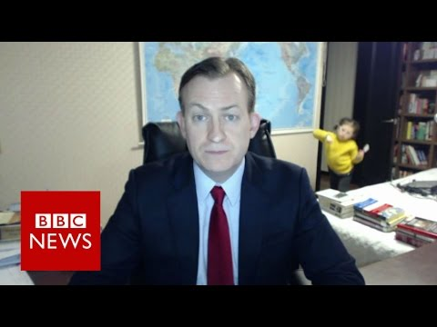
VIDEO INTERVIEW GUIDE: TIPS FOR A SUCCESSFUL INTERVIEW
Preparation is the most important first step.
Record yourself beforehand using your phone or computer
Check your Tech (plug in your computer, close browsers, check settings, turn off phone, etc...)
Control your setting as much as possible
Watch the video of a professional reporter dealing with real life and stay calm and interview on!
Source: youtube
Beware of background distractions!

Slide 26
It's now time to conduct your interview.
Ask your teacher if you require further clarification.

Slide 27
Complete the following interview reflection chart
What did you know about the importance of math in this field that was confirmed? | What did you learn from the interview? | How does this make you think about what you still have learn? How does this impact your future decisions?
Who did you Interview? Briefly describe their workplace and experience.

Slide 28
Module 3: Assessment
Contact an employer
Formulate questions
Prepare for the interview
Conduct the interview
Record what you learned from the interview about math literacy in your chosen pathways and how that knowledge may impact your future decisions
Submit your interview reflection chart to your SHSM lead teacher
Image Source:
https://unsplash.com/photos/fteR0e2BzKo

Slide 29
Module 4: Math Conversion Exercise
In this module, students will recognize that conversions apply to all sectors. Students will consider where problems related to math exist in their pathway and use a conversion chart to explain their approach to problem solving.

Slide 30
IDENTIFY Conversions by sector
Consider the numbers and conversions in the chart on the next slide In the last column, indicate which sector relates to the math problem (health and wellness, transportation, construction or hospitality and tourism).

Slide 31
Numbers | Units | What is this Measured for | Conversions (What are conversions that relate this number to others in the list?) | Sector where you commonly find this conversion?
A repair takes 2 hours and 17 minutes | Time in hours and minutes for calculating shop hours on a job | Billing a client for a repair at $75/hr. | 2 hours, 17 minutes 17/60 = 0.283 Billing = 2.283 X $75 = $171.25
A garage roof is 24 feet by 12 feet on each side | Feet | Determine the quantity of shingles required L X W = A (square feet) | 1 bundle of shingles covers 32 sq. ft 24 X 12 = 288 (X 2 sides) = 576 sq. feet 576 sq. ft/ 32 sq. ft = 18 bundles
A patient requires 35 mg of medication per 100 pounds | Milligrams (mass), converted to milliliters (volume), prescribed by mass of a patient (specified ratio) 1mg =1ml | How much should be given to a patient who weighs 145pounds? | 35mg per 100pds 35/100 = .35mg/pd Dosage is 145 X .35 = 50.75ml
Sold 250 gourmet brownies/week | Cost to produce is $2.00/brownie | Determine a price for a profit margin of 125% | Determine Price $2.00 X 1.25 = 2.50 Cost + Profit = $4.50 Sale price = $4.50 X 250/week = $1125 Cost per week = $500.00 Sales – Cost = $625.00

Slide 32
Example Conversion problem #1
A spray can of brake cleaner costs $8.00. If one can lasts for 11 brake jobs and a shop does 43 brake jobs a week, how much does it cost per week for brake cleaner? Estimate how many cans the shop owner should buy per year to ensure there is just enough brake cleaner?
Number | Units | What is this measured for | What are the conversions that relate to this number
11 brake jobs/can 43 brake jobs/week $8.00/can | Number of brake jobs Number of cans | Cost per week Inventory required/year | $8.00/11 jobs =.73/cost per job 43/11 = 3.91 cans/week = 4 cans .73 X 43 = 31.39/cost per week 52 weeks X 4 cans = 208 cans per year
There are different ways to solve this problem. Watch Ms. Martin Solves for X

Slide 33
Example conversion Problem #2
You are building a 20ft wall and you have a wall stud every 16 inches. The first stud is at 0 inches. How many more studs will be required? If each stud costs $4.82, what would the cost be for the studs?
Number | Units | What is this measured for | What are the conversions that relate to this number
20 ft. wall with studs every 16 in. | Inches " Feet ' | How many studs Cost | 20' X 12" = 240" 240"/16" = 15 studs (plus 1 at 0 inches) 16 studs X $4.82 = $77.12
Write the steps to solve this problem. Include a diagram illustrating your steps.

Slide 34
Pathway problem solving
Create a list of at least three problems involving math for your pathway.
Choose one of the problems and explain your solution by completing a chart that includes numbers, units, measurement and conversion.
Be prepared to share and explain the problem and the conversions required to find a solution.
Number | Units | What is this measured for | What are the conversions that relate to this number?

Slide 35
Module 4: Assessment
Connect conversion problems to sectors
Review the examples provided and Ms. Martin's problem-solving video
Create your own problems for your pathway
Share one problem with your SHSM lead teacher and include the numbers, units, measurements and conversions in the chart format provided.
Image Source:
https://unsplash.com/photos/fteR0e2BzKo

Slide 36
Module 5: SHSM Community Partner Connecting Math to the Workplace
In this module, students will hear from business owners about the importance of math and the passion that is needed to be an entrepreneur. Students will learn from Allyson Pele from the Northwest Business Centre and the Government of Ontario's Small Business Enterprise Centre network and other business owners and entrepreneurs in Ontario. Finally, students will be asked to complete an entrepreneurship self-assessment quiz and create a 60 second business pitch.

Slide 37
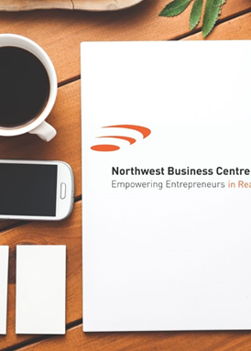
SMALL BUSINESS ENTERPRISE CEntre
Funded through the Government of Ontario, Small Business Enterprise Centres (SBECs), offer entrepreneurs all the tools they need to start and grow their businesses. These centres can help start or grow a business and offer free business consultations, resources and much more. Over 50 centres are located across the province. Here is a List of SBEC's
Allyson Pele is the Manager of the Northwest Business Centre, which is the SBEC that services the Kenora and Rainy River Districts in the Northwest part of the province. Click on the following link to learn more about entrepreneurship, the importance of math literacy and what it takes to be an entrepreneur. Click here to hear from Allyson and what to expect in this module.

Slide 38

Entrepreneurs speaking about math literacy
Watch the video links for Matt and Alexis below and reflect on three areas where these entrepreneurs use math literacy when operating their businesses.
1. Matt Kennedy, owner and operator of Upriver Media Inc., is based in Kenora, Ontario and specializes in creating engaging video content for digital advertising. Matt studied filmmaking and received his MFA in Film Production and Creative Writing. His films have screened in theatres around the globe, including the premiers at the prestigious Toronto International Film Festival and Sundance International Film Festivals.
Link to Matt's Video
Learn more and check out Matt’s website: https://www.uprivermedia.ca/

Slide 39

Entrepreneurs speaking about math literacy
2. Alexis Pernsky is the owner and operator of SWEET, Lake of the Woods Chocolate Shop, based in Kenora. Alexis opened her doors in 2018 on Kenora's Main Street. She creates handmade chocolates and seasonal treats that are made with Lake of the Woods flair and sells both wholesale and out of her storefront.
Link to Alexis' Video
Learn more and check out SWEET, Lake of the Woods Facebook page: •https://www.facebook.com/SweetLOTW/

Slide 40

Summer company program
Summer Company is a Government of Ontario program that helps young people between 15- and 29-years old start and run their own summer business by providing funding, advice and services. The programs are delivered by your local SBEC office. Link to List of SBEC's
If you are accepted into the program, you will receive:
An award of up to $3000.00
Hands-on coaching
Mentoring from business leaders in your community and from your program provider
You also get to keep any profits generated through the operation of your business.
Learn more and apply here
Hear more about the program from Allyson

Slide 41

Live your dream
Watch the Summer Company promotion video that Matt Kennedy from Upriver Media produced for the Northwest Business Centre:
Summer Company Video
Reflect on the math literacy that would be required for each entrepreneur. Choose one business from the video and consider how math would be an important consideration in daily operations.

Slide 42
Module 5: Assessment Part one
Complete the BDC's entrepreneurial potential self-assessment online quiz. The questionnaire includes 50 statements and, once completed, you will be able to evaluate your entrepreneurial traits!
Entrepreneurial Self Assessment
Summarize your entrepreneurial traits and share with your teacher.
Image Source:
https://unsplash.com/photos/fteR0e2BzKo

Slide 43
Module 5: Assessment Part two
You have viewed the testimonials from two business owners, four Summer Company students and heard from Allyson. It is your turn to create a 60 second pitch for a business idea or for a workplace that you want to work in. Follow these tips and watch this video to get started:
Introduce yourself and/or idea by grabbing the audience's attention. For example, summarize it in a sentence, highlighting its benefits and what makes it unique – or create a scenario showing how your idea solves a problem.
Describe how you came to this idea, show its impact and present possible results such as profits, future growth, or market opportunities (do research).
Use props like prototypes, sketches or current products to show the improvement needed.
Submit your 60 second pitch to your teacher.
Image Source:
https://unsplash.com/photos/fteR0e2BzKo

Slide 44
Module 6: Reflective Practice
In this module, students will be provided with an opportunity to further explore mathematics in the workplace and reflect on their learning throughout this Math Literacy SPCE.

Slide 45
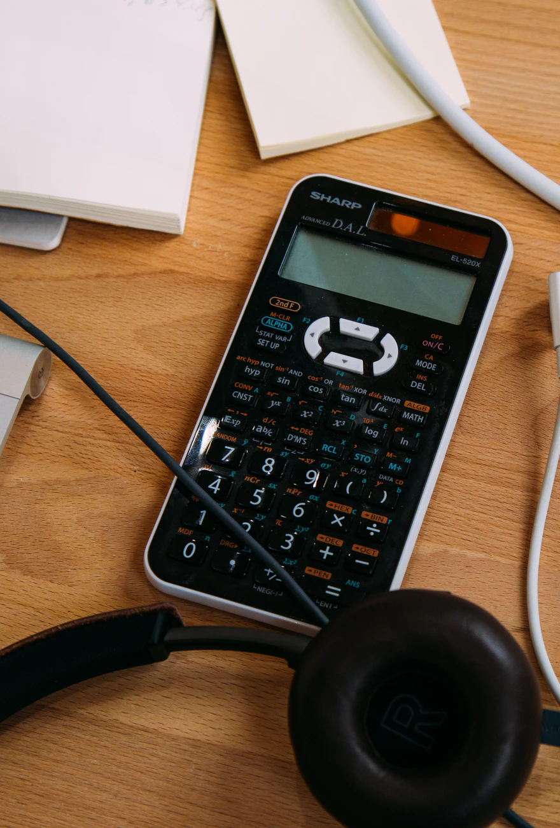
Please read this article about mathematics in the workplace and answer the following questions:
Choose one area that is highlighted in the article and write a brief description of how mathematics apply to that workplace environment
Brainstorm a list of three ways you think math applies to your particular SHSM job sector and provide an example for each
Do you think that mathematics is a larger or smaller component of your job sector than the ones highlighted in the article? Explain with examples.
Article Source: https://www.maa.org/programs/faculty-and-departments/curriculum-department-guidelines-recommendations/teaching-and-learning/examining-how-mathematics-is-used-in-the-workplace
Image Source: https://unsplash.com/photos/zGn2cg9qBvU

Slide 46
Reflective Questions
Now that you have had an opportunity to think about different approaches to problems, thinking of math as a tool to approach situations, interviewed someone in your job sector, explored math in your pathway, and listened to various business partners talk about how math is important in their field, you are now going to reflect on that learning.
What have you learned about math literacy from this SPCE?
So, what does this information make you think about when you consider your courses or experience with math currently or in the past?
Now that you have this knowledge about math literacy, how does that change the way you look at your job sector or your pathway?

Slide 47
Module 6: Assessment
Submit your answers to the questions about the Math in the Workplace article
Submit your answers to the reflective questions
Image Source:
https://unsplash.com/photos/fteR0e2BzKo

Slide 48

Congratulations!
You have worked through all the Math Literacy SPCE requirements.
You will receive your certificate once your teacher has had the opportunity to assess your submitted work.
Image Source: https://unsplash.com/photos/WPTHZkA-M4I

