Slide 1
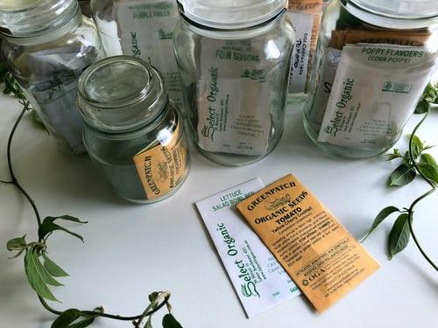
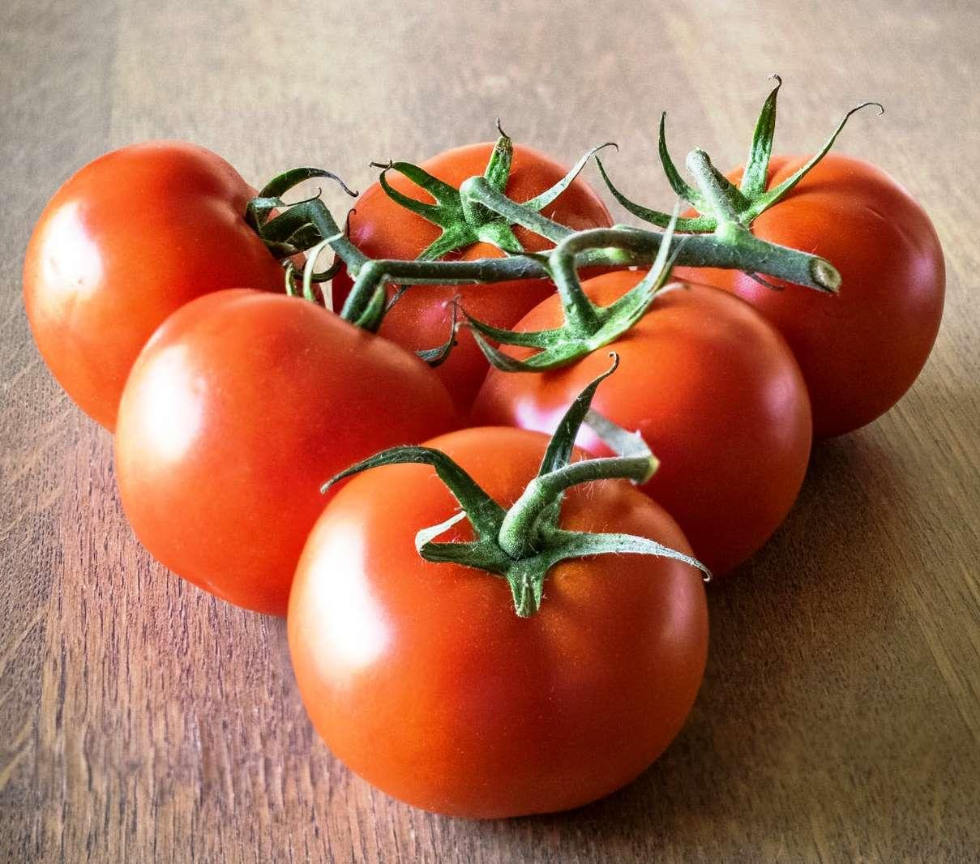
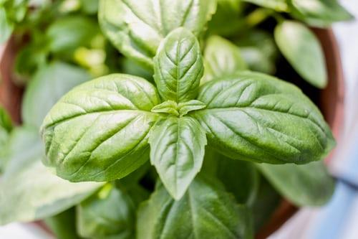
Home Grown Vegetables & Herbs
A Local Approach to Growing Food

Slide 2
TIJ10 - GREEN INDUSTRIES
Project Outline
Students are to create a google slide presentation and share it with their instructor
  Title: GROWING FOOD IN A BRAVE NEW WORLD
  Include: FIRST NAME, LAST NAME
  Each research assignment should be titled appropriately and answered in a slide presentation format.. Add images to support your research accordingly.
  Google Slides Tutorial
There are Four assignments listed under Project Assignments
1. How Growing Crops Changed the World
2. The Importance of Growing Our Own Food
3. Understanding Soil Basics
4. Seed Germination and Plant Care
There is ONE culminating activity
1. Home Grown Windowsill Gardening

Slide 3
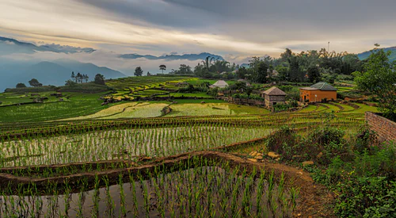
Research Assignment 1
How Growing Crops Changed the World
How did growing crops change the world? The fact is that civilization as we know it was born when we became farmers! Your research should help you better understand this.
Please click the link below
How growing crops changed the world

Slide 4
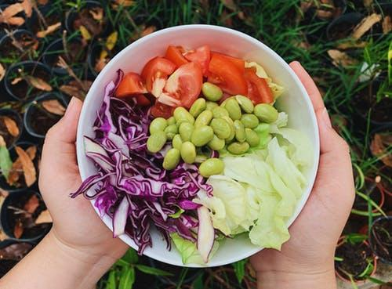
Research Assignment 2
The Importance of Growing our own Food
How did growing crops change the world? The fact is that when we experience an event like a pandemic, we realize just how fragile our supply chain can be. Much of the produce available in our supermarkets travels vast distances.Your research should help you better understand this.
Please click the link below
The Importance of Growing Our Own Food

Slide 5
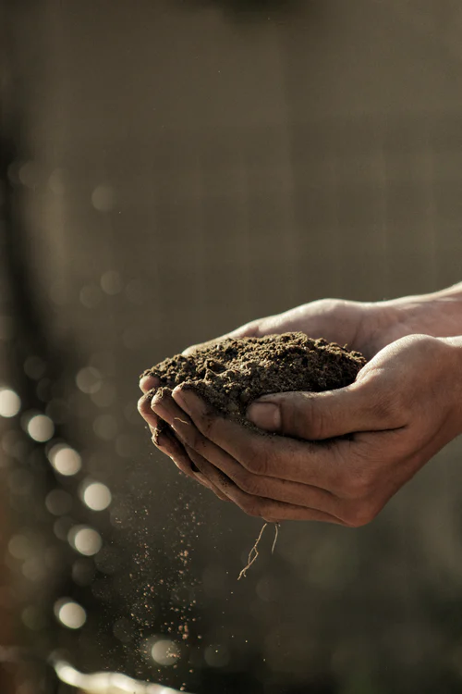
Research Assignment 3
Understanding Soil Basics and Plant Nutrition
What and where do plants get their nutrition? The soil a plant grows in is a key to its success. Your research should help you better understand this.
Please click the link below
Understanding Soil Basics and Plant Nutrition

Slide 6
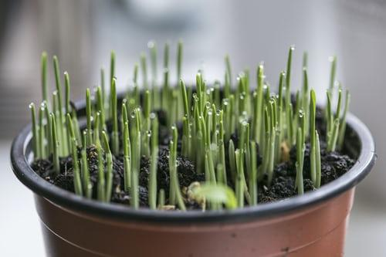
Research Assignment 4
Seed Germination and Plant Care
How can we germinate seeds and care for them? The fact is that if you provide adequate water, light, and proper nutrition growing plants is actually simple! Your research should help you better understand this.
Please click the link below
Seed Germination and Plant Care

Slide 7
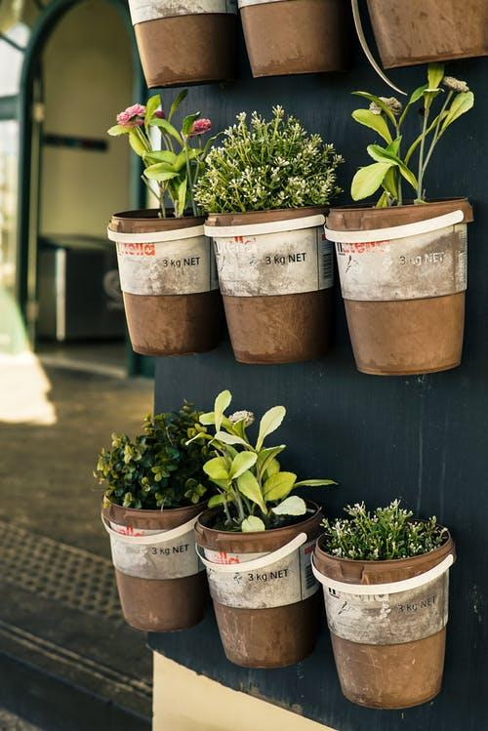
Home Grown Windowsill Garden (Culminating Activity)
Can we grow food at our own homes? The fact is that with a little knowledge and very limited resources we can grow vegetables and herbs almost anywhere. Now that you know what it takes to grow plants, it is time to start growing at home.
Helpful Resources
  Gardening Know How
  The Spruce
  Gardeners
  Tomatoes

Slide 8
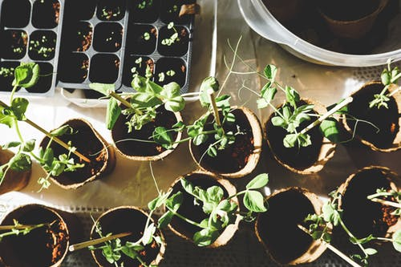
Home Grown Windowsill Garden
OPTION 1
A package will be mailed out to students, containing
  Potting mix
  Seeds
Students will be resourceful and create mini-greenhouses to start their own seeds
Students will use google slides to document their progress with their instructor
Please click the link below
Culminating Activity

Slide 9
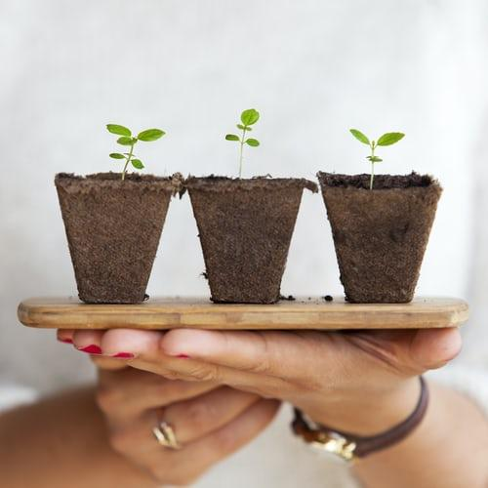
Home Grown Windowsill Garden
OPTION 2
Instructors who may not have a budget allowance to send seeds and potting soil to students can use this option.
The instructor will grow a few different seeds (herbs and/or vegetables) and post images to all students of the process from beginning to end.
Students will use research and the instructors slides to observe the process and gain an understanding of how to grow food at home.
Please click the link below
Culminating Activity

