Slide 1
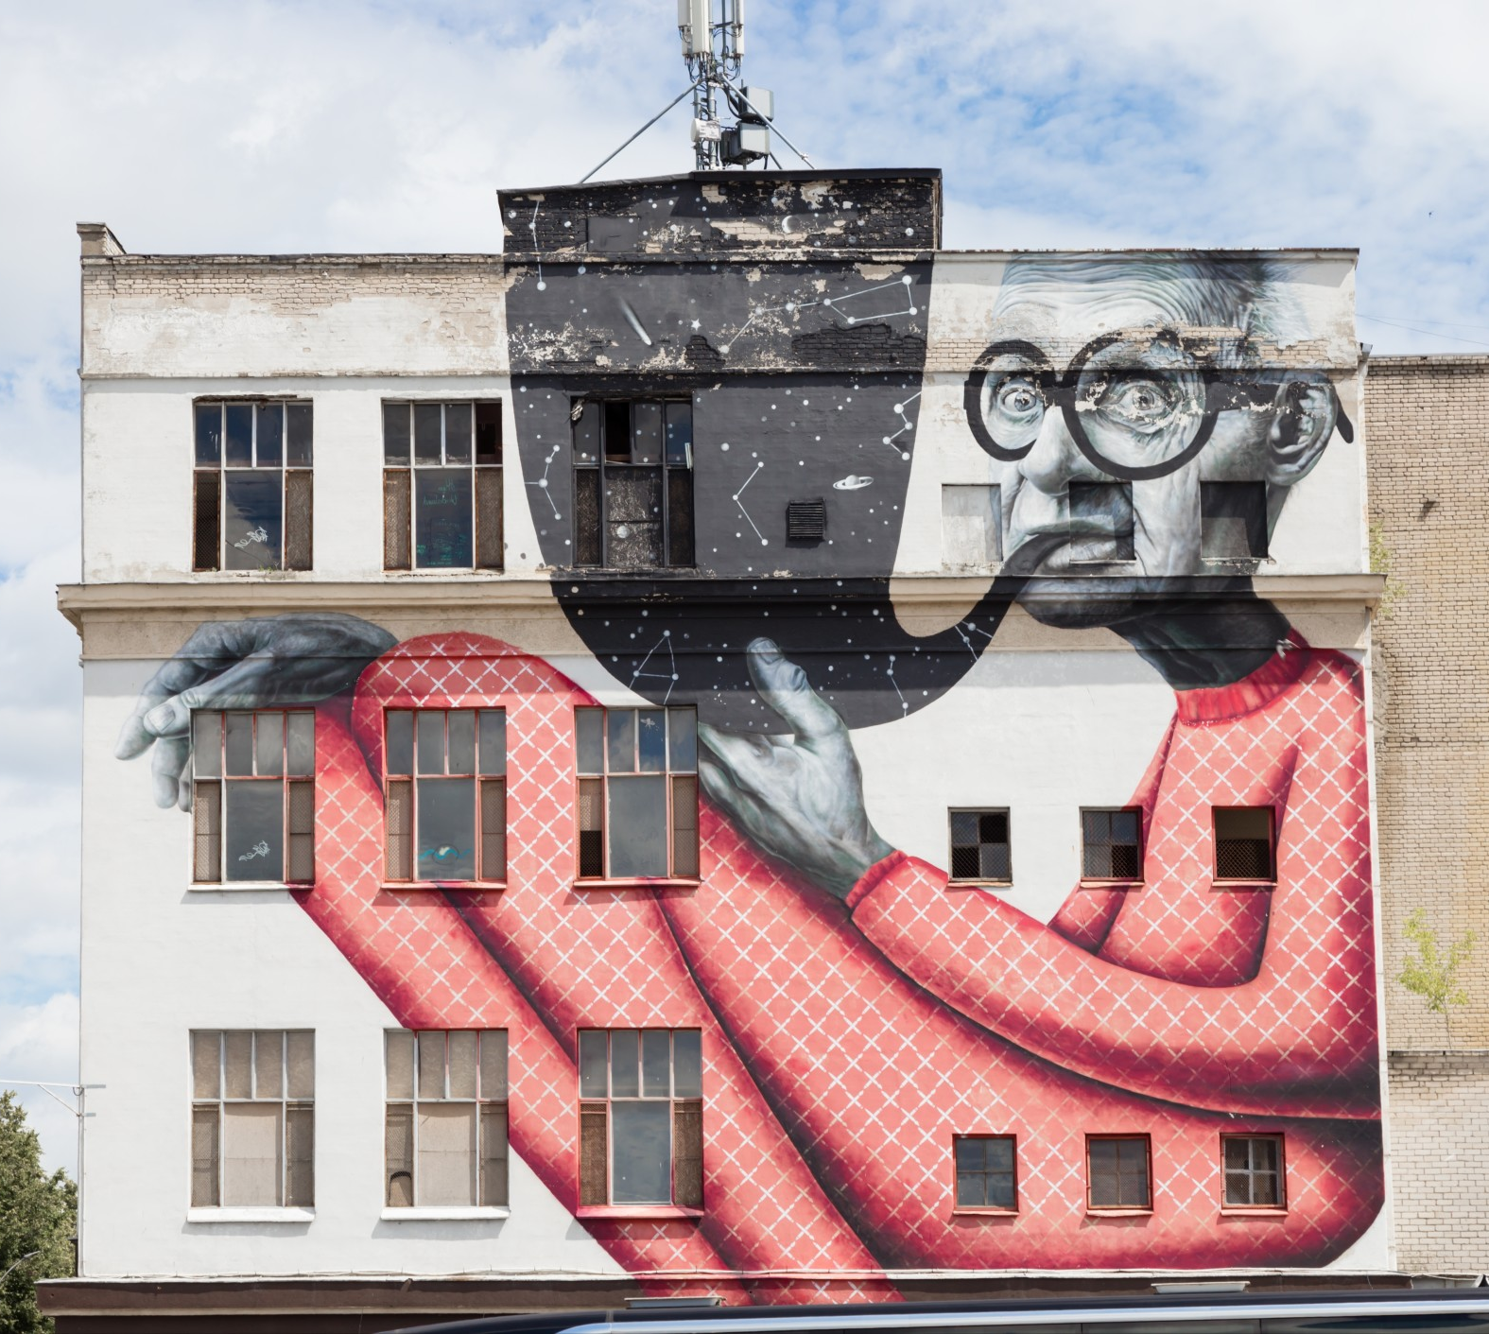
Graphic Design
Lesson and Activity 2

Slide 2
Activities &
Assignment
Activity 1 – Explore the role of a Graphic Designer
Activity 2 – Elements of Graphic Design
Activity 3 – Exploring Colour
Activity 4 – Create a simple vector image
Assignment – Create a sticker

Slide 3
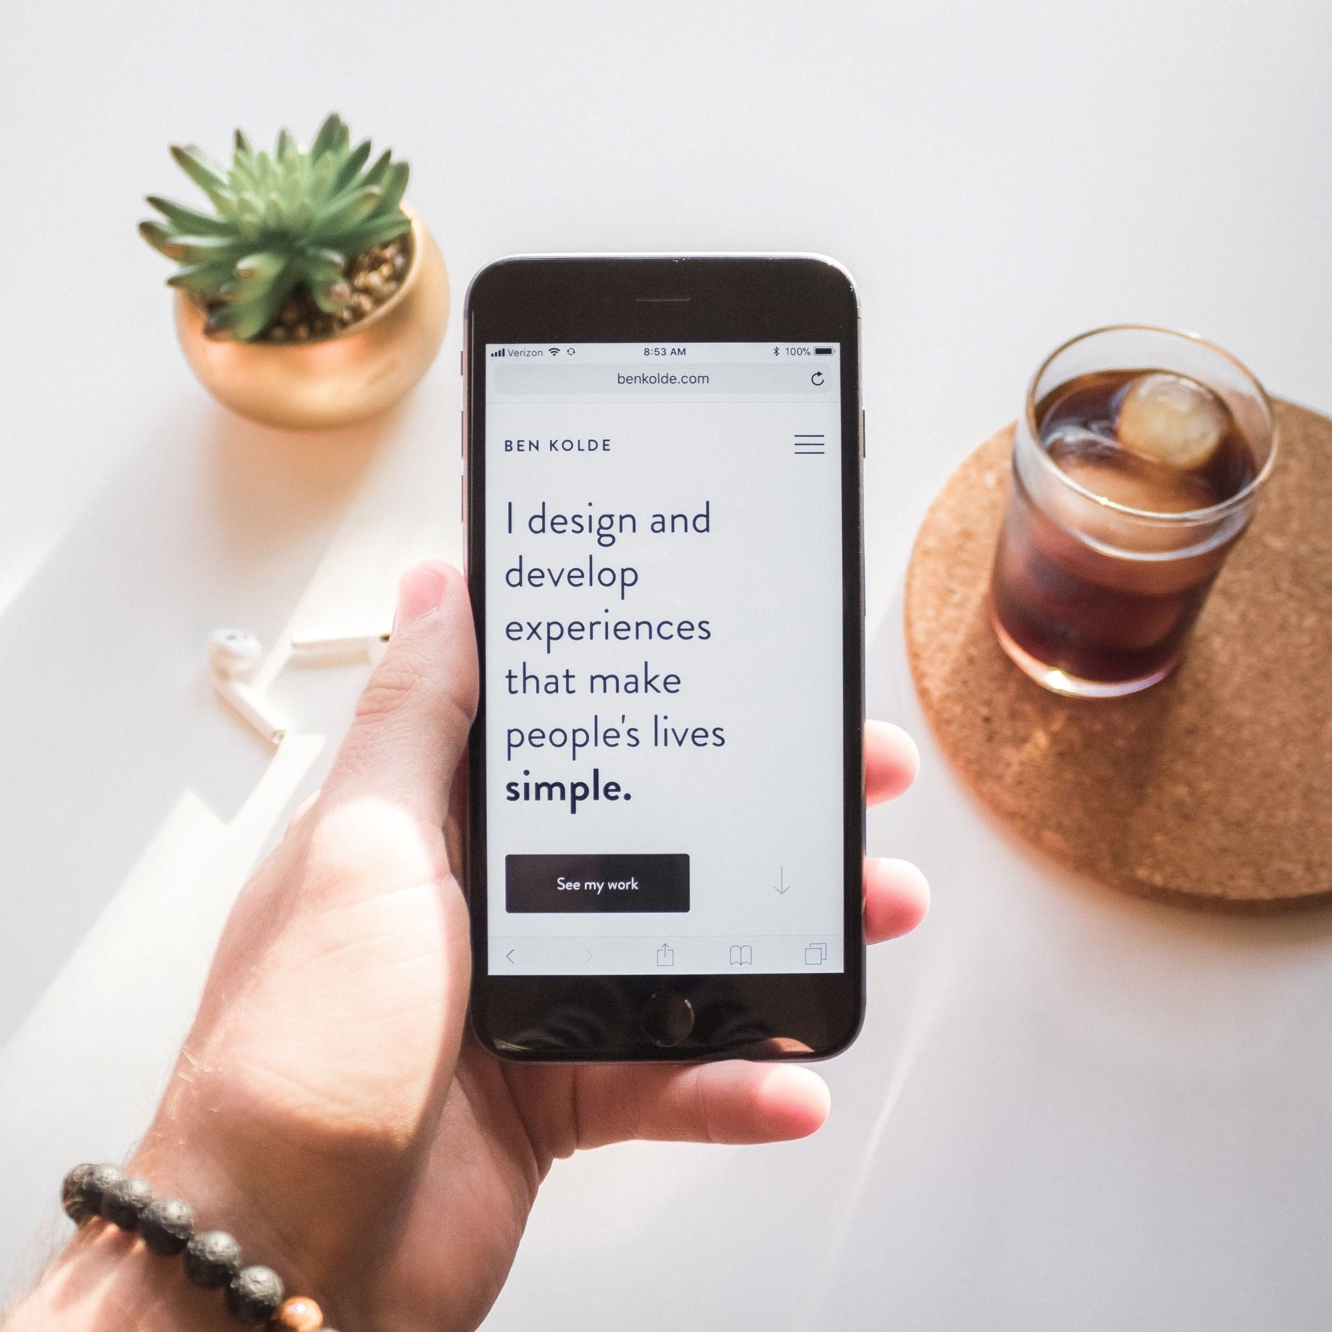
Elements of Graphic Design
The elements of design are the foundation of creating a cohesive and compatible visual message. Carefully placing elements on a page allows the graphic designer to communicate meaning and intent.
In this activity, you will learn to think of elements of design as a recipe. Each element (ingredient) is a crucial part of the visual message. (final product)
The elements of design can be combined or used alone; this decision depends on the message or “look” that you wish to achieve
Elements of Graphic Design
Explore the role of a Graphic Designer
The Power of Colour
Create Vector Images

Slide 4
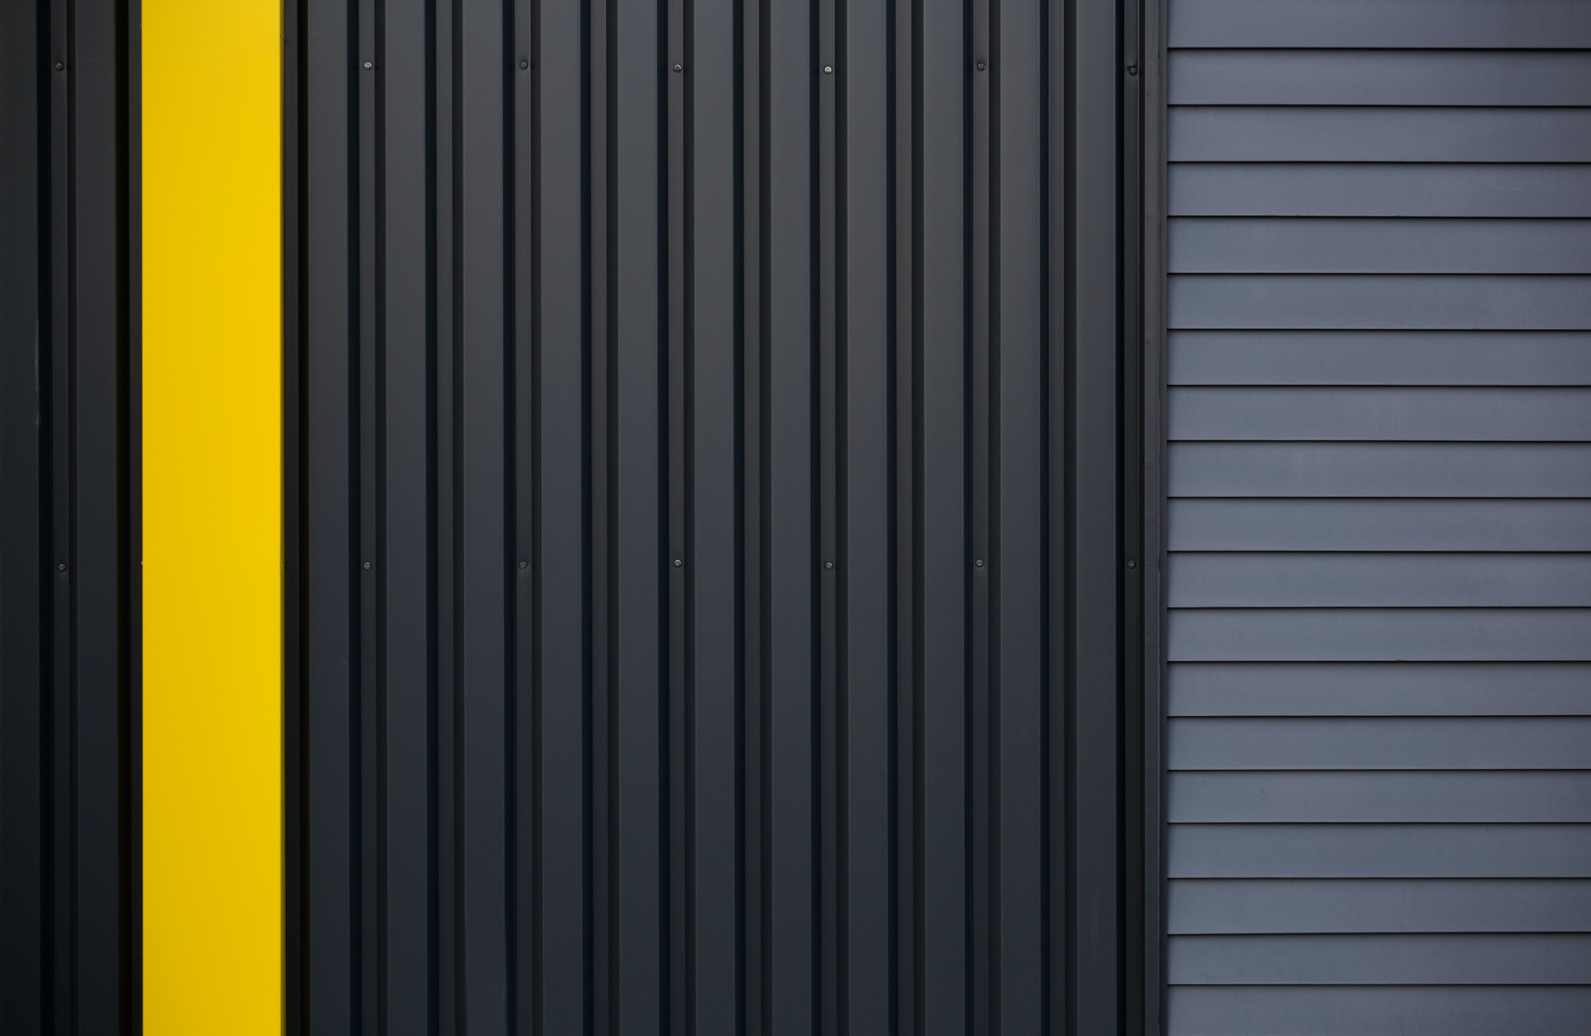
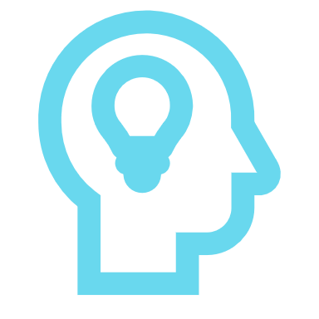
Line
Lines come in all colours, shapes, and sizes. They are the simplest element of design; once you are aware of how they are used; you will see lines and grids all around you.
Lines can be visible or invisible and provide us with direction; they can be used to guide your eye to a specific point, provide emphasis or divide and organize.
Line thickness can be used to communicate with the viewer thick or bold lines can draw attention, while thin lines may have the opposite effect.
Think About It: What was your eye first drawn to in this picture? (2.1)
Elements of Graphic Design
Explore the role of a Graphic Designer
The Power of Colour
Create Vector Images
Notes:
Lines are the most basic elements of design. They come in all shapes, sizes, and colors. Once you start noticing them, you’ll see grids all around you. Lines have direction; they can be visible or invisible and can help direct the eye to a specific spot. The thickness of a line can also communicate certain cues. Bold and thick lines can draw attention, while thin lines are the opposite

Slide 5
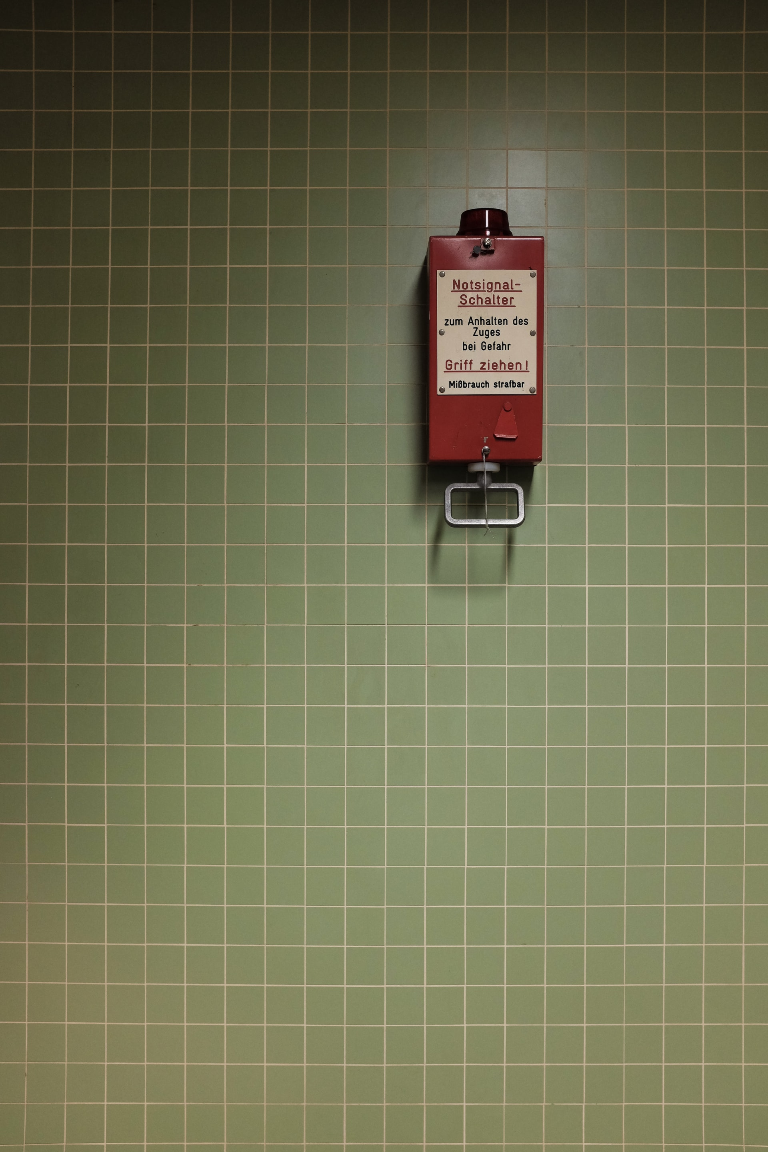
Line
Grids are made of multiple lines and provide a visual structure to an image.
When using lines in a composition, you can use different types of lines to convey different moods to the viewer. An example of this is a straight line may be used to create a sense of seriousness; however, a squiggly line can convey a sense of fun.
Think About It: What are some other types of lines? What feelings can be conveyed by different types of lines? (Q2.2)
Elements of Graphic Design
Explore the role of a Graphic Designer
The Power of Colour
Create Vector Images
Notes:
Most if not all layouts contain invisible lines. Grids are made of multiple lines and lend structure to a page. Lines can be used to create demarcation on a specific section of a design. Depending on the form of the line, you can convey different moods. A simple line can carry so much—for instance, a squiggly line is perceived as young and fun compared to a straight line.
Lines don't necessarily have to be solid. Dashed and dotted lines can also be used and have a friendlier feel than a solid line. Straight lines usually come across as a steady and static element. On the other hand, curved lines are dynamic and give energy to your design.

Slide 6
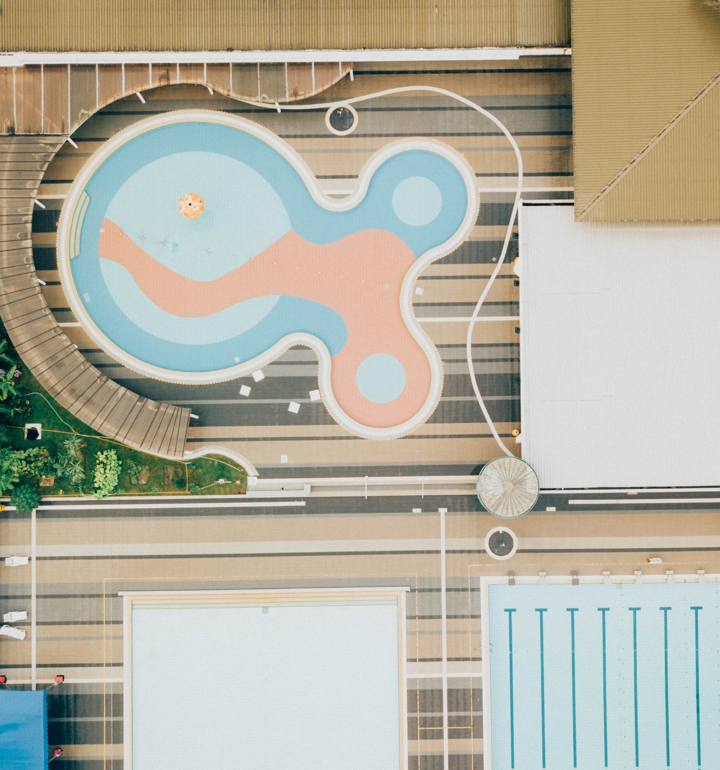
Shapes
Shapes are two-dimensional and can be Organic (well-defined edges that feel smooth and natural) Geometric (mathematical and precise like circles, squares, triangles…) and Abstract (these are typically minimalistic and can be found in logos, or vector packs)
Elements of Graphic Design
Explore the role of a Graphic Designer
The Power of Colour
Create Vector Images

Slide 7
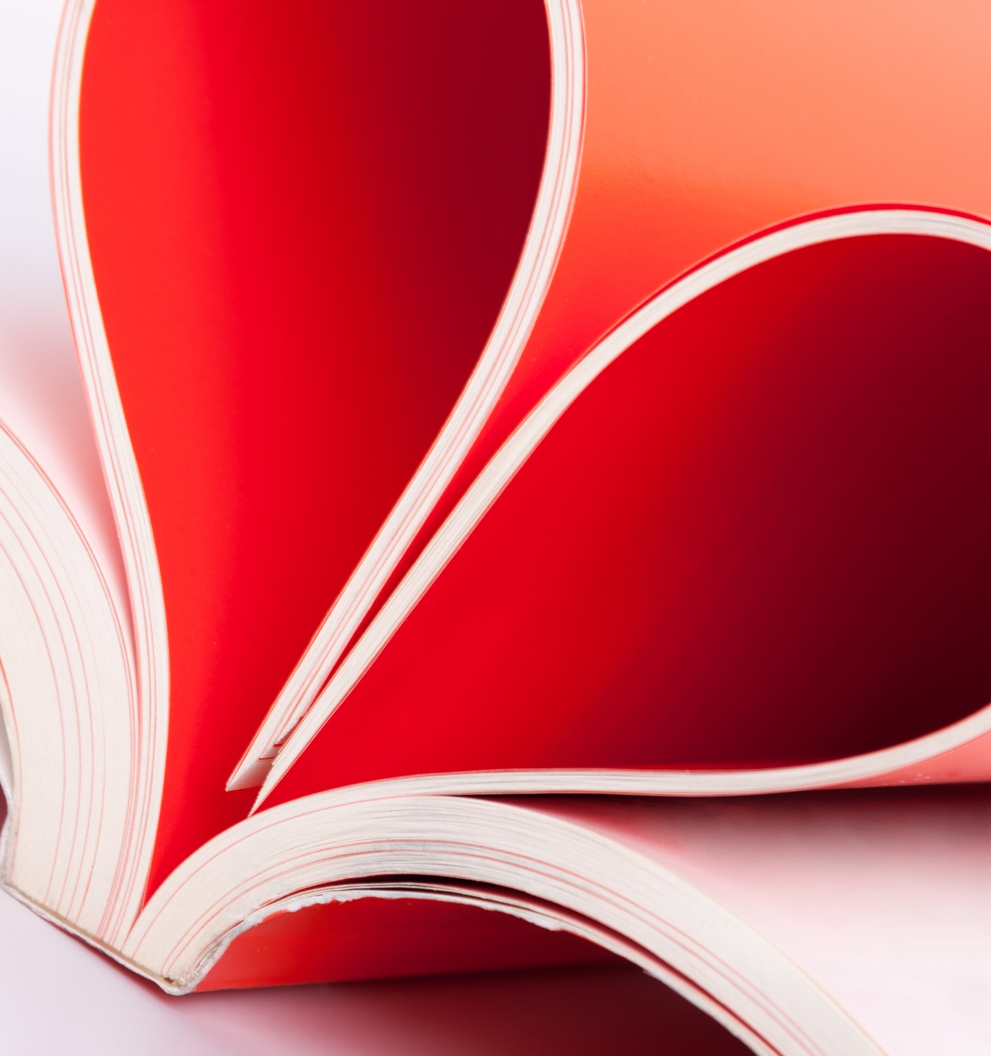
Shapes
The graphic designer can use color, size, and, the form of the shape to determine the mood that the viewer feels. An example of this is triangles direct the viewers’ eyes to a specific point the triangle can also be used to represent stability
Every day we are surrounded by shapes we usually think of as geometric images. However, for a graphic designer, shapes can be an important element when designing a company's brand
Think About It: What are some of the shapes that companies use to help identify their brand (Q2.3)
Elements of Graphic Design
Explore the role of a Graphic Designer
The Power of Colour
Create Vector Images

Slide 8
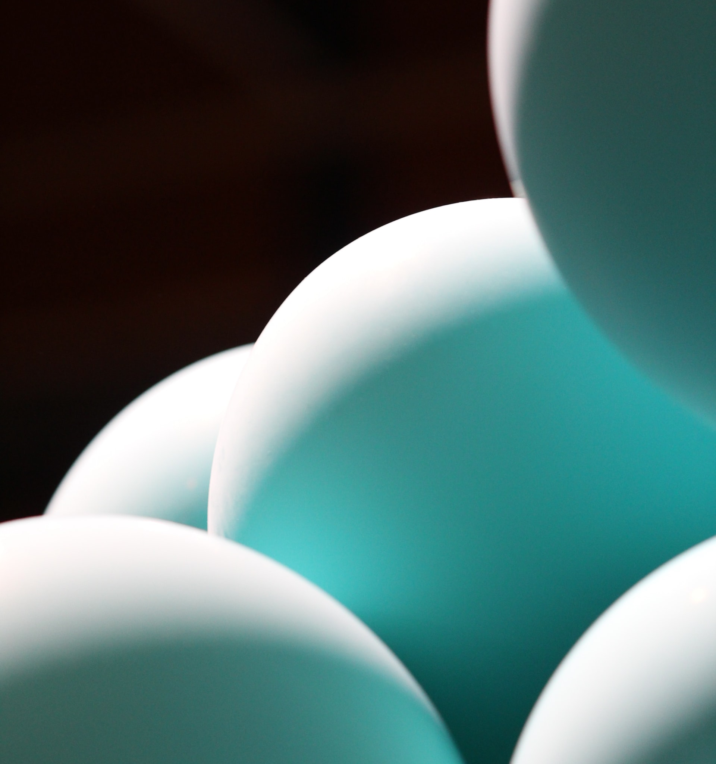
Form
The use of Form by a graphic designer gives a three-dimensional look to a two-dimensional shape. The illusion of Form can be created when we add light, shading, or other visual aspects to a shape to give it depth.
It is essential to know that Form and Shape are mutually dependent on each other because changing one aspect of either one will affect the other.
Elements of Graphic Design
Explore the role of a Graphic Designer
The Power of Colour
Create Vector Images

Slide 9

Colour
Colour can be applied to any element that you will learn about. In the next activity, “The Power of Colour,” we will learn about this element in depth.
Elements of Graphic Design
Explore the role of a Graphic Designer
The Power of Colour
Create Vector Images

Slide 10
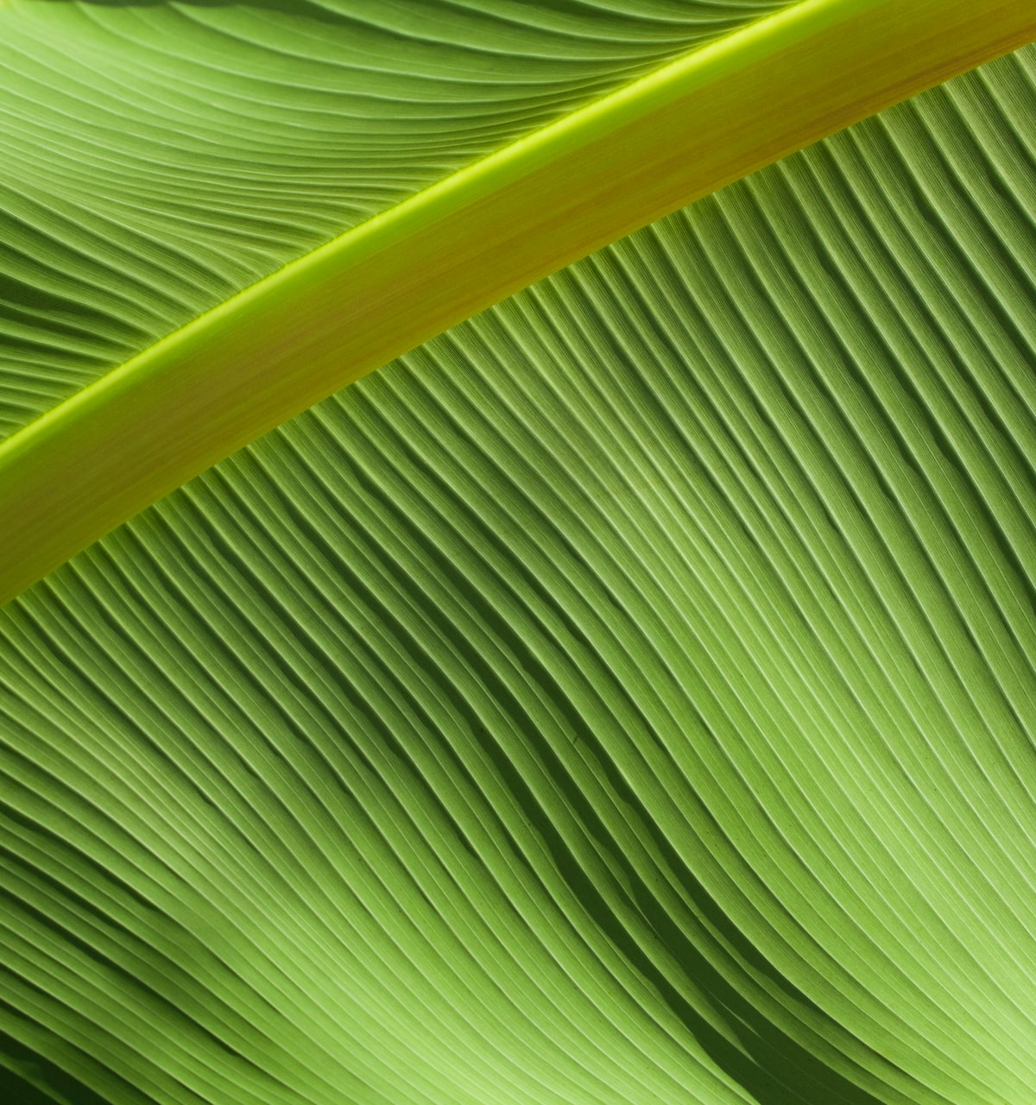
Texture
Texture is the physical quality of a surface that you can feel or touch, or visually implied in graphic design work.
Texture adds a physical appearance to a visual layout. This allows the viewer to imagine how a design would feel if they touched it. The goal of texture is to add depth to a two-dimensional surface.
Think About It: Have you ever picked up a book, or card that has a different feel to it? Some high school Yearbooks even had velvet on their covers (Q2.4)
Elements of Graphic Design
Explore the role of a Graphic Designer
The Power of Colour
Create Vector Images

Slide 11
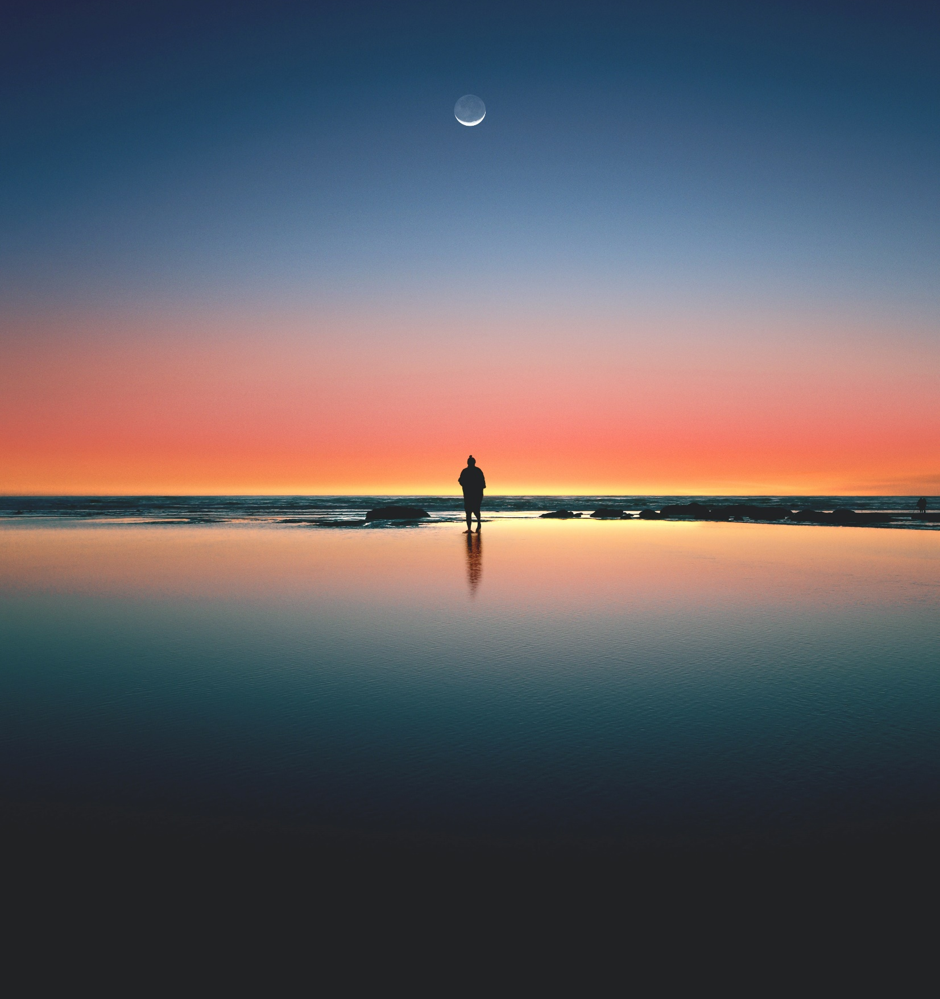
Balance
Balance is created for the viewer when the elements of design are arranged to create the impression of equity, weight, or importance.
To help you understand balance better, think that there is a weight given to each one of the visual elements in your design. Text, images, and shapes each have a visual weight, keep this in mind when creating a design.
However, this does not mean that the element of balance always needs to be distributed equally, but it is something that you need to be aware of.
Elements of Graphic Design
Explore the role of a Graphic Designer
The Power of Colour
Create Vector Images

Slide 12
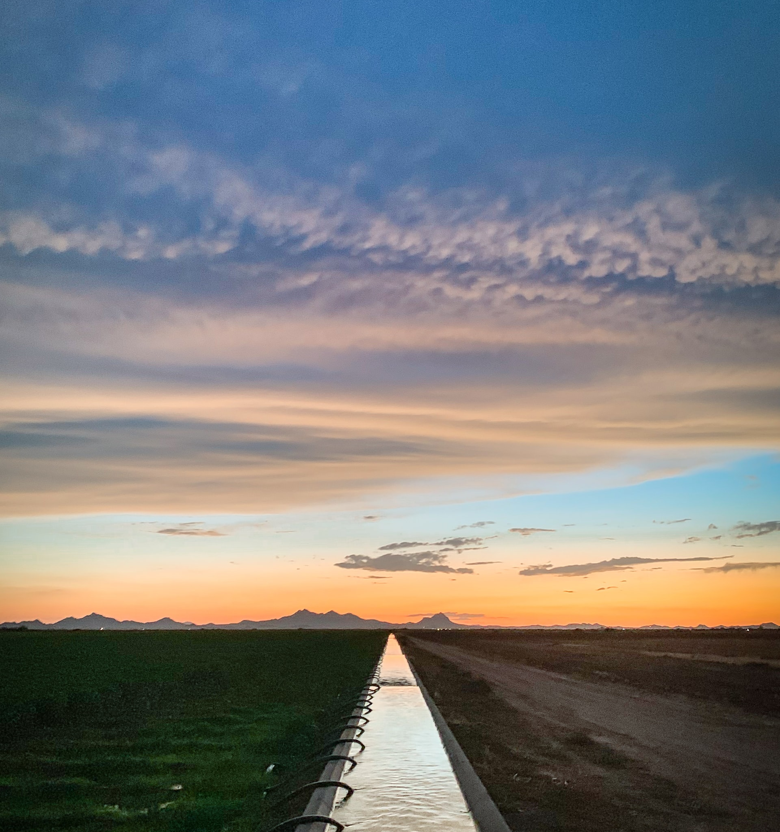
Balance
Balance is either symmetrical or asymmetrical.
Symmetrical balance is when the weight of elements is evenly divided on either side of the design.
Asymmetrical balance is a design that appears to be balanced despite a lack of symmetry, the graphic designer uses of scale, contrast, and colour to achieve the flow in design.
Think About It: Where have you seen examples of Symmetrical and Asymmetrical balance before? (Q2.5)
Elements of Graphic Design
Explore the role of a Graphic Designer
The Power of Colour
Create Vector Images

Slide 13

Elements of Design
Watch @ Learn – Fundamentals
  Beginning Graphic Design
Watch @ Learn – Beginning Graphic Design
  Images
Watch @ Learn –How Stamps Get Designed
  Stamp Design - Antonio Alcalá
Watch @ Learn – D&AD Awards
  2019 The Best Designs In The World
  Think About It: What did you learn from watching Fundamentals – Beginning Graphic Design that you did not know before (Q2.6)
Elements of Graphic Design
Explore the role of a Graphic Designer
The Power of Colour
Create Vector Images
Notes:
Unsplash

