Slide 1
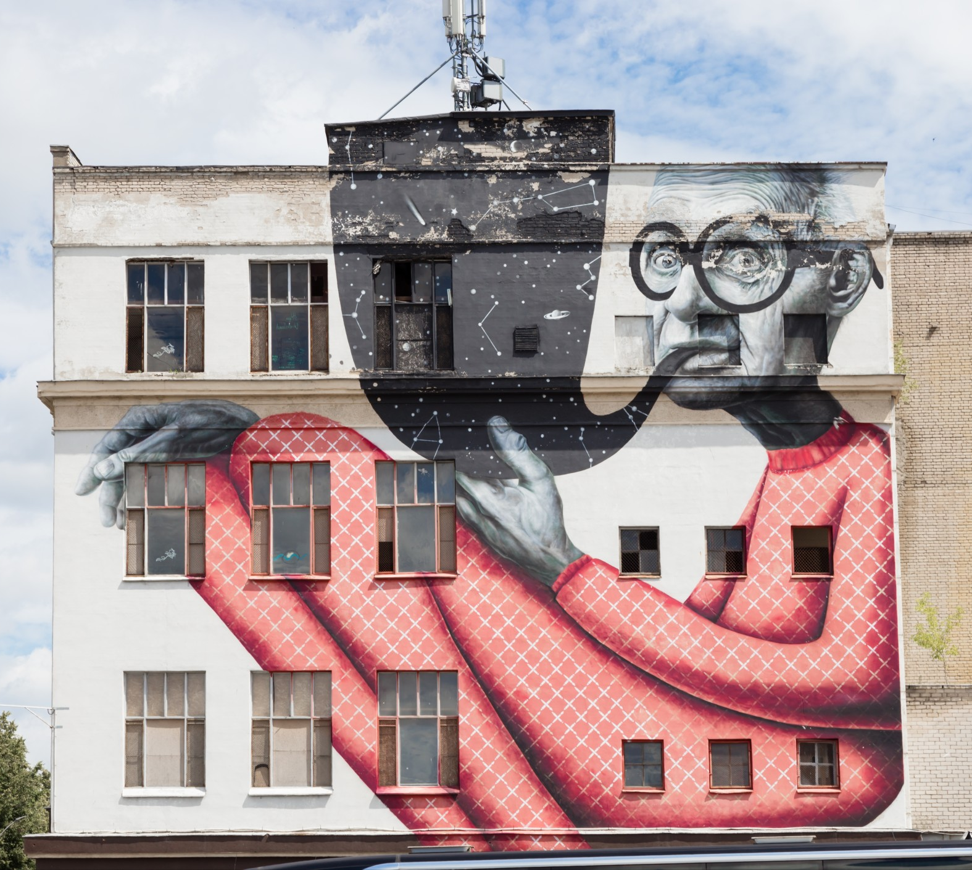
Graphic Design
Assignment

Slide 2
Activities &
Assignment
Activity 1 – Explore the role of a Graphic Designer
Activity 2 – Elements of Graphic Design
Activity 3 – Exploring Colour
Activity 4 – Create a simple vector image
Assignment – Create a sticker

Slide 3



Skills and Knowledge
Elements of Graphic Design
In this activity, you learned some of the principals of graphic design and how they can be used to convey a specific message to the viewer.
Exploring Color
In this activity, you learned how colour can influence the viewer and how you can use this to your advantage when creating your work.
Creating Vectors
In this activity, you were exposed to different types of Vector programs/applications and how you can use this tool to create finished work.

Slide 4


Examples
Create A Sticker
Task: You will create an effective graphic design that demonstrates complex, multi-step creations using a variety of tools, to convey an impactful message, sentiment, or emotion based on your research. In this assignment you will apply all your learning in the creation of a sticker for either your school or community.
EVIDENCE OF LEARNING & SKILL DEVELOPMENT – Include any relevant links below
Vector or Graphic Design Project Components | Check | Link to evidence of completion
Inspiration(s) | ✔️ | Functional link(s)
Tutorial(s) | ✔️ | Functional link(s) to tutorials used for knowledge & Skill development.
Copy of Final Product exported for multi-screen viewing (.pdf or .png or .jpg) | ✔️ | Functional link to final product! THANK YOU!

Slide 5
Examples
Create A Sticker - Continued
Time: 2 hours
Step 1: Research what type of sticker is needed in your school or community? Where the sticker will go (example: floor, wall, window, ceiling). Document and share your research.
Step 2: Pre-plan sketch out the design for your sticker or use your computer and piece elements together from the internet
Step 3: Use a Vector program/application to create your sticker
  •Use any tutorial to help you with your creations
Step 4: Share your sticker, or export your sticker and submit (sharing or exporting depends on the application or program that you are using)

Slide 6
Examples
Create A Sticker - Rubric
Expectation | Level 4 | Level 3 | Level 2 | Level 1 | R
Research type of sticker needed Communication: define project objectives and performance criteria precisely. Overall Expectation: C2 | Defines and explains project objectives, process & reflection with profound detail. | Defines and explains project objectives process & reflection with considerable detail. | Defines and explains project objectives, process & reflection with some detail. | Did not define or explain project objectives, process & reflection. | Did not submit prior to execution of sticker
Preplanning Submitted Sketch or Design Thinking Use a variety of planning techniques and tools when creating plans for communications technology projects. Overall Expectation: A1 | Uses a variety of planning techniques and tools when creating plans for communications technology projects with a high degree of logic. | Uses a variety of planning techniques and tools when creating plans for communications technology projects with considerable logic. | Uses a variety of planning techniques and tools when creating plans for communications technology projects with some logic. | Uses a variety of planning techniques and tools when creating plans for communications technology projects with limited logic. | Did not submit prior to execution of sticker
Completed Sticker Application: Produce rich media products that conform to evolving industry standards and formats. Overall Expectation: C2 | Produces rich media products that conform to evolving industry standards and formats with a high degree of fluency. | Produces rich media products that conform to evolving industry standards and formats with considerable fluency | Produces rich media products that conform to evolving industry standards and formats with some fluency. | Produces rich media products that conform to evolving industry standards and formats with limited fluency. | Does not meet the minimum requirements, please redo, and resubmit

