Slide 1
Introduction to Boolean Logic
TEJ2O

Slide 2
Remember that…
1 in the Binary System represents
  ON or YES
0 in the Binary System represents
  OFF or NO
Boolean logic is a part of almost every aspect of COMPUTER ELETRONICS

Slide 3
What is Boolean Logic
In the 1850s George Boole developed a new form of algebra, now called Boolean algebra in his honour.
Boolean equations use the binary number system to provide a very precise way of illustrating the logic of computer chips.
Interesting fact: Boolean equations were used long before computers or even electricity was invented!
- Details from Computer Engineering: An Activities-based approach by Smyth and Stephenson

Slide 4
Examining Logic Gates
A gate is where data (or electricity) flows through. The gate takes the input (usually A and/or B) and gives an output (Y)

Slide 5


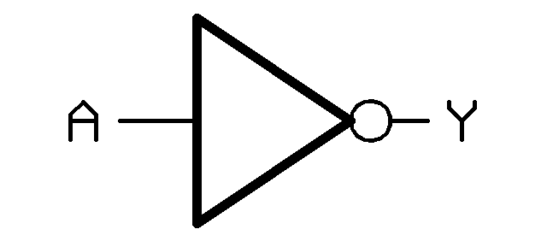

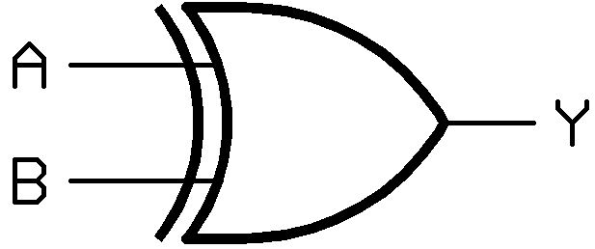

Summary of the Gates
Schematic | Gate | Symbol | Boolean Equation
 | AND | • | Y = A • B
 | OR | + | Y = A + B
 | NOT | - | Y = Ā
 | NOR | - + | Y = A + B
 | XOR | + | Y = A + B
 | NAND | - • | Y = A • B

Slide 6
TRUTH TABLES
Understanding the logic behind the gates will help us determine the output
We use truth tables to determine the outputs based on different inputs.

Slide 7
AND
A | B | Y (Output)
0 | 0 | 0
0 | 1 | 0
1 | 0 | 0
1 | 1 | 1
Y = A • B
Both inputs must be 1(YES) to get a 1(YES) as output.

Slide 8
OR
A | B | Y (Output)
0 | 0 | 0
0 | 1 | 1
1 | 0 | 1
1 | 1 | 1
Y = A + B
If either input is 1 (YES) the output is 1 (YES).

Slide 9
NOT
A | Y (Output)
0 | 1
1 | 0
Y = A
Output is opposite of input.

Slide 10
NOR
A | B | Y (Output)
0 | 0 | 1
0 | 1 | 0
1 | 0 | 0
1 | 1 | 0
Y = A + B
RESULT IS OPPOSITE OF OR

Slide 11
XOR
A | B | Y (Output)
0 | 0 | 0
0 | 1 | 1
1 | 0 | 1
1 | 1 | 0
Y = A + B
Only one input can be 1(YES) to have a 1(YES) output.

Slide 12
NAND
A | B | Y (Output)
0 | 0 | 1
0 | 1 | 1
1 | 0 | 1
1 | 1 | 0
Y = A • B
RESULT IS OPPOSITE OF AND

