Slide 1
Intro to Logic Chips
TEJ2O
I completed the slide for 74LS08!
You must do the same for 74LS32, 74LS04, 74LS00, 74LS02, and 74LS86

Slide 2
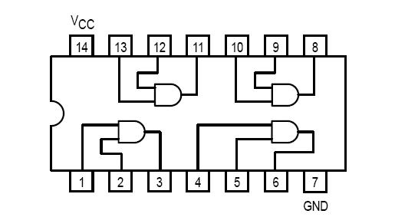
74LS08
Gate Name: AND
Truth Table
Chip Layout
A | B | Y
0 | 0 | 0
0 | 1 | 0
1 | 0 | 0
1 | 1 | 1

Slide 3
74LS32
Gate Name:
Truth Table
Chip Layout
A | B | Y

Slide 4
74LS04
Gate Name:
Truth Table
Chip Layout
A | Y

Slide 5
74LS00
Gate Name:
Truth Table
Chip Layout
A | B | Y

Slide 6
74LS02
Gate Name:
Truth Table
Chip Layout
A | B | Y

Slide 7
74LS86
Gate Name:
Truth Table
Chip Layout
A | B | Y

