Slide 1
The evolution of machines
And how technology affects society

Slide 2




The evolution of machines
Outline
Use a chronological timeline to present how a simple machine, complex machine or tool has evolved over time and how the technology has affected society.
Learning Goals
Describe how society influences technological innovation and how technology affects society.
Develop research skills using the internet.
Develop communication, summarizing and visual presentation skills.
Success criteria
Effective communication of your research material.
Clearly communicate the importance of the tool/machine, how the machine has evolved, changes in materials, process, shape, function, utilizes a simple machine.
Include at least 5 dates, images and chronological summary.
Include a minimum of 3 resources to conduct your research.

Slide 3
List of possible research topics –
Machine
Tools
Auger
Hammer
Wheel
Crowbar
Scissors
Pliers
Plough
Fishing reel
Crane
Ramp – Ancient Egypt - to full accessability
Bicycle
Car
Paddle
Oar
Car jack

Slide 4
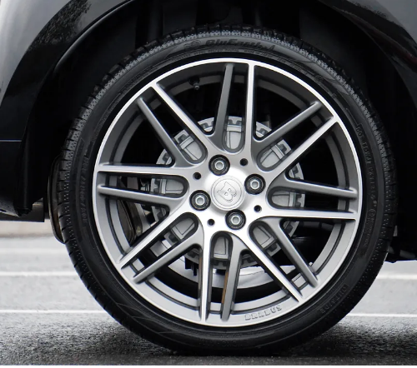


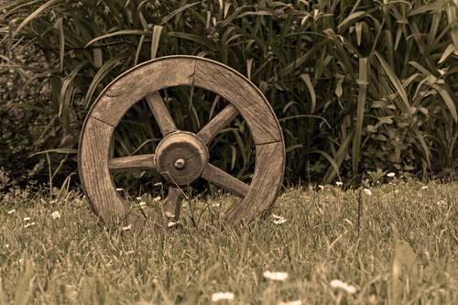
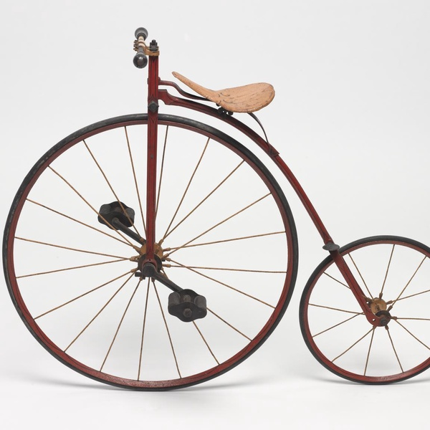
Exemplar – Evolution of the Wheel

Slide 5

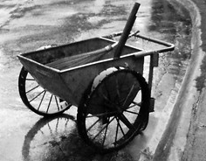
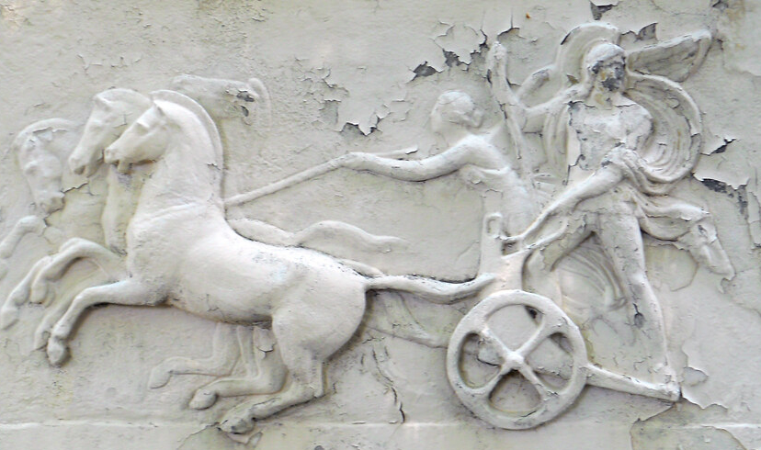
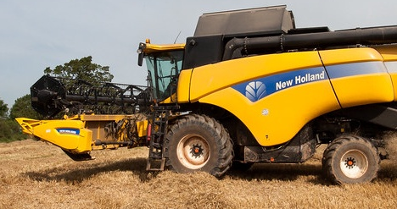
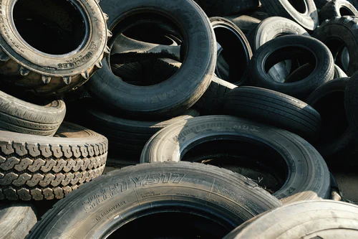


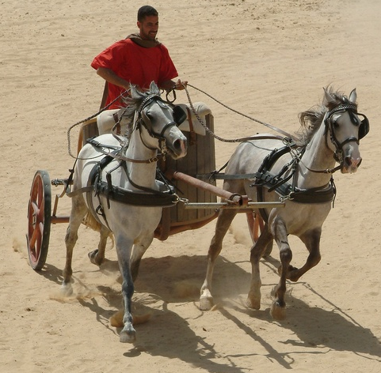

3500 BCE
It is believed that the first wheel was invented around 3500 BCE, in Mesopotamia (Known as Iraq today). At this time, the wheel was made from wood or stone and was used as a potter's wheel to make pottery.
2000 BCE
The Egyptians modified the solid wood wheel design to a lighter spoked wheel, looking for faster, more mobile chariots. Eventually becoming a suprememe military weapon.
600- 400 BCE
The wheel was first utilized with a wheelbarrow, ancient Greece around 600-400 BCE. This would allow the society to transport not only people but heavy objects, thus making manual labour more effient.
Present Day
Today wheels come in all sizes and materials. Mid-size tires with aluminum rims on cars or thin and fat tire bikes help us get to where we need to go every day.
Large wheels on combines and backhoes allow us to farm and build highways efficiently. While smaller harder rubber wheels are found on skateboards and scooters for a little outdoor activity.
The Wheel
3200 BCE
In Mesopotamia, a wood wheel was first used for transportation on chariots.
1845
The pneumatic tire, a tire made of reinforced rubber and filled with compressed air, was first to be patented by R.W. Thompson. This paved the way for automobile tires that we use today on cars, trucks, bikes and heavy machinery. Resulting in efficient transportation.
1000 BCE
The Celtics added iron rims to the outside of the chariot wheels for greater strength. This

Slide 6
Sources for the history of the wheel
Smithsonian Magazine - Salute to the wheel
Historyanswers - Evolution-of-the-wheel
Interestingengineering - The-history-and-evolution-of-the-wheel
Britannica - Technology - wheel
Timetoast - Timeline - The wheel
Ancient - chariot

