Slide 1
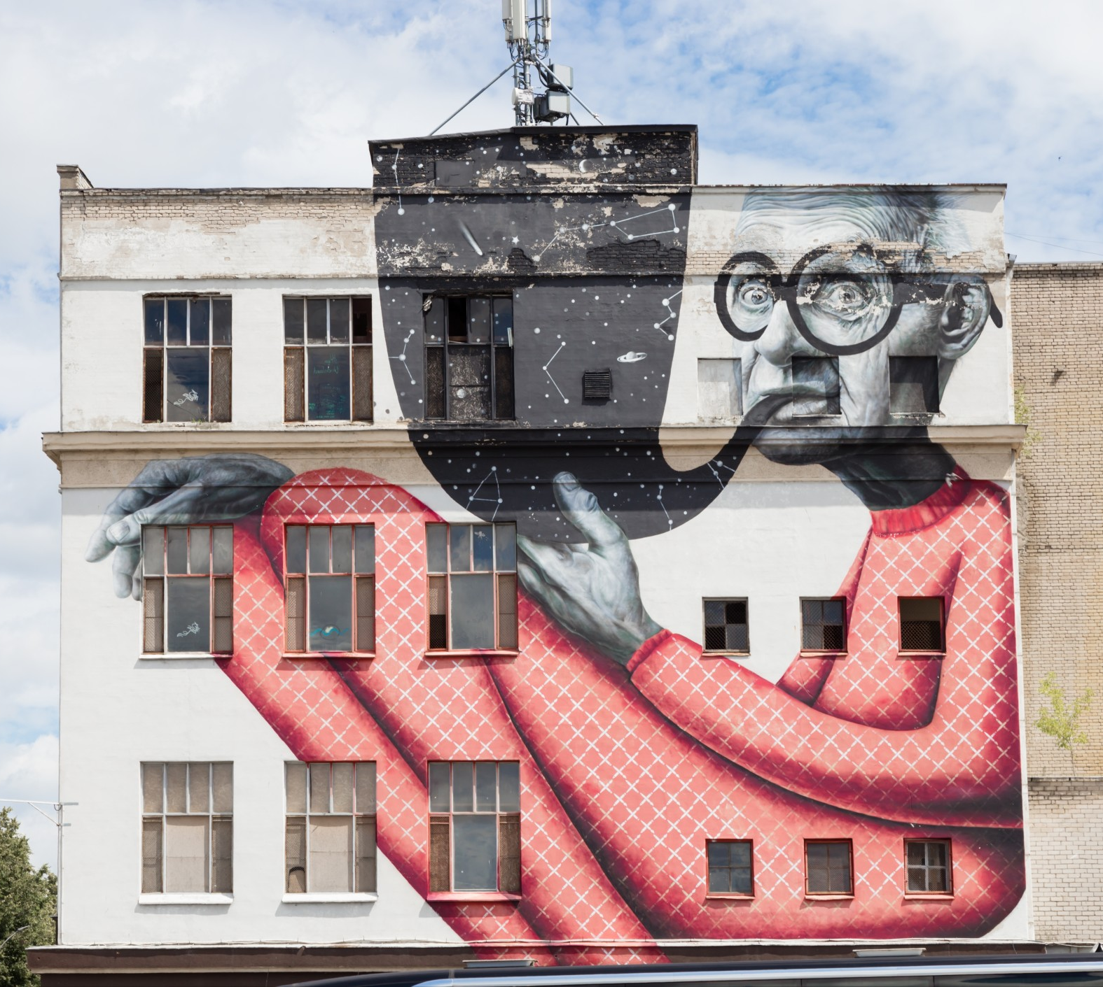
Graphic Design
Lesson and Activity 1

Slide 2
Activities &
Assignment
Activity 1 – Explore the role of a Graphic Designer
Activity 2 – Elements of Graphic Design
Activity 3 – Exploring Colour
Activity 4 – Create a simple vector image
Assignment – Create a sticker

Slide 3
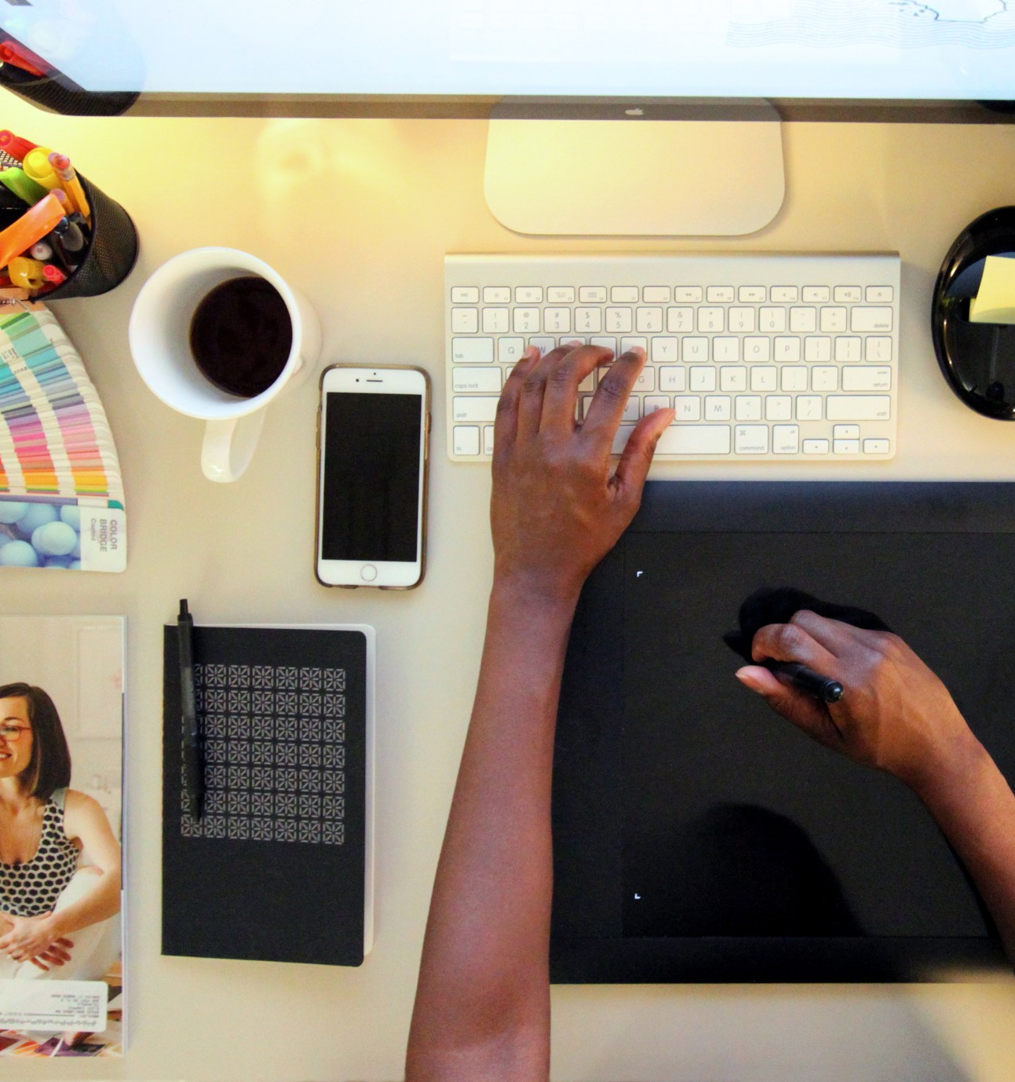
What is Graphic Design
Question: What is the definition of Graphic Design
Answer: The art or profession of using design elements (such as typography and images) to convey information or create an effect
Explore the role of a Graphic Designer
Elements of Graphic Design
The Power of Colour
Create Vector Images
Notes:
Image License - https://www.twenty20.com/photos/05abcd6e-025e-4f07-a05c-6734d34a6c74/?utm_t20_channel=bl

Slide 4


Role of a Graphic Designer
Creating and communicating ideas visually is the job of Graphic Designer. These ideas inform, inspire and attract the viewer's attention
Graphic designers combine their excitement for technology with their passion for art to visually communicate ideas with people.
The creation of graphic design is not typically a one-person job, it usually involves close collaboration with other individuals.
  Think About It: Identify a logo for a company that you know e.g. Microsoft, Google, Snapchat. (Q1.1)
Explore the role of a Graphic Designer
Elements of Graphic Design
The Power of Colour
Create Vector Images
Notes:
Image License - https://www.twenty20.com/photos/05abcd6e-025e-4f07-a05c-6734d34a6c74/?utm_t20_channel=bl

Slide 5

Role of a Graphic Designer
What can a Graphic Designer create?
A graphic designer can create a wide variety of visual products
  Examples: posters, bus wraps, billboards, packaging, logos and marketing materials
Watch @ Learn – Role of a Graphic Designer
  The Secret World of Annie Atkins, Graphic Designer for Films
  Think About It: What are some other items that a Graphic Designer might work on? (Q1.2)
Explore the role of a Graphic Designer
Elements of Graphic Design
The Power of Colour
Create Vector Images
Notes:
Image License - https://www.twenty20.com/photos/05abcd6e-025e-4f07-a05c-6734d34a6c74/?utm_t20_channel=bl

Slide 6

Role of a Graphic Designer
Watch @ Learn – PBS Digital Studios
  The Universal Arts of Graphic Design
Watch @ Learn – Design Careers
  Lexi Fontein talks Graphic Design
Watch @ Learn – Day at Work
  Maurice Woods talks Graphic Design
Watch @ Learn – Nike Talent Presents
  Day in the Life with Nike Design
  Think About It: What inspires you? What are some designs that have captured your attention (Q1.3)
Explore the role of a Graphic Designer
Elements of Graphic Design
The Power of Colour
Create Vector Images
Notes:
Unsplash

