Slide 1

Simple & Complex Machines
TDJ20

Slide 2
Simple Machines – What are they
A simple machine is a non-motorized device that makes it easier to accomplish a task by reducing the force required. A simple machine changes the direction or magnitude (size) of the input force.
There are 6 types of simple machines, can you name them?
Notes:
Think pair share to see how many levers the students can remember from previous science classes.

Slide 3
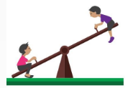
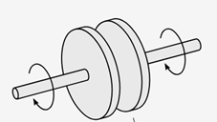
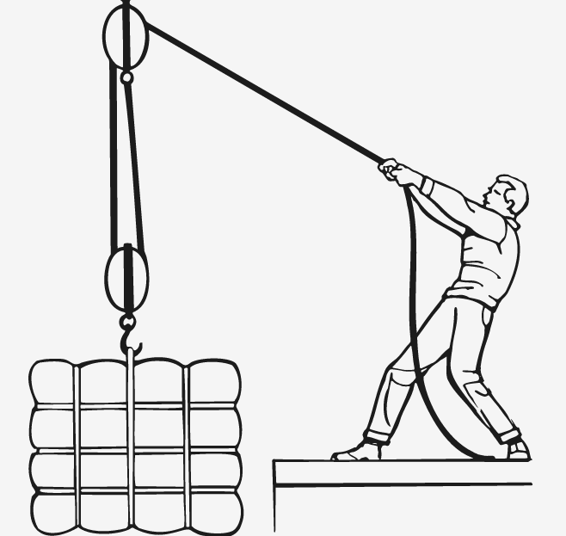
Simple Machines - There are 6 types
Lever - A rigid bar that can be turned freely about a fulcrum (fixed point). Levers make work easier by moving the force required a distance away from the fulcrum. There are 3 classes of levers. | Examples: wheelbarrow, see-saw, hockey stick, stapler, scissors.
Wheel and Axle (gear) – Is made up of a round disk (wheel), with a rod through the centre (axle). This simple machine reduces friction and magnifies the input force into the axle by turning a larger diameter wheel. | Examples: car, can opener, bicycle, wheelbarrow, shopping cart, suitcase wheels.
Pulley – Consists of a wheel with a groove in which a rope can run to change the direction or point of application of a force applied to the rope. | Examples: sails, flag poles, clothing lines, window shades and blinds, rock climbing gear, elevators.
Wheel
Axle

Slide 4
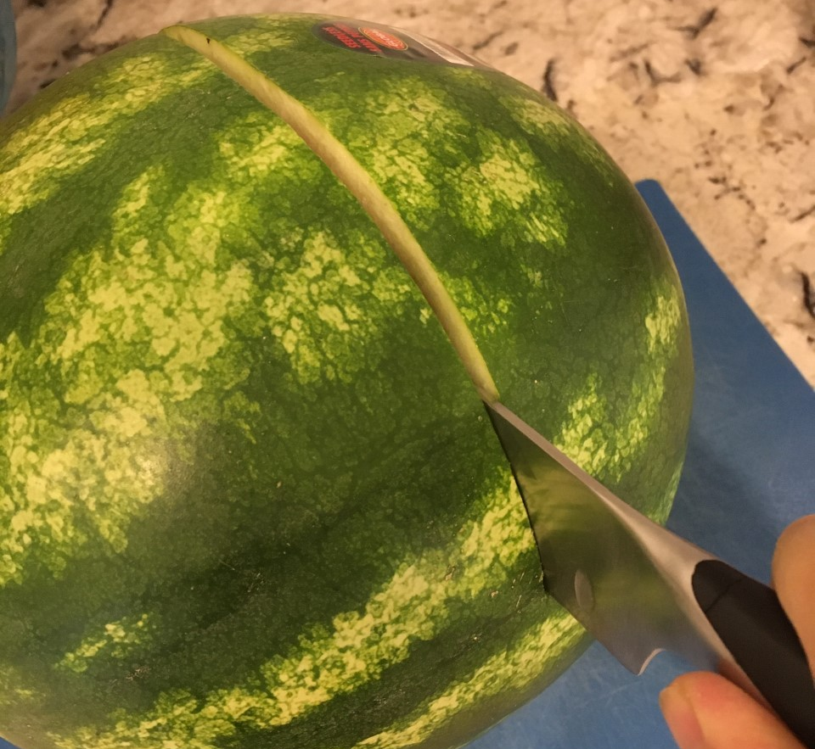
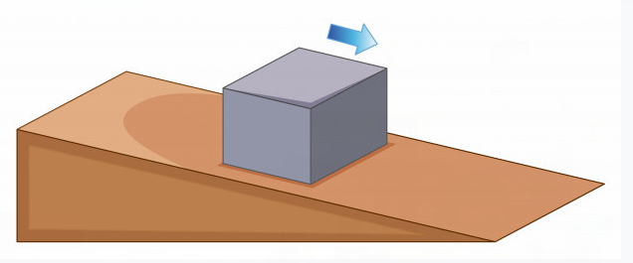
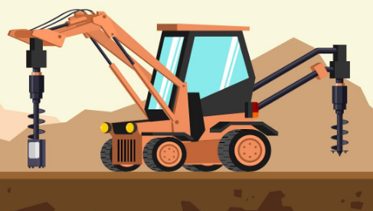
Simple Machines - There are 6 types
Wedge - A wedge is made up of 2 inclined planes used to push objects apart, lift up or hold it in place. A downward or upward force is redirected in a sideways direction. | Examples: scissors, axe, nail, zipper, knife, cheese grater, pencil sharpener, shovel.
Inclined Plane – A ramp or slope that makes moving a load up or down a height (doing work) easier. | Examples: ramps, stairs, inclined roads or sidewalks.
Screw – An inclined plane wrapped around a cylinder. Allowing a small torque to exert a large axial force on a load. It changes rotational motion and force into linear motion and force. | Examples: screws, lightbulb, clamps, jars and lids, corkscrew, auger.

Slide 5

Let's talk about Levers
The fulcrum is located between the effort and the load, which move in opposite directions.
Effort
Load
Motion
Class 1 Lever
Fulcrum
Can you think of a class 1 lever?
Take a minute to discuss in your group and produce examples used in everyday life.

Slide 6
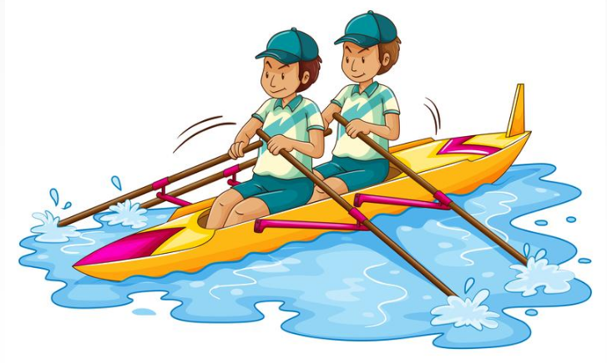
Let's talk about Levers
Motion
Effort
Load
Class 1 Lever
Examples – (students to generate this list)
Pliers (double lever)
Scissors (double lever)
Crowbar
Wrench
Boat Oars
Fulcrum
Effort
Fulcrum
Load

Slide 7
Let's talk about Levers
The load is located between the effort and the fulcrum, and the load and effort move in the same direction
The length of the effort arm is always greater than the length of the load arm.
Motion
Effort
Load
Class 2 Lever
Fulcrum
Can you think of a class 2 lever?
Take a minute to discuss in your group and produce examples used in everyday life.

Slide 8

Let's talk about Levers
Motion
Class 2 Lever
Effort
Load
Examples – (students to generate this list)
Nutcracker
Wheelbarrow
A door
Wrench
Fulcrum
Load
Effort
Fulcrum

Slide 9
Let's talk about Levers
The effort is located between the load and the fulcrum, and the load and effort move in the same direction
The length of the load arm is always greater than the length of the effort arm.
Motion
Load
Effort
Class 3 Lever
Fulcrum
Can you think of a class 3 lever?
Take a minute to discuss in your group and produce examples used in everyday life.

Slide 10

Let's talk about Levers
Motion
Class 3 Lever
Load
Effort
Examples – (students to generate this list)
Arm – lifting something
Hockey stick
Tweezers
Stapler
Tongs
Fishing Rod
Fulcrum
Effort
Load
Fulcrum

Slide 11


Let's talk about Levers
Motion
Class 3 Lever
Load
Effort
Examples – (students to generate this list)
Arm – lifting something
Hockey stick
Tweezers
Stapler
Tongs
Fishing Rod
Fulcrum
Effort
Load
Fulcrum

Slide 12


Applying your knowledge
Working in your groups, pick 1 item from each of the classes of levers to sketch. Label the fulcrum, load and effort locations and directions, as demonstrated in the examples.

Slide 13
Extra Slides for additional application opportunities in class or online

Slide 14
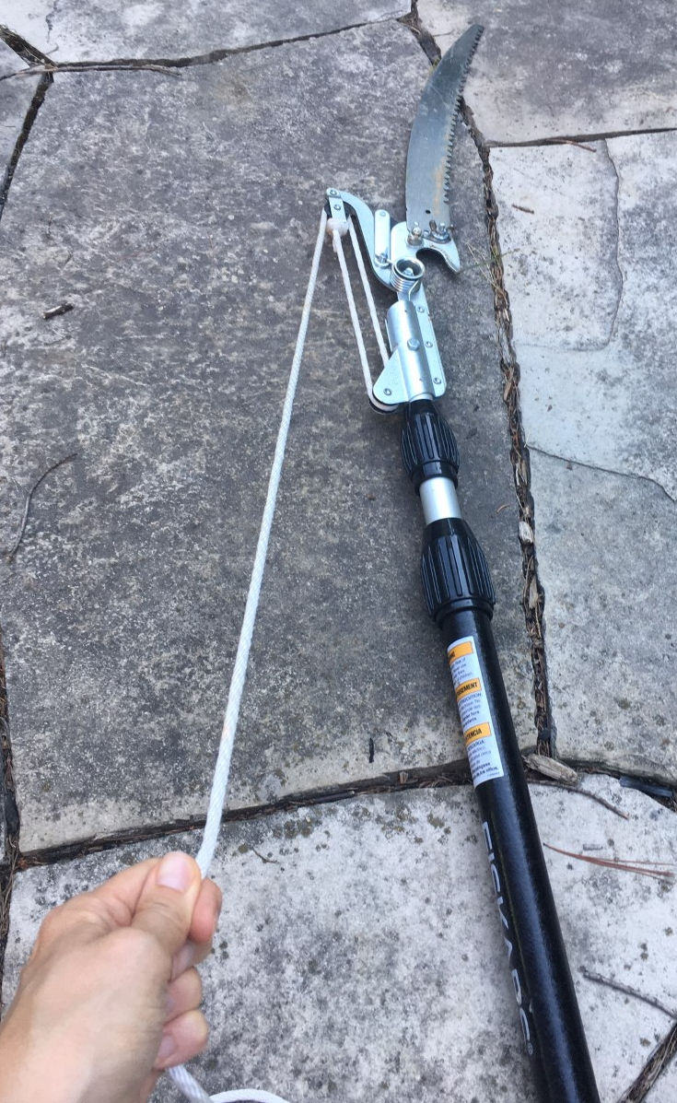
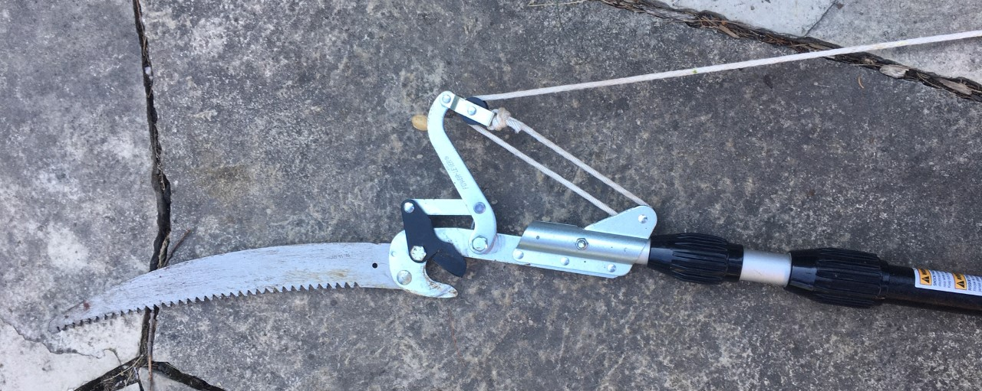
Look at this POLE SAW, can you identify all the simple machines used?
A pole saw is used to delimb medium size branches on trees that are high off the ground.
Notes:
If you have access to computers or phones, students can take 5 minutes to look up what a pole saw does online.
There is a wedge

Slide 15
Look at this POLE SAW, can you identify all the simple machines? - Answers
A Pole Saw is used to delimb medium size branches on trees that are high off the ground.
Pulley
Lever
Wedge
Notes:
If you have access to computers or phones, students can take 5 minutes to look up what a pole saw does online.
There is a wedge

Slide 16
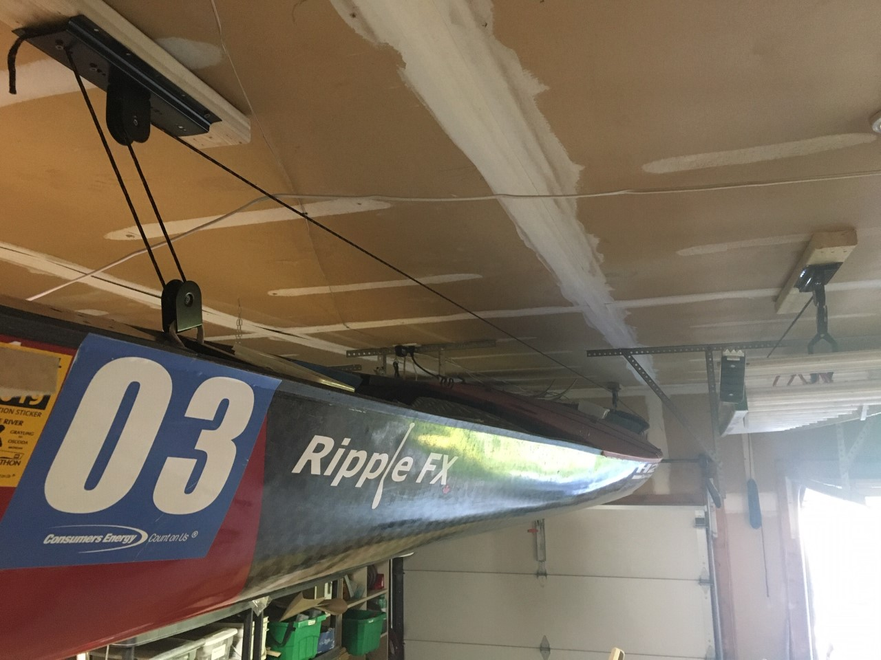
Look at this GARAGE STORAGE PULLEY SYSTEM, can you explain how the simple machine provides mechanical advantage?
Where else could a pulley system be utilized in your home or at school?
What would you use it for?
Pulley
Notes:
This slide shows a canoe being stored on the ceiling of a garage using a pulley system. A similar system is used for bike storage to save on space. This system makes it easy for anyone to lift the boat up to the ceiling, to store out of the way. The mechanical advantage is obtained by the use of the 4 pulleys.

