Slide 1
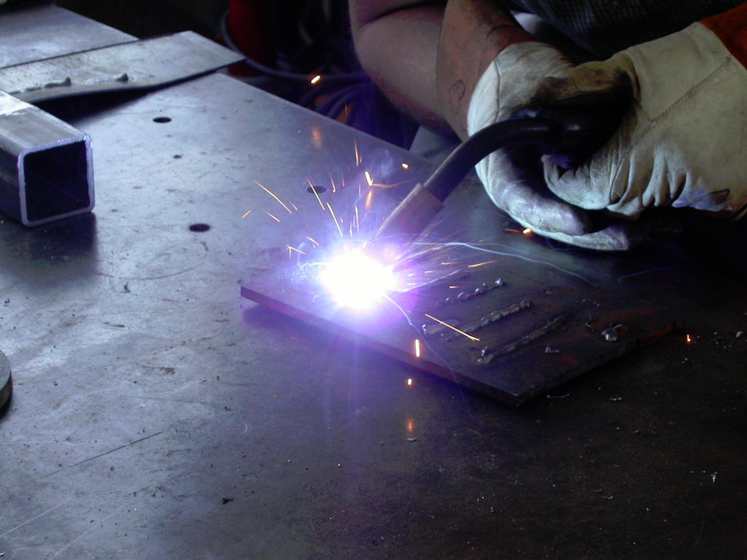
Manufacturing Technology
Career Awareness
Assignment.
MIG WELDING
By: Unknown

Slide 2
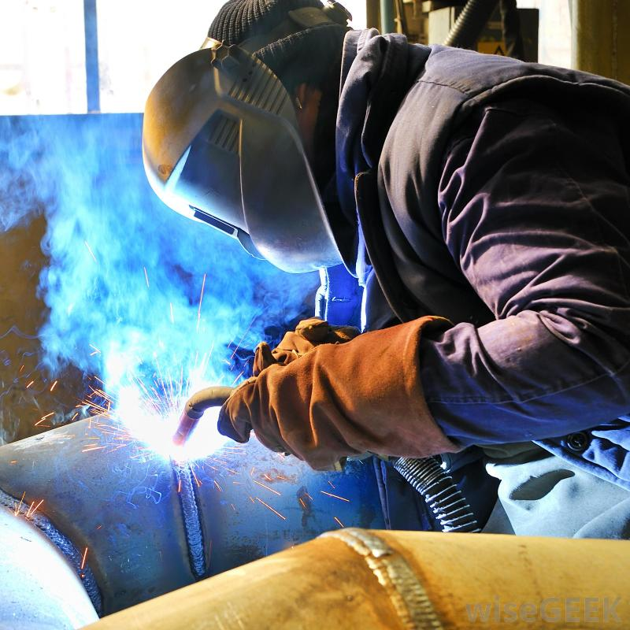
Job description
Uses MIG welder to assemble fabricated metal products in an efficient manner to maximize production.
Operates the equipment in a safe manner and reports hazards associated with the equipment or it's operators to the Safety Director and Maintenance Department.
Produces strong penetrated welds that are smooth, non-porous, and consistent.
Follows required procedures and uses appropriate jigs and fixtures to assist in the assembly process.
Maintains/produces a level of output that will minimize production delays.
Cleans and maintains an orderly work area.
Communicates effectively with other workers to direct personal workflow.
Assist other individuals in area when needed.

Slide 3
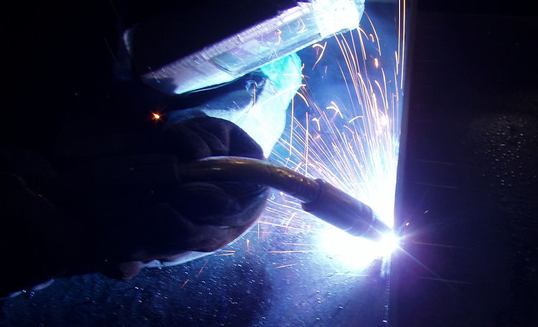
Salary range
Example: In Ontario Newmarket, GMAW flat horizontal CWB certified. 2-3 years experience. Metal shop. $15-18.
They make about $34,000 per year. (in USD as of October 28 2013)
Pay increase’s with skill & experience. The better you are, the more money you’ll make.

Slide 4
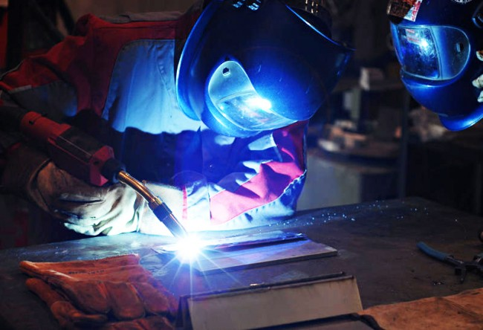
Work hours
18-44 per week once again this will also vary on experience, & job title.

Slide 5
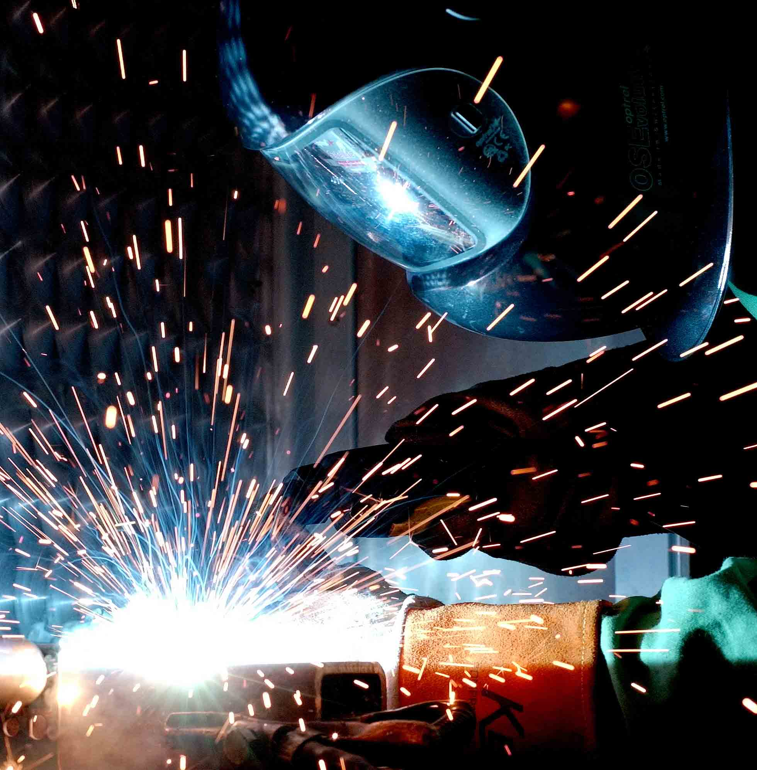
Vacation time
The pay scale for welder ranges from $36.66 to a top rate of $39.77 per hour depending on experience and the position held. In addition, hourly premiums may apply for evening, night, weekend or holiday work.

Slide 6
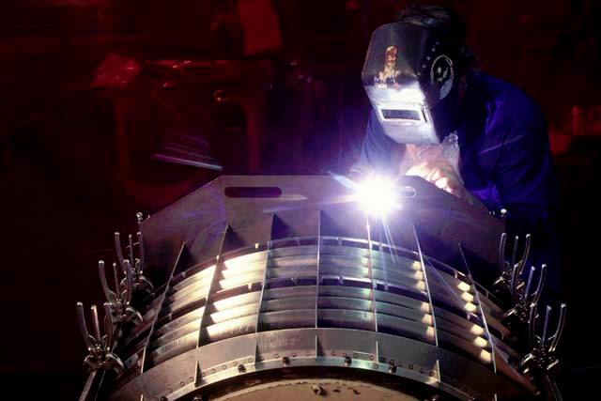
Required qualifications for a MIG Welder
GMAW welding is an arc welding process using a continuously feed filler wire from a spool. A variation of this process is Flux Cored Arc Welding. This process provides superior productivity and is gaining usage in industry. It is used extensively in the sheet metal industry.
GMAW welding courses builds on the fundamentals and carries the student through all position certification to American Welding Society D1.1 Structural Welding Code – Steel with Flux Core and D1.3 Structural Welding Code – Sheet Steel with MIG.
If you successfully complete the Fundamentals and Intermediate GMAW course, you can become a certified structural steel Flux Core and Sheet Metal MIG welder in just 78 hours. Become a certified MIG PIPE Welder by completing another 48 hours of training through Advanced Gas Metal Arc Welding.
Intermediate MIG Welding Certified Training.
Gain skills in the gas metal arc process. Prepare material and perform fillet and groove welds in carbon steel in all positions. Geared toward structural welding code vertical and overhead tests. Passing the certification tests provides an all-position limited thickness AWS D1.1 welder certification.

Slide 7
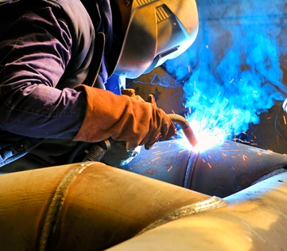
Recommended qualifications
What does it mean to be a certified welder?
Welding certification means “Certification in writing that a welder has produced welds meeting prescribed standards. “
It also means that the weld was performed by using a welding procedure specification (WPS).
Prescribed standards usually means the weld met visual inspection criteria as well as other tests like x ray, or bend testing.
Welding certification almost always involves complying with a welding code or standard of some kind.
There are structural welding tests, pipe welding tests, aerospace welding tests, food service welding tests and more. Structural welding like you see on high rises involves compliance to the American welding Society (AWS) D1.1 structural welding code.
Pipeline welding as in “Alaska pipeline” usually involves the American Petroleum Institute (API) 1104 code book.
Pressure vessels and boilers have their own welding code book too (ASME Section IX) and so does the Aerospace industry (AWS D17).
*The thing they all seem to have in common is this:
*The welding procedure itself must first be qualified ( or prequalified procedures can be purchased)
*Each welder must pass a certification test that resembles the tests used to qualify the procedure.
*Welders are only certified to weld within the limitations of the test they took to become a certified welder.

Slide 8
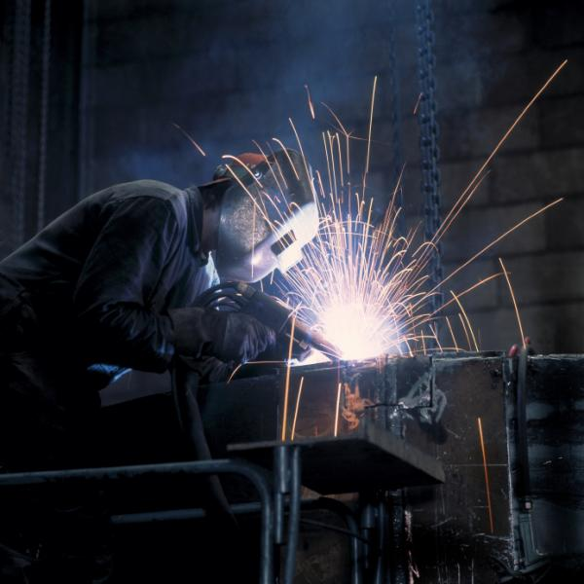
Recommended qualifications
EXPERIENCE!
Welding certifications
OYAP
College
Apprenticeship

Slide 9
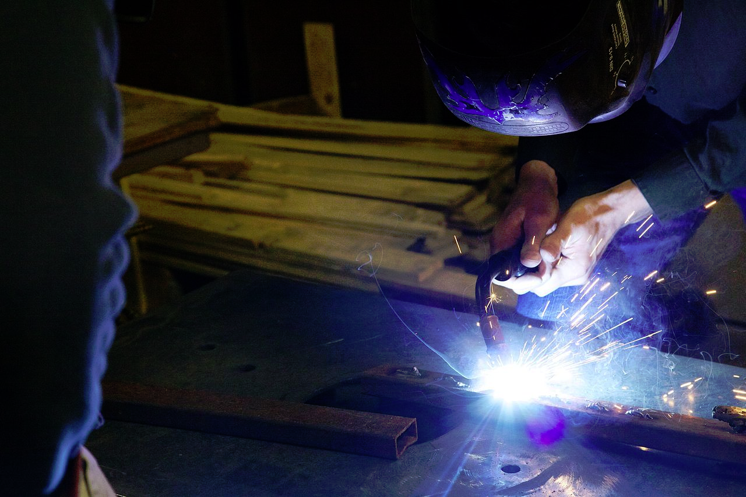
Related subjects in high school
Design tech
Manufacturing tech
Computer programming
Manufacturing ( focus welding)
Computer tech
Transportation tech
& some dual credits at Conestoga

Slide 10
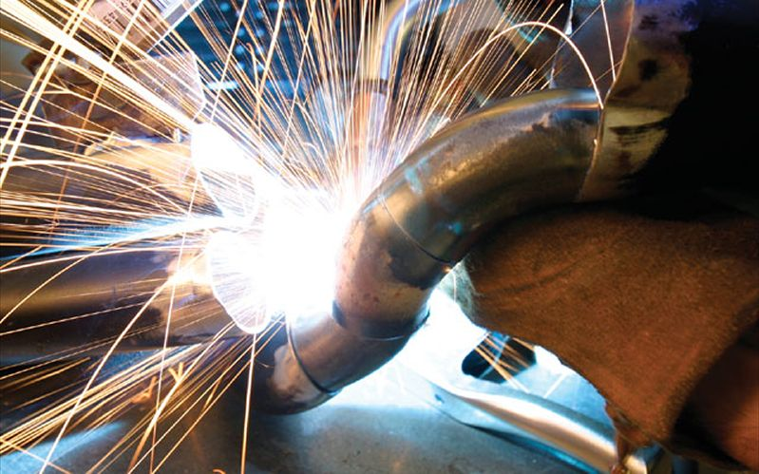
A sample career path
-Manufacturing
-OYAP
-High skills major
High school
-8 months to 2 years
Apprenticeship
College
-work with someone for 8 months to 2 years
Get some serious hours in your job field.
More welding need up to 100 hours of experience. But this also varies on which welder you become.

