Slide 1
Hairstyling & Aesthetics
TXJ
Roller-set

Slide 2
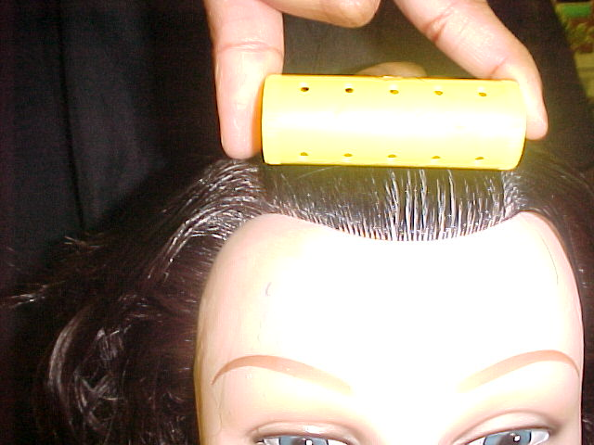
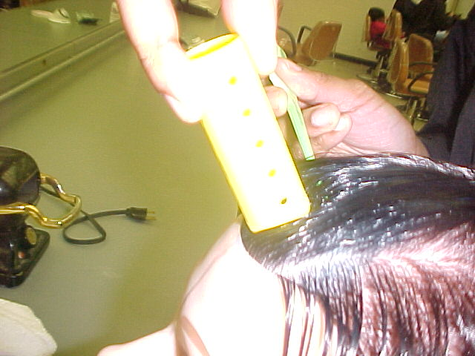
Measure for the Roller
Length cannot be longer than the roller
Width cannot be wider than the diameter of roller
Measure each sub-section with the roller to be used

Slide 3
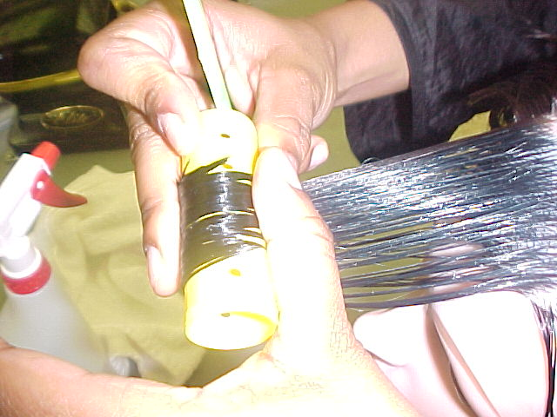
Smoothing Hair
Lay ends onto roller smoothly
No end wraps
Use gel or wave-set as necessary
Keep ends spread out across roller

Slide 4
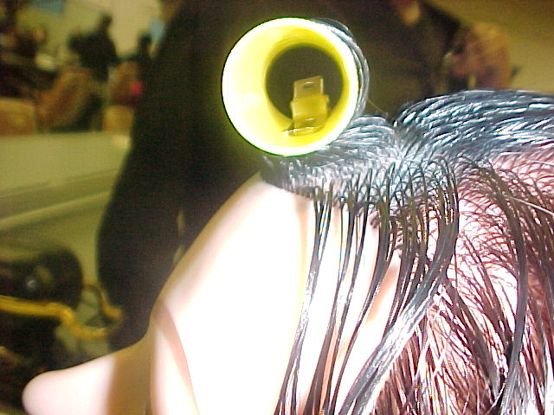
On-Base Roller
Measure for roller
Hold the hair at 45°
Comb hair out from the scalp
The roller sits directly on the base

Slide 5
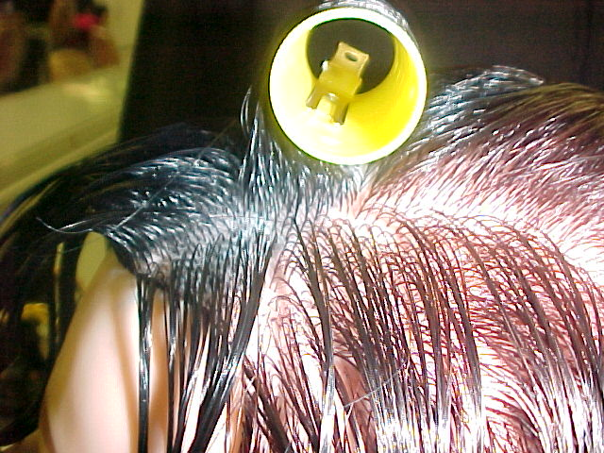
Half-Base Roller
Section for correct roller size
Comb hair up at 90°
Wrap ends smoothly onto roller
Use gel or wave-set if necessary
The roller sits half on, half off the base
Used in the crown area of the head
Creates medium volume

Slide 6
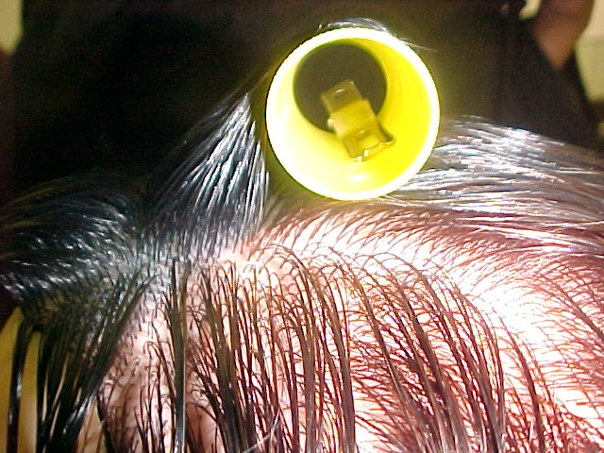
Off-Base Roller
Section for correct roller size
Comb hair to 110°
Wrap ends smoothly onto roller
Use gel or wave-set if necessary
The roller sits completely off the base
Used in the nape area of the head
Creates least amount of volume

Slide 7
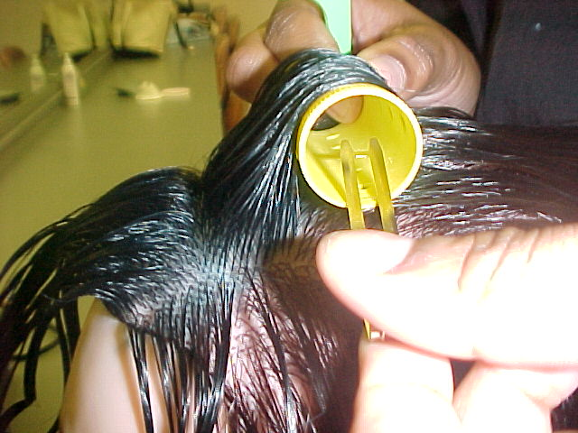
Anchoring the Roller
Use a double-prong clippie
Slide clippie bottom underneath roller
Attach to the base
Use only one clippie per roller
Do not clip to another roller

Slide 8
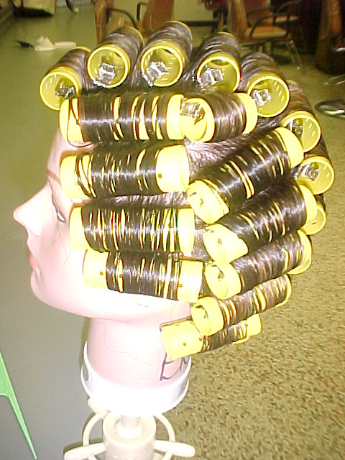
Completed Wet Set
On-base rollers in the top area
Half-base rollers used in crown area
Off-base rollers used in nape area

