Slide 1
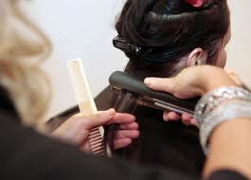
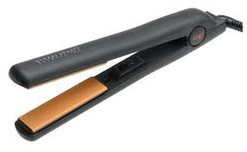
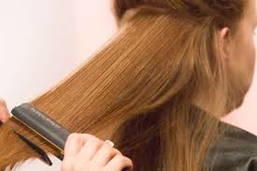
Thermal Hairstyling – Flat Irons
Safety, Care, and Manipulations of Flat Irons

Slide 2
Learning Expectations
Students will select and use the flat iron safely and appropriately.
Students will demonstrate an understanding of proper care of tool.
Students will apply working knowledge of proper handling and manipulations of flat Irons

Slide 3
Intro
The most important aspect of hairstyling is the understanding of proper technique for shaping and styling the hair.
Through demonstration, procedural handout and the PowerPoint presentation, you will learn the steps involved in thermal hairstyling with the flat irons.
In today’s lesson, we’re going to look at Safety, Care and Manipulations of Thermal Flat Irons

Slide 4
Assessment Methods
You will be assess through:
Skills Demonstration
Quiz
Exit Ticket and
Anecdotal Recording of your progress

Slide 5
Questions
How many of you ever flat iron your hair?
Have you or know someone who burns his or her hair or skin while performing thermal hairstyling?

Slide 6
Thought of the Day
“People who say it cannot be done should not interrupt those who are doing it”
Anonymous

Slide 7
Flat Irons Information
Flat irons have two hot plates ranging in size from 1.3cm to 8cm (1/2 to 3”) across.
Flat irons with straight edges are used to create smooth, straight styles, even on curly hair.
Flat irons with beveled edges can be manipulated to bend or curl the ends.

Slide 8
Flat Iron Information
The edge nearest the stylist is called the inner edge; the one farthest from the stylist is called the outer edge.
Modern technology is constantly improving electric curling and flat irons by adding infinite heat setting for better control, constant heat even on high settings, ergonomics grips, and lightweight designs for ease of handling.

Slide 9
Temperature of Flat Irons
There is no single correct temperature used for the iron when thermal curling or thermal waving of the hair
As a rule, coarse or grey hair can withstand more heat than fine hair

Slide 10
Temperature of Thermal Irons
The temperature setting for an iron depends on the texture of the hair, whether it’s fine or coarse, or whether it has been lightened or tinted, as well as white hair should be curled and waved with a gentle heating.

Slide 11
Safety Use with Thermal Irons
Keep thermal irons clean
Do not overheat thermal irons
Do not use metal combs when working with irons, as they will heat up and could burn the scalp
Test the temperature of the iron on a tissue paper or white cloth before placing it on the clients hair in order to prevent burning the hair
Use only hard rubber or non-flammable combs when working with irons and it should be 7” long
Remember to turn off and unplug your thermal iron and tuck all cords away when leaving your station unattended

Slide 12
Safety use with thermal irons
Place comb between iron and scalp, to prevent burning of the scalp.
Place hot iron in a safe place to cool
Beware of your surroundings when working with hot irons, (ex. children)
Client hair must be clean and completely dry to ensure a good thermal flat iron
Do not allow the hair ends to protrude over the iron, this causes fishhooks (hair that is bent or folded)
When ironing lightened, tinted, or relaxed hair, always use a gentle heat setting.

Slide 13
Care of thermal Irons
Before cleaning a thermal iron, be sure to check the manufacturer’s direction for care and cleaning.
To remove dirt, oils, and product residue is to dampen a towel or rag and wipe down the barrel of the iron with a soapy solution containing a few drops of ammonia.
Do not clean iron when it is turned on or when it is still cooling from a previous styling service.

Slide 14
Points to Remember…
Hair must be clean and 100% dry in order to ensure a good curl
When working with lightened or tinted, as well as relaxed hair, always use gentle heat to avoid scorching the hair.

Slide 15
Manipulations of Thermal Irons
Hold the iron in a comfortable position that gives you complete control
Grasp the handles of the iron in your dominant hand, far enough away from the joint to avoid the heat
Hold the comb between the thumb and all four fingers of the non-dominant hand, with the index finger resting on the backbone of the comb for better control.

Slide 16
Today’s learning objectives
Students will select and use the flat iron safely and appropriately.
Students will demonstrate an understanding of proper care of tool.
Students will apply working knowledge of proper handling and manipulations of flat Irons

Slide 17
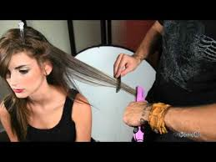
Activity
Practice flat iron technique

