Slide 1

An Introduction to Customer Service Excellence
TFJ3C-HOSPITALITY AND TOURISM

Slide 2

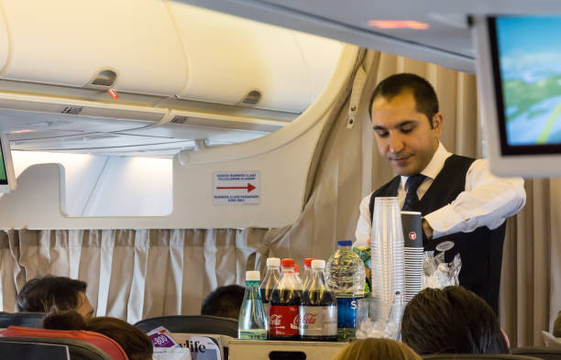
Let’s unpack the meaning of customer service.

Slide 3

Definition of great customer service:
Great customer service means consistently exceeding customer expectations and going out of your way to help people solve their problems.
When providing superb customer service is the main focus of your organization, your team will continuously be on the lookout for ways in which to better serve.
Once absorbed as an all-embracing philosophy, you’ll then be equipped to provide assistance to all of your customers’ needs—whether they’ve requested your help or not.
By placing the customer at the centre of every decision or action you will be able to focus on the main reason it exists: providing the most possible value regardless of how someone engages.

Slide 4

TIPS FOR SUCCESS
#1 A Clear Understanding of the Customer
Customers, buyers, and clients want to feel valued and cared for. They also need someone to understand their needs and answer their questions. Therefore, great customer service starts with the ability to actively listen to the customer and find out what they really need.
What motivates A CUSTOMER to make a purchase or decision?

Slide 5

TIPS FOR SUCCESS
#2 Have a customer friendly approach
One commonality among all companies or organizations that provide good service is the development of a system and approach that promotes customer-friendly service.
Let’s discuss/brainstorm examples of a positive approach to customers.

Slide 6
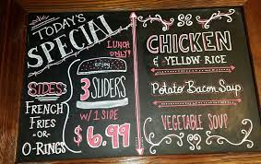
TIPS FOR SUCCESS
#3 ANTICIPATE THE CUSTOMER’S NEEDS
Be ready with information-know your services, products, prices, chef specials, promotions etc.
This means you require knowledge - an investigative/inquisitive approach to your customer will support great customer service. Research the :demographic, age, allergies etc. Eg.: If a family is travelling with kids, how can you support their needs?

Slide 7



TIPS FOR SUCCESS
#4 First Impressions matter!
The reality is, we prefer doing business with those we like and trust. Impressions are key to developing a sense of trust with the customer. They want to know that you are accountable and reliable in your service and attitude.
LinkedIn reports that only 4 percent of disappointed customers complain to staff members, but nine out of 10 never return.
In fact, 81% of people are more likely to work with a business again after good service!

Slide 8

Ways to Create a Positive Impression!
Ways to Create a Positive Impression:
• Thoughtfulness in meeting the customer’s needs
• Taking personal responsibility for a customer
• Quick problem-solving for the customer
• Offering immediate assistance
• Friendliness and empathy
• Using the customer’s name in a conversation
• Pleasant tone of voice
• Polite and courteous manners
• Genuine,caring and thoughtful conversations

Slide 9

Factors that Create a Negative Impression:
• Making the customer wait
• Not saying “please” and/or “thank you”
• Speaking loudly or condescendingly to customers or colleagues
• Making faces, frowning, acting distant, not smiling
•Looking disheveled or like you don’t care
•A poor handshake
•Focusing on another task while addressing a customer
Remember, impressions stay with those you meet, especially customers, and once registered; negative impressions are difficult to overcome!

Slide 10

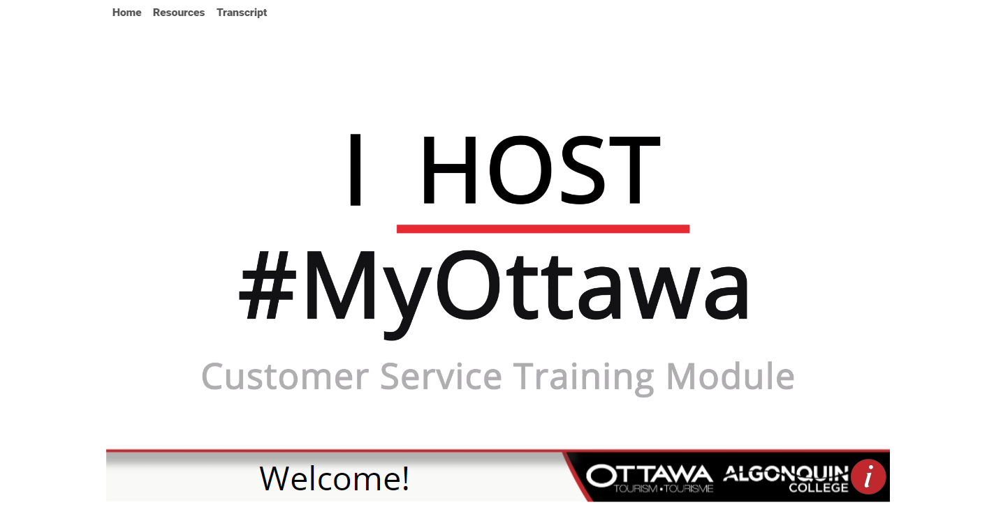
Let’s see what we have learned so far
https://ottawatourism.ca/sites/default/files/training_tool/ottawahost/story_html5.html
Ottawa Tourism Customer Service video

Slide 11
TIPS FOR SUCCESS
#5 Problem solving – how to deal with unsatisfied customers
It’s likely you’ll interact with a customer who is simply unsatisfied. However, there are steps to take that turn this problem into an opportunity to build a positive relationship with the client.
If your customer is unsatisfied (for just or unjust reasons), try these techniques to win their support and continued loyalty.
Listen: It is of primary importance when dealing with an unsatisfied or complaining customer to listen attentively to their complaint, gripe, frustration, or grievance. Be patient, attentive, and friendly
Express you are sorry: While some customers are looking for a sincere apology, some may feel it’s disingenuous. Apologize for frustration and inconvenience when applicable to let the customer know you care about their feelings.
Point out facts and look for solutions :Listen carefully and write everything down so you can accurately reference key facts or points made during the conversation.
Admit the problem. If you can suggest a solution, do it. If not, tell the customer what action you will take and what actions will follow. Never make the mistake of promising something you can’t do.

Slide 12
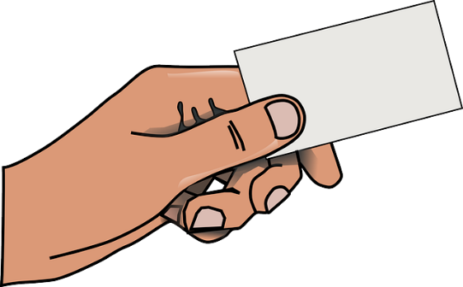



Let’s summarize what we have learned so far.
Exit ticket!
Let’s break up into groups of 3 or 4 students.
Let’s do A THINK , PAIR , SHARE ACTIVITY.
Create a google doc and title it : Customer service excellence .Place all of your names on it. Please think about 4 positive outcomes(PROS) of great customer service and 4 challenges/poor outcomes(CONS) when customer service is lacking. Perhaps create a chart to represent your answers.
Or, create a short video link using Screencastify to answer these questions.

