Slide 1

OCTE – Customer Service Certification
Teacher Information
This is designed to provide a broad-based Customer Service certification that can be delivered to a specific sector of SHSM students or as a multi-sector approach. There are five modules that will take between 75 – 90 minutes.
There is a Student Handout presentation that pairs with this slide deck; edit to suit the needs of the students and the certification
  It can be used in a digital format, but printing a hard copy for each student is recommended if this certification is being delivered in a classroom setting
  Students can also digitally record their responses
  A student certificate is available as a separate slide deck
    There are two versions; one is more printer friendly
Notes:
Note – this slide has been “hidden” – it appears in the slide deck in Normal but will not appear while presenting.
To hide/unhide slides: using the Slide and Outline tab, select the slide you want to hide. Right click 🡪 Hide (in PowerPoint)

Slide 2
OCTE – Customer Service Certification
Teacher Information
Check the OCTE website for additional resources that can be used with this Customer Service Certification
  Sector Partner Experience: Your Inner Entrepreneur reviews entrepreneurism, entrepreneurial traits and calculating the costs of running a Summer Company program
  Sector Partner Experience: Costs of Starting a Business is in-depth research of planning a business a business idea and the associated costs
  Other Suggestions:
  Check the Speaker’s Notes for instructions, learning extensions and additional resources
Change or delete aspects to better suit student needs
  Add specific examples to the modules to address the students’ SHSM sector need
Interaction and brainstorming is involved in the activities; it would be beneficial for students to be working in small groups of 3 – 4
There are reflective aspects for students to complete throughout each module; if using the certification over several days, teachers will need to consider collecting and assessing the student handout
Chart paper, markers and sticky notes may also be useful
Teachers should check all the links and resources prior to using the certification with students.
Notes:
Note – this slide has been “hidden” – it appears in the slide deck in Normal but will not appear while presenting.
To hide/unhide slides: using the Slide and Outline tab, select the slide you want to hide. Right click 🡪 Hide (in PowerPoint)

Slide 3
OCTE -
Customer Service
Certification

Slide 4
Customer Service Certification Roadmap
Module 1:
Definition and Relevance
Module 3:
Surprise and Delight!
Module 5:
Customer Service in your SHSM Sector
1
3
5
2
4
Module 2:
Essential Skills and Traits
Module 4:
Typical Customer Scenarios
Optional:
Sector Partner Experience
Notes:
Module 6 is OPTIONAL. Teachers can arrange the Sector Partner Experience – ICE with a local company that has a customer service problem that the ICE model can be applied to by the SHSM students. The resources for this are found in a separate slide deck.

Slide 5
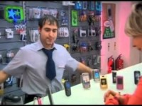
Have you ever experienced Customer Service like this?
Notes:
Video: Customer Service Compilation
https://www.youtube.com/watch?v=9oywp2qRRyc
Note – after watching the video, discuss what the employees could have done to improve the situation.

Slide 6
Warm-up: The Good and the Bad and Ugly Customer Experiences
Think about the best experience you have had when dealing with a customer service representative.
What did the employee do to create such a positive experience?
Think about the worst experience you have had when dealing with a customer service representative.
What aspects made this experience so poor for you?
Notes:
Note: If delivering this certification in-person, students can discuss these scenarios in small groups. Ask for volunteers to tell their Good and Bad and Ugly customer experience stories.
If using sticky notes, students can jot down the positive and negative aspects (one sticky note per experience). In their groups, students can organize the notes, looking for common points.

Slide 7
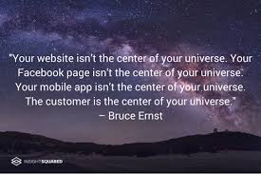
Chief Product Officer of WorkplaceDynamics

Slide 8
Definition & Relevance
1
Module

Slide 9
How you think about your customers influences how you respond to them.
Marilyn Suttle,
Customer Service consultant, speaker and author

Slide 10
Minds On
How would you define and describe “customer service”
Discuss with other SHSM students or think about it on your own. Add your thoughts to your copy of the student handout.

Slide 11
Customer Service is..
...the assistance and advice provided by a business to existing customers who buy or use its products or services and to consumers considering a purchase.
Effective customer service needs to be provided to the customer before, during and after the purchase.
Wikipedia and Oxford Languages
Notes:
There are many different definitions of customer service; different sources and different sectors will have specific areas and focus around customer service.
This simple definition has been created from many sources, primarily Wikipedia and Oxford Languages.

Slide 12

Is your definition similar to this one?
Add additional points to your definition
in the student handout.

Slide 13
Great companies realize that no matter what you sell, whether it’s a product or a service, what you are actually selling is an experience.
Marilyn Suttle,
Customer Service consultant, speaker and author

Slide 14

Why is Customer Service so important to a business?
It makes customer happy!
Happy customers means increased loyalty to the business:
  Customers will purchase more often
  Amount purchased per visit typically increases
Positive word-of-mouth marketing and reputation
  Will attract new customers to the business
Notes:
Related resources:
https://www.abetteranswer.com/blog/5-reasons-customer-service-is-important-to-the-growth-of-small-companies
https://www.acu-data78.com/the-importance-of-customer-service-in-small-business-relationships/
https://www.benchmarkone.com/blog/small-business-customer-service/
https://www.groovehq.com/blog/why-customer-service-is-important
https://www.ameritasinsight.com/employee-benefits/industry-buzz/why-good-customer-service-is-important
https://www.momentcrm.com/blog/why-customer-service-important/
https://www.performanceinpeople.co.uk/blog/why-is-customer-service-important/
https://www.indeed.com/career-advice/career-development/why-is-customer-service-important

Slide 15

OPTIONAL
Video: I Was “Seduced” by Exceptional Customer Service (8:20)
Notes:
Video: I was seduced by exceptional customer service (8:20)
John Boccuzzi Jr., TEDxBryantU
https://www.youtube.com/watch?v=GH1TXfQSwUQ
Key Take-Aways:
Exceptional Customer Service will change a casual customer into a brand loyal ambassador
The companies that stand out and succeed are those that focus on exceptional customer service
They don’t necessarily have big, multi-media marketing campaigns
They are not typically big box/large companies
Not necessarily offering the lowest prices
(4:42) “The customer experience is not about the product you offered, it is about how you make someone feel during the buying journey and frankly, after the purchase has been made.”
According to the John Boccuzzi Jr, successful businesses all focus on delivering exceptional customer experiences each and every day
(7:00 – 7:34) “Delivering customer experience isn’t just good for the customer, it actually good for business.”

Slide 16
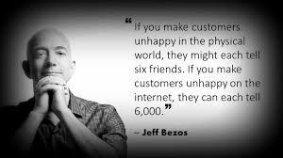
The Power of Word-of-Mouth
Founder and executive chairperson of Amazon.
Notes:
Jeff Bezos – founder and chairperson of Amazon

Slide 17
Reflect and Connect
Why are the quotations from Marilyn Suttle and Jeff Bezos in this module so relevant to the importance of effective customer service, in-person and online?
Discuss with other SHSM students or think about it on your own. Add your thoughts to your student handout.

Slide 18
Essential Skills and Traits
2
Module

Slide 19
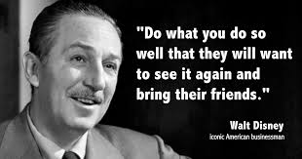

Slide 20
Minds On
How does the video clip, “Be Our Guest” from Disney’s Beauty and the Beast demonstrate Walt Disney’s idea of customer service?
Discuss with other SHSM students or think about it on your own. Add your thoughts to your copy of the student handout.

Slide 21
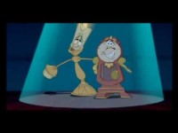
Disney’s Beauty and the Beast – Be Our Guest
Notes:
Beauty and the Beast – Be Our Guest
Video: https://www.youtube.com/watch?v=afzmwAKUppU

Slide 22

The “Disney Way” of Customer Service is recognized around the world!
The Disney Institute teaches other businesses about leadership and customer service.
The book, “Be Our Guest, Perfecting the Art of Customer Service” gives insights into Disney’s success.
Notes:
Disney Institute: https://www.disneyinstitute.com/
Additional Resources for the “Disney Way” of Customer Service:
Video: A Lesson in Customer Service from Disney
https://www.youtube.com/watch?v=_QD0PvjxXY0
Article: Forbes – Five Lessons from Disney’s Magical Customer Experience
https://www.forbes.com/sites/blakemorgan/2020/01/23/5-lessons-from-disneys-magical-customer-experience/?sh=28c381987555
Article: How Disney Beats All Others in Customer Service
https://www.wdwinfo.com/disneylandcalifornia/how-disney-beats-all-others-in-customer-service/
Article: Customer Service the Disney Way
https://www.forbes.com/sites/carminegallo/2011/04/14/customer-service-the-disney-way/?sh=13cffa5878f8

Slide 23

Disney has 5 Keys for the Guest Experience:
Notes:
Additional resource:
http://disneyatwork.com/disneys-four-keys-to-a-great-guest-experience/

Slide 24
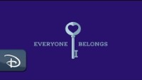
To All Who Come to this Happy Place: Welcome
Notes:
Video: To All Who Come to this Happy Place: Welcome
https://www.youtube.com/watch?v=QQTij9Rghls&list=RDCMUC1xwwLwm6WSMbUn_Tp597hQ

Slide 25
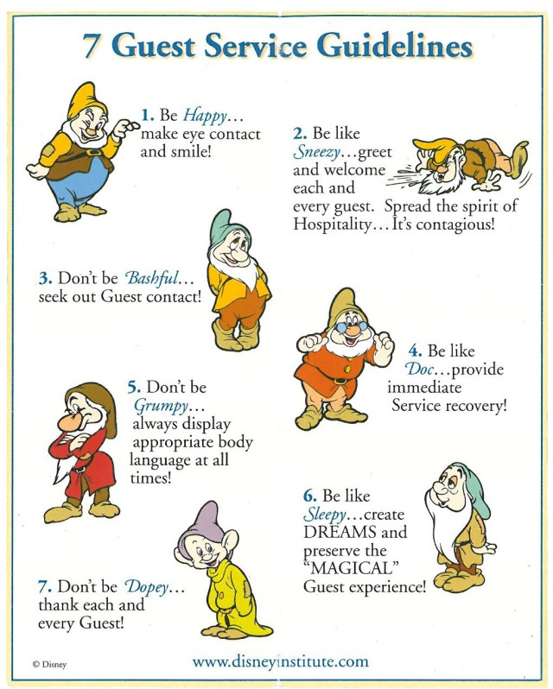
Disney’s 7 Guest Service Guidelines have been adapted over the years to align with their 5 Keys, but their commitment to exceptional guest experiences remains the same!
These guidelines are the essential skills of customer service for any employee in any business!
Be like the Seven Dwarfs!

Slide 26
Reflect and Connect
In the student handout, summarize Disney’s 7 Guest Guidelines
Why are these guidelines useful for skills for all employees working in any company?
  Discuss with other SHSM students or think about it on your own.
Notes:
Note: If the videos do not work, or other examples are needed, there are many online articles and resources for other examples:
https://www.inc.com/molly-reynolds/9-companies-that-nailed-the-whole-surprise-and-del.html
https://www.oberlo.ca/blog/customer-service
https://www.teamoutpost.com/blog/customer-care-methods/

Slide 27
Investigate and Describe
Watch video, “How to Approach Customer Service Like Disney”
  Alternative: Read the corresponding blog post:
  https://blog.hubspot.com/service/disney-customer-service-model
In the student handout, describe three to five different methods Disney uses to provide outstanding customer service.
  Discuss with other SHSM students or think about it on your own.
Notes:
Note: If the videos do not work, or other examples are needed, there are many online articles and resources for other examples:
https://www.inc.com/molly-reynolds/9-companies-that-nailed-the-whole-surprise-and-del.html
https://www.oberlo.ca/blog/customer-service
https://www.teamoutpost.com/blog/customer-care-methods/

Slide 28
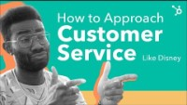
How to Approach Customer Service Like Disney
Notes:
Video: How to Approach Customer Service Like Disney
https://www.youtube.com/watch?v=dXz99gxUguk&t=302s
Supporting online resource:
https://blog.hubspot.com/service/disney-customer-service-model

Slide 29

OPTIONAL
Video: Be a Hospitalian (7:52)
Notes:
Video: Be a Hospitalian (7:52)
https://www.youtube.com/watch?v=TH2L_uNkt-Y
Bobby Stuckey, TEDxBoulder
This video would be a good option to use along with the Disney resources or as a substitution.
Key Take-Aways:
The notion of hospitality can be applied to businesses beyond restaurants, hotels, attractions, travel and tourism; it is method of providing an exceptional customer experience
(1:39) “Hospitality Intervention” – staff member shifting the mood of an upset customer by using hospitality
“A hospitalian” – someone who provides the authentic act of hospitality; thinks of others instead of themselves and focuses on making the customer feel great
(2:04 – 2:50) Difference between Customer Service and Hospitality
Service🡪 What you do to/provide for someone
Hospitality 🡪 How you make someone feel, looking outward instead of inward
(5:03 – 5:44) Importance of Hospitality between the traditional hospitality-based businesses
Application/Thinking for SHSM students:
In your SHSM sector, how can you provide hospitality over service?

Slide 30
“Customer Service is not a department, it is an attitude”
David Forman, Internet Entrepreneur
Successful companies make a commitment to providing excellent customer service from ALL employees
Regular training and coaching for staff help further develop their customer service traits and skills
Employees will often develop an Action Plan to further develop their Customer Service skills

Slide 31
Your Customer Service Skills
Action Plan
Refer to your student handout
Read through the list of customer service skills and list of customer service traits
Use the organizer in the student handout to indicate which skills and traits are Super Star, So-So and Need to Develop
Identify one skill and one trait in the So-So and Need to Develop that you want to improve
Describe at least one strategy to improve for each of the identified skill and trait.
Notes:
Adapted from:
Carlaw, P., & Deming, V. K. (1999). The big book of customer service training games: Quick, fun activities for training customer service reps, salespeople, and anyone else who deals with customers. McGraw-Hill.

Slide 32
Employees who stand out in their work have these Customer Service SKILLS:
Friendly
Quick
Efficient
Eager to please
Knowledgeable
Optimistic
Diligent
Attentive
Creatively helpful
Empathetic
Poised
Upbeat
Honest and fair
Solution-oriented
Able to understand customers’ requests
Notes:
Source:
Carlaw, P., & Deming, V. K. (1999). The big book of customer service training games: Quick, fun activities for training customer service reps, salespeople, and anyone else who deals with customers. McGraw-Hill.

Slide 33
Employees who stand in their work have these Customer Service TRAITS:
Listen attentively
Maintain a positive attitude
Speak clearly
Avoid technical terms or fancy words
Give customers a feeling of confidence in them, the information they give and the company
Make every customer feel important
Calm customers that are annoyed, frustrated, upset
Notes:
Source:
Carlaw, P., & Deming, V. K. (1999). The big book of customer service training games: Quick, fun activities for training customer service reps, salespeople, and anyone else who deals with customers. McGraw-Hill.

Slide 34
Essential Skills and Traits:
Optional Resources

Slide 35

3
Module
Notes:
Additional Resource:
https://www.inc.com/molly-reynolds/9-companies-that-nailed-the-whole-surprise-and-del.html

Slide 36
“Surprise & Delight doesn’t refer to special promotions or exclusive deals… there is no “catch”. Customers are simply treated to something of value, completely out of the blue, with no strings attached.”
Resource: https://stampme.com/what-is-surprise-and-delight-and-why-is-it-so-effective/.
Notes:
Supporting article:
Davis, B. (2020, July 30). What is "surprise and delight" and why is it so effective? - stamp me. Stamp Me Loyalty Card App. https://stampme.com/what-is-surprise-and-delight-and-why-is-it-so-effective/.

Slide 37
Minds On
How does the restaurant featured in the video “surprise and delight” their customer?
Add your thoughts to your copy of the student handout.
Notes:
If delivering the certification in-person, teachers can facilitate a discussion after watching the video.

Slide 38

Notes:
Video: Blind Woman Gets Chocolate Braille Birthday Surprise
https://www.youtube.com/watch?v=6hu0uyw0UG0
A restaurant created a birthday dessert with braille for a blind customer by using melted chocolate on a plate to write “Happy Birthday” in braille.

Slide 39
Surprise and Delight
“Surprise and Delight” customer service goes above and beyond the typical customer experience
The gestures can be small and inexpensive :
  Thank you cards, birthday acknowledgements, a giveaway, company swag
Some companies, like WestJet, make it an annual event that goes viral
Notes:
Supporting article:
https://stampme.com/what-is-surprise-and-delight-and-why-is-it-so-effective/

Slide 40
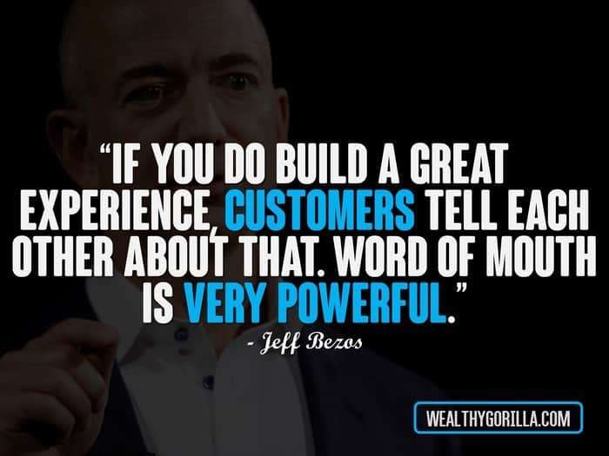
Notes:
Jeff Bezos, founder and executive chairperson of Amazon.

Slide 41
Benefits of Surprise and Delight
A very effective method of thanking and appreciating customers
Creates connections with customers
Builds long-term relationships with customers
Builds further loyalty with existing customers
Creates positive word-of-mouth
A very effective marketing strategy as well
All of these benefits creates more business for the business!

Slide 42
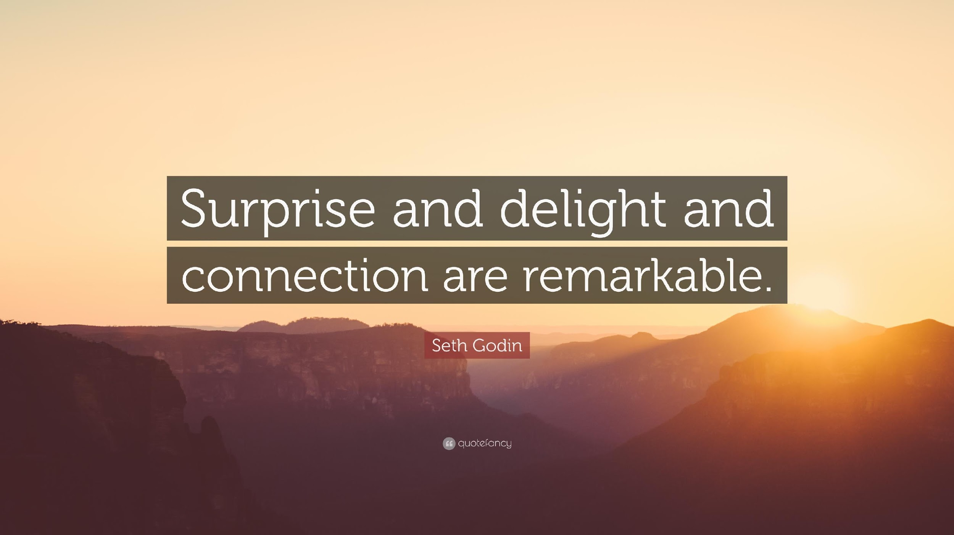
Notes:
Seth Godin is an entrepreneur, best-selling author, and speaker.
https://www.sethgodin.com/

Slide 43
Investigate and Describe
Watch one (or all!) of the videos that show a company surprising and delighting their customers.
In the student handout, describe the surprise and delight strategy for one of the companies.
  Discuss with other SHSM students or think about it on your own.
Explain the way in which the surprise and delight strategy creates a connection with the customer
Notes:
Note: If the videos do not work, or other examples are needed, there are many online articles and resources for other examples:
https://www.inc.com/molly-reynolds/9-companies-that-nailed-the-whole-surprise-and-del.html
https://www.oberlo.ca/blog/customer-service
https://www.teamoutpost.com/blog/customer-care-methods/

Slide 44
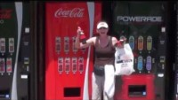
Coca Cola Happiness Machine
Notes:
Video: Coca Cola Happiness Machine at the World of Coca Cola, Atlanta
https://www.youtube.com/watch?v=qI_L7dF3OdY

Slide 45
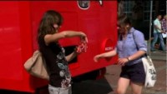
Coke Happiness Truck, Poland
Notes:
Coke Happiness Truck, Poland
https://www.youtube.com/watch?v=KhJP5dtC81g

Slide 46
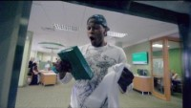
TD Bank – ATM (Automated Thank You Machine) #tdthanksyou
Notes:
TD Bank - Sometimes you just want to say Thank You
https://www.youtube.com/watch?v=bUkN7g_bEAI
#tdthanksyou

Slide 47
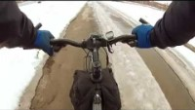
Kleenex – #sharekleenexcare
Notes:
Kleenex – Share Kleenex Care with Someone
https://www.youtube.com/watch?v=AaWzTf81aws

Slide 48
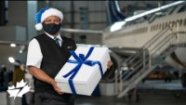
WestJet Christmas Commercial 2020 – Pandemic Response
Notes:
WestJet Christmas Commercial 2020 – Pandemic Response
Video: https://www.youtube.com/watch?v=jDucCdjUmBg

Slide 49

WestJet Real Time Christmas Giving, 2013 (You may need a Kleenex!)
Notes:
WestJet Real Time Christmas Giving 2013
https://www.youtube.com/watch?v=zIEIvi2MuEk

Slide 50
Brainstorm
Think about a local small business that is related to your SHSM sector; identify it on your student handout
In your student handout, list two to four “surprise and delight” strategies that the business could use.
  They can be inexpensive ideas or a larger in scale
  Use the internet to help you come up with some ideas!
(Discuss with other SHSM students or think about it on your own.)

Slide 51

OPTIONAL
Video: Popsicle Moments: Finding a New Flavour of Customer Service (15:03)
Notes:
Video: Popsicle Moments: Finding a New Flavour of Customer Service
https://www.youtube.com/watch?v=CfZrqej03As&t=738s
Darren Ross, TEDxSantaBarbara
(0:00 – 2:19) “Create a moment, earn a memory.”
Take an ordinary setting, create an elevated experience
Slow down the process and focus on the customer, creating a moment
(6:43) – Would I return, based on their service?
Customer Service versus “Nothing” Service
(10:25 – 15:03) Creating a “Customer Service Reflex”
Listen carefully to respond creatively
Companies slowing down for us, to take care of us

Slide 52
Typical Customer Scenarios
4
Module

Slide 53
It takes months to find a customer…and seconds to lose one.
Vince Lombardi,
American football coach and executive in the NFL.
Notes:
Vince Lombardi – American football coach and executive in the NFL

Slide 54
Watch the following three videos, keeping in mind the customer service skills and traits being demonstrated. (Or not being demonstrated!)

Slide 55
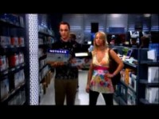
Big Bang Theory: Sheldon Shopping for Electronics
In what ways is Sheldon providing excellent customer service?
How does this clip demonstrate an issue with the customer service being provided by the store?
Notes:
Video: Sheldon Shopping for Electronics
https://www.youtube.com/watch?v=gORmiX-5PWU

Slide 56
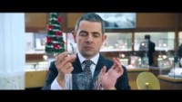
Love Actually – Gift Wrapping Scene
How is the employee providing excellent customer service?
How is the employee not providing excellent customer service?
Notes:
Video: Love Actually – Gift Wrapping Scene
https://www.youtube.com/watch?v=XUBeW_NFggM

Slide 57
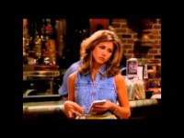
Friends – Rachel as a Server
In what ways does Rachel not provide excellent customer service?
Notes:
Friends – Rachel as a waitress
https://www.youtube.com/watch?v=b30evnsHJ_U

Slide 58
What would YOU do in the following situations when a customer…
…arrives ten minutes before closing time wanting to purchase several items.
What will you say or do?
…interrupts you while you are helping another customer.
What will you say or do?
…asks a question about a product that you do not know how to answer.
How will you respond?
Notes:
Instructor notes – students can work on these scenarios independently or in small groups. If working in small groups, encourage each group to present their scenario and customer service solution to the rest of the group.

Slide 59
What would YOU do in the following situations when a customer…
...asks your opinion about a product that you know has had some quality issues.
How will you balance being honest and trying to make a sale?
...is very upset about an unpleasant experience with someone you work with.
What will you say and do?
…calls your place of business with a question about the hours of business.
How will you answer the phone? Respond to the question?

Slide 60
Your most unhappy customers are your greatest source of learning.
Bill Gates,
Co-founder of Microsoft

Slide 61
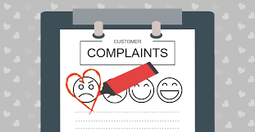
Helping Unhappy Customers
Assisting clients with complaints, issues and concerns is a part of every job, regardless of the industry
Helping an unhappy, angry, upset customer can be intimidating and challenging
Customer complaints can help companies figure out areas of improvement in their business
ACTION: Watch the video, “Dealing with Angry Customers,” to learn some pro tips!

Slide 62

Dealing with an Angry Customer
Notes:
Corporate Video – Dealing with an Angry Customer
Video: https://www.youtube.com/watch?v=T20hV4ynU7o&t=19s

Slide 63

Steps in Assisting an
Angry Customer
Stay Calm
Actively Listen
Repeat the Concerns
Actively Sympathize
Apologize
Find a Solution

Slide 64
Reflect, Connect, Demonstrate
Task: Create an upset customer scenario. It can be based on an experience you have had in a workplace. Try to connect the scenario to your SHSM sector.
Apply the six steps in dealing with the customer.
Can you also “surprise and delight” the customer?
Your scenario can be written as a script, acted out,
recorded or completed as a video.
Remember to share it with your teacher!

Slide 65
Customer Service in your SHSM Sector
5
Module

Slide 66
Customer Service is the new marketing, it’s what differentiates one business from another.
Jay Baer,
Entrepreneur,
consultant and author
Instead of focusing on the competition,
focus on the customer.
Scott Cook,
co-founder of Intuit

Slide 67
Minds On
Why are these two quotations important for a small business owner to keep in mind?
Add your explanation to your student handout.

Slide 68
Investigate and Describe
What are some common customer service issues related to your SHSM sector?
In your student handout, identify and describe two to four customer service issues.
Tips!
Brainstorm with other students in your SHSM
Think about your work-related experiences through co-op, SHSM experiential learning/reach ahead activities and part-time job to help you generate some ideas
Talk to a business owner in your SHSM sector (or more than one!)
Use online resources

Slide 69

Congratulations!
The Customer Service Certification is….
Remember to add your name to your student booklet and submit it to your teacher.

Slide 70
Print Resources
Carlaw, P., & Deming, V. K. (1999). The big book of customer service training games: Quick, fun activities for training customer service reps, salespeople, and anyone else who deals with customers. McGraw-Hill.
Evenson, R. (2011). Customer service training 101: Quick and easy techniques that get great results. American Management Association. Second Edition.
Kinni, T. B. (2011). Be our guest: Perfecting the art of customer service. Disney Editions.
Notes:
https://www.zendesk.com/blog/customer-support-vs-customer-service/
https://www.investopedia.com/terms/c/customer-service.asp
https://beldingtraining.com/customer-service-pillars/
Bad Customer Service – movie clips montage
- https://www.youtube.com/watch?v=9oywp2qRRyc
Love Your Customer - https://www.youtube.com/watch?v=ojOqUjbGsgQ
LAST method: https://www.youtube.com/watch?v=dnpMqQnt8WY

Slide 71
Credits
Special thanks to all the people who made and released these awesome resources for free:
Presentation template by SlidesCarnival

