Slide 1
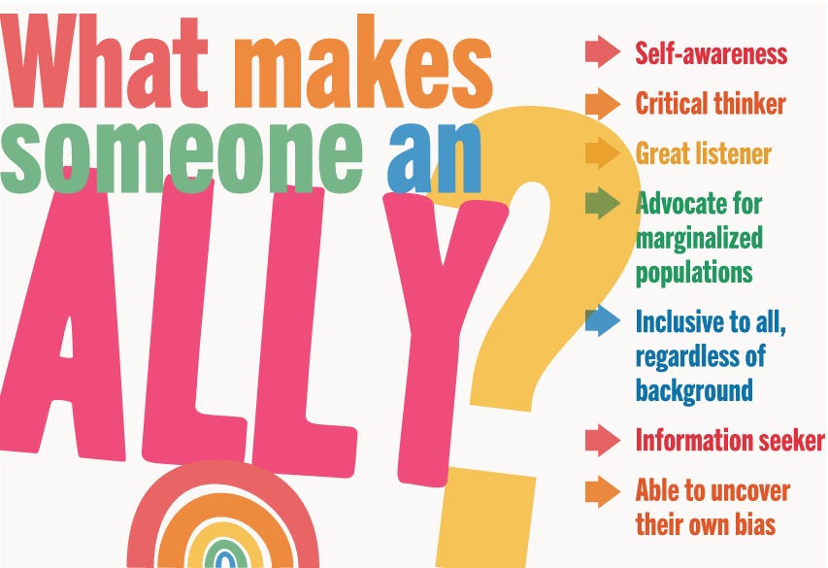
A Guide to Allyship
Informative training to understand what it means to be an Ally and who needs an Ally.

Slide 2
Background
Equality -> Equity -> Justice
Individuals and communities must be willing to move from thinking everyone requires the ‘same’ level of support (equality) to providing supports to overcome any barriers they encounter (equity) to have individuals and communities working to remove the barriers for those who are marginalized (justice).

Slide 3


Equality
Discuss
Why does a society need to have everyone measured to the same standard?
Comment
Review the following slide and determine which animal is going to pass the test with no intervention and which animal will require the most interventions? An example intervention might be to provide stairs.
Notes:
Does Fair mean Equal? Why would someone think that everyone in society needs to receive the same level of supports? Giving everyone the same level of support/input does not allow everyone to reach the same goal/output. On the next slide, what might the instructor do to show the strength of each creature.
We can think of LGBTQ+, Special Education, Poverty, Black Lives Matter, Indigenous People, People with Disability, and any groups that are brought forward in discussion that need our Allyship etc.

Slide 4
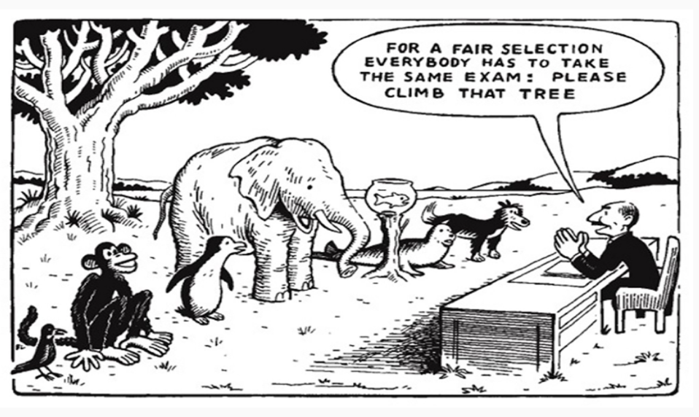
Equality

Slide 5
2. Equity
Discuss
In order to have an equitable society, every person or community must be provided the resources that will allow them to be successful. Equity refers to fairness and equality in outcomes, not just in supports and opportunity
Comment
Review the following slide and determine what resource was used to create the equity. Can you give other examples of resources from your community?
Notes:
Our federal and provincial taxes are done on a scale where those who make under a certain amount don’t need to pay tax. That is an example of equitable government policies. In schools, students with Special Needs receive varying degrees of supports depending on their individual special need(s). In education the supports provided will allow most students to graduate. The input/supports are different but the goal for everyone to graduate is the same.

Slide 6
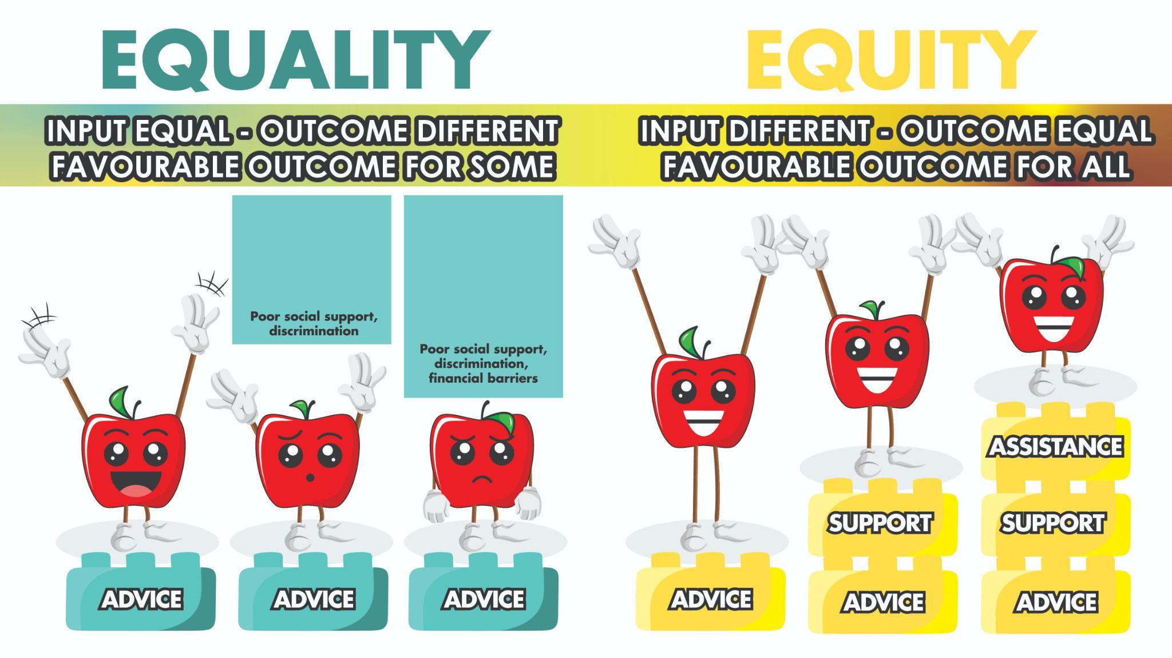
Equity

Slide 7
3. Justice
Discuss
In order to have a Just Society, every person or community must work at breaking down systematic barriers. What are examples of systematic barriers that lead to systemic racism?
Comment
Review the following slide and determine what was the barrier. Did a change to the barrier hurt or change anything with the outcome of the game? Can you give other examples of other barriers people from your community face?
Notes:
Organizational or systemic barriers are policies, procedures, or practices that unfairly discriminate and can prevent individuals from participating fully in a situation. Organizational or systemic barriers are often put into place unintentionally. Examples of systemic barriers can range from - those living in poverty not able to access all levels of healthcare to Indigenous people make up about 32 per cent of the federal prison population, despite accounting for less than five per cent of the total population. Indigenous women, meanwhile, account for 48 per cent of the population in women's prisons.

Slide 8
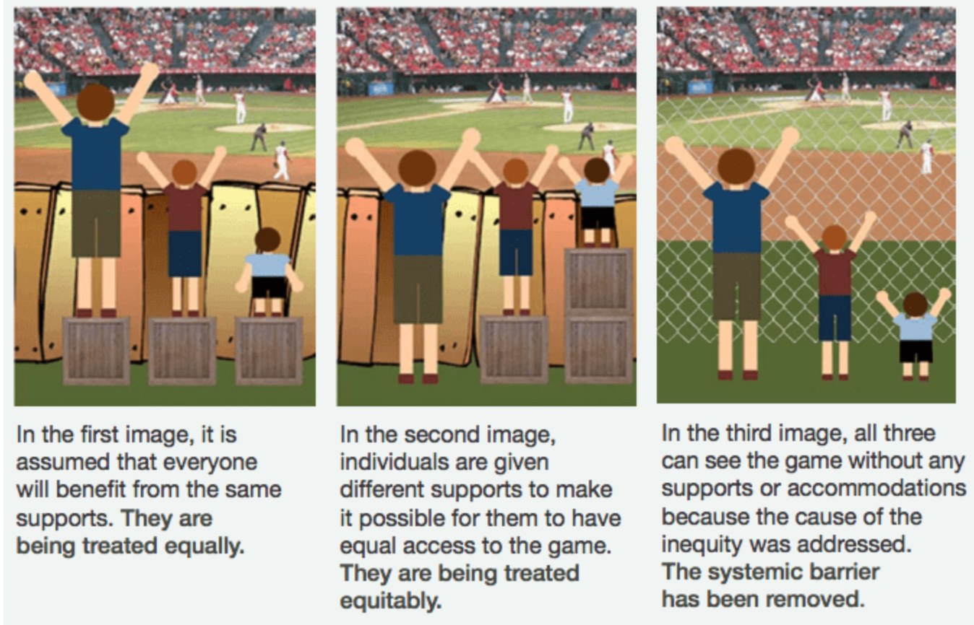
Just Society
Notes:
Please read and discuss the descriptions under each picture.

Slide 9
A Just Society - Why it matters?
Individuals and communities must be willing to move from thinking everyone requires the ‘same’ level of support (equality) to providing supports to overcome any barriers they encounter (equity) to have individuals and communities working to remove the barriers for those who are marginalized (justice).
For those who believe they are marginalized live every day in a system predicted on injustice, no explanation is needed. For others, a picture can hit home.
Notes:
This helps sum up the previous slide with the stark reality that so many in our country still live in an unjust environment. The next slide is the REALITY!

Slide 10
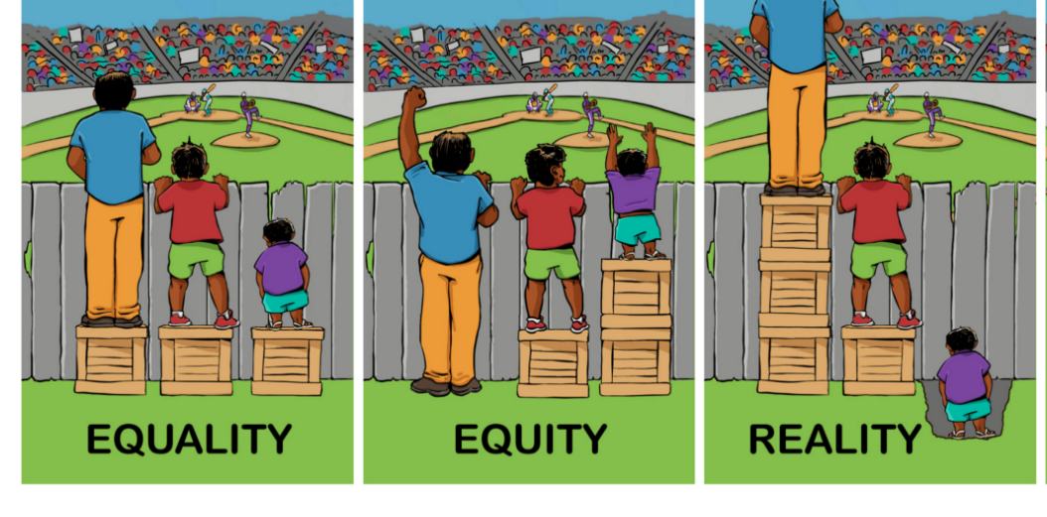
Notes:
Discuss the power of this slide. Allow the students to talk and discuss how this makes them feel.

Slide 11
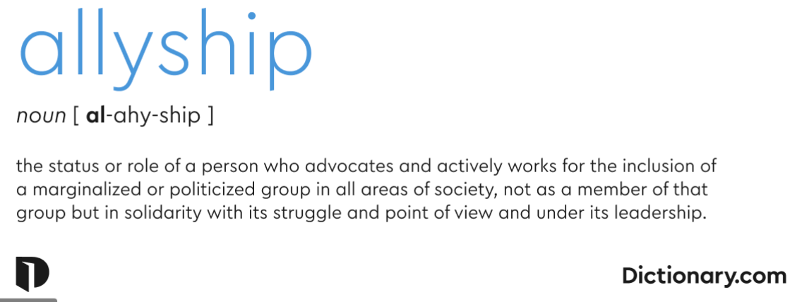
To create a just society -
become an ALLY

Slide 12
Who in society is considered marginalized?
marginalized
/ˈmärjənəˌlīzd/
adjective
(of a person, group, or concept) treated as insignificant or peripheral.
"members of marginalized cultural groups"
Discuss in small or large groups, who in your school or community do you believe is marginalized.
State why you believe or know who is marginalized.
Notes:
What makes a person or group marginalized? Is it race, gender, religion, etc. Who determines which race, gender, religion, etc determines is better than others? Every group should have a handout to record their answers. Sample of the handout is in next slide and the link to the handout is provided here ->

Slide 13
Who needs an Ally?
Who needs an Ally? eg. | Why we believe or know they are marginalized and need an Ally?
2SLGBTQ+
Indigenous
Why?
Notes:
Link to handout included to be distributed to students.

Slide 14
What can people do?
The essential elements of that description are:
Willingness to learn.
Trusted.
Authentic.
An ally is a trusted force for good.
To become an Ally

Slide 15
Steps to becoming an Ally:
Fairness, justice, equity, opportunity and human dignity — that’s the work of allies. It’s done for no personal glory or gain, although we all benefit when the work of allyship succeeds.

Slide 16
Indigenous communities need us all to be an Ally.
Allies also show the Indigenous Community that they are not alone in their struggle for a just society.
Allyship training can work with a marginalized person, group or community but we will work through the steps looking at promoting Allyship with Indigenous people.
Lets begin working through the Allyship steps.

Slide 17
Step 1: Take Charge of your Learning & Unlearning
Confront your own prejudices and biases, even if it is uncomfortable to do; this is the first step in seeing things from the perspective of others.
Be willing to have your ideas about the history of Canada’s Indigenous Peoples challenged – these are social constructs and are constantly evolving.
Determine if you must “Unlearn” or check on your Implicit Bias
In addition, it’s important to take time to learn more about Reconciliation.
A lot of the prejudice is biased in outdated ideals and ignorance about the history of Canada’s Indigenous Peoples.
Notes:
What does it mean to unlearn? Is every child raised in an inclusive thinking home? Well everyone has the responsibility to assess their own implicit bias to “unlearn” in order to have a Just Society. The term “implicit bias” : to describe when we have attitudes towards people or associate stereotypes with them without our conscious knowledge. Prejudice: preconceived opinion that is not based on reason or actual experience."prejudice against people from different backgrounds"

Slide 18
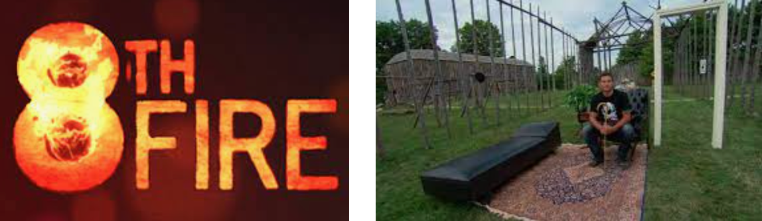
Step 1 Learning: Watch this video from CBC 8th Fire four-part Documentary. Wab Kinew, narrator and current Manitoba MLA, will bring you through 500 years of Indigenous History in Canada.
Link to Video: 8th Fire- Part 1
Notes:
This video clip is only a small part of a great four part series. Take the time to watch the entire series. Link to CBC 8th Fire Documentary four part series. https://www.cbc.ca/firsthand/blog/8th-fire-wabs-walk-through-history Look below video clip to see the four part video series links on the web page. It is a four part series Part 1: Indigenous in the City, Part 2: It’s Time, Part 3: Whose Land is it Anyway? and Part 4: At the Crossroads.

Slide 19
Step 2: TRUSTED
You can’t call yourself an ally. Others make that determination about you, one individual at a time.
To qualify, you must demonstrate trustworthiness.
Since we are defining our important terms, know that trust is confidence, in the face of risk, that another person will do the right thing.
Understandably, people who have historically faced injustice may have a higher threshold for extending trust.
Those who have experienced harassment, discrimination or incivility have every right to be cautious and skeptical.
Those who have harmed them (or still do) may be people they dared to trust. What makes you the person who will do the right thing?
Notes:
This is the background required to be an ally. Think about each point for your own learning and your growth as an Ally to be Authentic.

Slide 20
Step 2 Learning:
The word “ally” is being thrown around a lot these days . . . mostly in labels that people apply to themselves, tied to a hashtag or an inspirational quote. It does not mean nothing, but it also does not hold the power it should. We are calling ourselves allies without going beyond words of solidarity.
Don’t be mistaken: Solidarity is better than silence, but on its own, it isn’t action that affects change. It won’t help win the war against systemic racism. To get there, we must truly align with this cause. We must believe this fight is ours and we must act with a commitment equivalent to that belief in order to be authentic and trusted.
Stop and discuss:
What does being trustworthy mean to you?
What actions make us trustworthy?
What does being authentic mean?
Notes:
Solidarity means: unity or agreement of feeling or action, especially among individuals with a common interest; mutual support within a group.
"factory workers voiced solidarity with the striking students"

Slide 21
Step 3: Be Authentic so do not rush your Allyship Learning
Just as society will not change overnight, neither will you. Here are some important do’s and don’ts to consider as you learn, grow, and step into the role of an ally.
THE DOS
• Do be open to listening
• Do be aware of your implicit biases
• Do your research to learn more about the history of the struggle in which you are
participating
• Do the outer work and figure out how to change the oppressive systems
• Do use your privilege to amplify (digitally and in-person) historically suppressed voices
• Do the work every day to learn how to be a better ally
Notes:
A common example of implicit bias is favouring or being more receptive to familiar-sounding names than those from other cultural groups. Implicit bias doesn't mean that inclusivity is not one of our values. It means that we are not aware of how our own implicit bias can impact our actions and decisions.

Slide 22
Step 3 Allyship Learning:
THE DON’TS
• Do not expect to be taught or shown. Take it upon yourself to use the tools around you
to learn and answer your questions
• Do not compare how your struggle is “just as bad as” a marginalized person
• Do not behave as though you know best
• Do not take credit for the labour of those who are marginalized and did the work
before you stepped into the picture
• Do not assume that every member of a marginalized community feels oppressed
Stop and discuss:
Which of the “don’ts” gave you an “aha” moment about yourself?

Slide 23
What is something we can do now in learning to be an Ally?
The following are some suggested ideas/projects/work that can be done within our schools, communities, province, country.
These are only suggestions and/or examples. You may know of an existing group or individual doing great Allyship work, ask if you can join with them.
If you know of where some Allyship work is required, ask those in leadership positions (Teacher, School Board Indigenous Lead or Team Member, Principal, Mayor etc) to guide you in getting started on your Allyship journey.
Read through the following ideas to see where you might begin to be an Ally.

Slide 24
SHSM related Allyship
The following are project suggestions related to SHSM sectors to further Allyship with Indigenous communities and people.

Slide 25
SHSM Sectors in Ontario
Agriculture
Arts and Culture
Aviation/Aerospace
Business
Construction
Energy
Environment
Food Processing
Forestry
Health & Wellness
Horticulture & Landscape
Hospitality & Tourism
Information & Communications Technology
Justice, Community Safety & Emergency Services
Manufacturing
Mining
Non Profit
Sports
Transportation

Slide 26
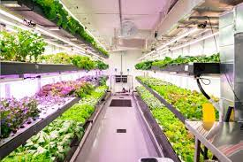
Agriculture
Many Indigenous communities are far north and live in isolated areas.
Research the company “GROWCER” Modular Food Solutions, Green Iglu - Strengthening food sovereignty in remote Indigenous communities.
Create an agricultural plan/idea for sustainable agriculture in your area.
Sector Project Ideas

Slide 27
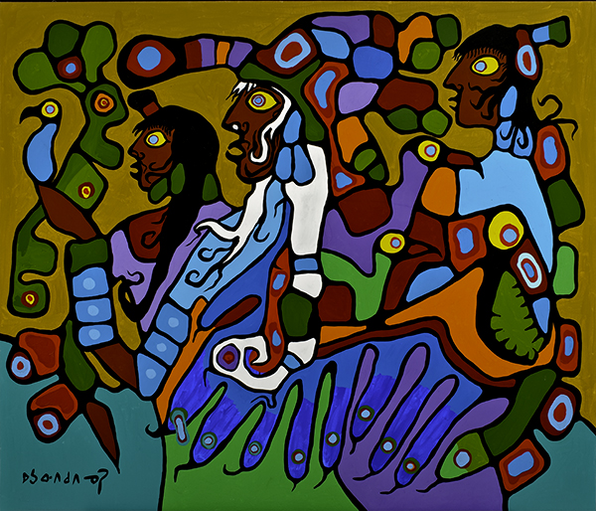
Arts & Culture
Arts and culture is an important expression of Indigenous culture. Research Indigenous arts and culture, create a video presentation showcasing four of your favorite Indigenous artists or cultural events and why you like them the most.
Sector Project Ideas

Slide 28
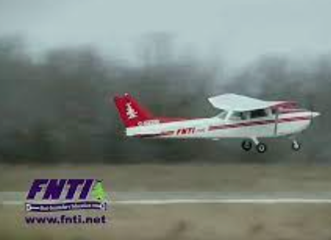
Aviation/Aerospace
First Nation Technical Institute (FNTI) in partnership with Canadore College has an Aviation Program operating on the Tyendinaga Territory near Belleville, Ontario.
Visit the FNTI website https://fnti.net/aviation-program and media reports on the program and create a news report/podcast on this exciting program geared towards potential Indigenous High School students.
Sector Project Ideas

Slide 29

Business SHSM
Fashion is an important expression of Indigenous culture. Research Indigenous fashion industry and create a Google slide presentation showcasing four of your favorite Indigenous fashion designers/companies and why you like them the most.
or
Design a logo, name of a company and an online brochure for an Indigenous business.
Sector Project Ideas

Slide 30
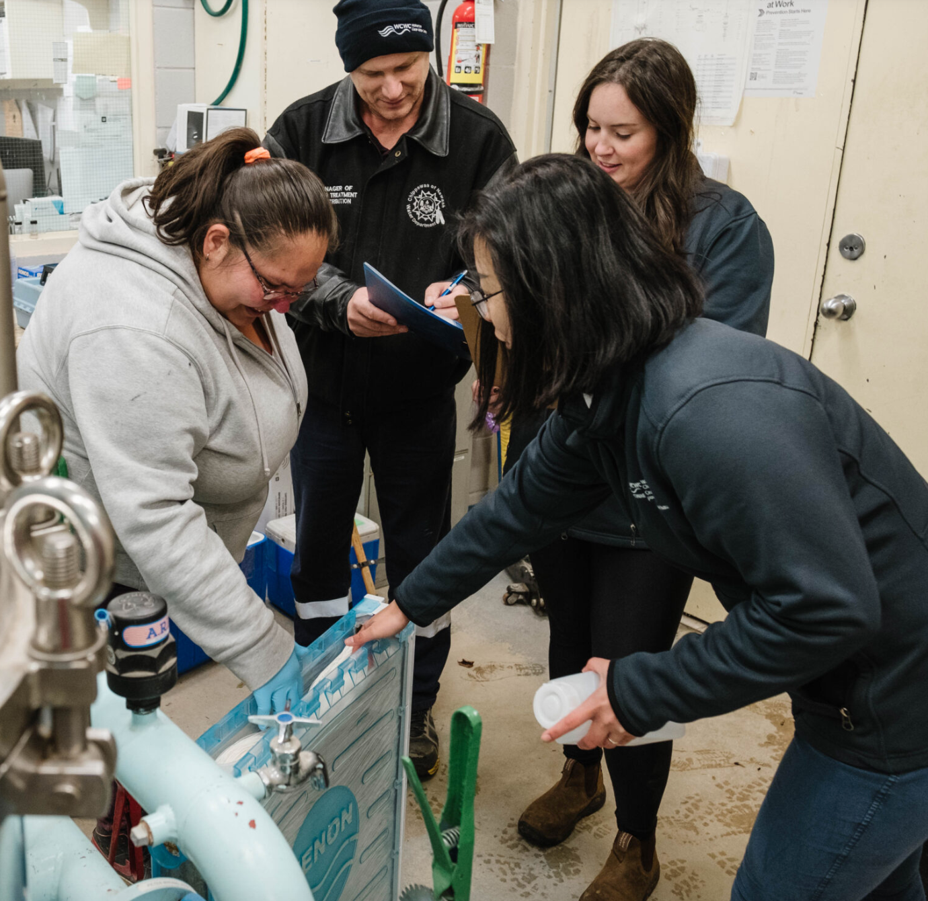
Construction
A single drinking water advisory can mean as many at 5,000 people lack access to safe, clean drinking water. 73 per cent of First Nations' water systems are at high or medium risk of contamination.
Review the following link discussing the four main types of water filtration from the Canadian Water Quality Association.https://www.cwqa.com/page/TypesofTreatment
Project A: Send a letter to the Minister of Indigenous Services Canada (ISC) and tell him it’s time to end drinking water advisories in First Nations.
Project B: Build a model of an Indigenous Filtration Station
Project C: Research Douglas Cardinal - Indigenous Architect
https://www.mcgilldaily.com/2019/09/indigenous-architecture-with-douglas-cardinal/
Sector Project Ideas

Slide 31
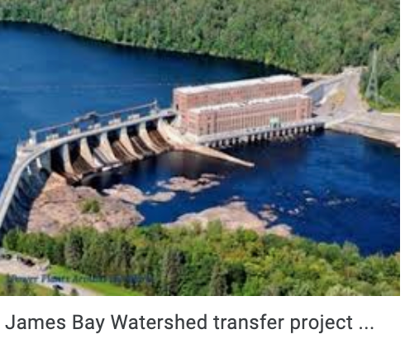
Energy
The James Bay Cree hydroelectric conflict refers to the resistance by James Bay Cree to the James Bay Hydroelectric Project and the Quebec Government, beginning in 1971.
The fall out from this environmentally harming energy project led to Quebec Cree First Nation signing a significant self-government agreement with the government.
Research the percentage of power in Ontario that is generated by Hydroelectricity. What water way have been altered due to the dams. Are these dams close to Ontario Indigenous Reserve lands? Create a slide presentation on your findings.
Sector Project Ideas

Slide 32
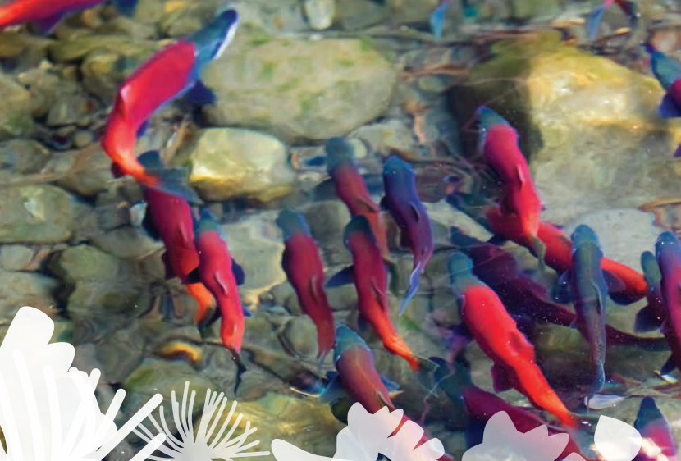
Environment
Environment through Indigenous lens:
In this unique combination of Environmental, Indigenous and Outdoor Education students will explore a variety of environmental issues through hands-on learning. Connect one or more of the United Nations Sustainable Development Goals (Link to the 17 goals: video: https://sdgs.un.org/goals
Document: http://www.nccah-ccnsa.ca/docs/determinants/RPT-UN-SDG-IndPeoplesCanada-Halseth-Odulaja-EN.pdf) to environmental sustainability, considering Indigenous knowledge, and with an emphasis on outdoor education. This program focuses on fostering leadership and developing teamwork skills, all while promoting safety and risk management strategies through learning outdoor skills, environmental awareness and stewardship for the local/ global community and greenspace.
Environment Challenge:
Choose a goal from the United Nations Sustainable Development Guide and create a project that would inspire your community to work towards the end goal. Examples: climate change, natural resource depletion, air and water pollution, and waste management.
Create a 2 minute Podcast or film explaining the project and how you would implement the community project.
Sector Project Ideas

Slide 33

Food Processing
Tea Horse, established in 2017 by Denise Atkinson, Anishinaabe ikwe (English: Ojibwe woman) and her partner Marc H. Bohémier, is an Indigenous-owned artisanal tea company located on the traditional territory of the Anishinaabeg Peoples in Northwestern Ontario.
With its proprietary roasting process, Tea Horse has created and produces an industry-first selection of custom roasted wild rice (Ojibwe: manoomin) and tea blends.
Project - review some of the teas produced by Tea Horse. Determine if you are able to roast wild rice and add tea ingredients that you like. Make a cup of tea and enjoy!
Sector Project Ideas

Slide 34
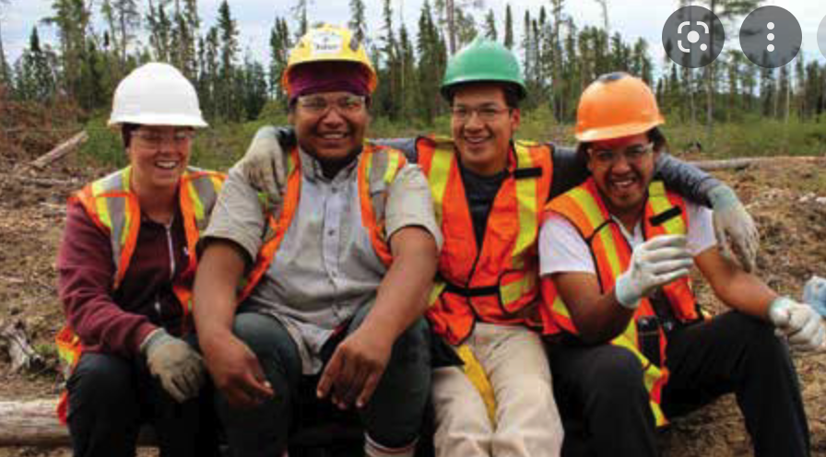
Forestry
Sustainable Forestry Initiative SFI Community Grants are awarded for collaborative community-based projects, activities or events that support SFI’s efforts to connect communities to forests. Projects supported have included providing educators with tools to showcase green career pathways with students, incorporating Indigenous knowledge into forest management planning and education curriculum, and building youth engagement in outdoor education and conservation project.
Choose one project:
Create a Google Slide presentation describing trees in your area, a community project that you are interested in starting https://forests.org/communitygrants/ or a Fuels planning managing forest structure to reduce fire hazard. https://www.fs.fed.us/rm/pubs_other/rmrs_2003_peterson_d001.pdf
Sector Project Ideas

Slide 35
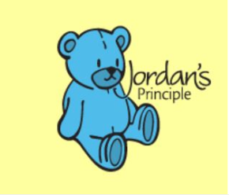
Health & Wellness
Jordan's Principle is a child-first and needs-based principle used in public policy and administration in Canada to ensure that First Nations children living on and off reserve have equitable access to all government funded public services. The Caring Society website outlines the Jordan’s fight for equitable medical care.
https://fncaringsociety.com/jordans-principle
Project: The Caring Society website list 7 ways to help with Jordan’s Principle. Create a podcast on the Jordanś Principle and examples.
Watch the NFB Documentary that outlines Jordan’s family struggle to get required medical care for their son.https://www.nfb.ca/film/jordan-river-anderson-the-messenger/
Sector Project Ideas

Slide 36
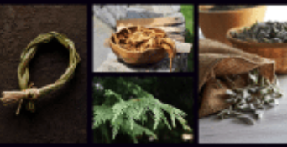
Horticulture & Landscape
Sage, cedar and sweetgrass, and tobacco, and together are referred to as the four sacred medicines. The four sacred medicines are used in everyday life and in ceremonies. All of them can be used to smudge with, though sage, cedar and sweetgrass also have many other uses.
The following link explains the rituals with the four sacred plants. https://downiewenjack.ca/four-sacred-medicines/
These sacred medicines must be cared for by keeping them in a dry place. They can be stored in paper bags or wooden boxes.
Research what is all involved in preparing for a smudging ceremony. Create a video or slide presentation.
Sector Project Ideas

Slide 37
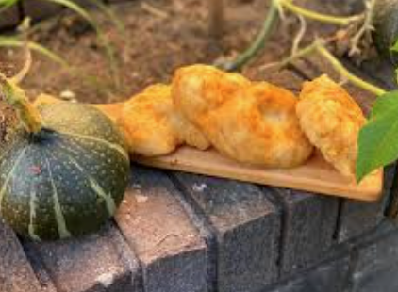
Hospitality & Tourism
Food is an important expression of Indigenous culture. Research Indigenous cuisine and create a Google slide presentation showcasing four of your favorite Indigenous chefs and why you like them the most.
Choose an Indigenous recipe and try your hand at cooking the recipe. Take a photo for an Indigenous Food Magazine. Maybe your photo could be on the cover!
Sector Project Ideas

Slide 38

Information & Communications Technology ICT
Internet service for remote regions in Ontario, especially fly in Indigenous Reserves, have had a difficult time receive reliable internet. SpaceX has developed a low latency, broadband internet system to meet the needs of consumers across the globe. This latest internet service advancement might be exactly what Ontario’s remote communities require.
Research the Starlink service map at starlink.com and confirm that all northern remote communities have access to this service. Create a social media post asking Crown-Indigenous Relations and Northern Affairs Canada (CIRNAC) to provide Starlink for all Indigenous Communities who currently can’t access reliable high speed internet.
Sector Project Ideas

Slide 39
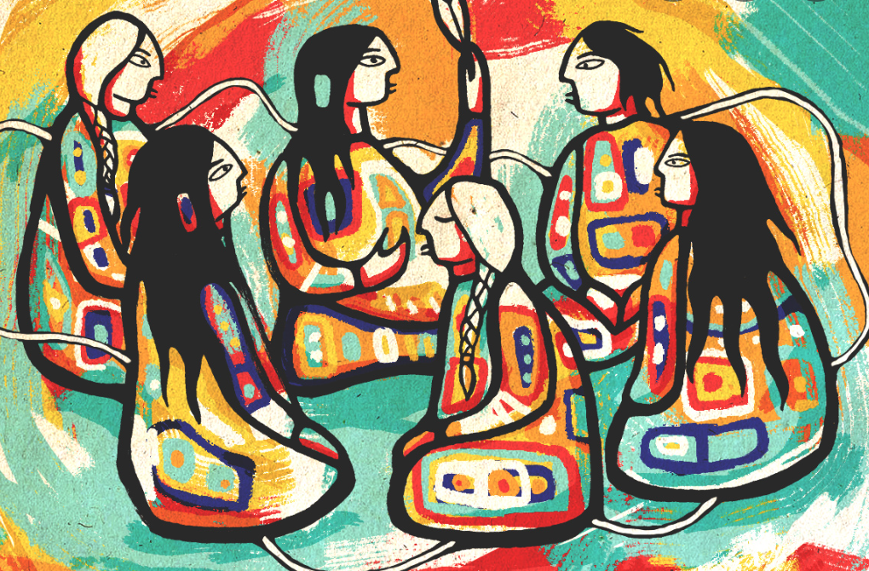
Justice, Community Safety & Emergency Services
Justice and Community
Talking Together is a circular process. ‘A Circle’ is a basic Aboriginal symbol. It is also a symbol of Indigenous Justice. In a Circle, there is no right or left, nor is there a beginning or an end. Every point (person) seated in a circle looks to the same center as the focus. The Circle is the symbol of justice because it is perfect, unbroken, and a simile of unity and oneness. It conveys the image of people gathering together for discussion.
Research a case that used the justice circle and create a podcast discussing the Indigenous justice circle process. Make sure you have an intro and outro, three minutes in length.
Sector Project Ideas

Slide 40

Manufacturing
Makwa Development Corporation and The Cahill Group have joined forces to create Makwa-Cahill LP, a fully qualified indigenous fabrication company. Focusing on industry fabrication and other strategic work scope opportunities in the energy sector, with Bruce Power being the largest customer.
Makwa- Cahill will employ approximately 150 people including millwrights, welders, metal shop workers, pipe-fitters and other tradespeople as well as project managers and administration staff.
Why is it important for Indigenous companies to hire Indigenous tradespeople. Research what Makwa-Cahill offers for training, work environment and current job opportunities. Create a slide or video presentation on your findings.
Sector Project Ideas

Slide 41
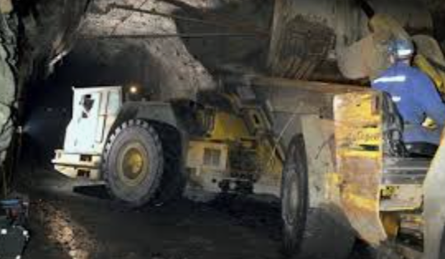
Mining
Research how many mining companies are conducting their operations on Indigenous reserve lands in Ontario.
Pick one company and create a report on what the mining company is doing to work in solidarity with the Band in areas of employment, supports, contracts, community supports, education, etc.
Sector Project Ideas

Slide 42
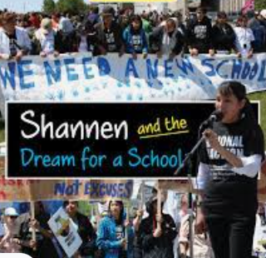
Non-Profit
Shannen Koostachin of Attawapiskat First Nation, Ontario, is listed as one of the country's top 150 Canadians. Before her death in 2010, the namesake behind Shannen's Dream, fought for better, safer education for aboriginal students on reserves.
Research Shannon’s Dream and create a flyer/magazine article outlining what this Non-Profit fundraising organization is doing now to improve education for Indigenous students on reserves.
Sector Project Ideas

Slide 43
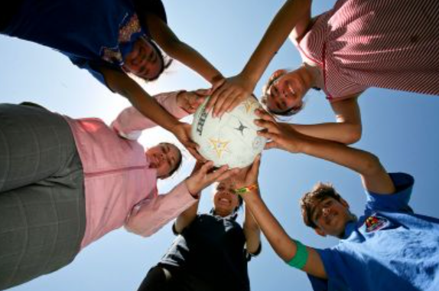
Sports
In the Truth and Reconciliation Report (2015), sport and recreation are identified as tools for social development to improve the health and wellbeing of Indigenous individuals and communities. Sport can save lives and build healthier Aboriginal people, who contribute to healthier communities. A by-product of that is more Aboriginal athletes pursuing sport excellence and standing on top of the podium. This resource seeks to provide guidance for that sport journey – from the playground to the podium – and everywhere in between.
Create a social media post to promote five Indigenous sport programs in Ontario that are encouraging involvement and athletic development.
Sector Project Ideas

Slide 44
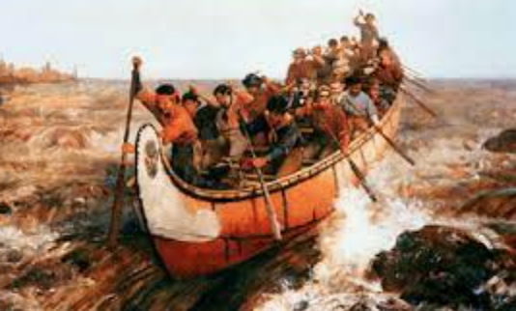
Transportation
Inuit and Subarctic Indigenous peoples have traversed the North since time immemorial. Indigenous knowledge and modes of transportation helped early European explorers and traders travel and survive on these expanses. Later settlements depended to an extraordinary degree on the development of transportation systems. Today, the transportation connections of northern communities vary from place to place. While the most remote settlements are often only accessible by air, some have road, rail and marine connections. These are often tied to industrial projects such as mines. https://www.thecanadianencyclopedia.ca/en/article/transportation-in-the-north
Project - Compare the modes of transportation used by Canada’s Indigenous people throughout history on water, land and air. Complete a digital presentation on your findings.
Sector Project Ideas

