Slide 1
Hot Tools
Soldering Iron
Clothes Iron
Hot Glue

Slide 2
Indroduction
“Hot tools” refer to tools that have some kind of heating element and operate at a very high temperature and as a result can present a serious health and safety risk. The Computer Engineering courses use the following hot tools:
SOLDERING IRONS
CLOTHES IRONS
HOT GLUE GUNS

Slide 3
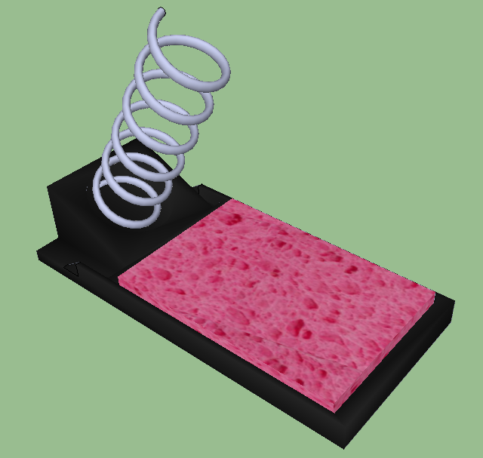
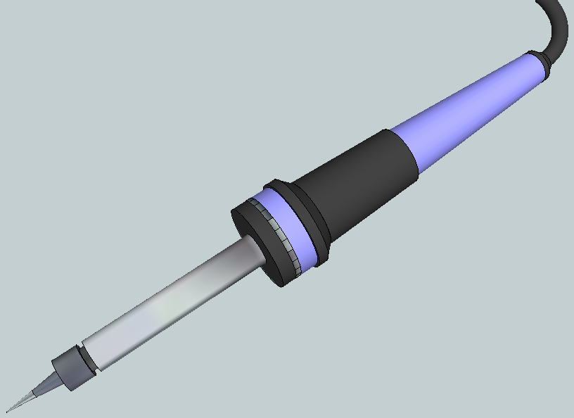
Soldering irons
A soldering iron is used to melt solder (tin and other alloys) so that two or more pieces of metals can be bonded together. The iron is very hot well exceeding temperatures of 200°C. If the skin touches the tip of the iron a second degree burn will result.
When the iron is not being used it should be placed in the stand. The tip is placed inside the coil. The stand is never near the edge of the table where you are soldering.
Never touch the tip of the iron, even when it is not plugged in. Always assume it is hot.

Slide 4
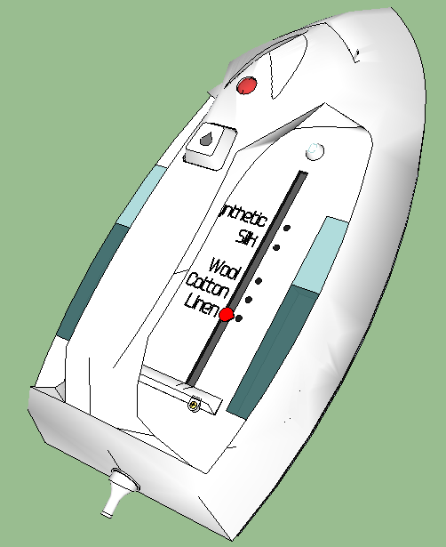
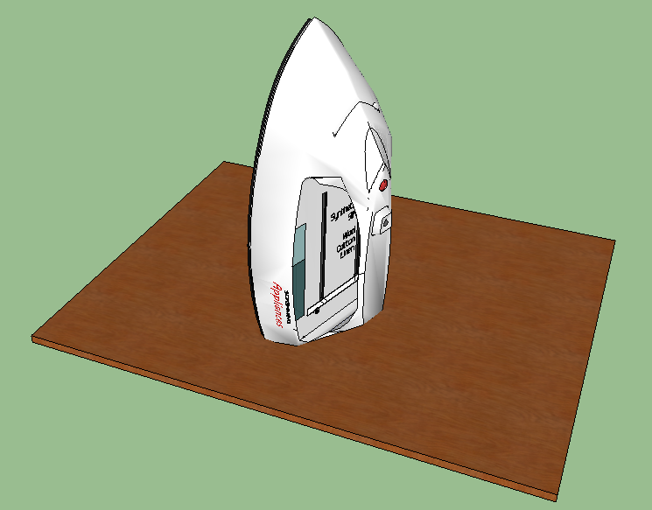
Clothes irons
The clothes iron will be used to melt the toner from the transfer onto the copper printed circuit board. It is on the highest setting which is over 200°C. A second degree burn can be received if the iron touches the skin.
When not in use have it standing up with the hot face plate facing away from you and your classmates.
Work with the iron on a wooden board so that the heat does not transfer and ruin the desktop.
Never touch the sole plate of the clothes iron, even when it is not plugged in. Always assume it is hot.
SOLE PLATE

Slide 5

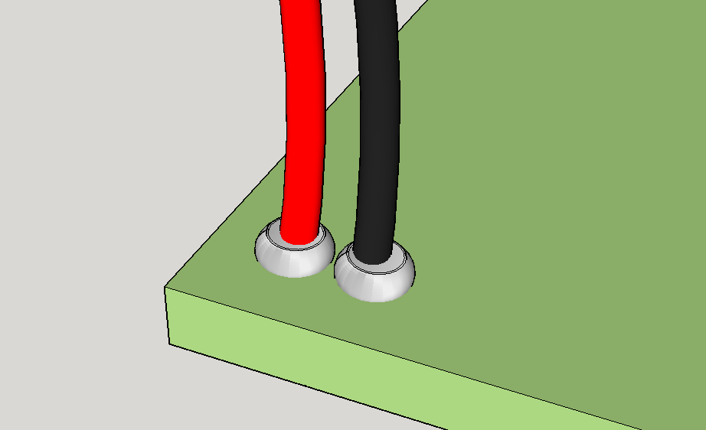
Hot glue gun
The hot glue gun is used to attach insulated stranded wire to the printed circuit board on the component side after it has been soldered on the solder side. By doing so it forces the wire to bend through the insulation rather the bare wire and prevents the wire from breaking. Hot glue gun come in two temperatures. HOT temp, which operates around 190°C and LOW temp, which operates around 120°C. A second degree burn can be received if the hot glue gets on the skin.
Generally the hot glue has legs in front of the trigger. Make sure the gun is standing on the legs when it is not being used. Also, a wooden board should be underneath to catch the dripping hot glue.

Slide 6
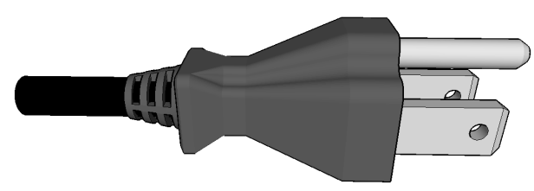
cords
Make sure that the cord is in good repair and bare wires are not exposed. If they are, inform the instructor so that the hot tool can be replaced.
When using the hot tool make sure the cord is tucked away so no one can trip or catch on the cord. If that was to happen the hot tool could be ripped out our your hand or its storage place creating an opportunity to burn you or a classmate.
Make sure the cord does not lie over the hot part of the tool. This may cause the insulation on the cord to melt, whereby the wires will be able to touch causing a short or a chance that o you or your classmates receive an electrical shock

Slide 7
Burns
There are three types of burns:
First-degree burns cause minimal skin damage. They are also called “superficial burns” because they affect the outermost layer of skin. Signs of a first-degree burn include:
  Redness
  minor inflammation (swelling)
  Pain
  dry, peeling skin (occurs as the burn heals)
To treat this type, you can:
  soak the wound in cool water for five minutes or longer
  take acetaminophen or ibuprofen for pain relief
  apply aloe vera gel or cream to soothe the skin
  use an antibiotic ointment and loose gauze to protect the affected area

Slide 8
Burns cont’d
Second-degree burns are more serious because the damage extends beyond the top layer of skin. This type of extensive damage causes the skin to blister and become extremely red and sore. Some blisters pop open, giving the burn a wet appearance.
A mild second-degree burn can generally be treat by:
  running the skin under cool water for 15 minutes or longer
  taking over-the-counter pain medication (acetaminophen or ibuprofen)
  applying antibiotic cream to blisters

Slide 9
Burns cont’d
Third-degree burns are the worst burns. They cause the most damage, extending through every layer of skin. The damage can even reach the bloodstream, major organs, and bones, which can lead to death.
There is a misconception that third-degree means most painful. With this type of burn, the damage is so extensive that you may not feel pain because your nerves are damaged. Depending on the cause, third-degree burns cause the skin to look:
  waxy and white
  charred
  dark brown
  raised and leathery
Never attempt to self-treat a third-degree burn. Call 911 immediately.

Slide 10
Burns cont’d
When applying first aid to first and second degree burns make sure you don’t use ice, as this may make the damage worse. Never apply cotton balls to a burn because the small fibers can stick to the injury and increase the risk of infection. Also, avoid home remedies like butter and eggs as these are not proven to be effective.
More information can be found at:
http://www.mayoclinic.org/first-aid/first-aid-burns/basics/art-20056649
http://www.healthline.com/health/burns#BurnLevels2
☹ Last Slide ☹

Slide 11
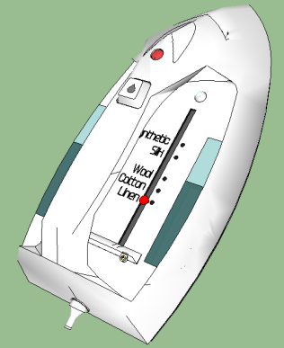
Images
Clothes Iron
https://3dwarehouse.sketchup.com/model.html?id=3f69197dcf89a8eb4310636931b68fdb
Soldering Iron
https://3dwarehouse.sketchup.com/model.html?id=9a142d0f5c672f13705ec0fd0da50d03
Soldering Iron Stand and Sponge
https://3dwarehouse.sketchup.com/model.html?id=9c1c528c01f25f66ee5859c3d1ce7d6c
Hot Glue Gun
http://cliparts.co/clipart/151858
Stranded wires on PC Board
SketchUp File
Plug
https://3dwarehouse.sketchup.com/model.html?id=e7ecf5f32dc61625c3280eb061472969

