Slide 1
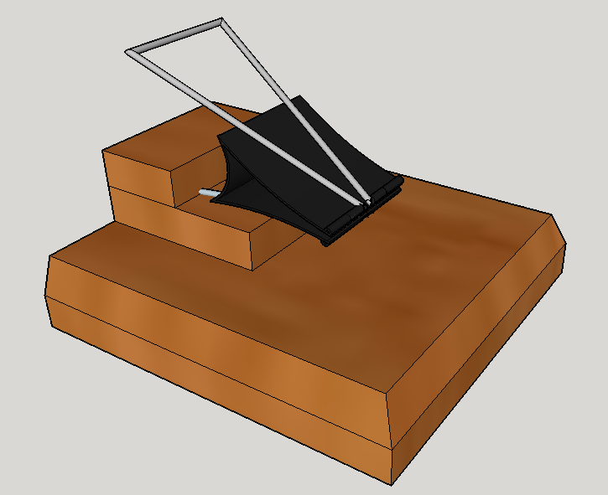
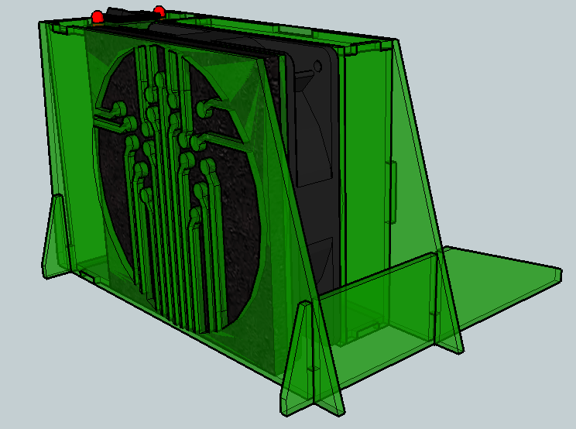
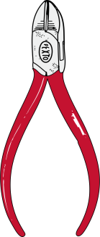
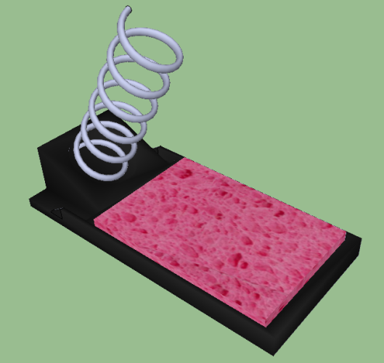
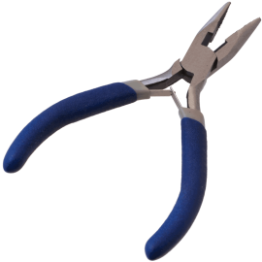
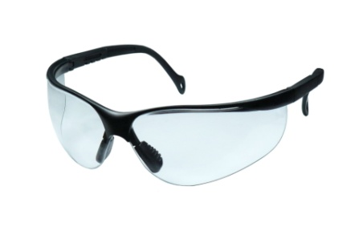
Soldering

Slide 2
LEARNING OUTCOMES
I WILL BE ABLE TO:
IDENTIFY THE DIFFERENT TYPES OF SOLDERING TOOLS AND WHEN AND HOW TO USE THEM.
BE AWARE OF THE DIFFEREN T TYPES OF SOLDER AND THEIR CHARACTERISTICS.
FOLLOW ALL THE SAFETY PROTOCALS FOR SOLDERING.
MAKE A PROPER SOLDER CONNECTION THAT WILL RESULT IN A WORKING CIRCUIT .

Slide 3
WHY SOLDER
GOOD PHYSICAL CONNECTION – a soldered connection between a component and the PCB or between a wire and a terminal is very strong. Usually another part will break before it will. Also, it will never come apart under heavy vibration.
GOOD ELECTRICAL CONNECTION – a soldered connection provides an excellent pathway for electrons to flow through. Solder has resistance similar to that of components and wires it is bonding together.

Slide 4
TERMINOLOGY
  DELAMINATING – is the separation of the copper foil (that makes up the pathways and pads) from the fiberglass board. This is a result of prolonged heating of the PCB. The maximum time the iron should be in contact with the board is 2 seconds.
FLUX – is a material that is used to remove oxides on the copper during the soldering process. The two types of flux are acid and rosin. Acid is never used for electronics as it is very corrosive and conductive. Rosin is only corrosive while at the temperature of melting solder.
HEAT SINK – is used to help draw away heat from sensitive components (like semiconductors) that be damaged when exposed to excessive heat. During the soldering process a heat skink (like an alligator clip) may be used to protect the component.
TINNING – is the process of applying a thin layer of solder.
①Soldering irons must be constantly tinned to protect the tip of the iron from oxidization.
②Stranded wires are tinned to stop them from fraying and make it easier to solder to other components.

Slide 5
TERMINOLOGY CONT’D…
TIP TEMPERATUE – refers to what the temperature is at the end of the soldering iron. Effective soldering requires the tip to reach a required temperature.
WETTING – is the action of solder dissolving and penetrating the copper surface. This intermetalic bond forms a new alloy. This happens when both the solder and copper are hot. Also, the copper must be free of contaminates and oxides for the bonding to occur.
WICKING – refers to when solder, in its liquid state, is drawn or absorbed into stranded wires by capillary action. Braided wire or solder wick is used to remove solder from a joint when a component is being removed.

Slide 6
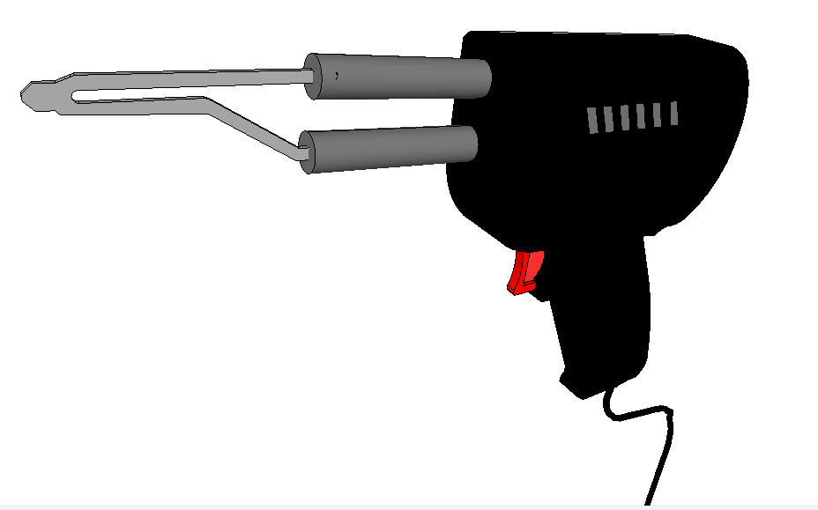
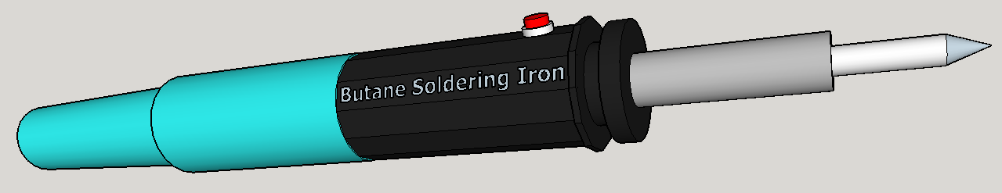
TYPES OF SOLDER
HEATING ELEMENTS
SOLDERING GUN
Not used because :
generates too much heat
too large of a tip
requires pulling the trigger to reheat the tip
BUTAIN TORCH
Advantages :
portable – can operate where there is no electricity
Disadvantages:
more expensive to purchase than a soldering iron
more expensive to operate

Slide 7
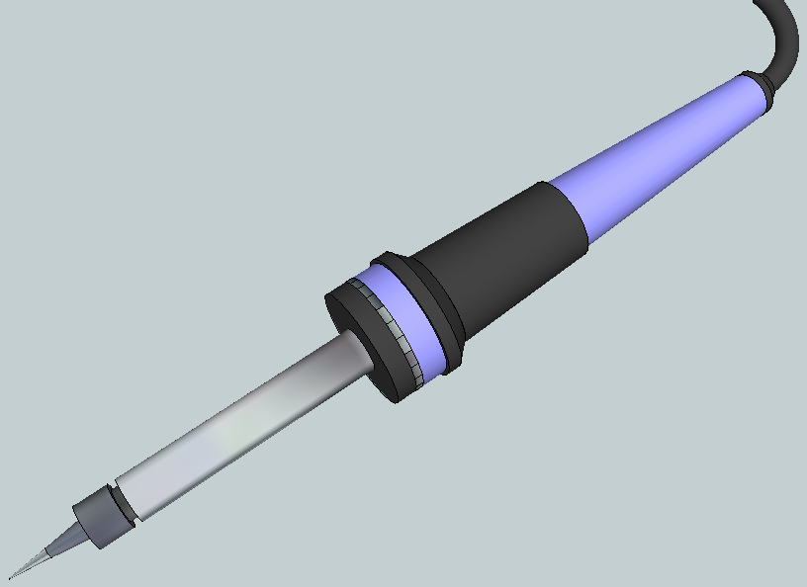
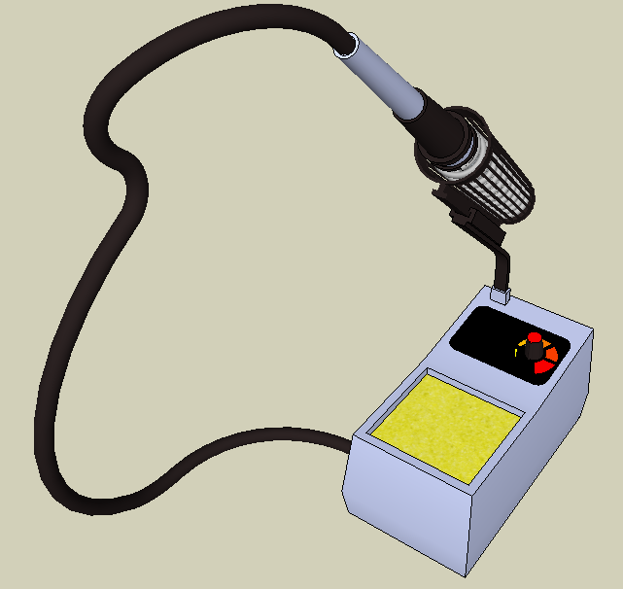
HEATING ELEMENTS CONT’D…
SOLDERING IRON
(a.k.a. soldering pencil)
Advantages:
inexpensive to purchase
Disadvantages:
only one set temperature
SOLDERING STATION
Advantages :
can adjust tip temperature to suit the type of solder used.
Disadvantages:
expensive to purchase
bulky

Slide 8
WHAT is RoSH
RoSH stands for Restriction of Hazardous Substances a directive from the European Union (EU) on the restriction of certain hazardous substances in electrical and electronic equipment and was adopted in February 2003. It is to help address the problem of huge amounts of toxic e-waste that is being generated as we discard our obsolete electronics for newer technology. The directive requires, among other things, the use of lead free solder.

Slide 9
TYPES of SOLDER
Solder is made up of tin and some other elements to make an alloy that will bond components to the pad on the PCB. Solder with lead should be avoided for environmental reasons.
Solder Type | Sn/Cu | Sn/Ag/Cu | Sn/Pb
Makeup % | 99.3/0.7 | 96.5/3/.0.5 | 60/40
Suggested Tip Temperature | 315-350°C | 315-350°C | 200-260°C
Melting Temperature | 227°C (441°F) | 227°C (441°F) | 183°C (361°F)
Tip Temp. not to exceed | 350°C | 350°C | 260°C
WE WILLUSE THIS
SOLDER

Slide 10
TOOLS REQUIRED
Common soldering irons are rated between 25-30 watts. The iron is there to provide heat to the pad and lead. It does not apply solder to the joint. When not is use make sure solder is applied to the tip to protect it. Before every use check the cord for damage. If there is, inform the instructor right away. Also, place the cord so that it can’t get caught and pulled on. Warning: the tip of the iron is greater than 200°C. Never touch the end of the iron even when unplugged.
SOLDERING IRON

Slide 11
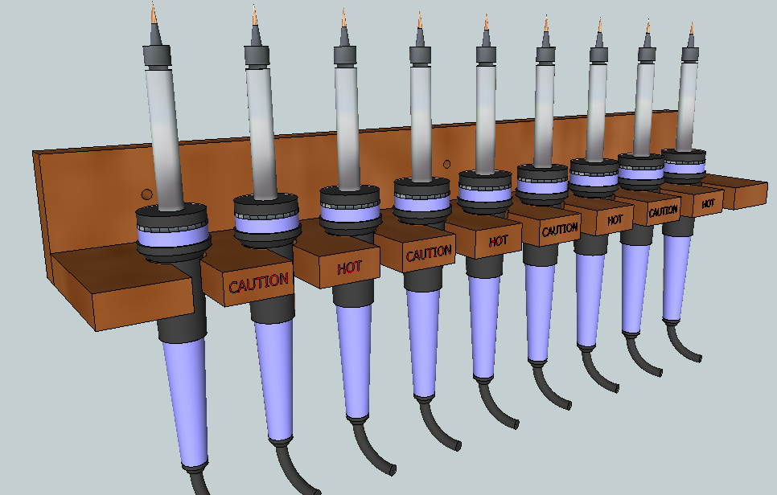
TOOLS REQUIRED CONT’D…
It is important to have a place to store an iron when it is hot. Our classroom has a rack that can safely store the irons. Always treat the iron as if it were hot.
SOLDERING IRON RACK

Slide 12
TOOLS REQUIRED CONT’D…
When the new solder is being heated by the iron the flux creates some smoke that should not be inhaled. The fume extractor, which is made up of a fan and a carbon filter draws and captures the smoke when placed close to where you are soldering.
FUME EXTRACTOR

Slide 13

TOOLS REQUIRED CONT’D…
While soldering there needs to be a place for the hot iron so that you and others are protected while. The tip is inserted into the coil while not in use. Dampen the sponge with water. Use it to clean the tip every time before soldering your next lead.
STAND AND SPONGE

Slide 14
TOOLS REQUIRED CONT’D…
Molten solder at the end of a wire or lead can be easily flicked off and travel some distance. At over 200°C it can permanently damage your eyes. You must always wear safety glasses while soldering.
SAFETY GLASSES

Slide 15
TOOLS REQUIRED CONT’D…
Most printed circuit boards (PCB) are small and very light. Also, as the components are being added to the PCB cannot lie flat. Therefore the PCB will rock back and forth plus move around making it very difficult to solder. The stand will hold the PCB in place increasing the chances of a better solder joint.
PC Board Stand

Slide 16
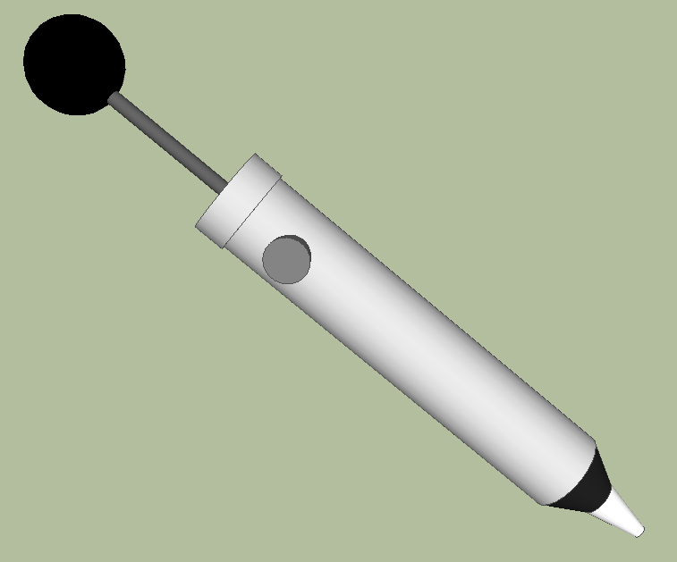

TOOLS REQUIRED CONT’D…
If a component has to be removed from the PCB the solder must first be removed. Push the plunger down until it clicks. Put a hot iron on one side of the lead on the solder. On the other side of the lead place the nozzle of the desoldering pump. When the solder turns to liquid, press the button on the desoldering pump. The plunger will spring back creating a vacuum inside the pump, which will suck up the liquid solder.
Desoldering Pump
Remember your
SAFETY GLASSES!

Slide 17
TOOLS REQUIRED CONT’D…
Components on the PCB are to lie flat against the board. The component leads may have to be bent 90° so that they can go through the holes. Needle-nose pliers allow the neat bending of the leads. The diagonal cutters are used to trim the leads once soldered into place. Place a finger over the lead to prevent it from flying.
Cutting & Bending Tools
Diagonal Cutters
Needle-Nose Pliers

Slide 18
STEPS FOR SOLDERING
For a good solder joint remember the following steps:
Clean the tip every time with a wet sponge,
Apply solder to the tip to help transfer heat,
Place tip on pad beside the lead,

Slide 19
STEPS FOR SOLDERING CONT’D
Apply solder to other side of pad,
When solder melts feed in enough to fill hole around lead,
Raise solder and iron up along the lead.
This has to happen within 2 seconds. If it is not completed within the 2 seconds, let the joint cool and try again.

Slide 20
STEPS FOR SOLDERING CONT’D
The solder joint should be shiny and volcano shaped. If it is ball shaped, it has not bonded to the pad. If there is a gap between the solder and the lead, flux is still present preventing bonding to the lead. Trim the leads as you go with the diagonal pliers. Caution: leads being cut off by the diagonal pliers travel a great distance. Place a finger over the lead to stop this from happening.
REMEMBER YOUR SAFETY GLASSES

Slide 21
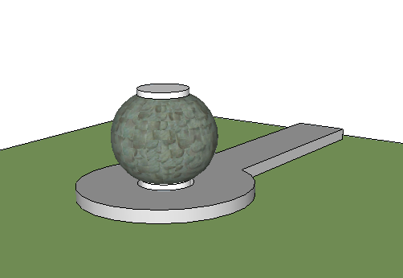
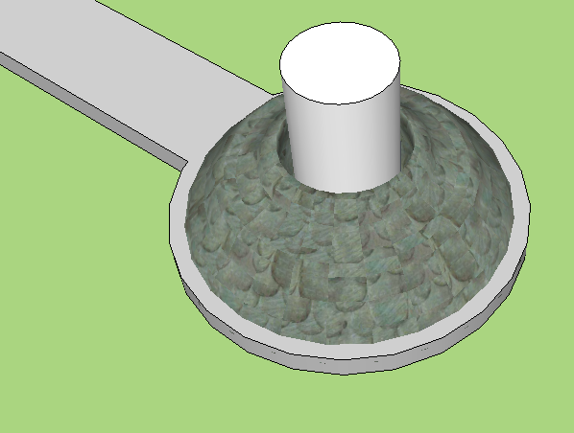
BAD SOLDERING TECHNIQUES
Bad solder connections are a result of not heating the pad or the lead so that wetting can properly occur.
NOT CONNECTED TO PAD
NOT CONNECTED TO LEAD

Slide 22
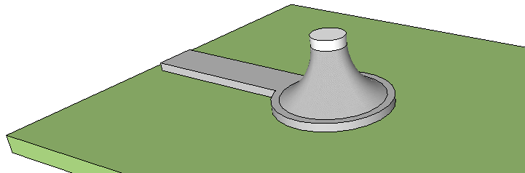
GOOD SOLDERING TECHNIQUES
A good soldering connection should have proper wetting so that the solder bonds to both the pad and the lead. The solder should be shiny and have a curved surface.

Slide 23
SUMMARY
Soldering provides the best way to permanently connect components and pathways together both physically and electrically.
Lead solder is to be avoided because of the environmental hazards it presents. The EU has the RoSH directive which bands the use of lead in solder for electronic devices sold in that region.
A 25-30 watt soldering iron is used for soldering electronic devices because: its economical, it provides the correct tip temperature and the right tip size.
A good solder connection bonds the pad to the lead of the component through proper wetting of the surfaces. Rosin flux plays an important role in removing all oxides. During the soldering process.
☹ Last Slide ☹

Slide 24



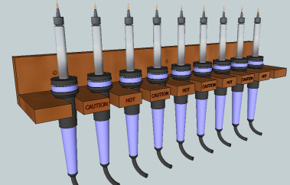


Attributions of Images Used
Soldering Gun
SketchUp File
Butane Iron
SketchUp File
Soldering Iron
https://3dwarehouse.sketchup.com/model.html?id=9a142d0f5c672f13705ec0fd0da50d03
Soldering Rack
SketchUp File
Soldering Station
https://3dwarehouse.sketchup.com/model.html?id=84d05262ce72d6b98be9bd8e132e9ee
Fume Extractor
https://3dwarehouse.sketchup.com/model.html?id=6f2056c5526ad5be98d5276ae594aba0

Slide 25


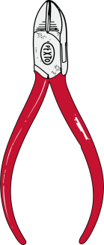
Attributions of Images Used Cont’d
Soldering Iron Stand and Sponge
https://3dwarehouse.sketchup.com/model.html?id=9c1c528c01f25f66ee5859c3d1ce7d6c
Safety Glasses
http://cliparts.co/clipart/2582253
Desolder Pump
https://3dwarehouse.sketchup.com/model.html?id=5b4f08d5c0dd1b52b5e626e2211072
Needle-Nose Pliers
http://cliparts.co/clipart/1537203
Diagonal Cutting Pliers
http://cliparts.co/clipart/1538198
Safety Glasses Symbol
http://www.clker.com/clipart-2731.html

