Slide 1
Foot Shear
For
Cutting printed circuit boardS

Slide 2
FOOT SHEAR
JUST READ
Straight edges can be cut on sheet metal stock using a foot shear. Ensure that the shear is rated to cut the gauge of sheet metal you're working with, or you may damage the blade. The gauge rating of a shear is generally marked prominently on the machine. Sheet stock should be placed on the table and slid below the pressure foot. Use the right angle guide to ensure a 90° cut is made. When the stock is oriented properly, make a cut by stepping down on the treadle. When the material shears, the treadle may pressed down forcefully. The treadle stops are designed to prevent the treadle from crushing your someone's foot. Still, it is good practice to make sure your other foot isn't beneath the treadle.

Slide 3
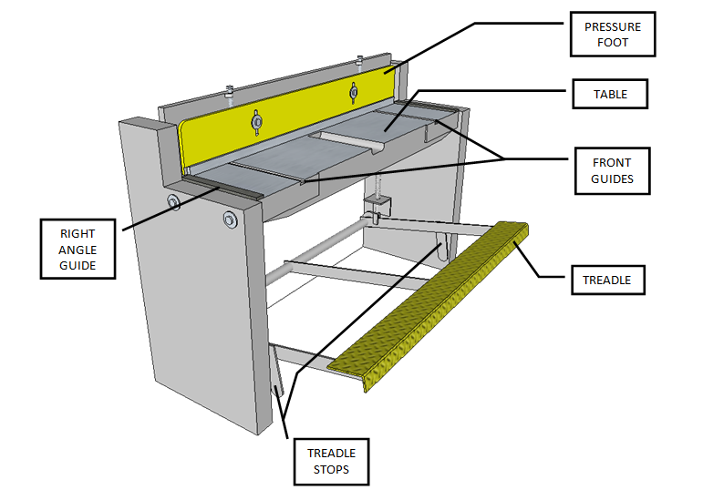
Foot Shear
(LABEL YOUR WORKSHEET)

Slide 4
Steps to Operating a Foot Shear
(COPY ONTO YOUR WORKSHEET)
Mark the material where it should be cut.
Place the material on the shear along the edge guide (right angle guide).
Slide the material in until the markings line up with the shear edge of the table.
Check that the foot pedal (treadle) is free to operate without hitting anything.
Hold the material with your fingers well back from the clamp (pressure foot).
Place foot on the foot pedal and with one firm motion cut the material.

Slide 5
Web Pages
Foot Shear Parts - John
http://www.youtube.com/watch?v=fCfUcdHPahE&feature=fvsr
Operation of Foot Shear 1 - John
http://www.youtube.com/watch?v=w8d3n_kvlyM&feature=relmfu
Operation of Foot Shear 2 - John
https://www.youtube.com/watch?v=u5aZcjGRCYI
Sartell PreEngineering
https://www.youtube.com/watch?v=Y770ds3xSxA
More Foot Shear Information
http://electron.mit.edu/~gsteele/mirrors/www.nmis.org/EducationTraining/machineshop/sheet/intro.html

