Slide 1
Street Foods in Australia
Culinary Explorer

Slide 2
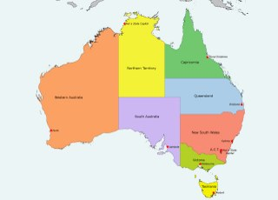
The geography of australia encompasses a wide variety of biogeographic regions being the world's smallest continent but the sixth-largest country in the world. The population of Australia is concentrated along the eastern and southeastern coasts. The geography of the country is extremely diverse, ranging from the snow-capped mountains of the australian alps and tasmania to large deserts, tropical and temperate forests. https://en.wikipedia.org/wiki/Geography_of_Australia

Slide 3
street foods
In Our research we discovered some popular street foods in the eastern and southern coasts of Australia
In the dessert category
Pavlova and lamingtons
Meals
Chico rolls
Sausage Sanger
Aussie Meat pies
We decided to investigate aussie meat pies

Slide 4
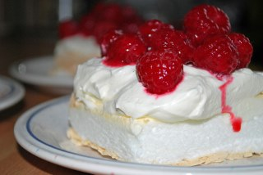
Legend has it that, inspired by the Russian ballerina Anna Pavlova during her 1926 and 1929 tours of Australia, Western Australian chef Herbert Sachse of Perth's Hotel Esplanade created a desert recipe that was as light as the ballerina herself. With its wispy meringue base, smothered in a layer of freshly whipped cream and topped with fresh fruit and tangy passionfruit pulp, it's no wonder it has stayed firmly cemented in modern Australia's food culture. The origins of the 'Pav' are, however, disputed, and New Zealand has claimed that their cookbooks have older versions of the light, summer dessert. To this day, it remains one of the great bones of contention between us and our Kiwi cousins.
Pavlova

Slide 5
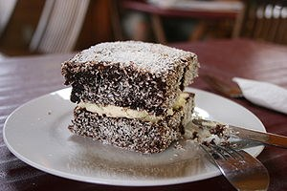
Lamingtons
There are many versions of the lamington's origin, and it is still in dispute whether it was in Australia or New Zealand that sponge cake was first dipped in chocolate icing and rolled in desiccated coconut. One legend has it that Lord Lamington of Queensland was served the treat by his personal chef in 1900. Upon tasting this new delicacy, he requested it be named after him. Today the lamington can be found in every true-blue Australian bakery and features in almost every CWA (Country Women's Association) recipe book, where it may well have first appeared - in times when waste was frowned upon - as a way of using up imperfect or stale sponge cake.

Slide 6
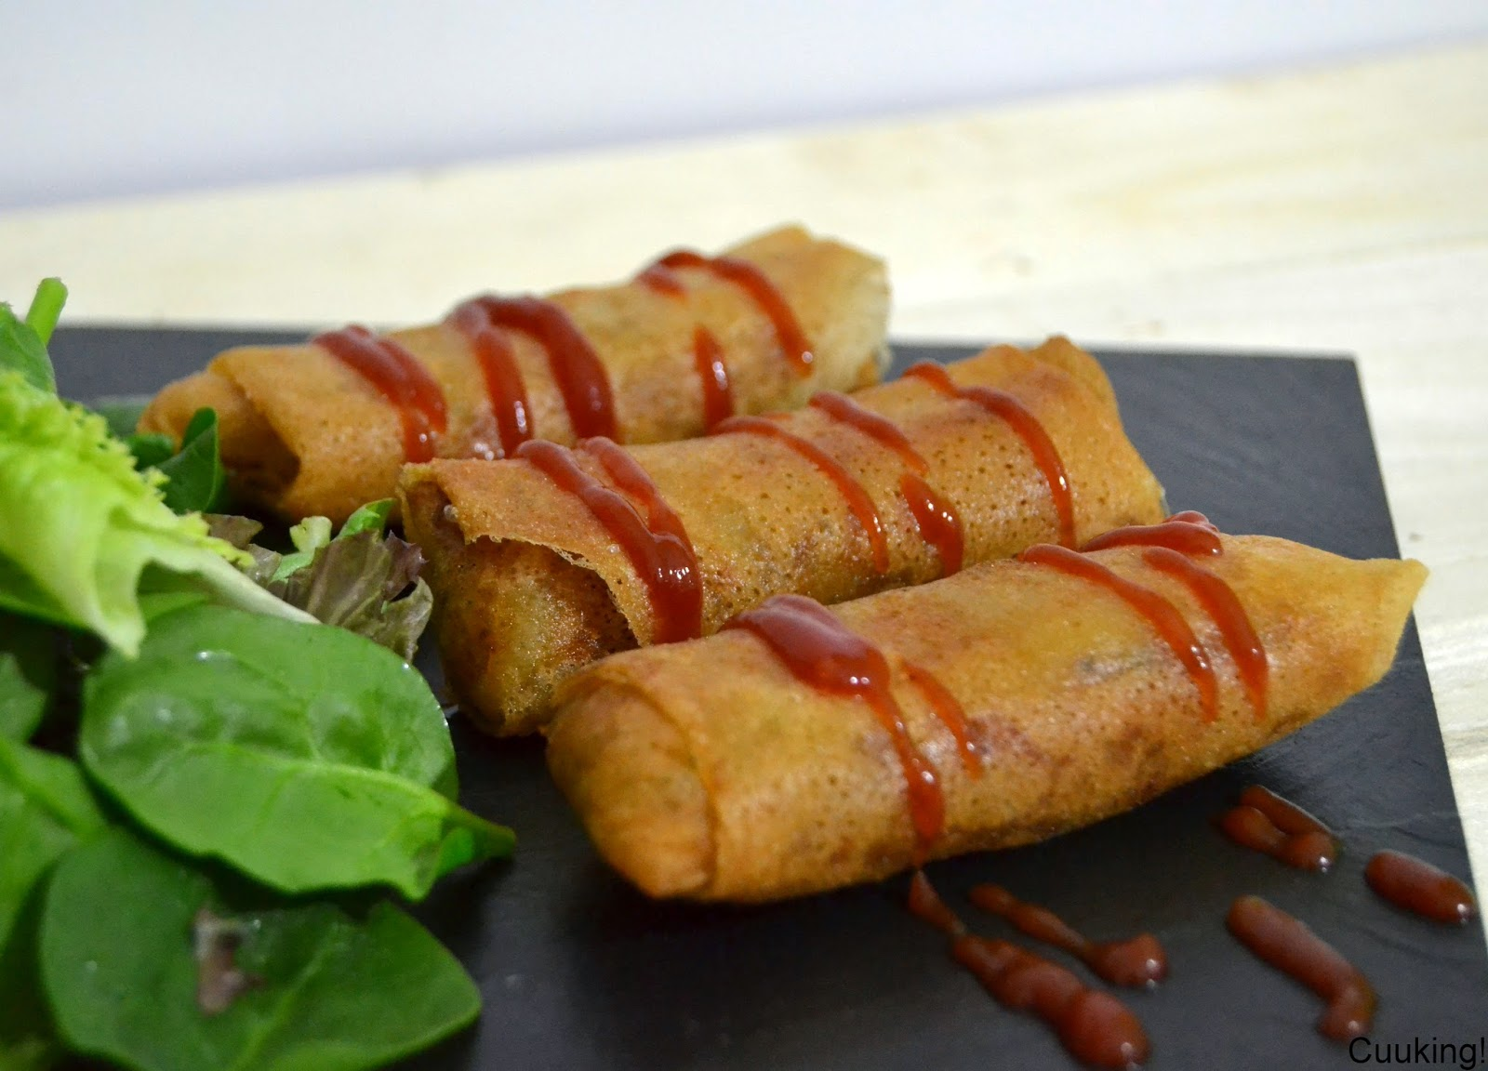
Chiko roll
Chiko Rolls are an Australian version of spring rolls or egg rolls. They are deep fried fast-food item, with a thick, almost chewy dough wrapper on them. The dough is made of egg and flour. Ingredients in the filling inside are mutton, barley, cabbage, carrot, celery and rice, and seasonings.

Slide 7
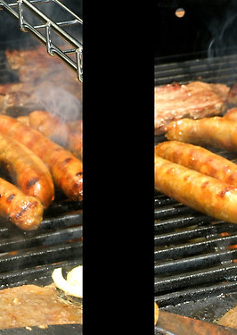
Sausage sanger
A sausage sandwich is a sandwich containing cooked sausage. It generally consists of an oblong bread roll such as a baguette or ciabatta roll, and sliced or whole links of sausage, such as hot or sweet Italian sausage, Polish sausage, German sausage (knackwurst, weisswurst, bratwurst, bockwurst), Mediterranean merguez, andouille or chorizo. Popular toppings include tomato sauce, mustard, brown sauce, ketchup, steak sauce, peppers, onions, sauerkraut, chili, and salsa. A sausage sandwich may also be sold as a hot dog.
en.wikipedia.org · Text under CC BY-SA

Slide 8
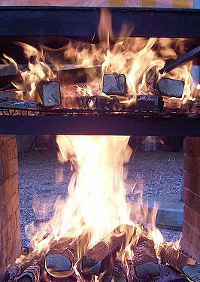
Given Australia's love of the outdoors, our superb weather and the rise of the portable barbecue perhaps it was inevitable that the 'sausage sizzle' Australia's answer to the US 'weiner roast' and a mainstay of community fundraising – was born. And what better way to serve a sizzled snag but in a sausage sanger? As simple as a single slice of bread folded over a sauce-drenched sausage has also become a classic lunch-time meal for Australians and reflects our love of slang – sanger being a venerable term for sandwich. Authorities even tailored infrastructure – from the 1970s introducing public barbecues to many parks and reserves – so that they can be enjoyed pretty much anywhere.

Slide 9
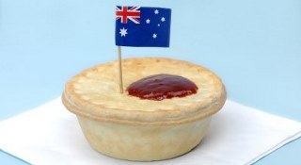
The History of the meat pie
The history of the meat pie is a bit murky, with many countries laying claim to creating the first pie.

Slide 10
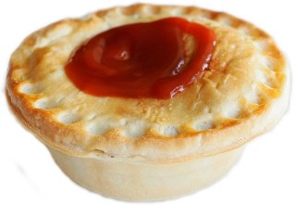
An Australian or New Zealand meat pie is a hand-sized meat pie containing largely diced or minced meat and gravy, sometimes with onion, mushrooms, or cheese and often consumed as a takeaway food snack. The pie itself is similar to the United Kingdom's steak pie.
en.wikipedia.org · Text under CC BY-SA

Slide 11
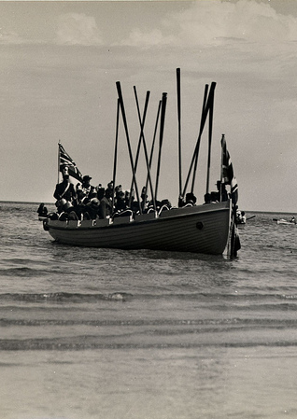
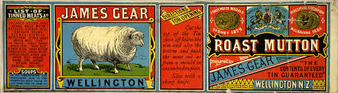
History of the meat pie in australia
Early settlers brought the pie to Australia, which instantly gained popularity due to it's basic, readily available ingredients. Mutton was used in early pies as in those days it was a lower price even than vegetables.

Slide 12
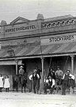
Early street foods
The golden crust meat and gravy snacks were available in Sydney in the mid-1800's, often sold as a counter lunch in hotels

Slide 13
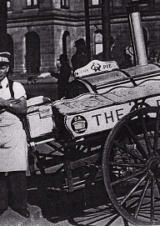
Early Street Foods
In years to follow, pies were sold from pie carts which stopped near places of entertainment or where large groups gathered. The Pie Man was a common sight in the streets of Sydney and Melbourne, selling hot pies from a large tin box kept warm by a small charcoal stove.

Slide 14
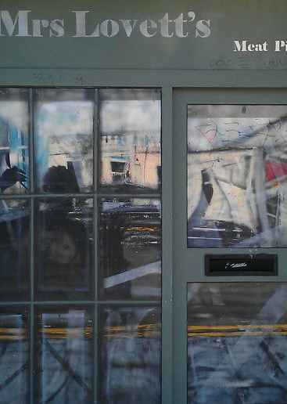
Famous Pie shop
Mass produced pies began to make an appearance in the 1960's. Australian's eat over 500,000,000 pies each year.

Slide 15
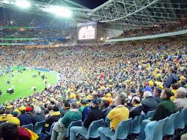
Meat pies are still people's first choice while they watch sporting matches. An Aussie rules Final crowd in Melbourne can consume 90,000 pies in one day.
“A good old Australian meat pie and an afternoon at the footy screaming your team to victory goes hand in glove; it's very Aussie!”

Slide 16
How to make the meat pie Video link
https://www.youtube.com/watch?v=yZGTkzhCrIU
Jamie’s beef and ale aussie meat pie

Slide 17
sources
Flickr.com
https://en.wikipedia.org/wiki/Main_Page
https://www.theguardian.com/lifeandstyle/australia-food-blog/2014/may/07/meat-pie-a-great-australian-dish
http://www.australian-information-stories.com/meat-pie.html

