Slide 1
Street Foods of the World
International small plates of indigenousness cultures.

Slide 2
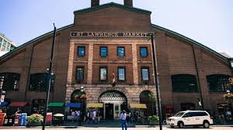
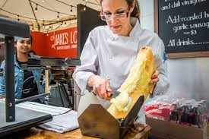
What is street food?
Street food is ‘ready-to-eat’ food sold by a vendor, in a street or public setting, such as at a market or fair.

Slide 3
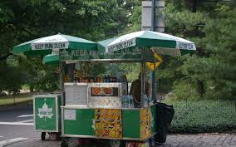
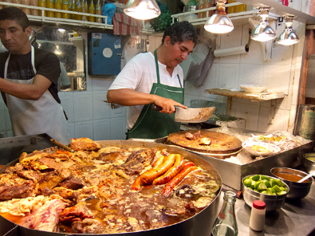
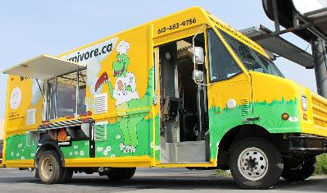
In many cultures street food is literally sold on the streets in villages and boroughs of cities. Street food is often sold from a portable food cart or food truck and meant for immediate consumption.

Slide 4


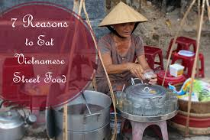
Street foods are generally regional, meaning the food is indigenous to the area of the world the city is in.

Slide 5
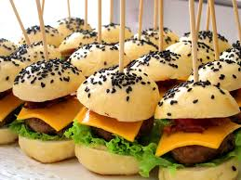
Most street foods are classed as finger foods or sold in small portions. Street food is generally much less expensive than restaurant food and designed to be eaten on the go.

Slide 6
Here are some international street food examples…..

Slide 7
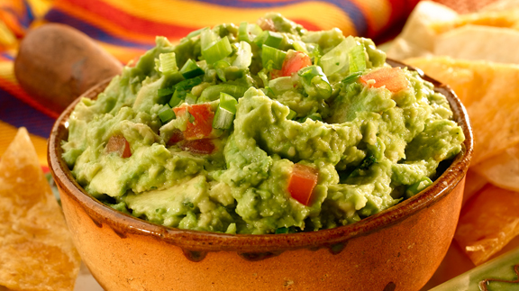
Guacamole with tortillas from Mexico

Slide 8
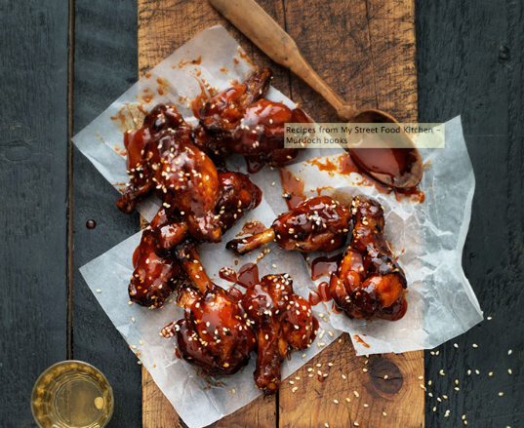
Street grilled sesame BBQ chicken wings from Spain.

Slide 9
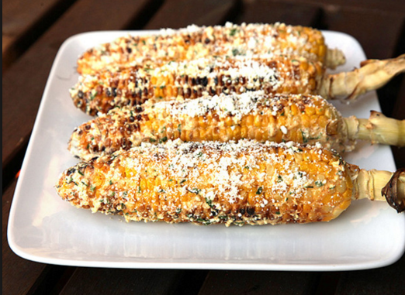
Mexican street corn.

Slide 10
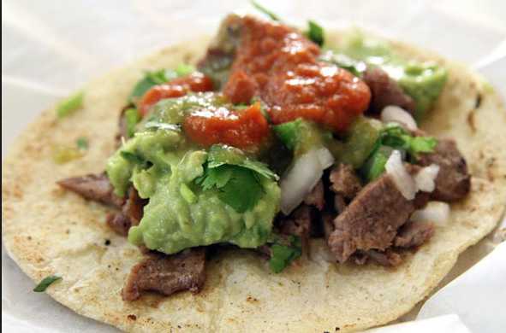
Tacos con carne from Mexico

Slide 11
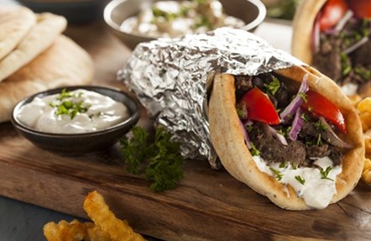
Lamb shawarma kebob from the Mediterranean or Middle East.

Slide 12
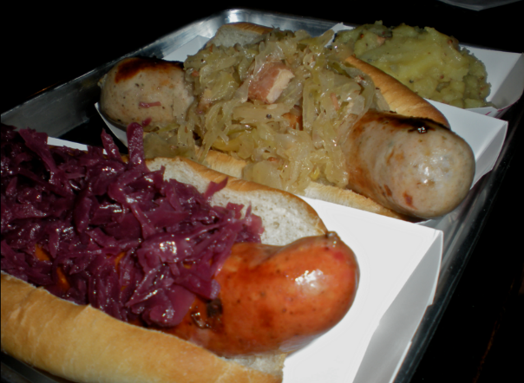
Bratwurst with sauerkraut from Bavaria

Slide 13
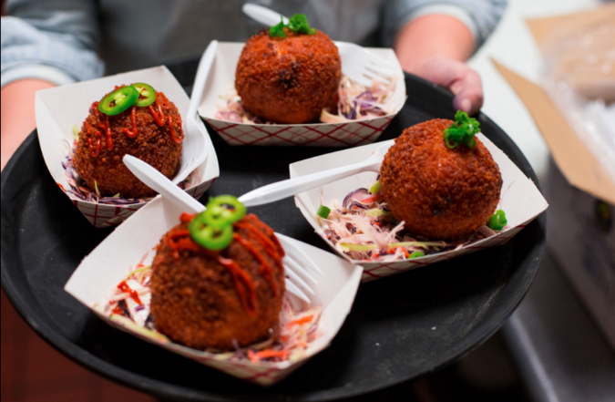
Fish balls with fresh slaw from Korea

Slide 14
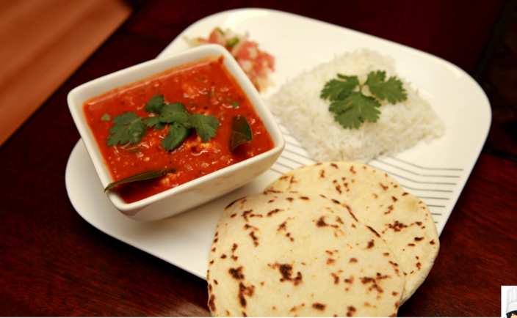
Naan bread and curry from India.

Slide 15
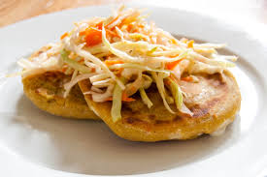
Salvaroran Pupusas

Slide 16
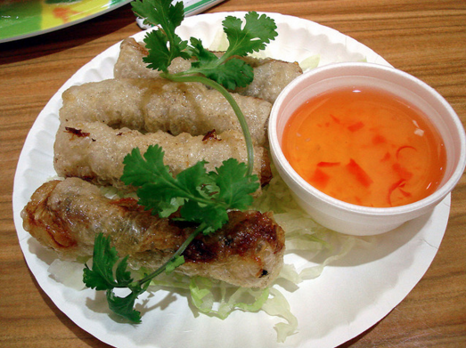
Fried rice paper spring rolls and sweet chili dip from Thailand.

Slide 17

Vegetable sushi from Japan.

Slide 18
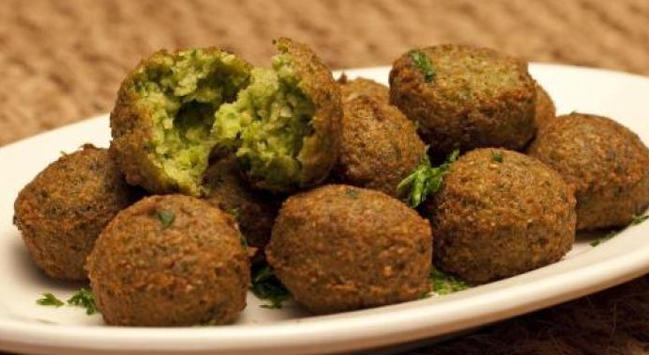
Falafels from Egypt.

Slide 19

Brazilian cheese bread.

Slide 20
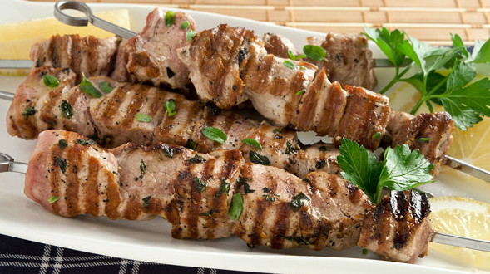
Souvlaki from Greece.

Slide 21

Beaver tails from Canada.

Slide 22
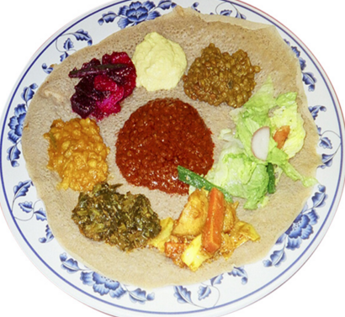
Fasika from Ethiopia.

Slide 23
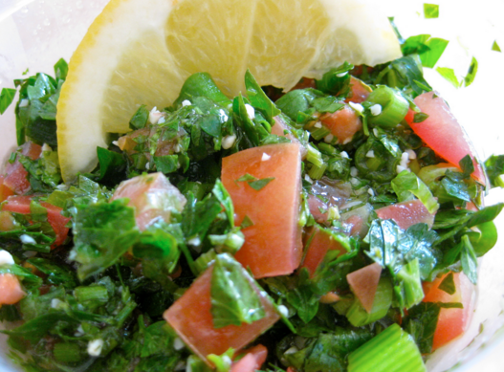
Al-Fayhaa from Lebanon

Slide 24
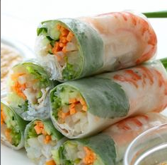
Fresh rolls from Vietnam.

Slide 25
The options are ENDLESS!!!!!

Slide 26
Culinary Explorer
Students will work in groups of 2-3 to become Culinary Explorers and research “street foods” from a country or culture of your choosing. Your learning goal is to introduce your classmates to a new food or taste experience. You will demonstrate your learning by preparing a class media presentation to introduce your theme and then prepare a recipe from your research of “street foods”.

Slide 27
Sources
https://www.youtube.com/results?search_query=national+geographic+street+food+around+the+world
http://www.seriouseats.com/recipes/2013/07/mexican-street-corn-elotes-recipe.html
http://www.epicurious.com/recipes-menus
http://www.epicurious.com/archive/cuisines/aroundtheworldin80dishes?offset=20&pageNumber=3&pagesize=10
www.seriouseats.com

