Slide 1
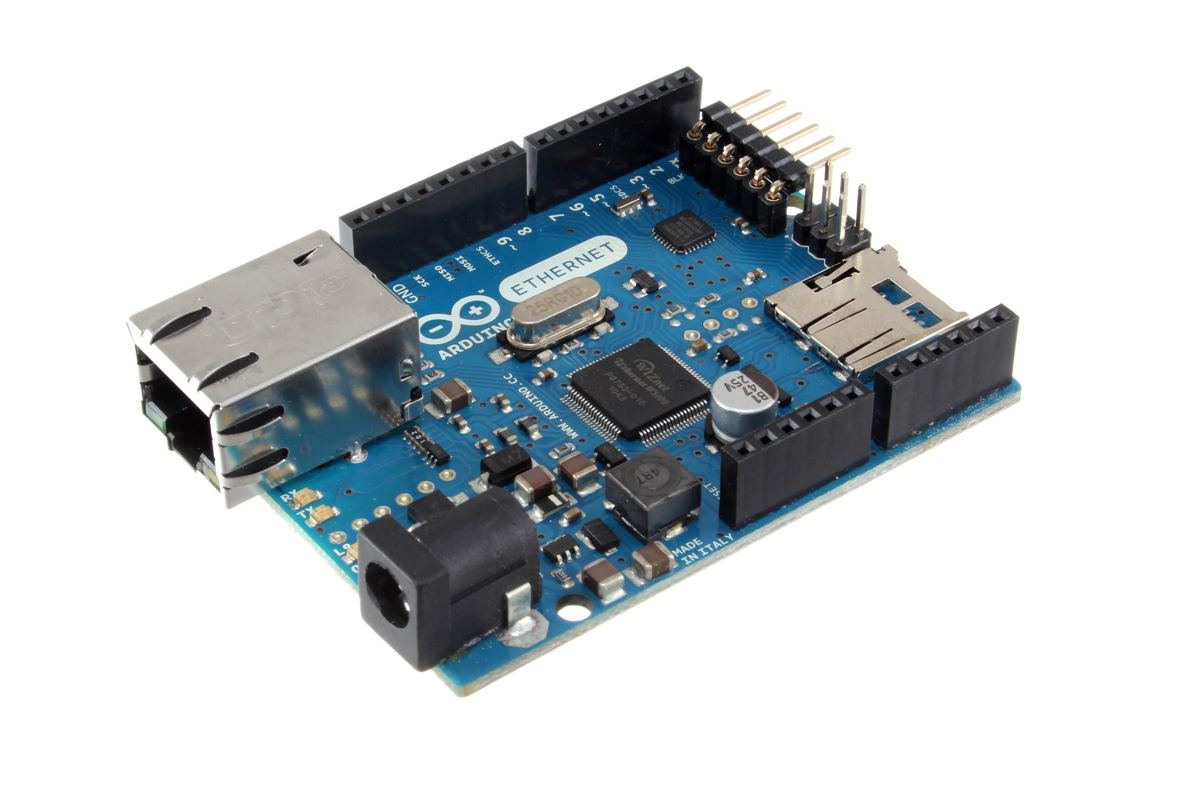
Arduino 101
Credit(s): https://eu.wikipedia.org/wiki/Arduino

Slide 2
Arduino refers to an open-source electronics platform or board and the software used to program it.
Credit(s): https://www.techopedia.com/definition/27874/arduino

Slide 3
A pre-assembled Arduino board includes a microcontroller, which is programmed using Arduino programming language and the Arduino development environment. In essence, this platform provides a way to build and program electronic components. Arduino programming language is a simplified form of C/C++ programming language based on what Arduino calls "sketches," which use basic programming structures, variables and functions. These are then converted into a C++ program.

Slide 4
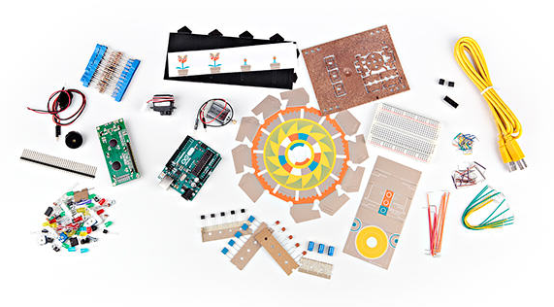
Main Reference:
http://www.arduino.org/products/kits/arduino-starter-kit

Slide 5
Intro Videos

Slide 6
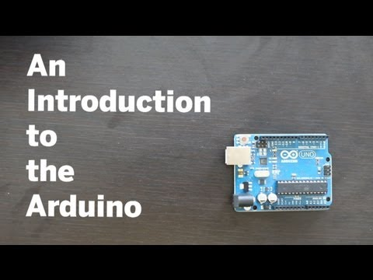
An Introduction to the Arduino (from Make Magazine) (4:25)
https://www.youtube.com/watch?v=CqrQmQqpHXc

Slide 7
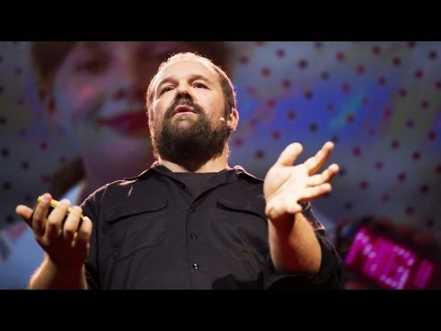
Massimo Banzi: How Arduino is open-sourcing imagination (15:46)
https://www.youtube.com/watch?v=UoBUXOOdLXY

Slide 8
Our First Program!

Slide 9

“Tutorial 01 for Arduino: Getting Acquainted with Arduino” (14:31)
https://www.youtube.com/watch?v=fCxzA9_kg6s

Slide 10
“Blink”
This program turns on an LED on for one second, then off for one second, repeatedly.
Most Arduinos have an on-board LED you can control. On the Uno and Leonardo, it is attached to digital pin 13.
Credit(s): http://labs.arduino.org/STARTER+KIT+-+GET+TO+KNOW+YOUR+TOOLS

Slide 11
Save as “Blink”
// the setup function runs once when you press reset or power the board
void setup() {
// initialize digital pin 13 as an output.
pinMode(13, OUTPUT);
}
// the loop function runs over and over again forever
void loop() {
digitalWrite(13, HIGH); // turn the LED on (HIGH is the voltage level)
delay(1000); // wait for a second
digitalWrite(13, LOW); // turn the LED off by making the voltage LOW
delay(1000); // wait for a second
}
Note!
Save the code for all your programs in a folder named “Arduino” in your home folder.
The highlighted comments are not necessary for your program, but it’s good programming practice for you to include lots of them to help document your program.
Credit(s): http://labs.arduino.org/STARTER+KIT+-+GET+TO+KNOW+YOUR+TOOLS

Slide 12
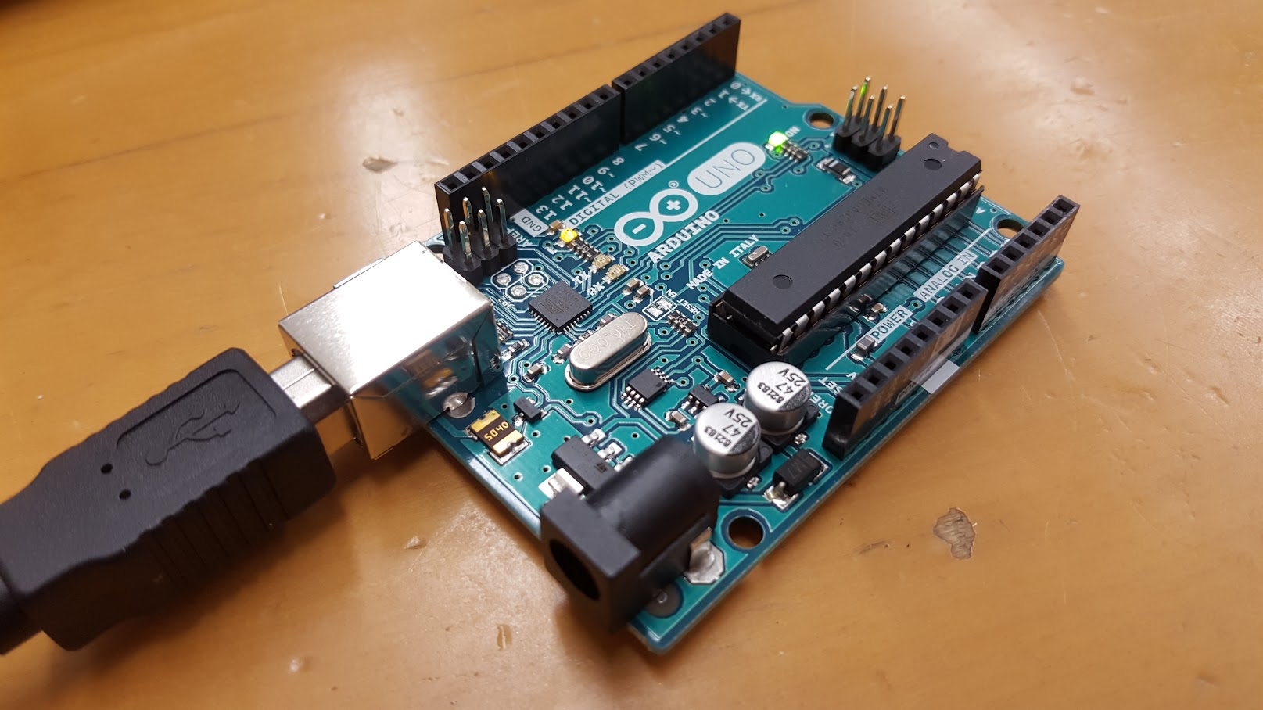
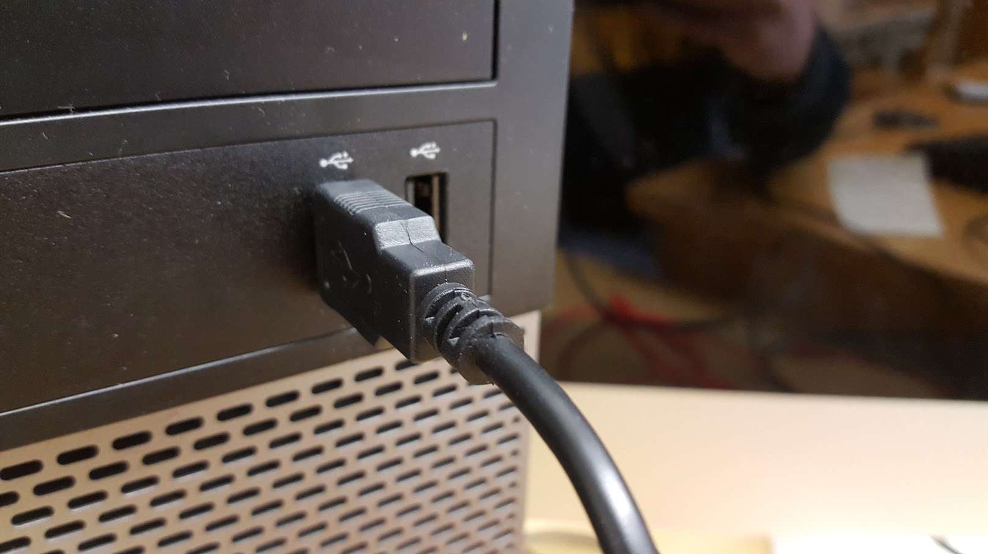
Connect Your Arduino...

Slide 13
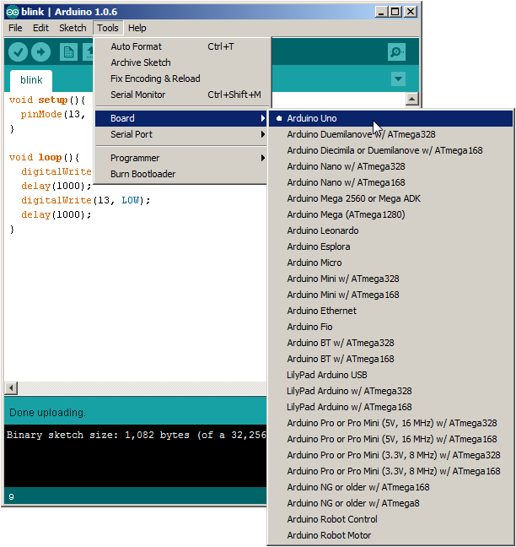
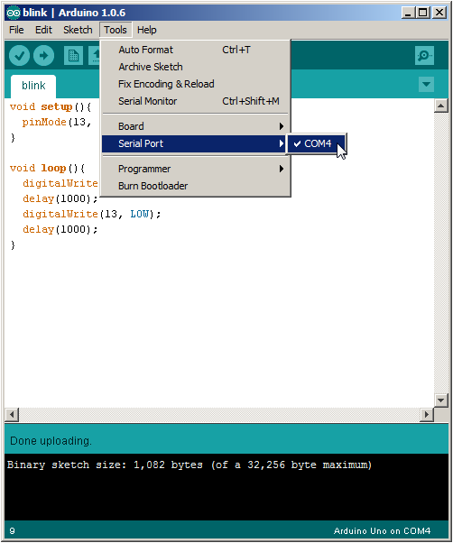
Before Uploading...

Slide 14
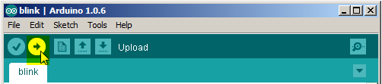
Upload!

Slide 15
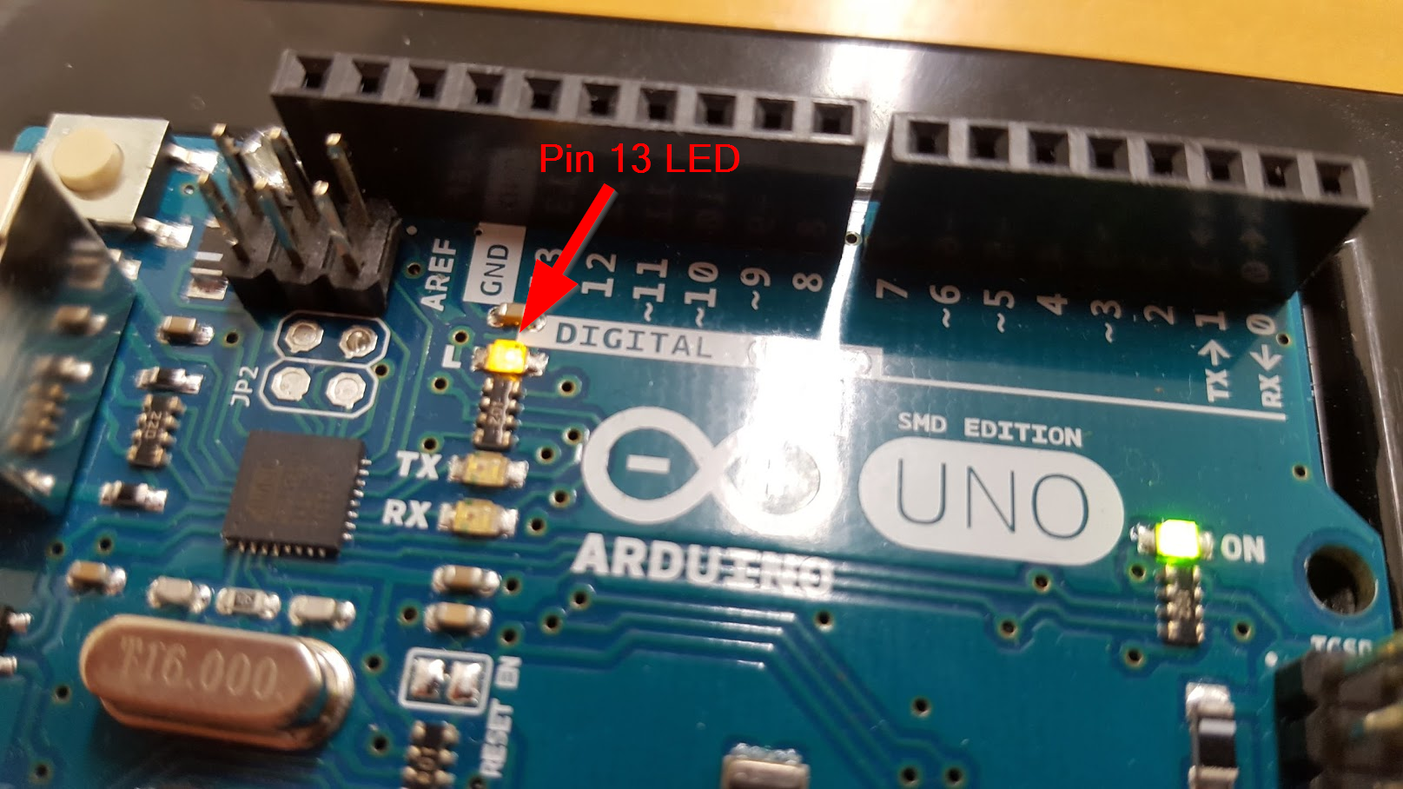
Did it Work?!!

Slide 16
Some Arduino Programming Basics

Slide 17
Note!
The #1 rule in programming is:
Save Early, Save Often!

Slide 18
Variables
A variable is a place for storing a piece of data. It has a name, a type, and a value.
Example:
Credit(s): http://labs.arduino.org/What+is+a+Sketch

Slide 19
Variables (cont’d)
This example declares a variable with the name ledPin, the type int, and an initial value of 13.
It's being used to indicate which Arduino pin the LED is connected to.
Every time the variable “ledPin” appears in the code, its value will be retrieved (i.e. the value 13).
Credit(s): http://labs.arduino.org/What+is+a+Sketch

Slide 20
Task!
Modify your Blink program by inserting the ledPin declaration (as shown in the previous slide) and substituting “13” with “ledPin” everywhere in your program.
The declaration line should go above the setup() function.
Don’t forget to save your program!

Slide 21
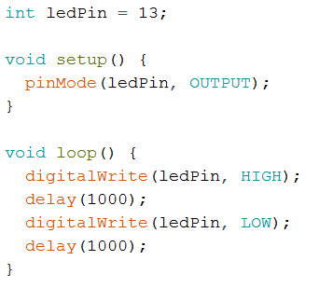
Your code should look like this:

Slide 22
Let’s Hook Up an External LED!

Slide 23
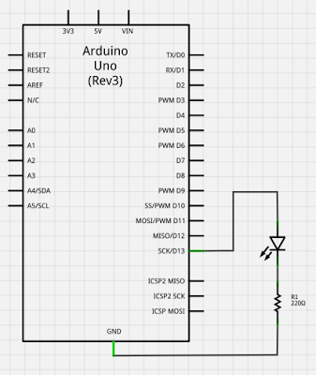
Schematic
The resistor is needed to protect the LED. It limits the current to a safe amount and drops the voltage across the LED to about 2 volts.
Image source: http://www2.beens.org/computer-technology/arduino/activities/blinking-led

Slide 24
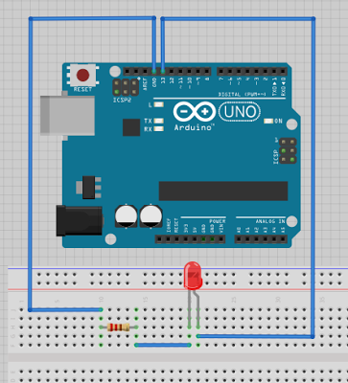
Pictorial
Note!
Unplug your Arduino while hooking up the electronic components. Get the circuit checked before applying power.
Image source: http://www2.beens.org/computer-technology/arduino/activities/blinking-led

Slide 25
Supplemental Information: Fritzing
Fritzing is an open-source hardware initiative that makes electronics accessible as a creative material for anyone. We offer a software tool, a community website and services in the spirit of Processing and Arduino, fostering a creative ecosystem that allows users to document their prototypes, share them with others, teach electronics in a classroom, and layout and manufacture professional pcbs.
http://fritzing.org

Slide 26
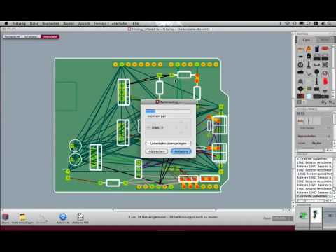
Fritzing cont’d

Slide 27
Let’s Build a Traffic Light!
Save your Blink program as “TrafficLight”.
Modify “ledPin” to be “redLED” throughout your program.
Add two variables “yellowLED” and “greenLED”, using pins 12 and 11, respectively.
Modify your program and your circuitry to simulate a traffic light!

Slide 28
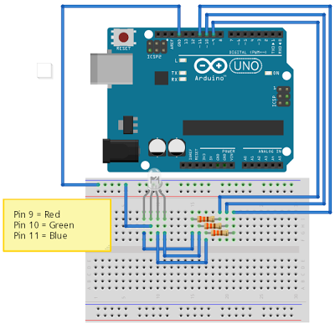
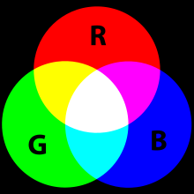
From a Traffic Light to RGB!
Assignment
Write a program that loops through the following colours, with each colour being displayed for 500 mS:
green
yellow
red
magenta
blue
cyan
white
Frtizing diagram source: http://www2.beens.org/computer-technology/arduino/activities/rgb-leds
RGB image source: http://upload.wikimedia.org/wikipedia/commons/thumb/c/c2/AdditiveColor.svg/220px-AdditiveColor.svg.png

Slide 29
Further Exploration:
https://123d.circuits.io
(Electronics and Arduino simulator)

Slide 30
Thanks!

