Slide 1
Multiplexing seven-segment displays

Slide 2
Why multiplex?
Arduino (or any other microcontroller) does not have too many pins to connect all segments.
For example, four seven-segment displays will need 4 x 7 = 28 segment and 4 power pins, total of 32 pins.
Arduino does not have 32 pins.
By multiplexing, we just need 11 pins. We will see how.

Slide 3
How to multiplex?
Our eyes cannot see if a light flickers faster than 15 times a second. That is why fluorescent lights, TV, movie screens appear to be on, but not flicker.
Since there are 4 displays, we need to switch them at 4 x 15 or 60 times a second and they will appear to be on all the time.

Slide 4
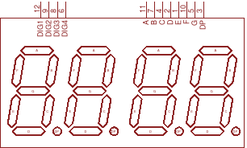
Display pins
Seven Cathode pins A to G are common to all four displays. We don’t need DP or decimal point.
Anode pins Dig1 to Dig4 are used to turn each display on / off; faster than 60 times a second.

Slide 5
Programming the Arduino v1.0
Let us connect Arduino digital pins 0 to 6 to cathode segments A to G. Ignore DP - decimal point.
And Arduino digital pins 9, 10, 11 and 12 to DIG1 to DIG4 (Anode pins). Refer to the pin numbers on the display.

Slide 6
Sketch v1.0
Your Setup code.
void setup() {
// initialize anode pins as output.
pinMode(9, OUTPUT);
pinMode(10, OUTPUT);
pinMode(11, OUTPUT);
pinMode(12, OUTPUT);
// initialize cathode pins as output.
pinMode(0, OUTPUT);
// do the same for other 6 pins 1 to 6.
}
// can we improvise? Hmmm…..

Slide 7
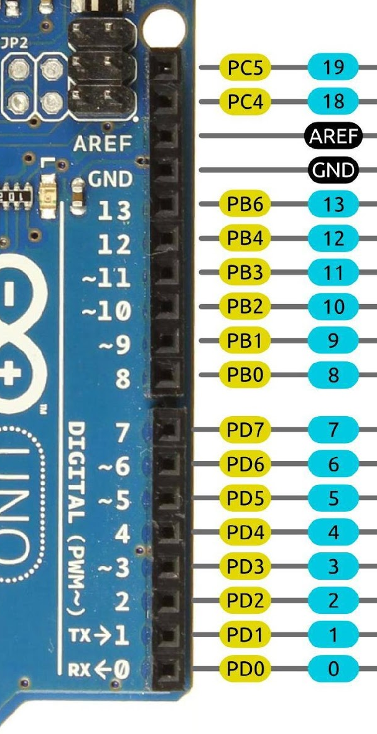
Sketch 1.1, second try
Since digital pins 0 to 6 are connected to PD0 to PD6 of Register D, we can write one line in setup:
DDRD = B01111111;
This will make all the 7 pins from 0 to 6 as output. 1=output, 0=input

Slide 8
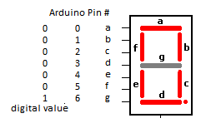
Showing numbers v1.1
Let us show 0 on digit 1. The sequence will be...
void loop() {
// turn on DIG1 (anode),HIGH on pin 9
digitalWrite(9, HIGH);
// now cathodes, output LOW to light a segment
digitalWrite(0, LOW); digitalWrite(1, LOW);
digitalWrite(2, LOW); digitalWrite(3, LOW);
digitalWrite(4, LOW); digitalWrite(5, LOW);
// 0 does not need the segment G
digitalWrite(6, HIGH);
// keep it on for 10 mS
delay(10);
// turn off the display
digitalWrite(9, LOW);
}

Slide 9
Showing numbers v1.2, second try
Earlier, we have seen how to use all the 7 pins together. Let us use the trick here for the cathode pins 0 to 6.
void loop() {
// turn on dig1 anode, output HIGH on pin 9
digitalWrite(9, HIGH);
// again, just one line of code
// xgfedcba x,not used, don’t care
PORTD = B11000000;
// keep it on for 10 mS
delay(10);
// turn off the display
digitalWrite(9, LOW);
}

Slide 10
Showing numbers v1.2… cont’d
By changing the bit pattern, we can show any number we want.
How about number 8? We need all segments to be on, so the code will be, all pins 0 to 6 will be low, or 0.
void loop() {
// turn on dig1 anode, output HIGH on pin 9
digitalWrite(9, HIGH);
// again, just one line of code
// xgfedcba x,not used,don’t care
PORTD = B10000000;
// keep it on for 10 mS
delay(10);
// turn off the display
digitalWrite(9, LOW);
}

Slide 11
How to pick other digits? v1.2
Selecting the anode pins 9, 10, 11 or 12, we can choose any of the four digits.
Assume we want to show 3 on digit 2.
void loop() {
// turn on dig2 anode, output HIGH on pin 10
digitalWrite(10, HIGH);
// xgfedcba x,not used, don’t care
PORTD = B10110000;
// keep it on for 10 mS
delay(10);
// turn off the display
digitalWrite(10, LOW);
}

Slide 12
Next steps
Use an array to store the bit patterns (cathode) for numbers from 0 to 9. This will make your code shorter and more efficient.
Use a blinking colon to show the ticking of seconds.
Layout your circuit on Fritzing, colour code the wires for easy tracing.

Slide 13
Review
Multiplexing reduces pins needed.
Sequence is: choose the digit (anode), write the bit pattern (cathode), wait for 10ms (could be 5mS), then turn off the digit.
Use the anode pins to choose the digit.
Direct Register accessing avoids many lines of pinMode() and digitalWrite() functions, easy to type and efficient.
Have fun and Enjoy coding!
Come out with v2.0 or v3.0 !!!

Slide 14
Thank you!

