Slide 1
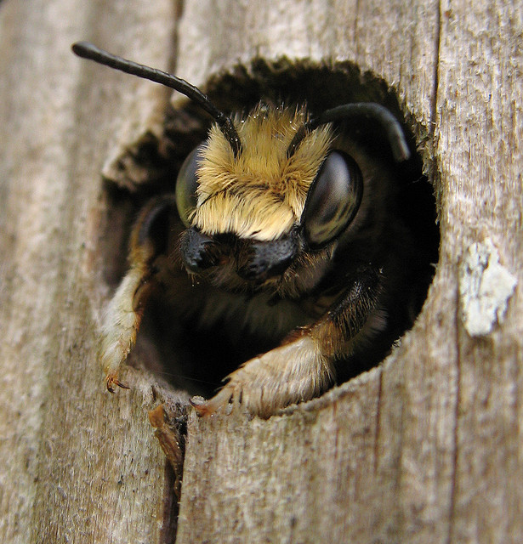
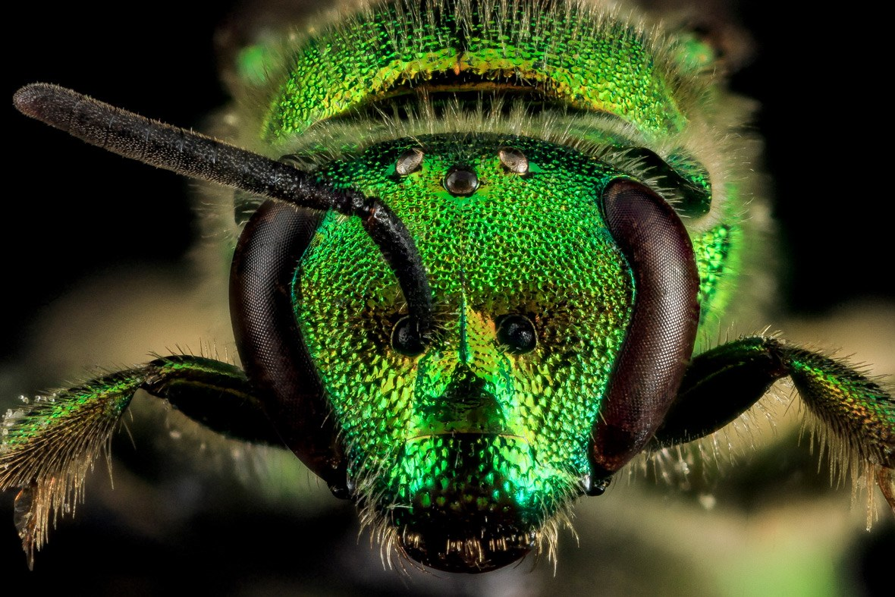
Native Bees

Slide 2
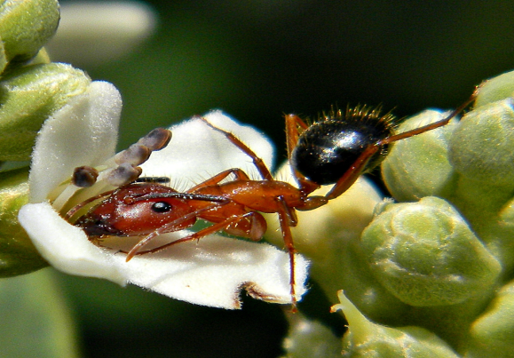
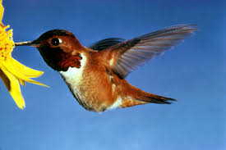
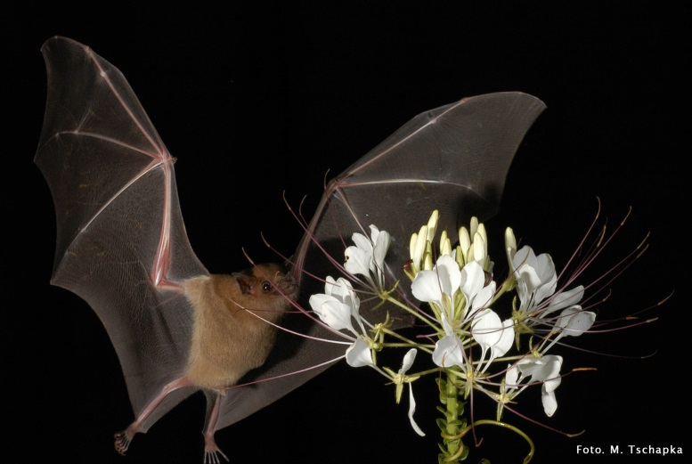
An Essential Service: Pollination
Did you know that plants and pollinators are essential to the production of most of the food we eat as well as treats like chocolate, coffee and almonds? Pollination is not only important to crops such as fruits and vegetables, but it is required for the success of almost 90% of all plants on our planet. It is a vital component of healthy ecosystems. The work that pollinators do impacts heavily on food and many related products produced around the world.

Slide 3
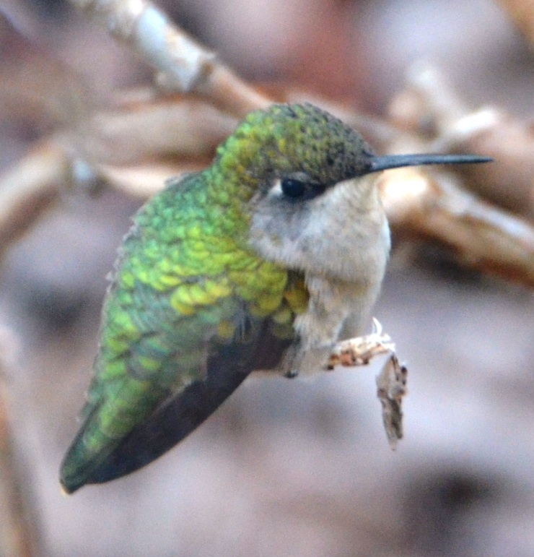
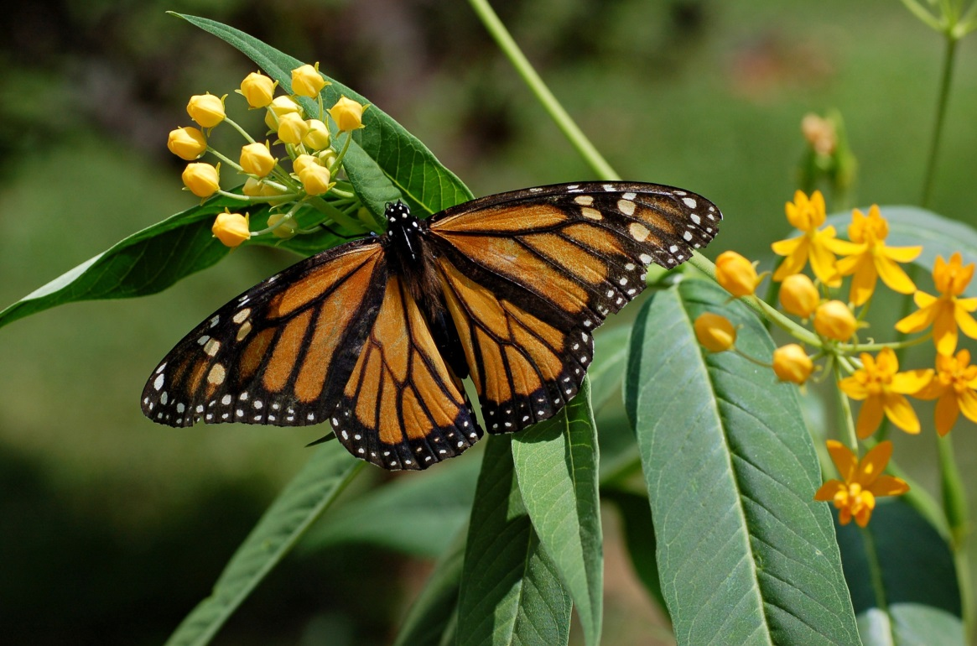
Every year, just in Canada alone, pollinators assist in billions of dollars of food production including apples, pears, cucumbers, melons, berries, as well as many other pollinator-reliant industries such as wines, beers and medicines. They do not purposely pollinate plants but in the process of visiting a flower for their own food (pollen and nectar) they accidentally pick up pollen which is transferred when visiting other flowers. Without pollinators, scientists predict we would lose 75-95% of all flowering plants on Earth. The most important group of pollinators are bees.

Slide 4
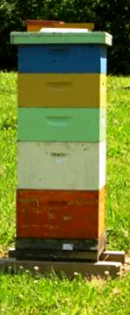
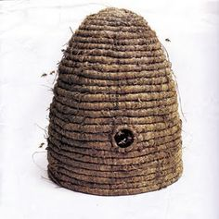
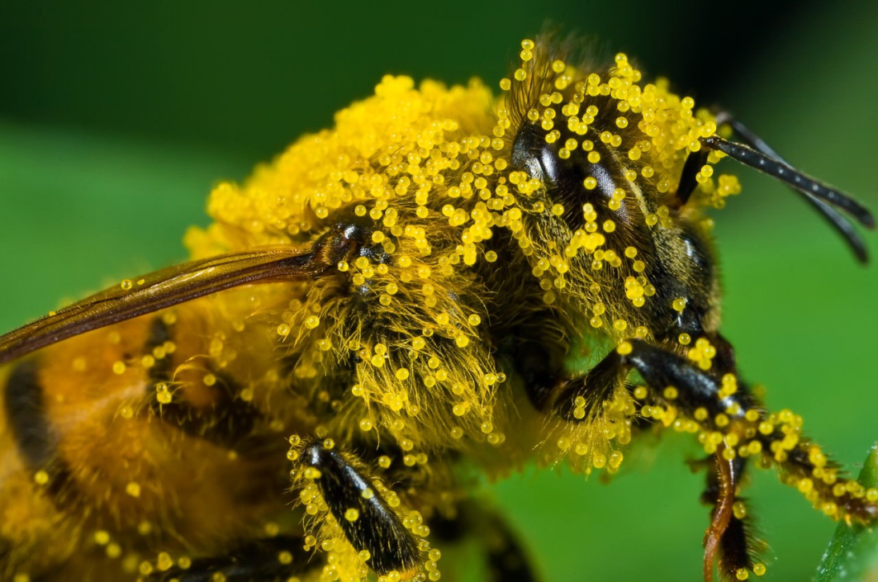
Honey Bees:
Foreign Friends & Welcome Visitors
When we picture bees, we most often associate them with the production of honey, beeswax and stingers! That image of the bee is far too narrow and only takes into account the honey bee (Apis mellifera) which is not North American but a European import brought over for the express purpose of producing honey and pollinating crops.

Slide 5
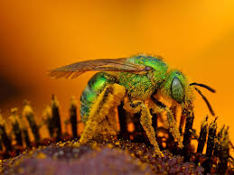
Home Grown Talent:
Our native bees are equally proficient at pollinating, they do not swarm and generally, they do not sting. While native bees do not produce honey like its foreign counterpart, they still take on the vital role of pollination in the farm and garden. Our home grown bees are believed to be responsible for a large proportion of the economic benefits that are mostly attributed to honey bees.

Slide 6
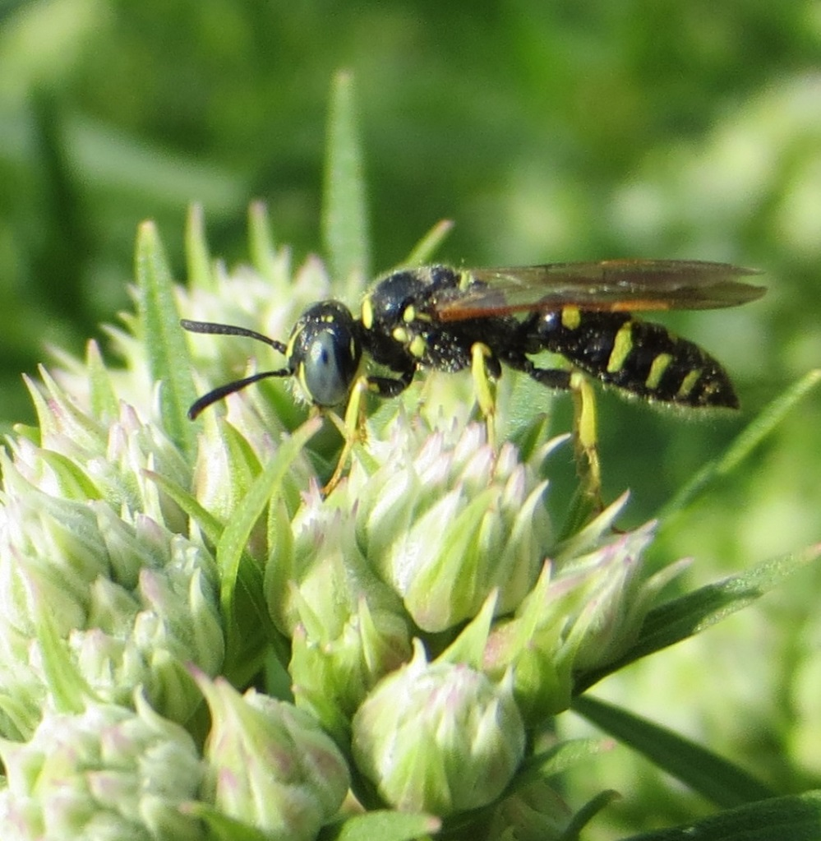
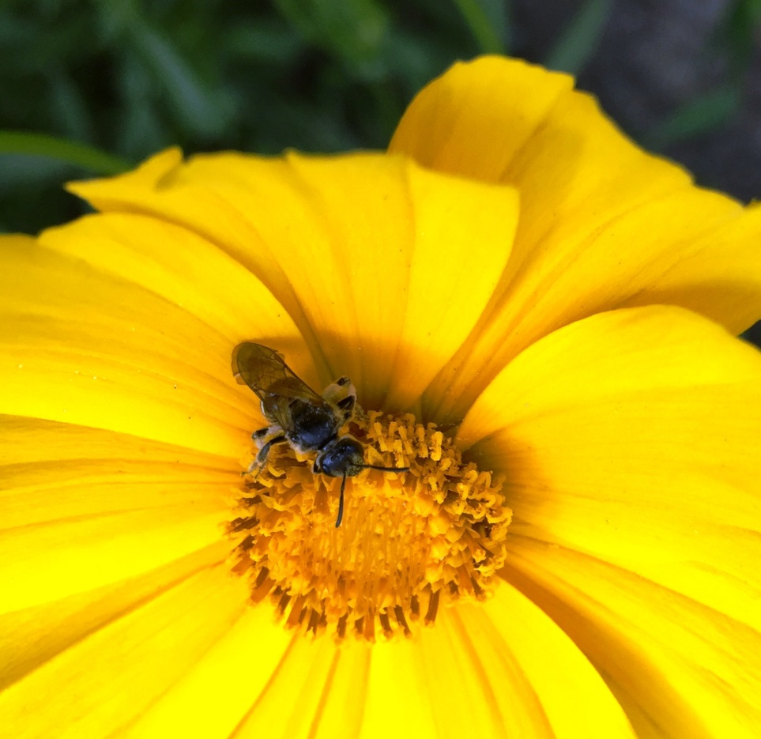
Plenty to Choose From:
Native bees are often harder to notice or recognize than the honey bee since they prefer to work alone and can be very tiny. Ontario is home to more than 400 species of indigenous (native) bees including Miner, Carpenter, Masked, Sweat and Mason bees, to name a few.

Slide 7
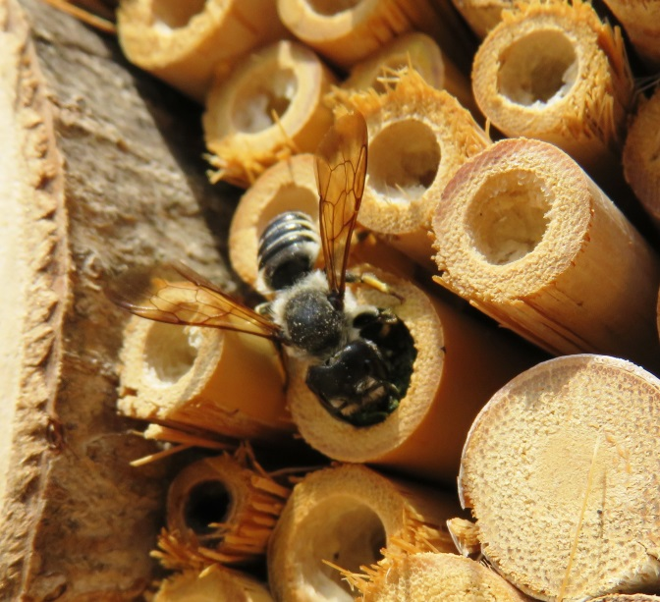
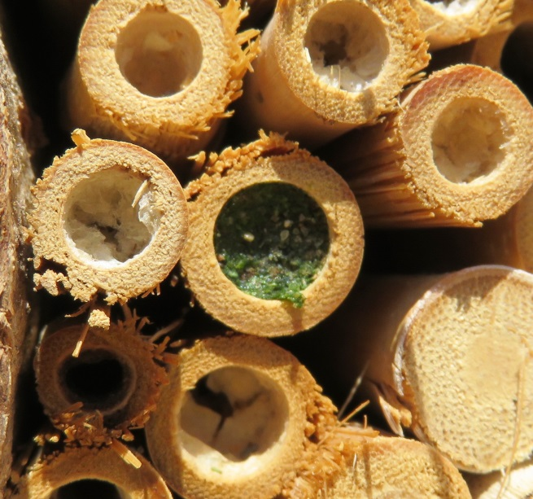
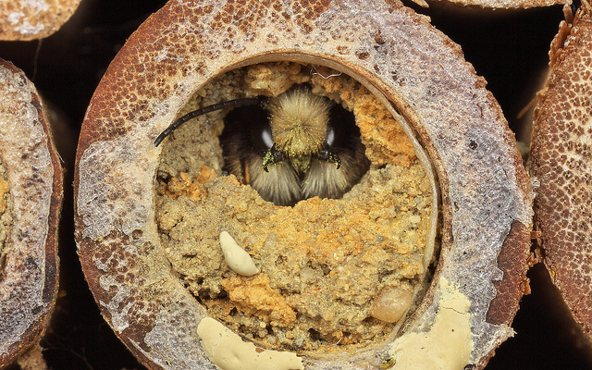
Motherly Instinct:
The female native bee is a fiercely devoted single mother, independently providing food and shelter for her offspring. She usually prepares her nest in the early spring and then spends a portion of the season gathering pollen and nectar to feed her children. Once the food is gathered, this devoted mother seals her eggs into carefully constructed egg chambers with ample food for the newborns. Where and how a native bee builds these egg chambers varies greatly.

Slide 8
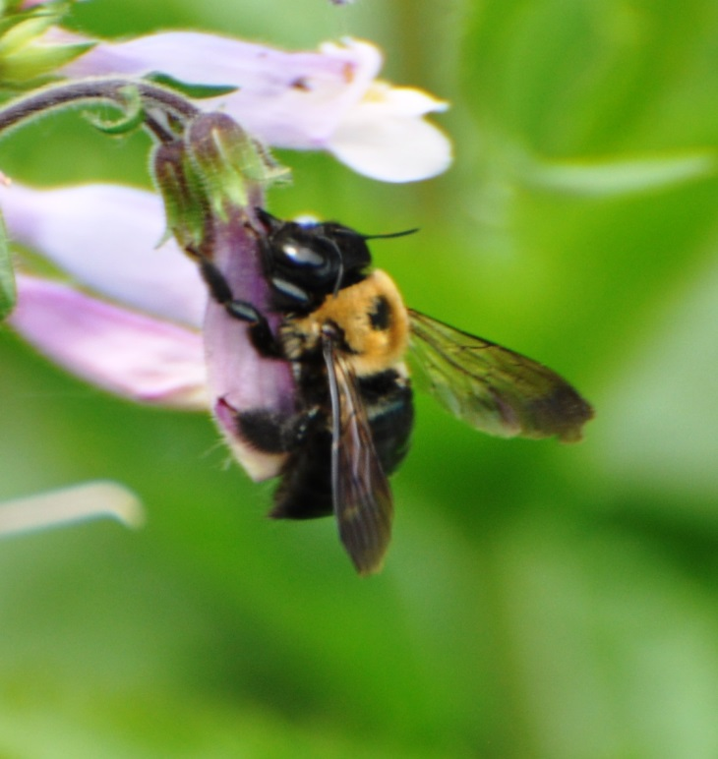
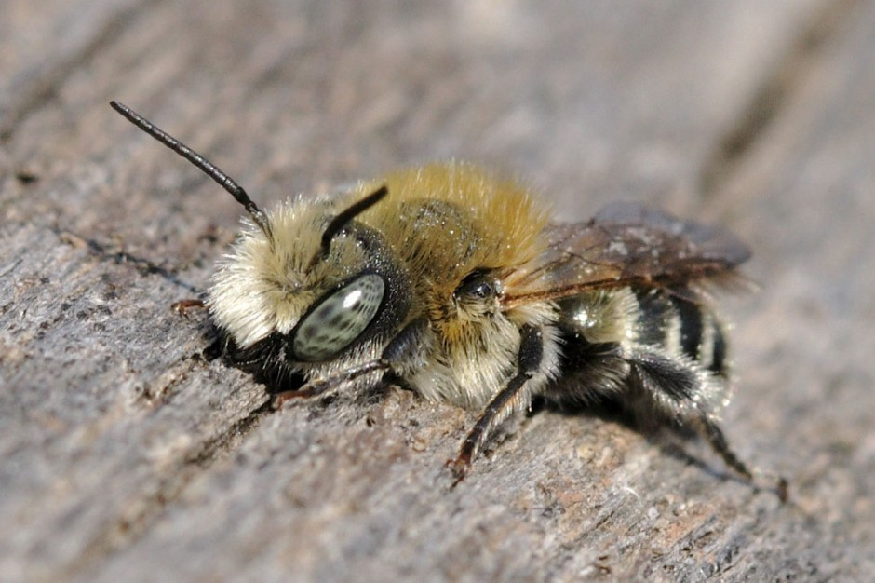
Some bees, like the giant Carpenter bee will chew the wooden walls of their nest site and tunnel in, mixing the wood pulp with their spit to make their own particle board enclosures. Mason bees use mud to seal their entrances. Cellophane bees produce their own saran wrap from glands and use that substance to seal their egg chambers. With some species, once the egg cells are built and the offspring laid, the mother bee will fly off to her eventual death. With other species, hives are built big enough that parents may share it with the next generation of their offspring, handing the nest down like an ancestral home.

Slide 9
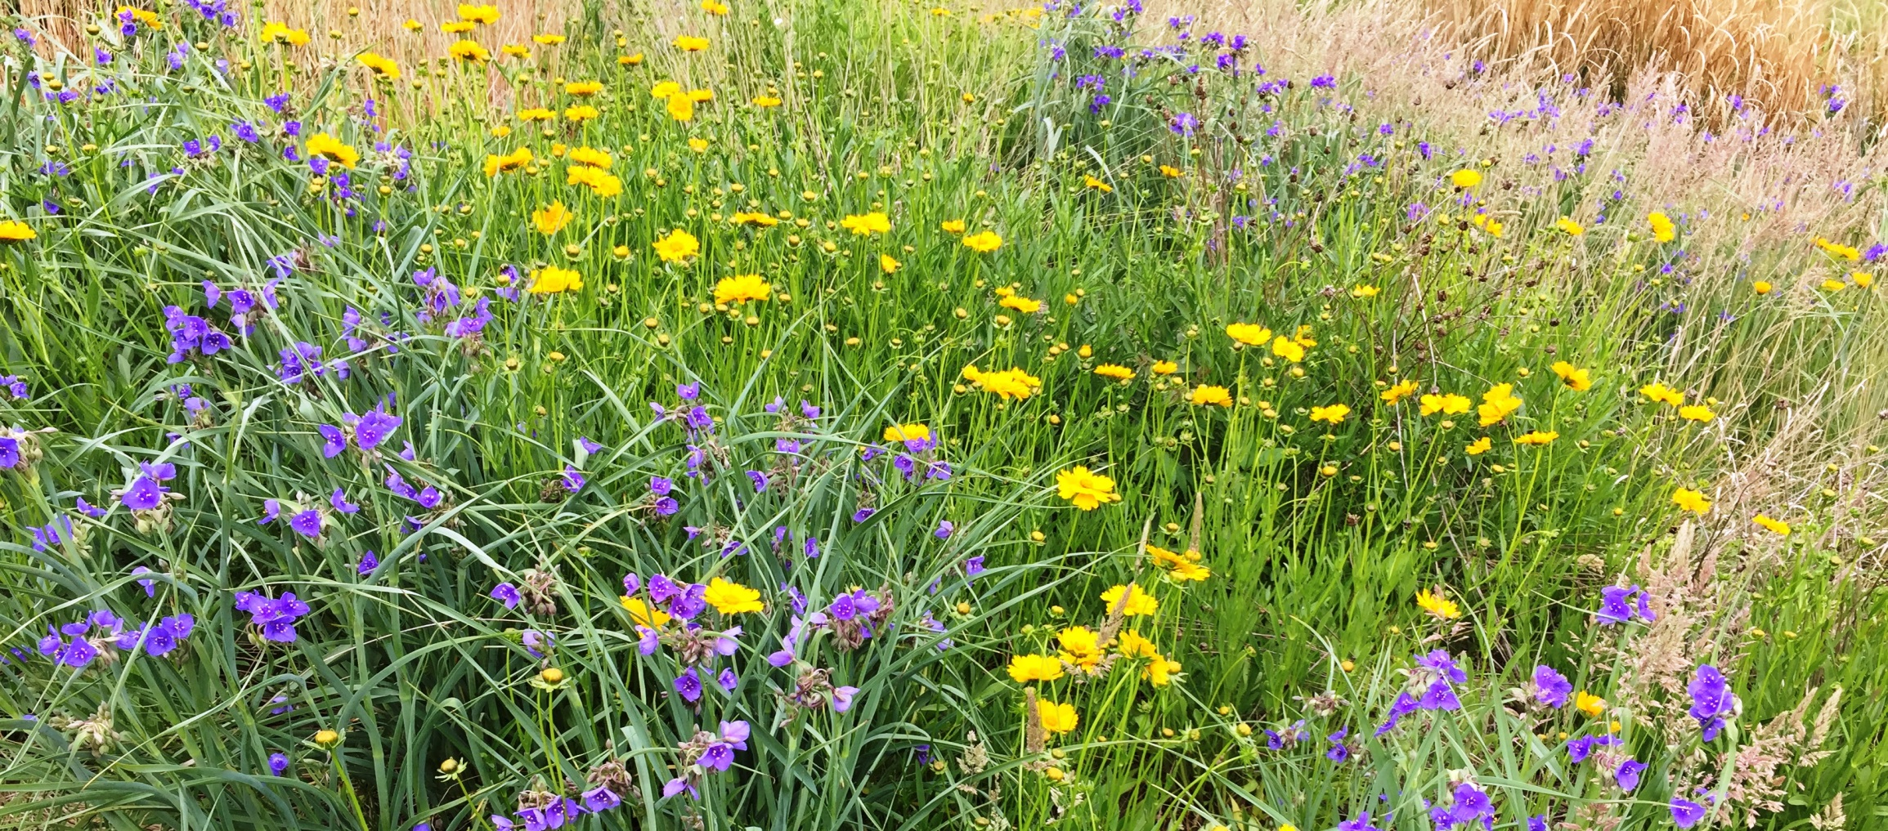
A Healthy Ecosystem:
Native bees work tirelessly to ensure that their offspring are fed, simultaneously providing the vital service of pollination to the many flowers they encounter. Loss of habitat and a general fear of these little winged workers are causing their populations to decline. We can help them by planting pollinator plants, installing bee hotels, and even just by telling others how important bees are to us and a healthy ecosystem.

Slide 10
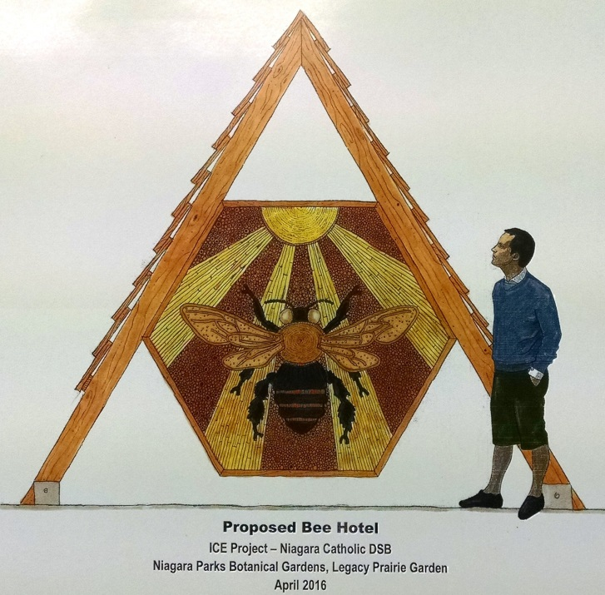
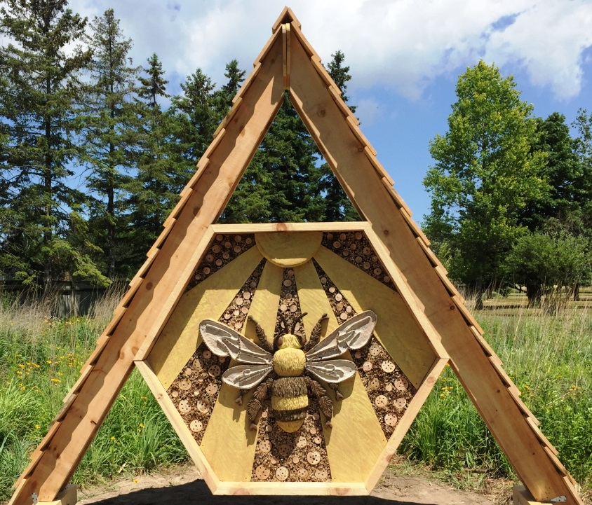
Stay for Free… If You’re a Bee!
This Native Bee Hotel is installed at the Niagara Parks Botanical Gardens. It is made from natural materials and contains thousands of holes of varying sizes. These tunnels are attractive to native species where they can take refuge and nest undisturbed by predators. This bee hotel was designed and constructed by students from the Niagara Catholic District School Board in collaboration with students from the Niagara Parks School of Horticulture.

Slide 11
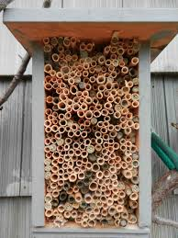
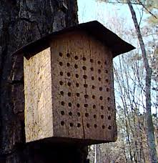
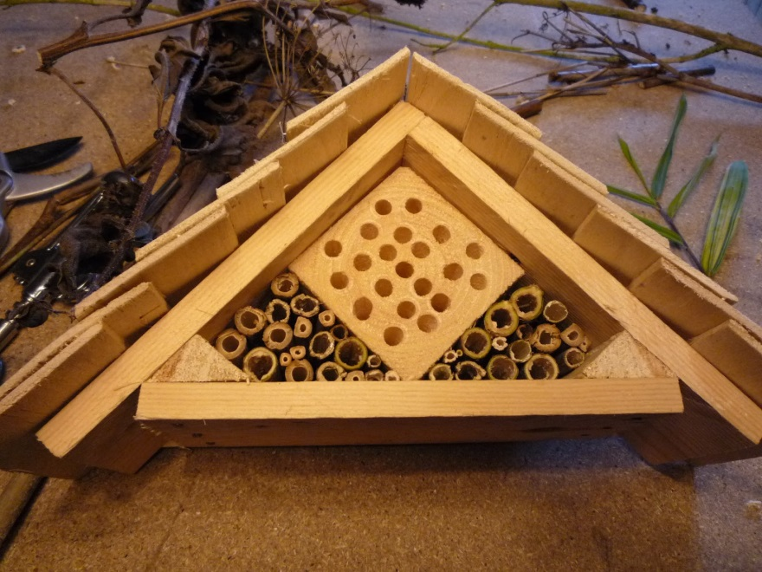
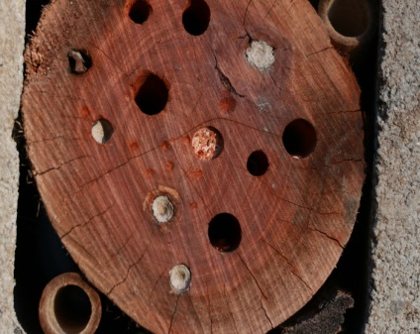
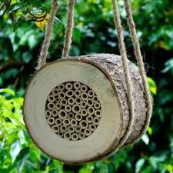
Native Bee Habitats:
Native bees require a place to
spend the night, overwinter and
rear their young. These shelters
can be made easily from reeds,
bamboo or by drilling holes in
cross-sections of wood.

Slide 12
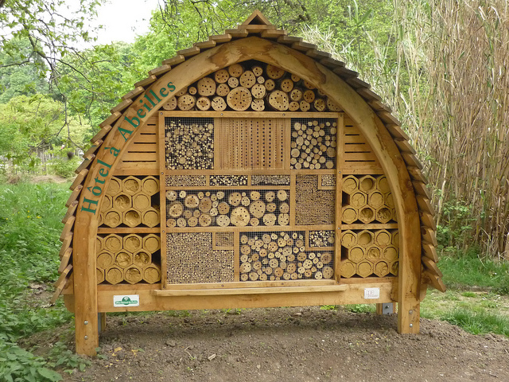
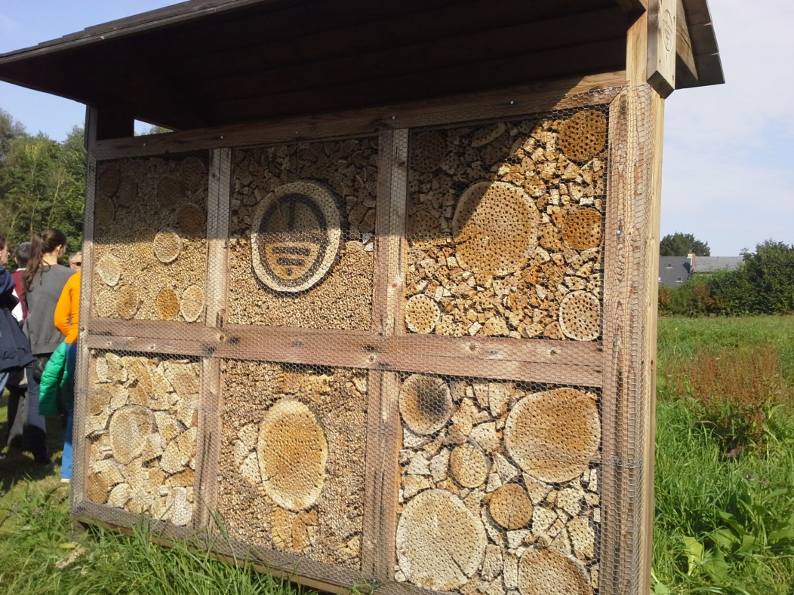
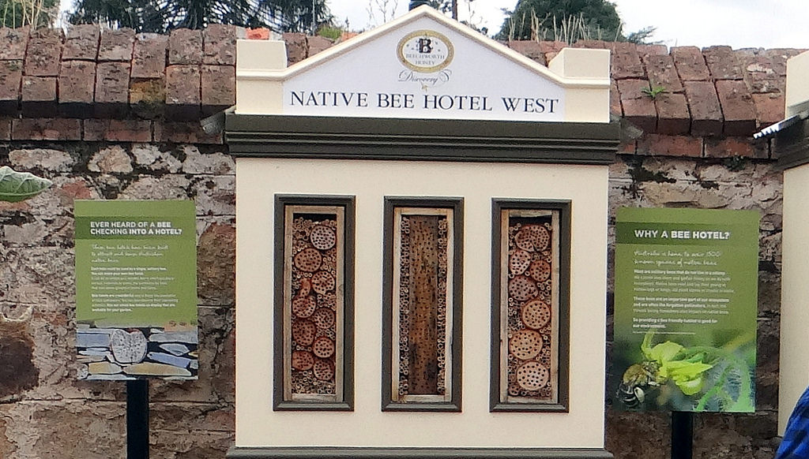
Large Scale Native
Bee Habitats

Slide 13
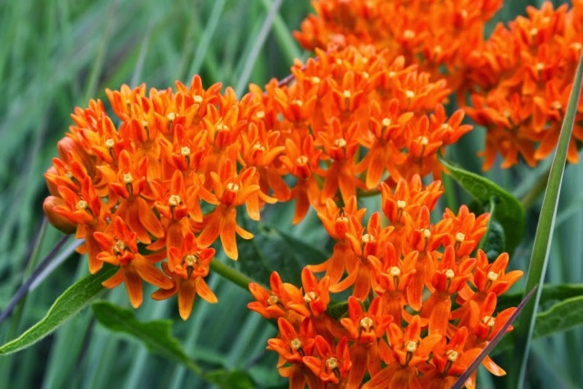
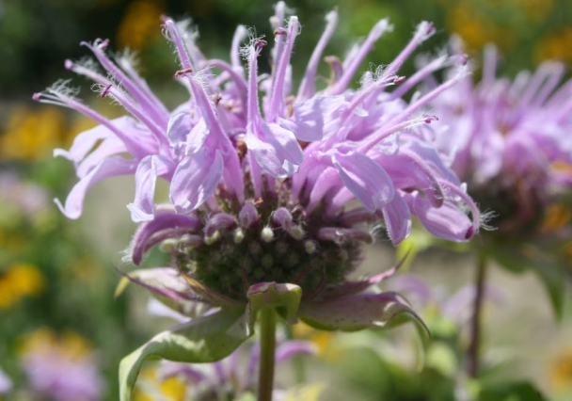
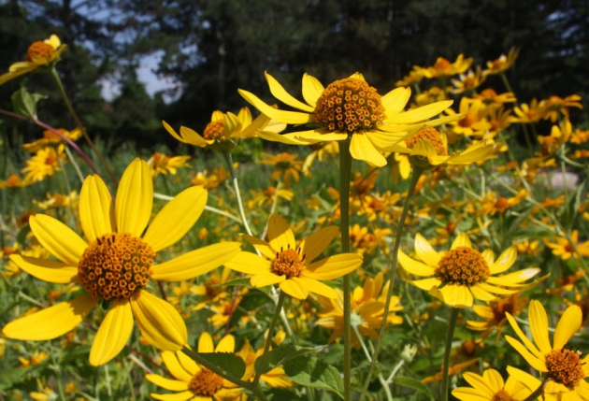
Healthy Ecosystems
As bee and other pollinator habitat continues to feel the pressure from sprawling cities and urbanization it is more important than ever to plant species beneficial to these important creatures. Try to include a mix of plants that have a varied season of bloom. In early spring, Red Maple and Crocus provide important early meals for pollinators. Summer is the most active season and plants such as Echinacea and Butterfly Weed are just a few examples. Autumn blooming plants like Falls Aster, Goldenrod and Witch Hazel help provide pollinators an important source of energy late in the season as they lead into winter.

Slide 14
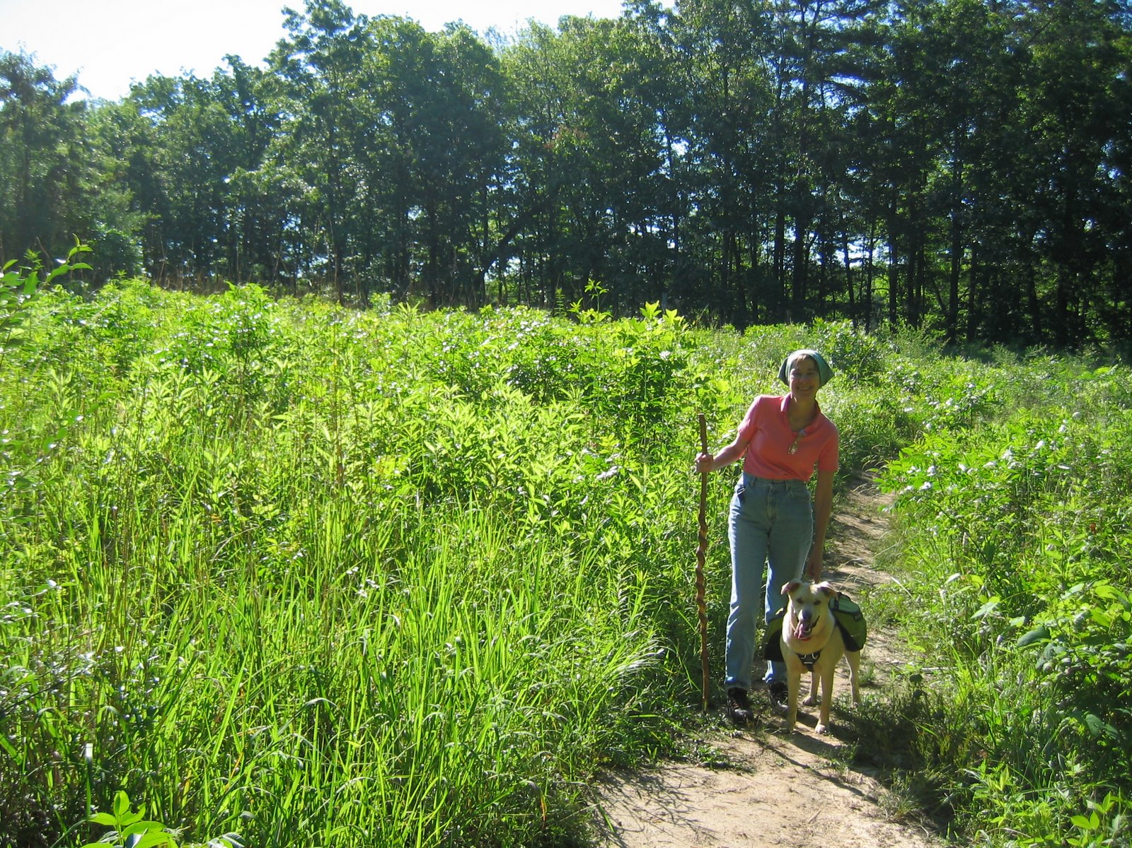
Ontario Prairies

Slide 15
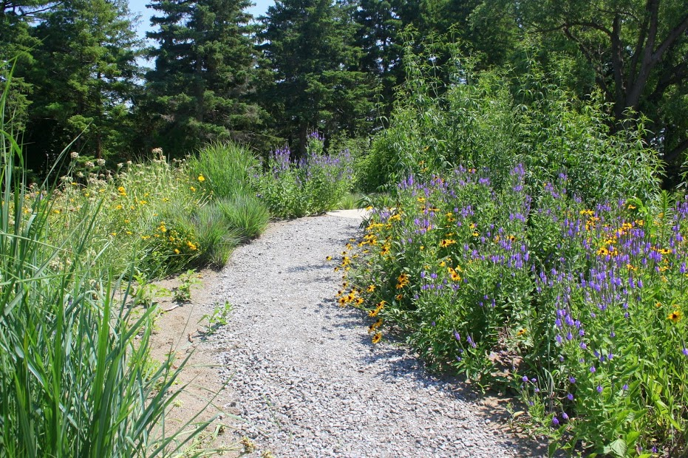

Slide 16
Sources
www.davidsuzuki.org/conservation/pollinators
http://tcpermaculture.com/site/2013/05/02/mason-bees-a-quick-overview/
http://www.xerces.org/wp-content/uploads/2008/11/nests_for_native_bees_fact_sheet_xerces_society.pdf
http://www.seeds.ca/pollination/making-bee-nests

