Slide 1
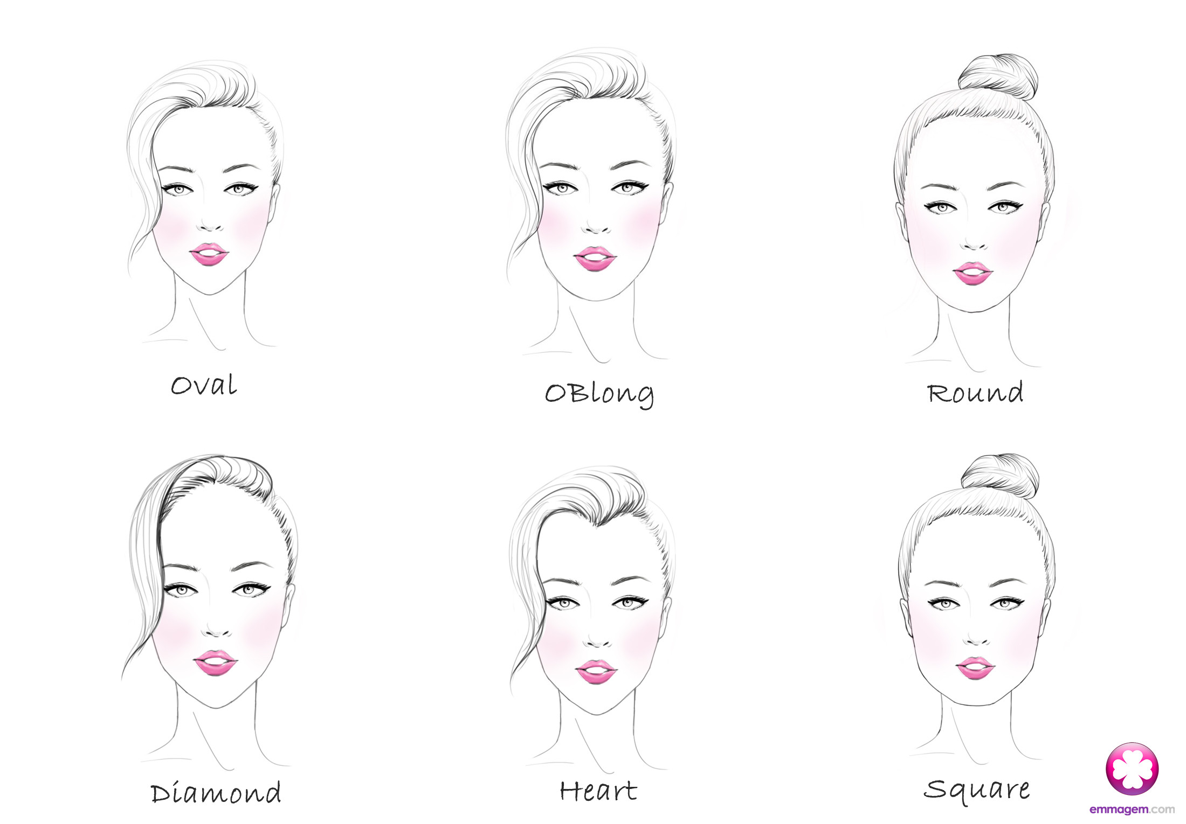
FACE SHAPES
THE IMPORTANCE OF FACE SHAPES IN HAIRDRESSING

Slide 2
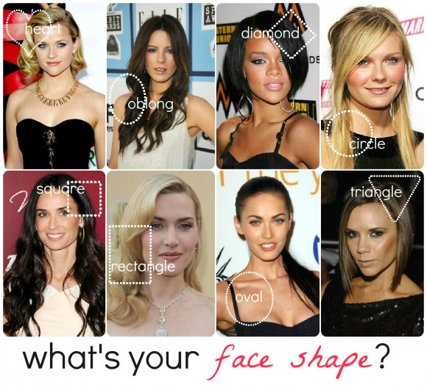

Slide 3
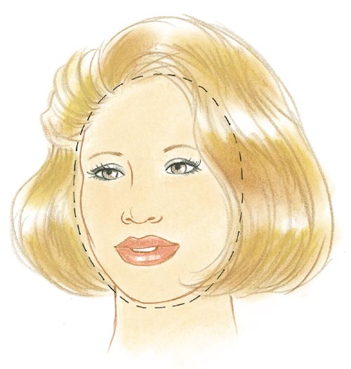
OVAL
This is the ideal face shape that forms the basis of which all other face shapes try to create the illusion of.
The length of the oval face is equal to one and a half times the width across the brow.
The forehead and the jaw are the same width.

Slide 4
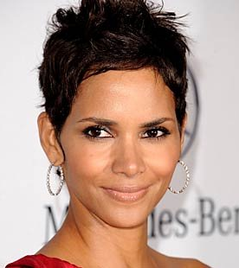
OVAL
Best Styling Choices – any length of cut will look best with layers near whatever feature you want to highlight ex. cheekbones, lips, chin, etc…
Halle Berry, Megan Fox, Jessica Alba

Slide 5
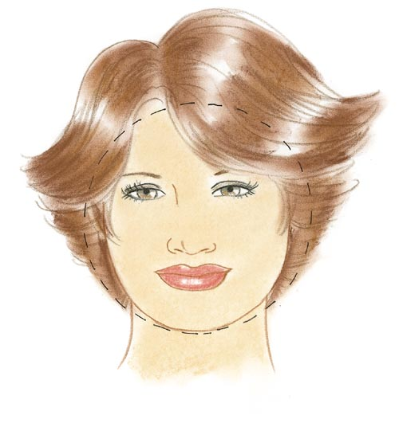
ROUND
Circular shaped with round hairline and round chin line.
Length and width of the face are approximately the same.
Aim is to deflect roundness of the face by creating the illusion of length.

Slide 6
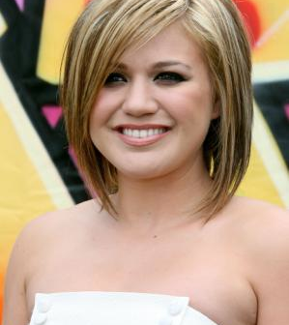
ROUND
Best Styling Choices – need to create height and volume at crown and keep sides close and sleek; best cut will fall a few inches below chin or longer; long layers (with the shortest layer hitting earlobe or lower) will create the illusion of length; gentle waves will also deflect roundness; avoid volume at sides which widens cheeks
Kelly Clarkson, Emma Stone, Jennifer Lawrence

Slide 7
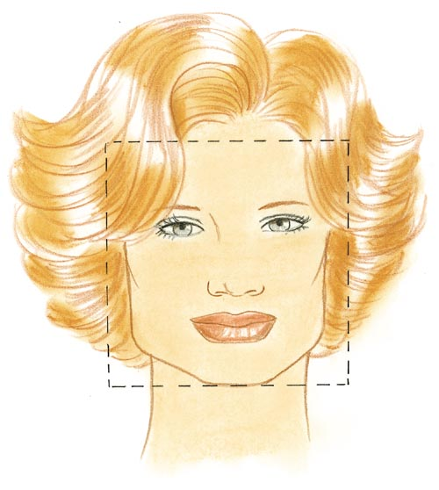
SQUARE
Wide at temples creating a strong and broad forehead, narrows in length and squares off at jaw.
Aim is to deflect any severity in jawline.

Slide 8
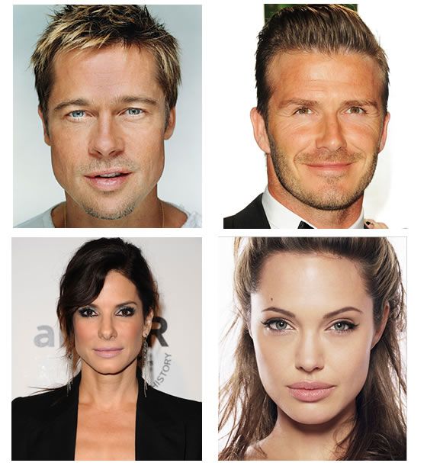
SQUARE
Best Styling Choices – keep hair soft and flowing around temples and jaw; soft waves from ears down creates volume between temples and jaw by adding width around ear area; avoid heavy bangs which will exaggerate square face
Sandra Bullock, Brad Pitt, Angelina Jolie

Slide 9
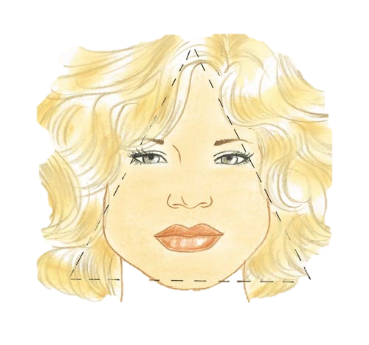
TRIANGULAR (PEAR)
Narrow forehead and cheekbones but wide jaw and chin line.
Aim is to try and create the illusion of a wider forehead.

Slide 10
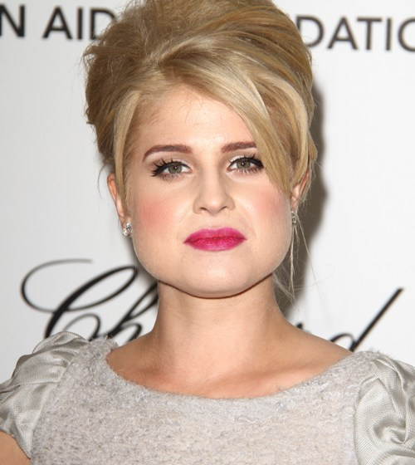
TRIANGULAR (PEAR)
Best Styling Choices – need to create a style with fullness and volume in the fringe area and then taper off to very minimal volume at lower areas of the face to camouflage wide jaw line; soft bangs can disguise narrow forehead
Kelly Osbourne, Geena Davis, Fantasia Barrino

Slide 11
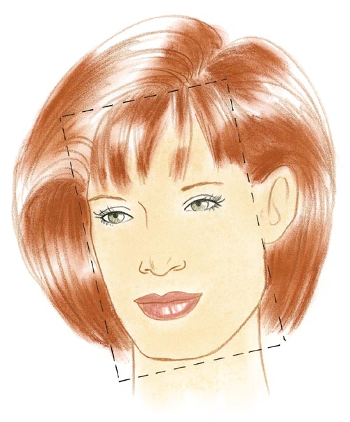
OBLONG (RECTANGULAR)
Most challenging face shape to work with.
Face is long and narrow with long, straight cheek line.
Aim is to create the illusion of a shorter, wider face.

Slide 12
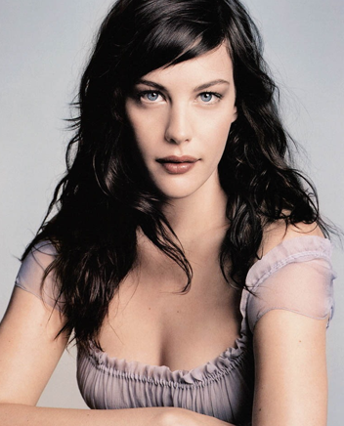
OBLONG (RECTANGULAR)
Best Styling Choices – hairstyle should create volume at sides of face not on top of the head; length should not be too long or it will elongate the oblong shape even more; chin length hair works best; long side swept bangs will keep volume at sides and create the illusion of roundness
Liv Tyler, Sarah Jessica Parker

Slide 13
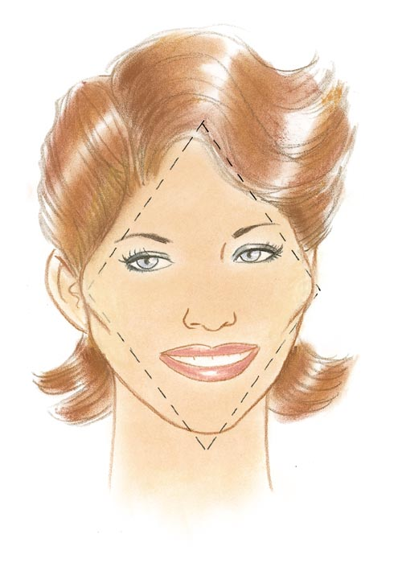
DIAMOND
Narrow forehead and jawline, but wide and high cheekbones.
Diamond face shape is basically an oval with angles.
Almost any style can work with this face shape.
Aim is to reduce the width across the cheekbones.

Slide 14
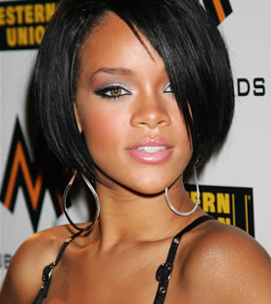
DIAMOND
Best Styling Choices – need to create volume in the upper and lower corners of the face; avoid volume at top and sides which will create a “cone head” look
Rihanna, Felicity Huffman

Slide 15
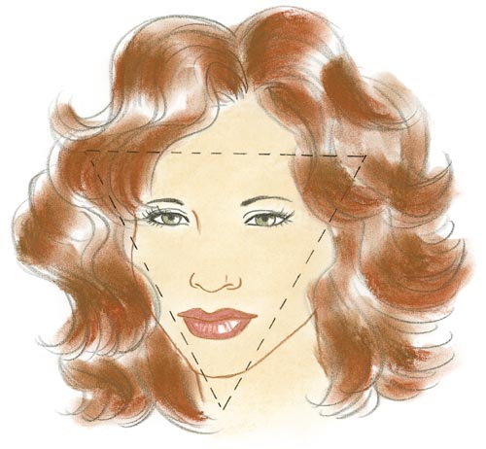
INVERTED TRAINGLE (HEART)
Wide at forehead and cheekbones but narrow at chin line.
Aim is to minimize the upper portion of the face while creating volume in the lower portion to create width.

Slide 16
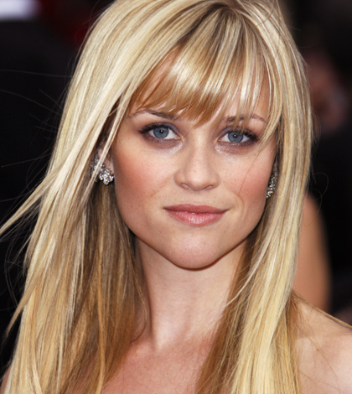
INVERTED TRIANGLE (HEART)
Best Styling Choices – style hair close to head with no volume; bangs are recommended (narrow bangs work best to minimize broad forehead); increase volume of hair near cheekbones and ears but keep most volume at jaw and neck area; avoid styles that will emphasize bare forehead
Jennifer Love Hewitt, Reese Witherspoon, Christina Ricci

Slide 17
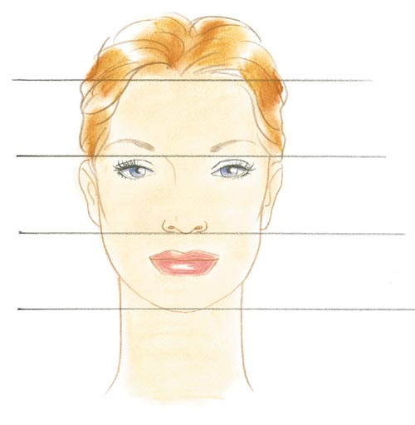
IDEAL FACIAL PROPORTIONS

Slide 18
KEY POINTS TO REMEMBER
Overall main goal is to create the appearance of an OVAL face.
Minimize non-pleasing attributes while maximizing and complimenting the positive ones.
Use soft curves and waves to minimize angles in face shapes.
Use horizontal lines and soft curls to add volume and width to a narrow area.
Use vertical lines and volume to add height to a shortened or round face.
Use different styling techniques, (bangs, off center partings) to camouflage or deflect from prominent features.

Slide 19
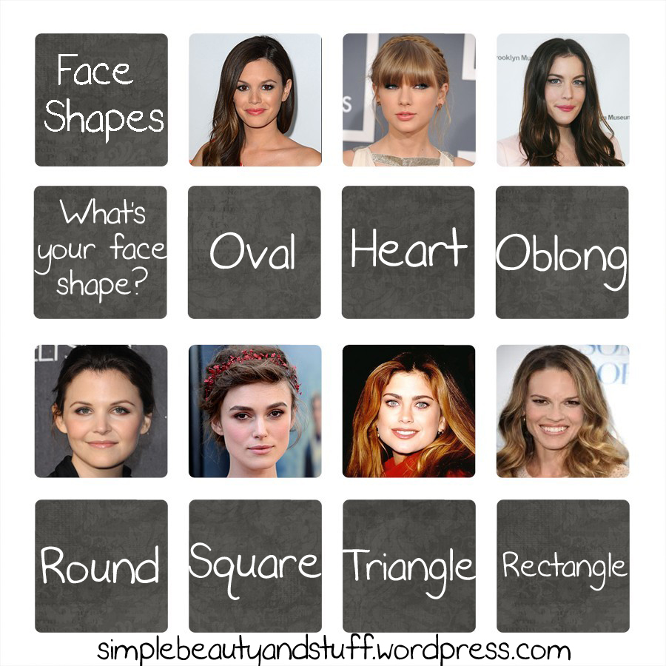

Slide 20
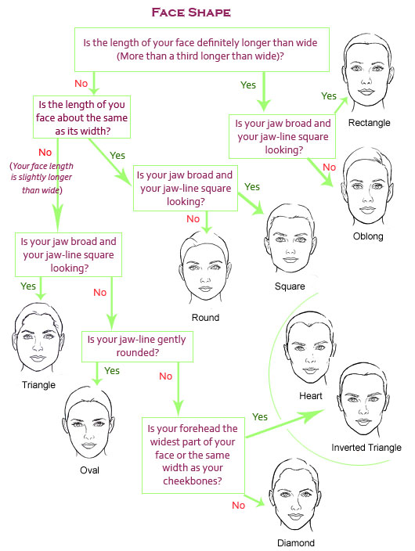
DETERMINING YOUR FACE SHAPE

